Slide 1
THE 101
agent-skills
Production-grade engineering skills for AI coding agents
What they are, and why they matter.
agent-skills
agent-skills 101
1 / 8

Slide 2
THE PROBLEM
AI coding agents default to the shortest path.
That usually means skipping specs, tests, and reviews. The practices that make software reliable are the first to go.
agent-skills
agent-skills 101
2 / 8

Slide 3
THE IDEA
A skill is a workflow, not a prompt
- Structured steps the agent follows, with checkpoints and exit criteria
- An anti-rationalization table that rebuts the excuses to skip a step
- Red flags that signal the process is being violated
- Verification that demands evidence: tests, build output, runtime data
agent-skills
agent-skills 101
3 / 8

Slide 4
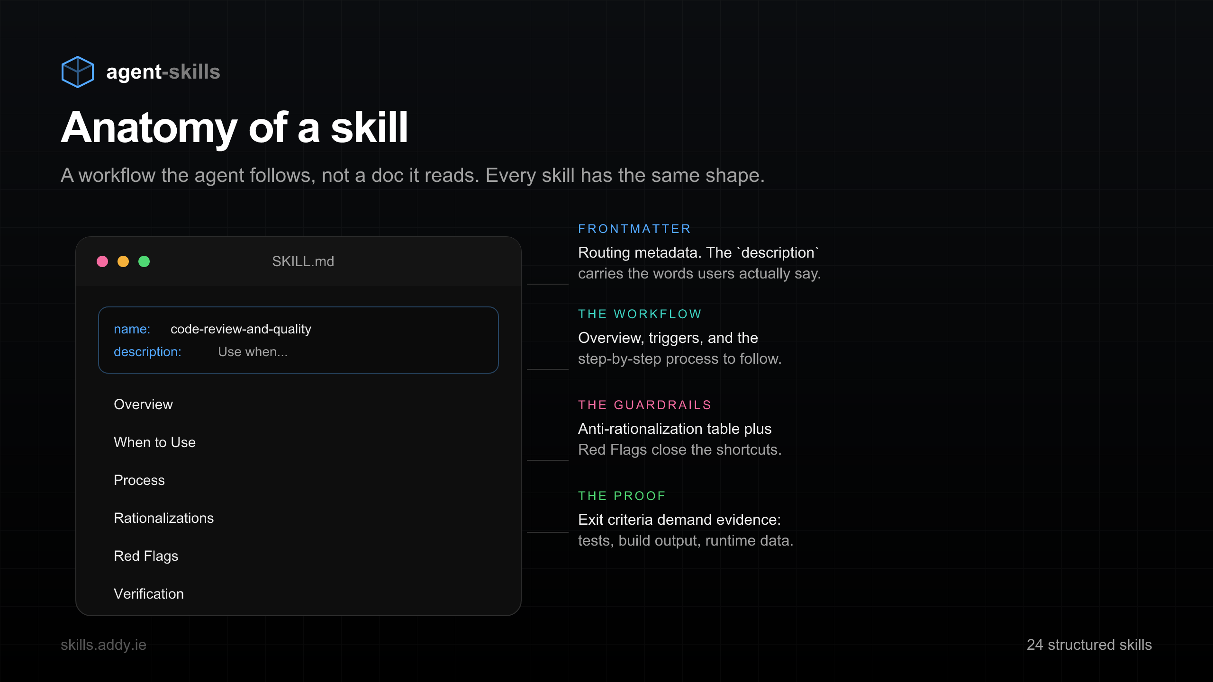
ANATOMY
Every skill has the same shape
Frontmatter routes the work. The body is a process. Guardrails and proof are built in.
agent-skills
agent-skills 101
4 / 8

Slide 5
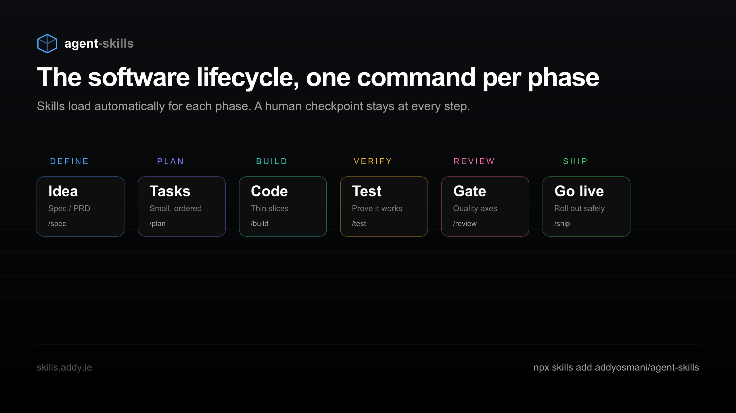
THE LIFECYCLE
One command per phase, Define to Ship
24 skills spanning the whole SDLC. The right ones load automatically for each phase.
agent-skills
agent-skills 101
5 / 8

Slide 6
GET STARTED
Install into 70+ agents in one command
$ npx skills add addyosmani/agent-skills
Works with Claude Code, Codex, Cursor, Copilot, and more. Or add a single skill with --skill.
agent-skills
agent-skills 101
6 / 8

Slide 7
YOUR FIRST WIN
Start with a spec, then build
- Run /spec to write a short PRD before any code
- Run /build to implement in thin, tested slices
- Every slice is committed and verified individually
- You approve at each checkpoint. Nothing ships on vibes.
agent-skills
agent-skills 101
7 / 8

Slide 8
Give your agent a senior engineer’s instincts
$ npx skills add addyosmani/agent-skills
skills.addy.ie github.com/addyosmani/agent-skills
agent-skills
agent-skills 101
8 / 8

