Slide 1
THE 201
The SDLC, in practice
How you actually drive a feature from idea to production
Eight commands, six phases, one checkpoint at each step.
agent-skills
agent-skills 201
1 / 8

Slide 2
THE COMMANDS
Eight commands map to the lifecycle
/spec | Define what to build | Spec before code
/plan | Break it into tasks | Small, atomic tasks
/build | Implement incrementally | One slice at a time
/test | Prove it works | Tests are proof
/review | Review before merge | Improve code health
/webperf | Audit performance | Measure, then optimize
/code-simplify | Simplify | Clarity over cleverness
/ship | Deploy | Faster is safer
agent-skills
agent-skills 201
2 / 8

Slide 3
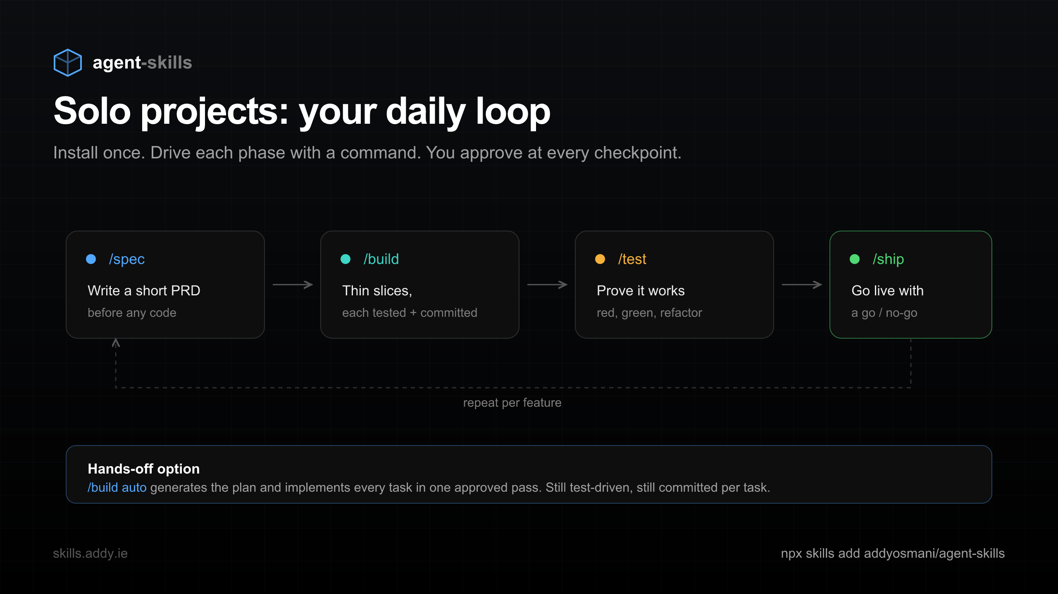
SOLO PROJECTS
The daily loop
Install once. Drive each phase with a command. Repeat per feature.
agent-skills
agent-skills 201
3 / 8

Slide 4
DEFINE + PLAN
Get the intent right before writing code
- interview-me extracts what you actually want, one question at a time
- spec-driven-development writes objectives, structure, tests, and boundaries
- planning-and-task-breakdown turns the spec into small, ordered, verifiable tasks
agent-skills
agent-skills 201
4 / 8

Slide 5
BUILD + VERIFY
Write it in slices, prove each one
- incremental-implementation lands thin vertical slices, rollback-friendly
- test-driven-development enforces red, green, refactor with a real test pyramid
- Anti-rationalization tables stop "I will add tests later" before it happens
- debugging-and-error-recovery finds the root cause instead of guessing
agent-skills
agent-skills 201
5 / 8

Slide 6
REVIEW + SHIP
Gate on quality, then roll out
- code-review-and-quality runs a five-axis review with severity labels
- security-and-hardening applies OWASP Top 10 prevention and boundary checks
- shipping-and-launch handles staged rollouts, monitoring, and rollback
agent-skills
agent-skills 201
6 / 8

Slide 7
HANDS-OFF
Approve the plan once, let it run
$ /build auto
Generates the plan and implements every task in one approved pass. Still test-driven, still committed per task, still pauses on failures.
agent-skills
agent-skills 201
7 / 8

Slide 8
Drive the whole lifecycle with a checkpoint at each phase
$ npx skills add addyosmani/agent-skills
skills.addy.ie/lifecycle github.com/addyosmani/agent-skills
agent-skills
agent-skills 201
8 / 8

