Slide 1
THE 301
Teams and customization
Scale the discipline across a team, and bend it to your stack
Review panels, context budgets, custom skills, and evals.
agent-skills
agent-skills 301
1 / 7

Slide 2
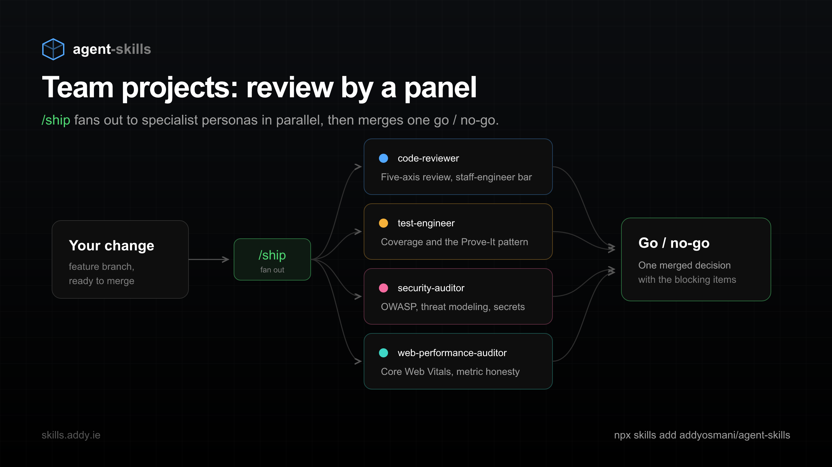
TEAM PROJECTS
Ship past a panel, not a rubber stamp
/ship fans out to four specialist personas in parallel, then merges one go / no-go.
agent-skills
agent-skills 301
2 / 7

Slide 3
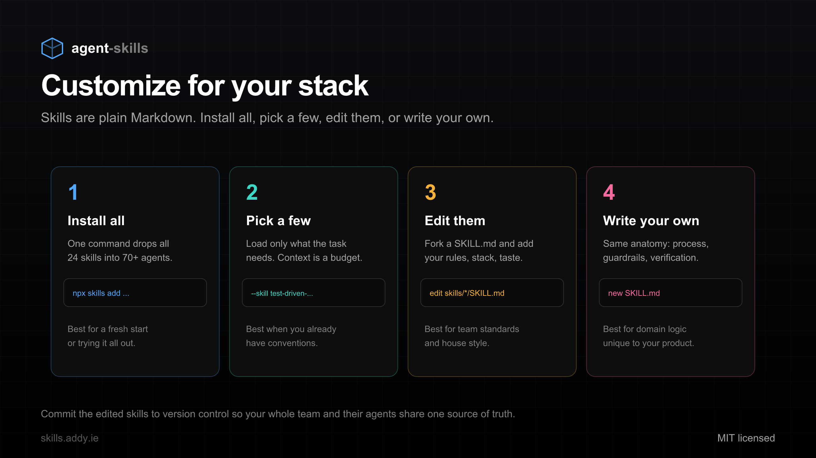
CUSTOMIZE
Four ways to make it yours
Install all, pick a few, edit them, or write your own. Skills are plain Markdown.
agent-skills
agent-skills 301
3 / 7

Slide 4
CONTEXT ENGINEERING
Load only what the task needs
- More context is not better. Context is a budget you spend deliberately.
- context-engineering configures rules files and packs the right information
- Working on UI? Load frontend-ui-engineering. Debugging? Load the debugging skill.
- The using-agent-skills meta-skill routes each task to the right workflow
agent-skills
agent-skills 301
4 / 7

Slide 5
MEASURE IT
The skills are measured, not asserted
- A three-tier eval framework lives in the repo
- Tier 1 checks structure. Tier 2 checks routing so no two skills collide.
- Tier 3 grades a real execution trace against per-skill expectations
- Some of it runs in CI, so regressions are caught early
agent-skills
agent-skills 301
5 / 7

Slide 6
ROLL OUT
One source of truth for the whole team
- Commit your edited skills to version control
- Every engineer and their agent share the same conventions
- Spec and task artifacts are living documents during the work
- New team members inherit the standards on day one
agent-skills
agent-skills 301
6 / 7

Slide 7
Encode your team’s standards once. Every agent follows them.
$ npx skills add addyosmani/agent-skills
skills.addy.ie/teach github.com/addyosmani/agent-skills
agent-skills
agent-skills 301
7 / 7

