Slide 1
Fake News Detection Analysis
Adithiyya Kishoore
Gaurav Madarkal

Slide 2

What is FAKE NEWS? and why is it a TERRIBLE THING?
Misinformation created with the purpose of misleading the reader.
Usually causes outrage or grabs the reader’s attention.

Slide 3

Why is it a TERRIBLE THING?
Is disastrous when weaponized with an agenda.
Spreads like a virus.

Slide 4
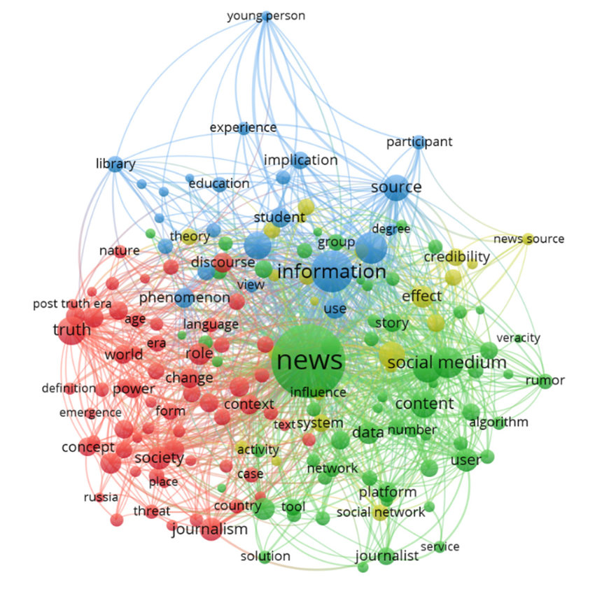
Existing Approaches and what they LACK…
Contextual knowledge of the world.
Ability to correlate with other forms of data and reason what is true from false.

Slide 5
Leveraged Approaches
LSTM - Long Short Term Memory
Hochreiter and Schmidhuber (1997)
BERT
A Google Project (2018)
RoBERTa
Facebook’s Advancement on BERT (2019)

Slide 6
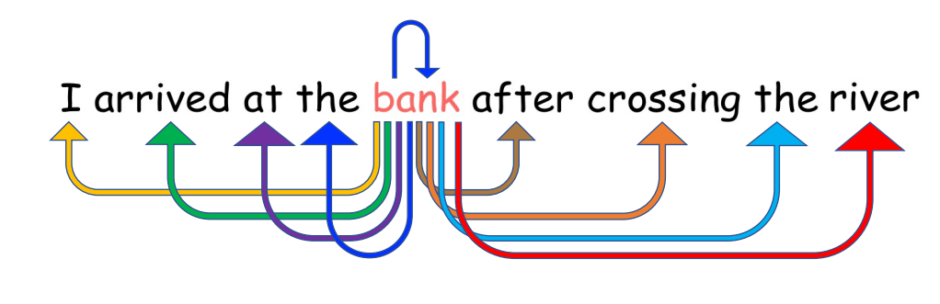
Self-Attention was what we NEEDED
How are words related
to each other
Context is important

Slide 7
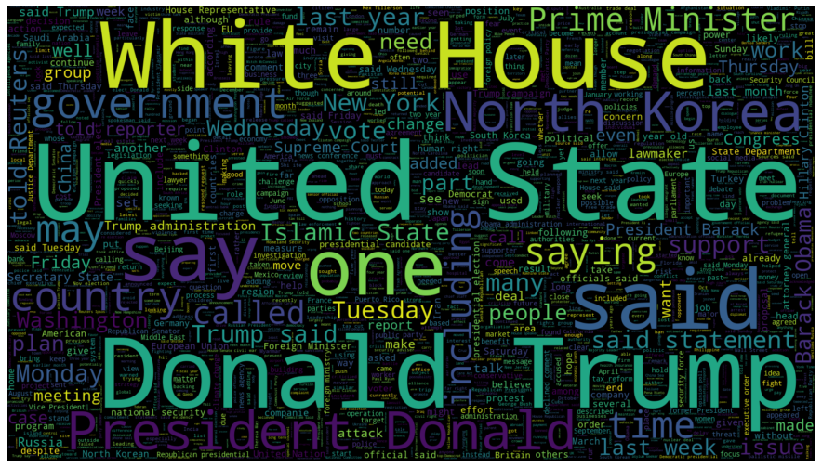
Insights - I
Biased towards certain topics?
Less than optimal results with unseen data

Slide 8
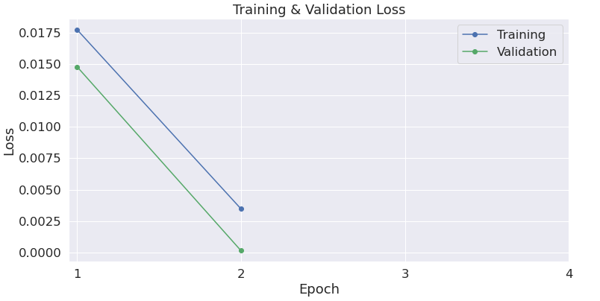
Insights - II
Exceedingly well on the dataset it was given
Poor, when it came to articles from other domains

Slide 9
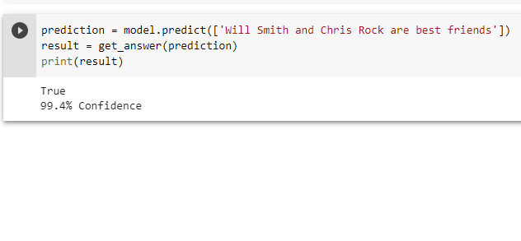

What are we saying?
Are we saying there is no solution to this problem?
There cannot be a definitive solution

Slide 10
Thank you

