Slide 1
Introduction to machine learning
BY:
JHANNA SHAMMEL ADELAN
BSCS 3B

Slide 2

What is Machine Learning?
Machine learning (ML) is a branch of artificial intelligence (AI) and computer science that focuses on the using data and algorithms to enable AI to imitate the way that humans learn, gradually improving its accuracy.

Slide 3
Machine learning methods - Machine learning models fall into three primary categories.
Supervised learning, also known as supervised machine learning, is defined by its use of labeled datasets to train algorithms to classify data or predict outcomes accurately. As input data is fed into the model, the model adjusts its weights until it has been fitted appropriately.
Unsupervised learning, also known as unsupervised machine learning, uses machine learning algorithms to analyze and cluster unlabeled datasets (subsets called clusters).
Reinforcement machine learning is a machine learning model that is similar to supervised learning, but the algorithm isn’t trained using sample data. This model learns as it goes by using trial and error.

Slide 4
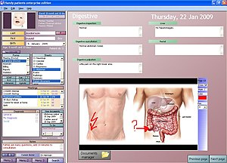

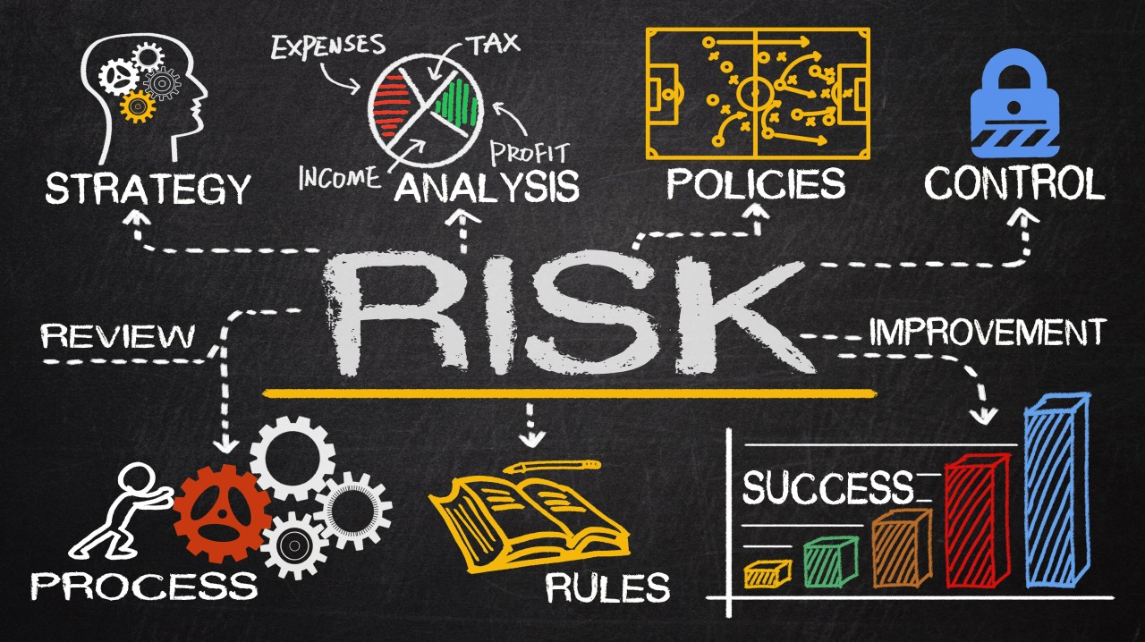
APPLICATION OF MACHINE LEARNINGS IN: HEALTH CARE, FINANCE, AND MARKETING
Healthcare: Electronic Health Record (EHR) Analysis
Finance: Risk Management
Marketing: Sentiment Analysis

Slide 5
Healthcare: Electronic Health Record (EHR) Analysis
Problem solve - can significantly enhance EHR systems by improving data accuracy, supporting clinician decision-making, optimizing training and usage, and continuously adapting to the needs of healthcare providers. By addressing the challenges identified in your study, machine learning can contribute to better healthcare quality and patient safety, and foster greater acceptance of EHR systems among clinicians.
The type of machine learning method used – Supervised learning is the most commonly applied method in EHR systems due to its ability to make predictions and classifications based on historical data.
Solution Impact - EHR systems has the potential to transform healthcare by improving patient safety, enhancing clinician satisfaction, increasing EHR adoption, and optimizing healthcare delivery. The ripple effects of these improvements can lead to more efficient healthcare systems, better patient outcomes, and substantial economic benefits for healthcare organizations.

Slide 6
Finance: Risk Management
Problem Solve - financial institutions can enhance their risk management processes by uncovering hidden risks, understanding complex correlations, and making data-driven decisions. This approach supports the holistic, enterprise-wide perspective emphasized in enterprise risk management, enabling organizations to navigate both negative and positive risks more effectively.
The type of machine learning method used – Supervised learning models, such as decision trees, logistic regression, and neural networks, are highly effective at making predictions based on labeled historical data. This is crucial in risk management, where predicting the likelihood of events like credit defaults, fraud, or market downturns is a key objective.
Solution Impact - The impact of a well-implemented risk management program is far-reaching, affecting nearly every aspect of an organization. It not only helps in mitigating threats but also in identifying opportunities, leading to better decision-making, financial stability, operational resilience, and long-term sustainability. By aligning risk management with strategy, organizations can navigate uncertainties more effectively and achieve their strategic goals.

Slide 7
Marketing: Sentiment analysis
Problem Solve - sentiment analysis provides actionable insights that help businesses make informed decisions, enhance their offerings, and ultimately build stronger relationships with their customers.
The type of machine learning method used - Supervised Learning: In sentiment analysis, labeled datasets are used to train models. These datasets consist of text data annotated with sentiment labels (e.g., positive, negative, neutral). Supervised learning algorithms, such as logistic regression, support vector machines, or neural networks, are trained on this labeled data to learn patterns and relationships between text features and sentiment labels. Once trained, the model can predict sentiment in new, unseen text.
Solution Impact: sentiment analysis helps businesses build stronger customer relationships, optimize their marketing efforts, and make more informed strategic decisions, ultimately contributing to long-term success and growth.

Slide 8
References:
What is machine learning (ML)?. IBM. (2021, September 22). https://www.ibm.com/topics/machine-learning
Upadhyay, S., & Hu, H.-F. (2022b, March 3). A qualitative analysis of the impact of electronic health records (EHR) on Healthcare Quality and safety: Clinicians’ lived experiences. Health services insights. https://www.ncbi.nlm.nih.gov/pmc/articles/PMC8902175/
Tucci, L., & Stedman, C. (2023, September 11). What is risk management and why is it important?. Security. https://www.techtarget.com/searchsecurity/definition/What-is-risk-management-and-why-is-it-important#:~:text=Risk%20management%20is%20the%20process,errors%2C%20accidents%20and%20natural%20disasters.
Kendall, M. (2024, June 21). The role of sentiment analysis in marketing. Sprout Social. https://sproutsocial.com/insights/sentiment-analysis-marketing/

Slide 9
Thank you!

