Slide 1
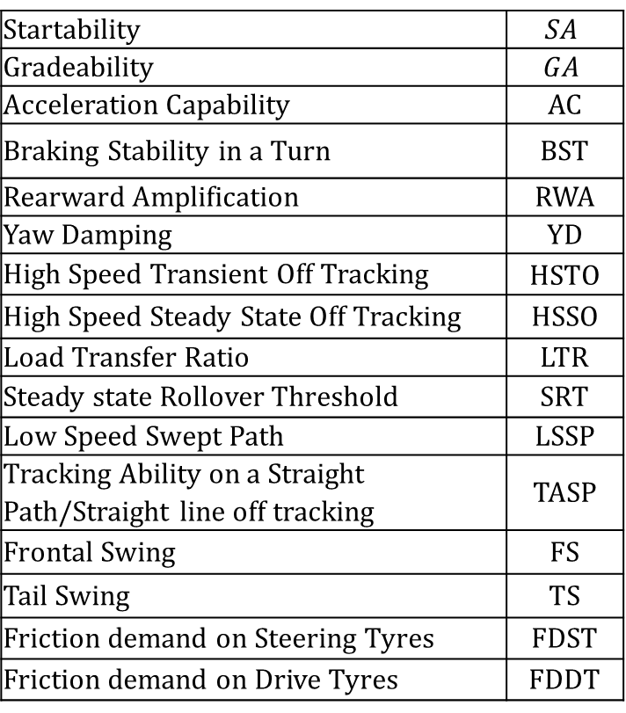
About these slides
These slides are the original for descriptive picture for each PBS in the Open PBS tool.
Generate a bitmap file for each of slide 3 to last slide. Link each such bitmap to Info layer in Modelica model for each PBS.
Description of definition of each PBS (independent of the vehicle model).
Here is a list of all PBSes:
Startability | $$SA$$
Gradeability | $$GA$$
Acceleration Capability | AC
Braking Stability in a Turn | BST
Rearward Amplification | RWA
Yaw Damping | YD
High Speed Transient Off Tracking | HSTO
High Speed Steady State Off Tracking | HSSO
Load Transfer Ratio | LTR
Steady state Rollover Threshold | SRT
Low Speed Swept Path | LSSP
Tracking Ability on a Straight Path/Straight line off tracking | TASP
Frontal Swing | FS
Tail Swing | TS
Friction demand on Steering Tyres | FDST
Friction demand on Drive Tyres | FDDT
Wouldn’t it be better to develop and store as much as possible as text in Modelica information layer (as opposed to bitmap figure)?
When update processes in GitHub is more understood by more in the team, a migration towards that should be done.

Slide 2

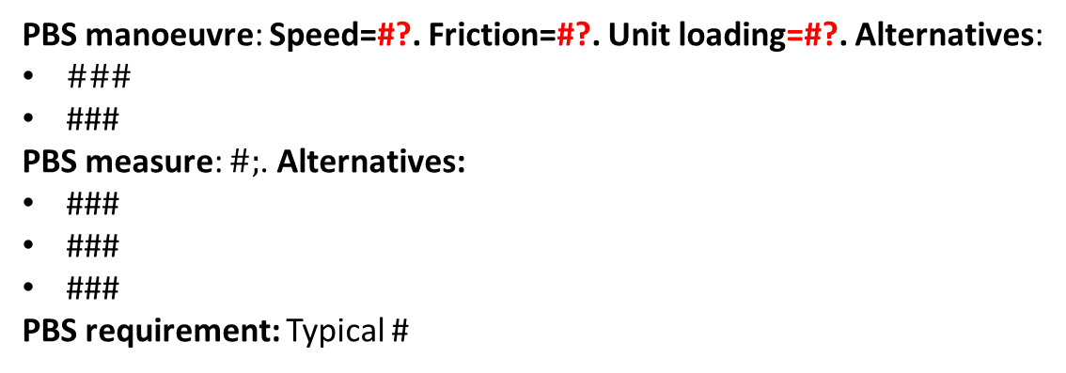
#Abbrev, #Name
TEMPLATE
WAI=WorstAI
RAI=RearAxleInner
FAI
FBI=FBInner
WAM
RBM
FAM
FBMiddle
$$φ_{upgrade}$$
WAO
FAO
FBO=FrontBumperOuter
PBS manoeuvre: Speed=#?. Friction=#?. Unit loading=#?. Alternatives:
$\#\#\#$
###
PBS measure: $\#;$. Alternatives:
###
###
###
PBS requirement: Typical #
Some relevant alternatives to be presented, in order to document and agree also which alternatives are deselected, and possibly why.
Mark which manoeuvre and measure in Open PBS Tool and in project:
Implemented in Open PBS tool, version ###
Present (20##-##-##) proposal from “HCT in Swe-project”
Present known open issues with this slide: ###, ###, …

Slide 3

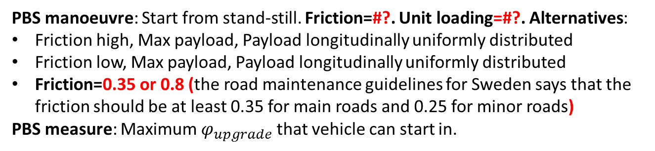
SA, Startability
$$φ_{upgrade}$$
PBS manoeuvre: Start from stand-still. Friction=#?. Unit loading=#?. Alternatives:
Friction high, Max payload, Payload longitudinally uniformly distributed
Friction low, Max payload, Payload longitudinally uniformly distributed
Friction=0.35 or 0.8 (the road maintenance guidelines for Sweden says that the friction should be at least 0.35 for main roads and 0.25 for minor roads)
PBS measure: Maximum $φ_{upgrade}$ that vehicle can start in.
Mark which manoeuvre and measure in Open PBS Tool and in project:
Implemented in Open PBS tool, version ###
Present (20##-##-##) proposal from “HCT in Swe-project”
Present known open issues with this slide: ###, ###, …

Slide 4
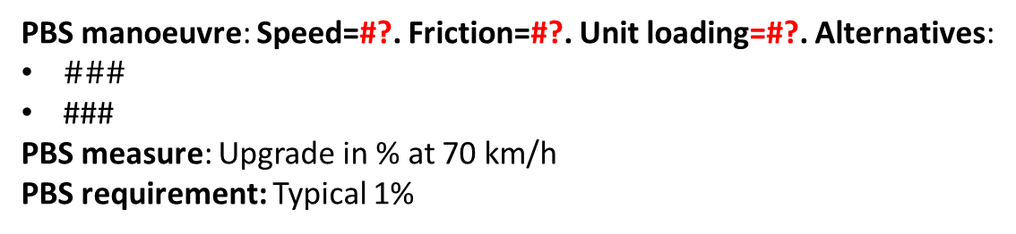
GA, Gradeability
$$φ_{upgrade}$$
PBS manoeuvre: Speed=#?. Friction=#?. Unit loading=#?. Alternatives:
$\#\#\#$
###
PBS measure: Upgrade in % at 70 km/h
PBS requirement: Typical 1%
Some relevant alternatives to be presented, in order to document and agree also which alternatives are deselected, and possibly why.
Mark which manoeuvre and measure in Open PBS Tool and in project:
Implemented in Open PBS tool, version ###
Present (20##-##-##) proposal from “HCT in Swe-project”
Present known open issues with this slide: ###, ###, …

Slide 5
AC, Acceleration capability
PBS manoeuvre: Acceleration from stand-still to 70 km/h. Friction=#?. Unit loading=#?.
PBS measure: Time in s
PBS requirement: Typical #s
Some relevant alternatives to be presented, in order to document and agree also which alternatives are deselected, and possibly why.
Mark which manoeuvre and measure in Open PBS Tool and in project:
Implemented in Open PBS tool, version ###
Present (20##-##-##) proposal from “HCT in Swe-project”
Present known open issues with this slide: ###, ###, …

Slide 6
BST, Braking Stability in Turn
Top level Alternatives:
A performance measure (deceleration, lateral deviation, etc…)
or each unit “EBS certified” (we need to assume this is in UnitSpec)
SteGrp meeting 2016-12-14: 2nd option seems accepted and proven by winter tests.
PBS manoeuvre: Acceleration from stand-still to 70 km/h. Unit loading=#?. Alternatives:
friction 0.35
friction 0.8
PBS measure: Time in s
PBS requirement: Typical #s
Some relevant alternatives to be presented, in order to document and agree also which alternatives are deselected, and possibly why.
Mark which manoeuvre and measure in Open PBS Tool and in project:
Implemented in Open PBS tool, version ###
Present (20##-##-##) proposal from “HCT in Swe-project”
Present known open issues with this slide: ###, ###, …

Slide 7
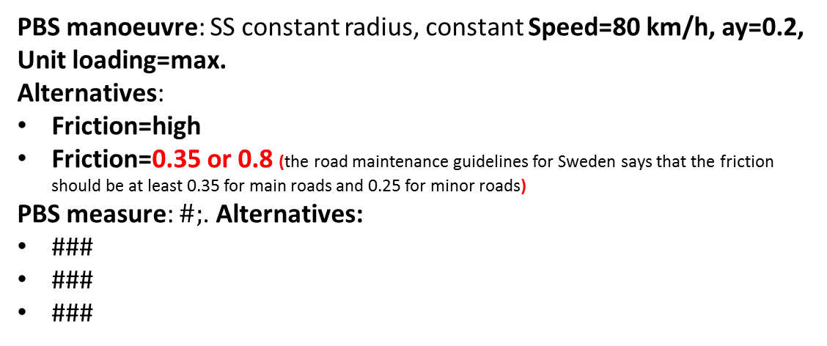
HSSO, High Speed Steady State Off Tracking
WAI=WorstAI
RAI=RearAxleInner
FAI
FBI=FBInner
WAM
RBM
FAM
FBMiddle
WAO
FAO
FBO=FrontBumperOuter
PBS manoeuvre: SS constant radius, constant Speed=80 km/h, ay=0.2, Unit loading=max.
Alternatives:
$\text{Friction}\text{=}\text{high}$
Friction=0.35 or 0.8 (the road maintenance guidelines for Sweden says that the friction should be at least 0.35 for main roads and 0.25 for minor roads)
PBS measure: $\#;$. Alternatives:
###
###
###
Some relevant alternatives to be presented, in order to document and agree also which alternatives are deselected, and possibly why.
Mark which manoeuvre and measure in Open PBS Tool and in project:
Implemented in Open PBS tool, version ###
Present (20##-##-##) proposal from “HCT in Swe-project”
Present known open issues with this slide: ###, ###, …

Slide 8
RWA, Rearward Amplification
ay_last
ay1
ay11
RWA_ay = ay_last_cg/ay_1_cg
RWA_ay = ay_last_cg/ay11
RWA_ay
RWA_w
RWA_randinput
ay
w
RWA is the “last” vs. “first”?
or, “worst” vs. “first”
What if
“dolly” is worst for active case?
 | freq | vx | amplitude
RWA_ay
RWA_w
RWA_randinput
Does “converter dolly + semi trailer” or “full trailer” influence?
Does “converter dolly with or without turn table” influence?
Can typically influence RWA and low speed manouverability.

Slide 9
YD, Yaw Damping
How many YD for a vehicle: scalar or vector?
Steering angle sine input
ay11 sine input
YD means “damping ratio”?
 | Freq = ? | Vx = ? | Amplitude = ?
YD_articangle
YD_yawrate

Slide 10
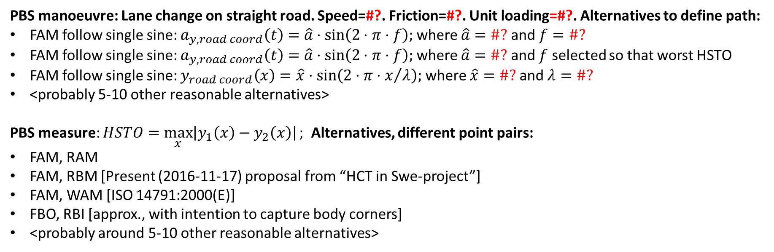
HSTO, High Speed Transient Off Tracking
WAI=WorstAI
RAI=RearAI
FAI
FBI=FrontBumperInner
WAM
RBM
FAM
FBMiddle
WAO
FBO
PBS manoeuvre: Lane change on straight road. Speed=#?. Friction=#?. Unit loading=#?. Alternatives to define path:
FAM follow single sine: $a_{y,road coord}\left(t\right)=\hat{a}⋅\text{sin}\left(2⋅π⋅f\right);$ where $\hat{a}=\#?$ and $f=\#?$
FAM follow single sine: $a_{y,road coord}\left(t\right)=\hat{a}⋅\text{sin}\left(2⋅π⋅f\right);$ where $\hat{a}=\#?$ and $f$ selected so that worst HSTO
FAM follow single sine: $y_{road coord}\left(x\right)=\hat{x}⋅\text{sin}\left(2⋅π⋅x/λ\right);$ where $\hat{x}=\#?$ and $λ=\#?$
<probably 5-10 other reasonable alternatives>
PBS measure: $HSTO=\max_{x}\left|y_{1}\left(x\right)−y_{2}\left(x\right)\right|;$ Alternatives, different point pairs:
FAM, RAM
FAM, RBM [Present (2016-11-17) proposal from “HCT in Swe-project”]
FAM, WAM [ISO 14791:2000(E)]
FBO, RBI [approx., with intention to capture body corners]
<probably around 5-10 other reasonable alternatives>
#Mark which is: “Implemented in Open PBS tool, version ###”
Present known open issues with this slide: …

Slide 11
LSSP, Low Speed Swept Path
WAI=WorstAI
RAI=RearAI
FAI
FBI=FrontBumperInner
WAM
RBM
FAM
FBMiddle
follower
WAO
FAO
FBO
guide
Implemented in Open PBS tool, version ###
Present (20##-##-##) proposal from “HCT in Swe-project”

Slide 12
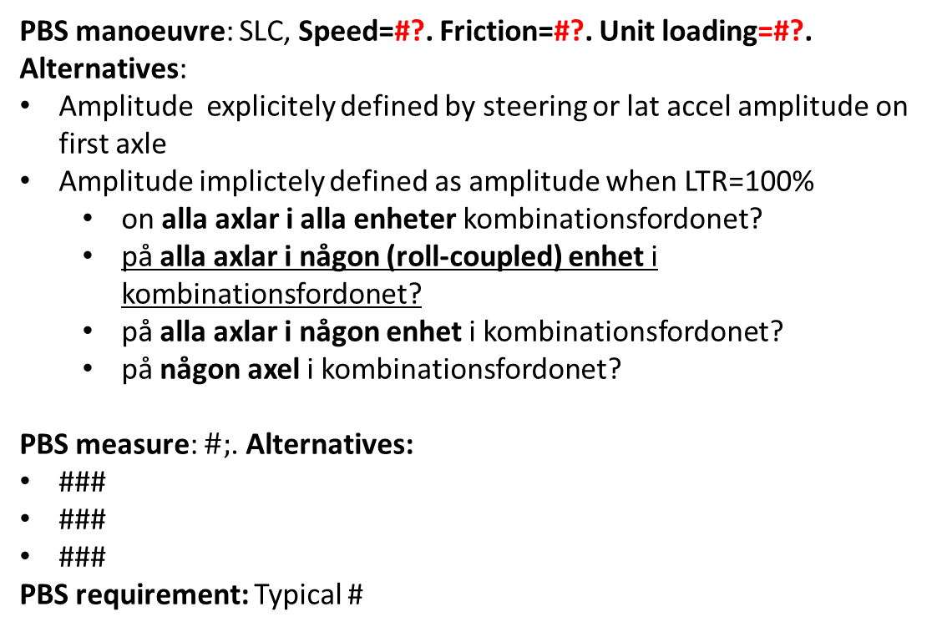
LTR, Load Transfer Ratio
PBS manoeuvre: SLC, Speed=#?. Friction=#?. Unit loading=#?. Alternatives:
Amplitude explicitely defined by steering or lat accel amplitude on first axle
Amplitude implictely defined as amplitude when LTR=100%
on alla axlar i alla enheter kombinationsfordonet?
på alla axlar i någon (roll-coupled) enhet i kombinationsfordonet?
på alla axlar i någon enhet i kombinationsfordonet?
på någon axel i kombinationsfordonet?
PBS measure: $\#;$. Alternatives:
###
###
###
PBS requirement: Typical #
Some relevant alternatives to be presented, in order to document and agree also which alternatives are deselected, and possibly why.
Mark which manoeuvre and measure in Open PBS Tool and in project:
Implemented in Open PBS tool, version ###
Present (20##-##-##) proposal from “HCT in Swe-project”
Present known open issues with this slide: ###, ###, …

