Slide 1
Grid Maintenance Prioritization Assistant
PG&E-style hackathon demo: dashboards • automations • ML

Slide 2
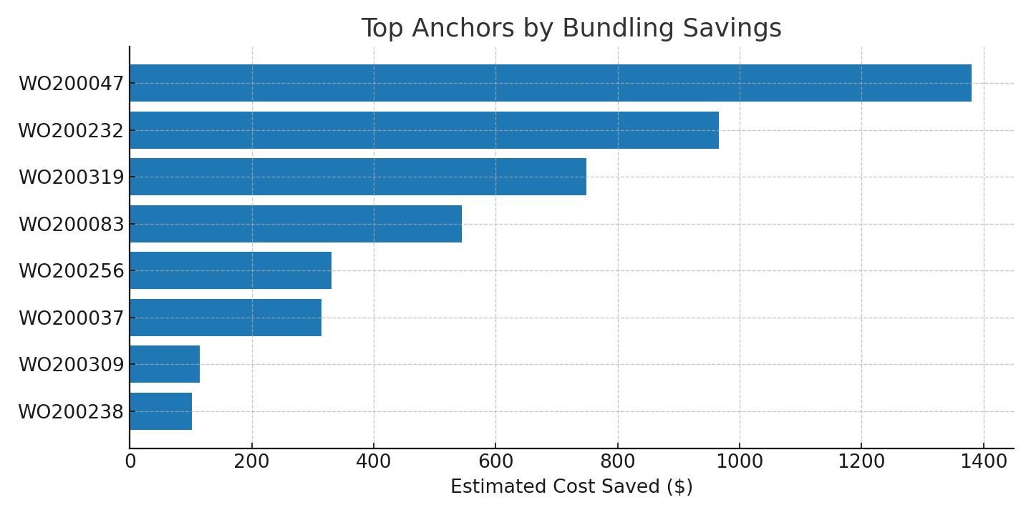
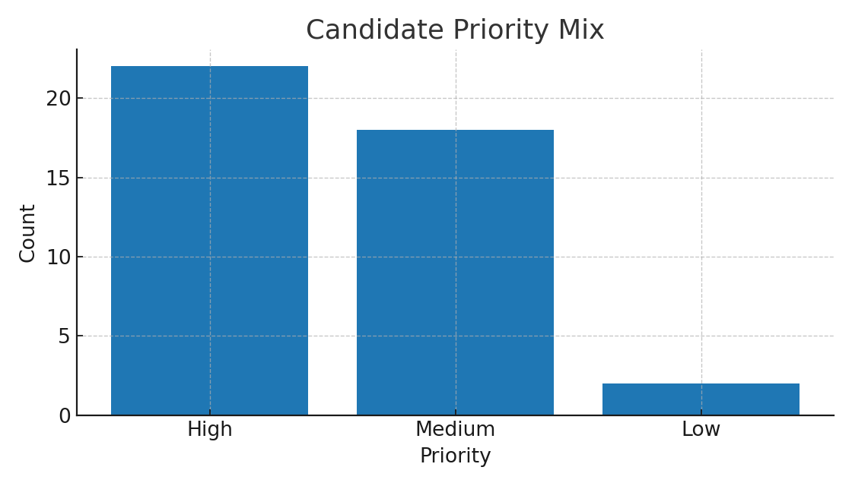
Bundling – Results (Sample Data)

Slide 3
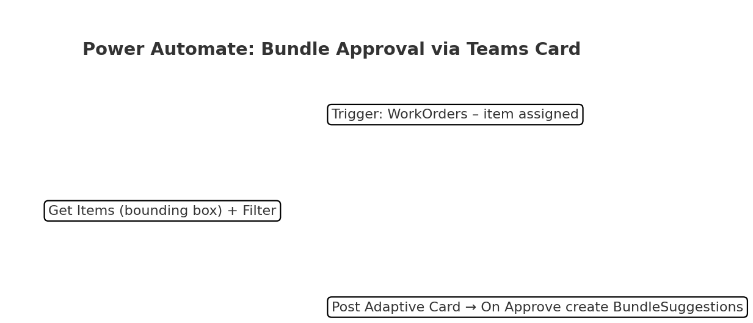
Bundling – Teams Adaptive Card Approval Flow

