Slide 1
Grid Maintenance Prioritization Assistant
Power Platform solution to optimize maintenance safety, reliability, and crew efficiency
Tools: Power BI · Power Automate · Copilot

Slide 2
The Problem
Maintenance backlog increases safety & regulatory risk
Work is tracked in silos; prioritization is reactive
Crew scheduling isn’t risk-aware; oversight lacks real-time view

Slide 3
The Solution
Power BI command center for overdue work & risk
Power Automate alerts & escalations for high-risk cases
Copilot Q&A: natural-language insights and actions

Slide 4
Workflow Architecture
Power BI: map, KPIs, risk & overdue analytics
Power Automate: Teams/email alerts, item updates
Copilot: Ask 'Which substations have the highest risk this week?'

Slide 5
Value to PG&E
Faster repairs → fewer outages & improved safety
Lower regulatory risk via proactive tracking
Optimized crew utilization and targeted dispatch
Executive visibility with weekly auto-briefs

Slide 6
Next Steps
Add wildfire overlays (weather, fuels, PSPS zones)
Integrate predictive asset failure models
Embed in Teams or mobile app for field crews

Slide 7
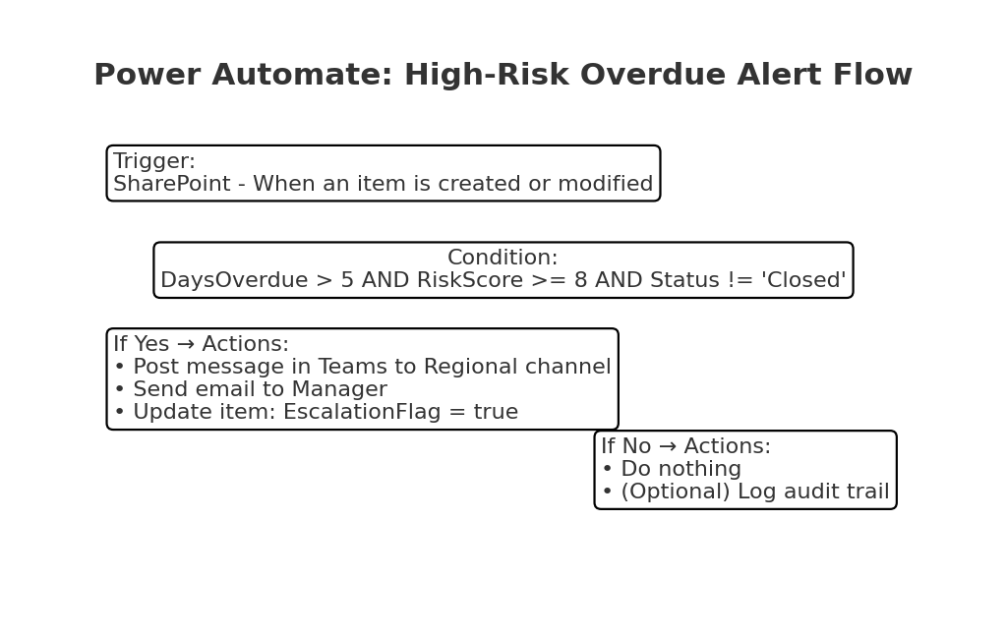
Power Automate – High-Risk Overdue Alert

