Slide 1
13
MOODLE PLUGIN
13 reasons to choose Modern Course Reminder
A rule-based reminder engine for Moodle that chases incomplete, inactive and overdue learners automatically, escalates to their managers, and proves it works — all on cron, with audit-ready logs.
● Moodle 4.5–5.2
● GPLv3
● Stable

Slide 2
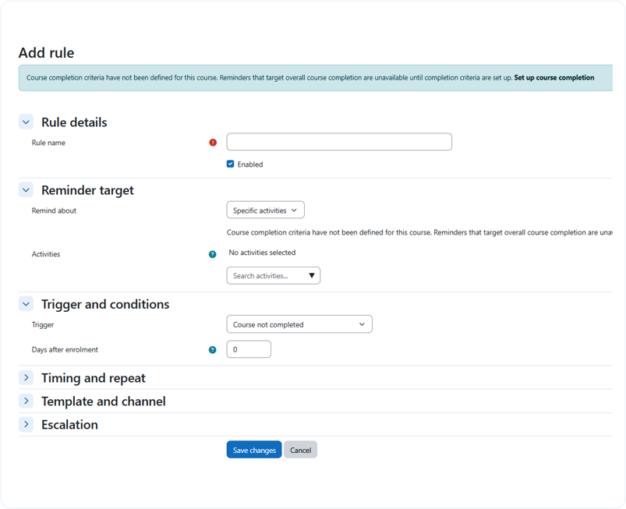
01
Reminders on autopilot
01
Rules detect not-started, incomplete, inactive and overdue learners
Scope a rule to a course, category, cohort or the whole site
Target course completion or specific completion-tracked activities
Notes:
IMAGE TO ADD: IMAGE TO ADD: The rule builder form open on a new/edited rule, showing the Trigger and conditions section (Course not completed / Learner inactive / Deadline / Enrolled-but-not-started) and the 'Applies to' scope selector. Capture /local/moderncoursereminder/rule_edit.php (#region-main), light UI, 16:9 crop.

Slide 3
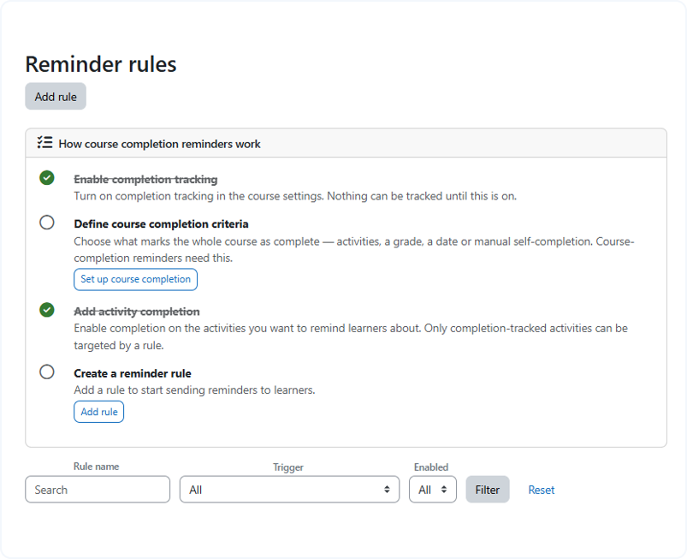
02
02
Guided setup, no broken rules
Teachers manage reminder rules right inside their own course
A setup checklist covers completion tracking, criteria and activities
Rules that target completion are blocked until the course is set up correctly
Notes:
IMAGE TO ADD: IMAGE TO ADD: The course-level rules page showing the 'How course completion reminders work' checklist and the guardrail notice ('Course completion criteria have not been defined… Set up course completion'). Capture /local/moderncoursereminder/rules.php?courseid=85 (#region-main); if the course is fully set up, capture rule_edit.php?courseid=85 to show the criteria-missing guidance. 16:9 crop, light UI.

Slide 4
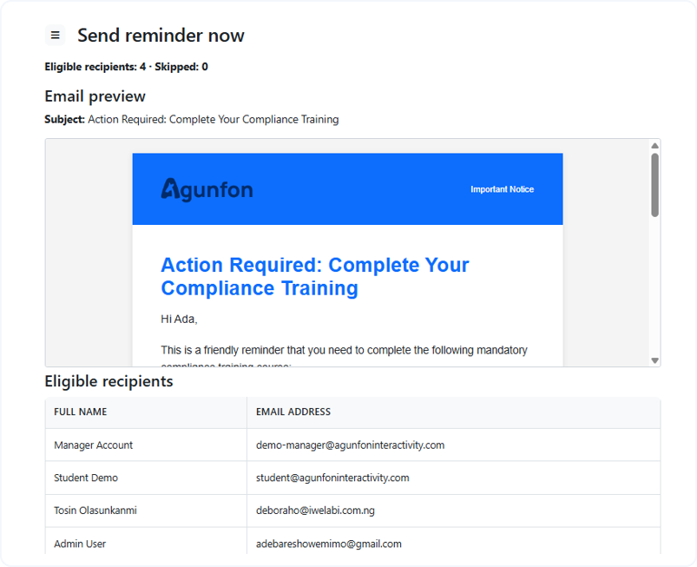
03
03
Rescue inactive learners
Re-engage learners with no course access or no progress for X days
Repeat every N days with a maximum-reminders cap
Preview the exact learners a rule matches before it sends
Notes:
IMAGE TO ADD: IMAGE TO ADD: The 'Preview matched learners' screen for an inactivity rule — the list of learners who match right now with their reason (e.g. 'No course access for 14 days'). Capture /local/moderncoursereminder/rule_preview.php (#region-main). Alternatively the inactive-learners report at report_inactive.php. 16:9 crop, light UI.

Slide 5
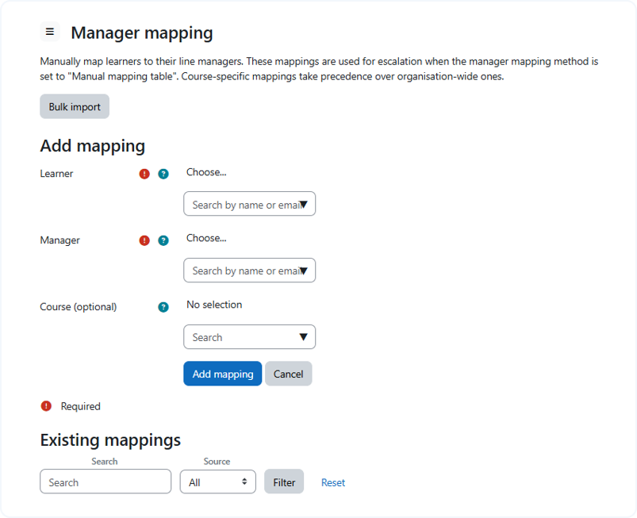
04
04
Escalate to managers
Resolve a line manager by Moodle role, profile field or manual mapping
Bulk-import learner-to-manager mappings from CSV
Escalate on days overdue, reminders received, or a fixed date
Notes:
IMAGE TO ADD: IMAGE TO ADD: The Manager mapping page showing the mappings table (learner → manager, course/org-wide) and the Add mapping / Bulk import actions. Capture /local/moderncoursereminder/managermap.php (#region-main). Optionally inset the rule's Escalation section (days overdue / number of reminders / date). 16:9 crop, light UI.

Slide 6
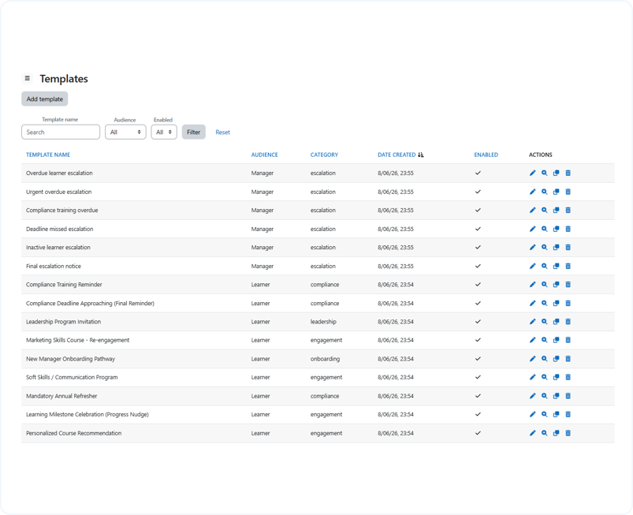
05
05
Branded, AI-drafted templates
Reusable learner, manager and digest templates with ~25 placeholders
Brand colours and an email-safe logo, with a sandboxed preview
Draft with Moodle's own AI subsystem — no API keys stored here
Notes:
IMAGE TO ADD: IMAGE TO ADD: The AI template generator — the 'Describe the email' brief box and a generated draft preview with brand colours. Capture /local/moderncoursereminder/template_ai.php (#region-main). Alternatively, the template editor with the live brand-coloured preview (template_edit.php / template_preview.php). 16:9 crop, light UI.

Slide 7
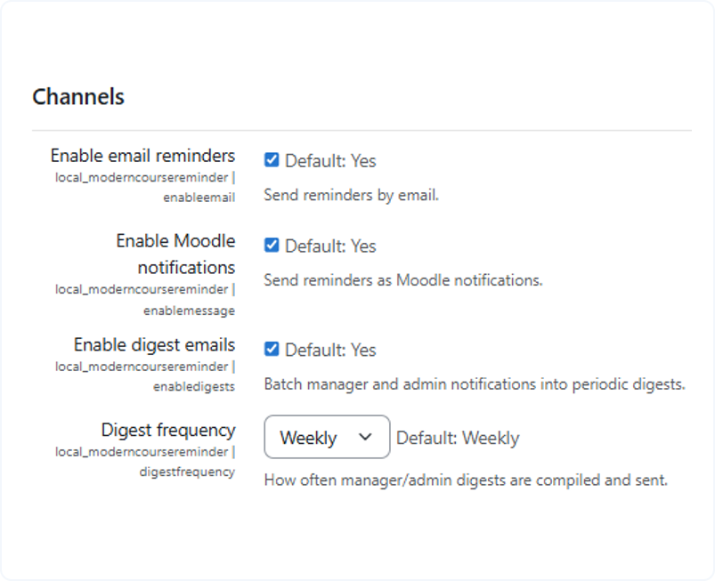
06
06
Every channel, batched digests
Email and Moodle notification, selectable per rule
Manager and admin digests batched daily, weekly or monthly
Channels gated by site-wide switches for safe rollout
Notes:
IMAGE TO ADD: IMAGE TO ADD: The plugin Settings page showing the Channels section (Enable email / Enable Moodle notifications / Enable digests / Digest frequency). Capture /admin/settings.php?section=local_moderncoursereminder_settings, the Channels heading region. Or a rendered manager digest email ('the following N team members are overdue'). 16:9 crop, light UI.

Slide 8
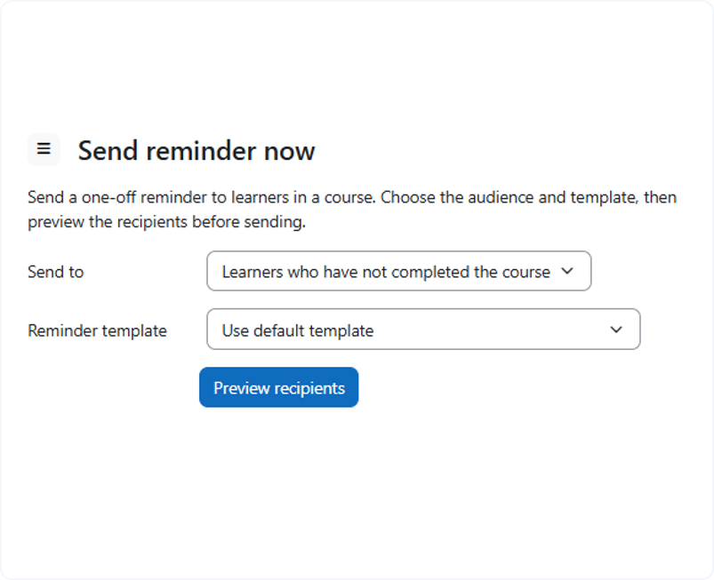
07
07
Send a reminder now
One-off manual send to a course, with audience filters
Preview eligible before sending
Email preview, then send now — no rule or schedule required
Notes:
IMAGE TO ADD: IMAGE TO ADD: The Send reminder now page — the course + audience selector (All enrolled / Not completed / Not started), the 'Preview recipients' result showing the Eligible and Skipped lists (with reasons), and the email preview. Capture /local/moderncoursereminder/manualsend.php (#region-main). 16:9 crop, light UI.

Slide 9
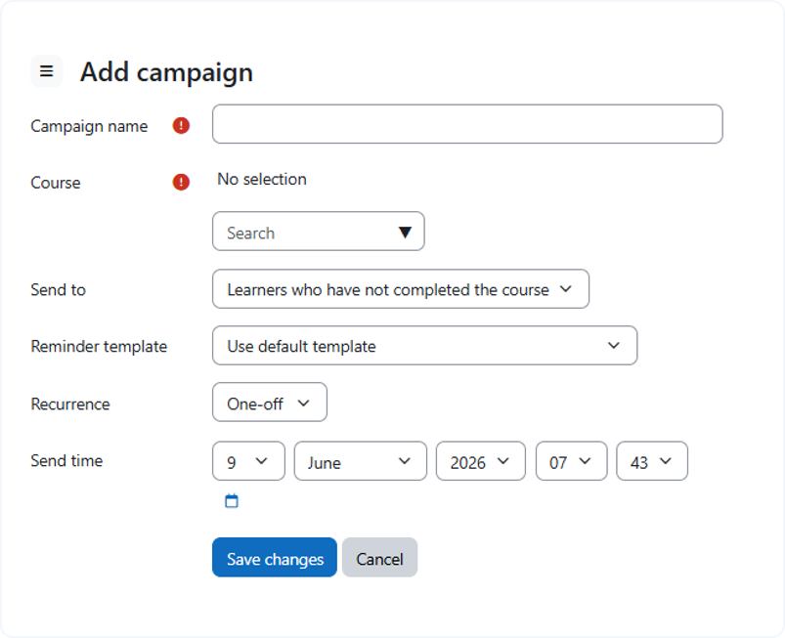
08
08
Scheduling & campaigns
Ready-made starter rules — launch a campaign in a click and adjust
One-off and recurring scheduled campaigns (daily / weekly / monthly)
Daily send windows and start/stop dates control exactly when sends go out
Notes:
IMAGE TO ADD: IMAGE TO ADD: The Scheduled campaigns page — the campaigns list with recurrence (One-off / Daily / Weekly / Monthly) and send time, plus the Add campaign action. Capture /local/moderncoursereminder/schedules.php (#region-main). Optionally inset the Rule library starter blueprints at ruletemplates.php. 16:9 crop, light UI.

Slide 10
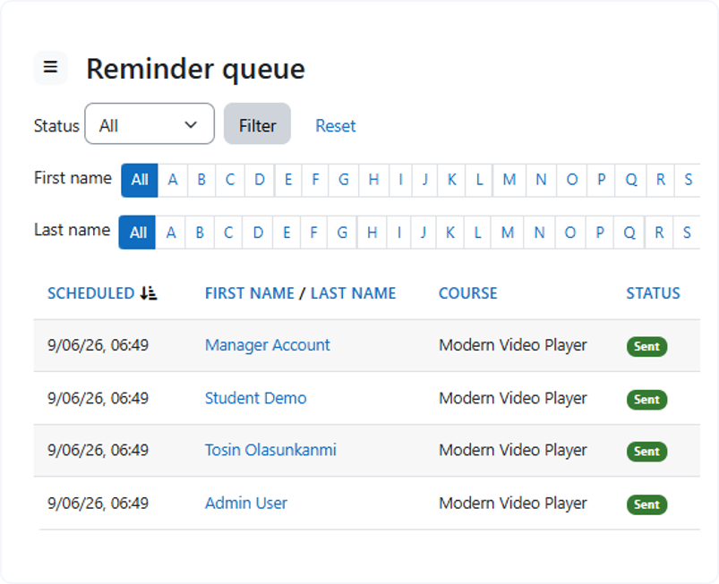
09
09
Runs entirely on cron
Evaluate → queue → send → retry across seven scheduled tasks
De-duplication so a learner is never spammed
Per-run throttle, retry limits and a cancel/requeue queue viewer
Notes:
IMAGE TO ADD: IMAGE TO ADD: The Reminder queue page — the per-recipient queue table with status (Pending / Sent / Failed / Cancelled), attempts, scheduled time, and Cancel/Requeue actions. Capture /local/moderncoursereminder/queue.php (#region-main). 16:9 crop, light UI.

Slide 11
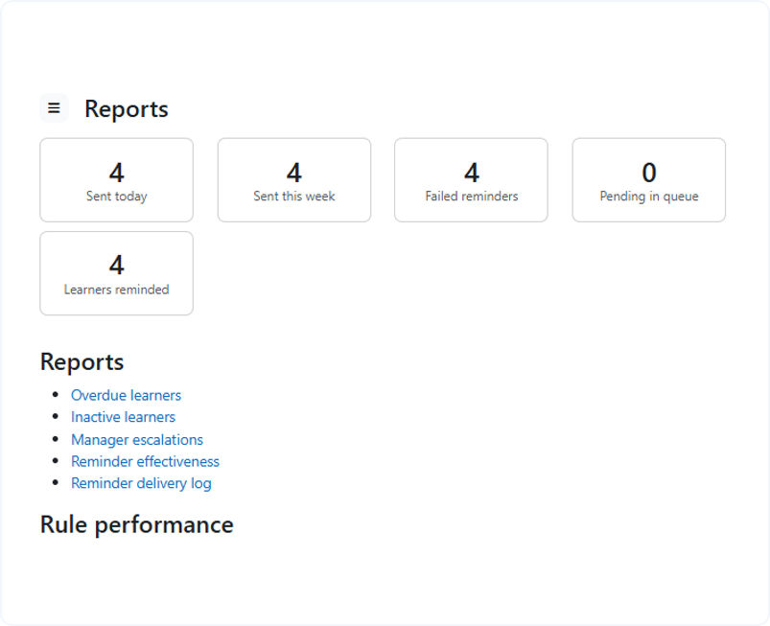
10
10
Prove it lifts completion
Effectiveness: learners reminded and completed-after-reminder
Average days-to-complete and repeated-reminder counts
Live dashboard of rules, sends, pending, failed, overdue and escalations
Notes:
IMAGE TO ADD: IMAGE TO ADD: The Reminder effectiveness analytics page — cards/charts for learners reminded, completed after reminder, average days to complete, repeated reminders. Capture /local/moderncoursereminder/report_analytics.php (#region-main). Alternatively the main dashboard metric cards at index.php. 16:9 crop, light UI.

Slide 12
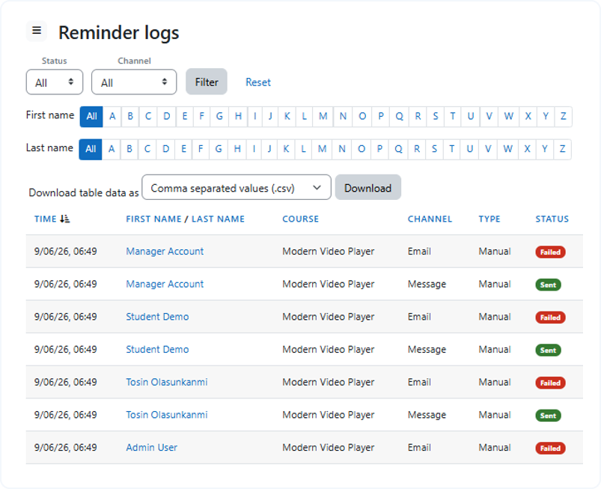
11
11
Audit-ready by design
Filterable, exportable delivery logs of every reminder sent
Overdue, inactive, rule-performance and escalation reports
Report Builder datasource for the reminder delivery log
Notes:
IMAGE TO ADD: IMAGE TO ADD: The Reminder logs page — the audit log table with filters (course, audience, channel, status, date) and an export control. Capture /local/moderncoursereminder/logs.php (#region-main). Optionally inset the Reports index (reports.php). 16:9 crop, light UI.

Slide 13
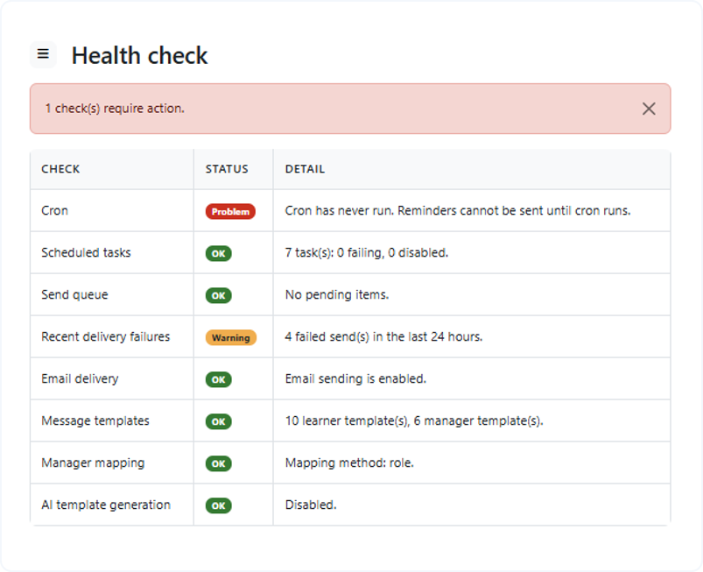
12
12
Safe, respectful sending
Learner opt-out and auto-skip of suspended / no-email / exempt users
De-dup and a daily send window keep volume sane
Built-in health check for cron, email, queue, mapping and templates
Notes:
IMAGE TO ADD: IMAGE TO ADD: The Health check page — the status table (Cron, Email delivery, Send queue, Scheduled tasks, Manager mapping, Message templates, AI) with OK / Warning / Problem badges. Capture /local/moderncoursereminder/healthcheck.php (#region-main). 16:9 crop, light UI.

Slide 14

13
Moodle-native, future-proof
13
Built on core Completion, Enrolment and Messaging APIs — nothing external to host
Full GDPR privacy provider with export and deletion
Moodle 4.5–5.2; one-command switch from the old free reminder plugin
Notes:
IMAGE TO ADD: IMAGE TO ADD: The Modern Course Reminder dashboard as a confident 'home' shot — the sidebar navigation plus the overview metric cards and recent activity. Capture /local/moderncoursereminder/index.php (#region-main). 16:9 crop, light UI.

Slide 15
Convinced?
Get Modern Course Reminder now
BUY NOW
https://agunfoninteractivity.com/plugins/modern-course-reminder
Moodle 4.5–5.2 · GPLv3 · 30-day money-back guarantee
Notes:
OPTIONAL BACKGROUND IMAGE: Optional background: a clean office/desk lifestyle photo with a deep navy/blue overlay (Lambda-style), kept dark enough that the white headline and BUY NOW button stay legible.

