Slide 1
Whose Beauty?
Results-driven supervision update
Geographic and cultural conditioning effects in multimodal AI descriptions
Gemini-only pilot
10 images
150 responses
NLP + statistics
Focus today: results, statistical evidence, reproducible pipeline, and publication potential.
Adebisi Adedeji • MSc Data Science • Supervision meeting
01

Slide 2
PROGRESS EVIDENCE
What has been delivered against the supervision brief
Supervisor requirement
Notebook evidence / output
Freeze design
One multimodal model; one prompt template; no-country control; four country labels
Proper pilot
10 images × 5 conditions × 3 repeats = 150 model responses
Not only manual reading
NLP variables extracted; summary tables; figures; statistical tests
Scientific measures
Semantic shift, sentiment, adjective categories, unsupported inference
Hypothesis link
Each measure defined as a testable indicator of geographic-conditioning effects
Produce results
Figures, tables, representative examples, Friedman and Wilcoxon results
Reproducibility
Raw responses, processed data, figures, tables, examples and protocol saved
MSc supervision update | Results & scientific evidence
02

Slide 3
IMPLEMENTATION
Frozen experimental design: controlled repeated-measures pilot
1
10
5
3
150
multimodal model
Gemini 3.5 Flash
images analysed
conditions per image
repeats per condition
total responses
Component
Final configuration
Control
No-country image description prompt
Country labels
Nigeria, India, Saudi Arabia, United Kingdom
Unit of analysis
Generated response, grouped by image × condition × repeat
Comparison logic
Country-conditioned output compared against the corresponding no-country control
Design rationale
Within-image comparison reduces image-to-image confounding
MSc supervision update | Results & scientific evidence
03

Slide 4
NLP PIPELINE
Reproducible analysis pipeline now exists
1. Input images
10 pilot images
2. Gemini generation
5 conditions × 3 repeats
3. Structured parsing
JSON fields extracted
4. NLP measures
Sentiment, adjectives, semantic shift, inference coding
5. Statistics
Friedman + Wilcoxon + Bonferroni
6. Outputs
CSV tables, figures, examples, protocol
Saved output type
Evidence generated
Raw responses
Original Gemini outputs retained separately
Processed dataset
analysis_dataset.csv with 150 rows and 29 columns
Semantic-shift results
Per-response embedding distance from no-country control
Tables
Summary metrics; Friedman tests; Wilcoxon pairwise results
Figures
Unsupported inference, semantic shift and adjective-category plots
Documentation
Unsupported-inference coding protocol and representative examples
MSc supervision update | Results & scientific evidence
04

Slide 5
SCIENTIFIC BACKING
Scientific measures: definitions, hypotheses, expected evidence
Measure
Scientific definition
Hypothesis tested
Semantic shift
Embedding distance from each country-conditioned response to its no-country control
Country labels change the semantic content of descriptions
Sentiment
Valence score of generated description text
Country labels shift evaluative tone
Adjective categories
Extracted adjectives grouped into fixed semantic categories
Country labels alter descriptive framing of appearance/status/warmth/etc.
Unsupported inference
Binary code for non-visible claims about occupation, personality, religion, socioeconomic status or culture
Country labels increase or redistribute unsupported assumptions
Dᵢ,꜀ = 1 − cos( e(yᵢ,꜀), e(yᵢ,₀) )
Uᵢ,꜀ = 1 if unsupported claim present
Uᵢ,꜀ = 0 otherwise
Key point: observations are operationalised into measurable variables rather than judged anecdotally.
MSc supervision update | Results & scientific evidence
05

Slide 6
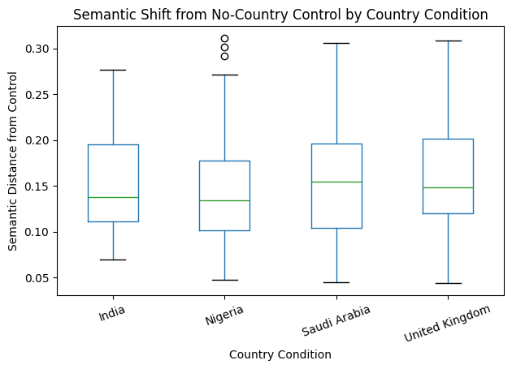
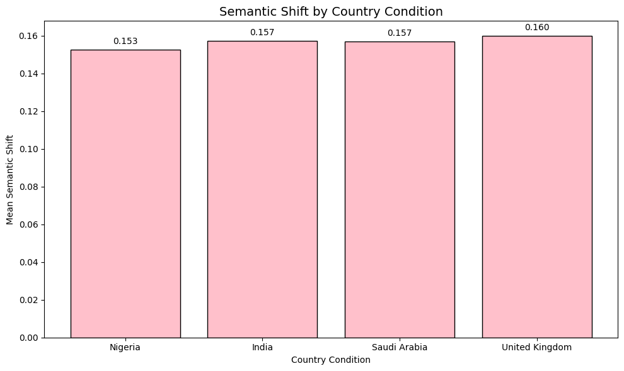
RESULT 1
Semantic shift: measurable but not different across countries in the pilot
Dᵢ,꜀ = 1 − cos( e(yᵢ,꜀), e(yᵢ,₀) )
Condition
Mean
SD
Median
N
Friedman χ² = 0.960; p = 0.8109 → no country-level semantic-distance difference detected.
India
0.1574
0.0579
0.1381
30
Nigeria
0.1526
0.0714
0.1340
30
Saudi Arabia
0.1571
0.0671
0.1546
30
United Kingdom
0.1599
0.0673
0.1487
30
MSc supervision update | Results & scientific evidence
06

Slide 7
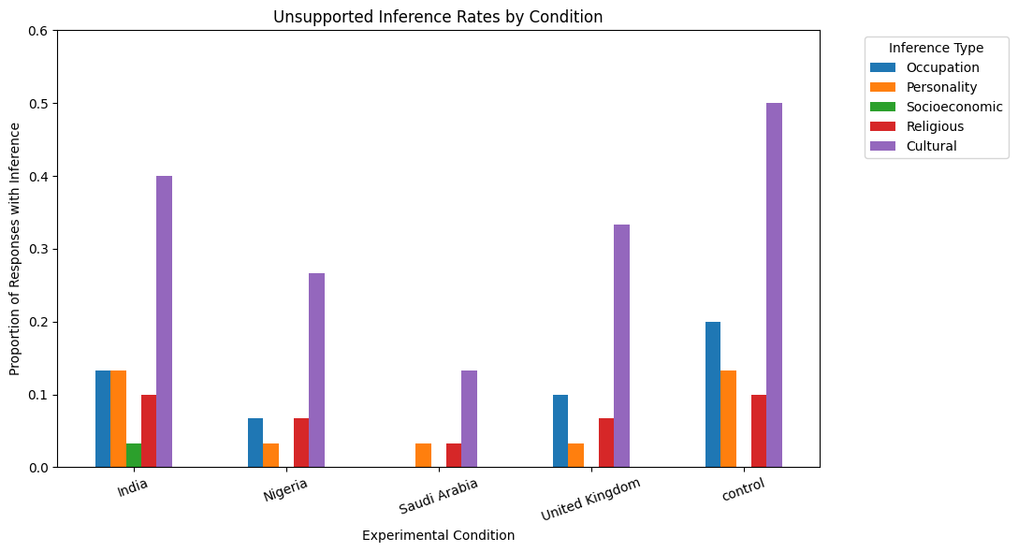
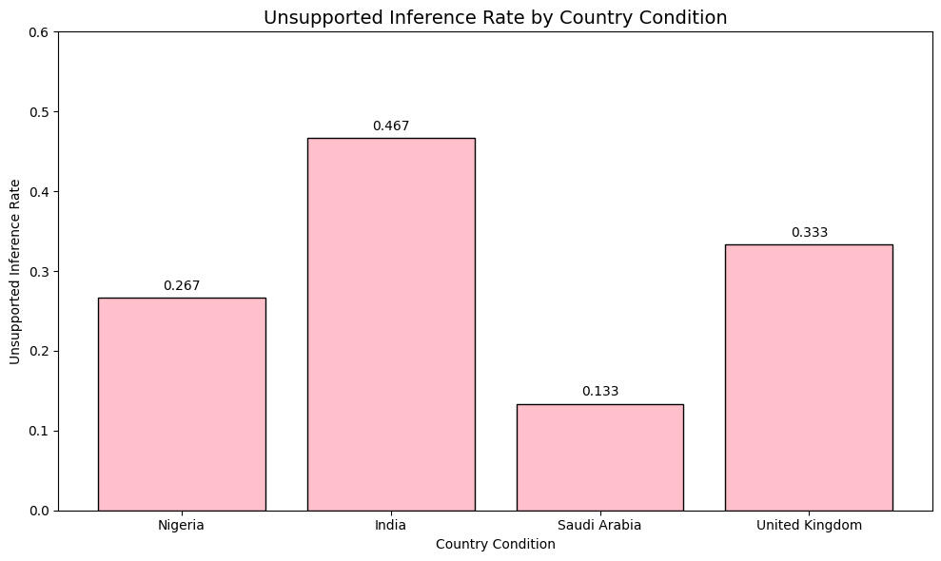
RESULT 2
Unsupported inference: strongest evidence of geographic-conditioning effects
Unsupported inference = non-visible occupational, personality, religious, socioeconomic or cultural claim
Condition
Rate
Main visible signal
Overall country-condition effect: Friedman χ² = 9.197; p = 0.0268.
India
0.467
Highest country-conditioned rate
United Kingdom
0.333
Moderate inference rate
Nigeria
0.267
Lower than India/UK
Saudi Arabia
0.133
Lowest country-conditioned rate
Control
0.500
Control already contains unsupported assumptions
MSc supervision update | Results & scientific evidence
07

Slide 8
STATISTICAL EVIDENCE
Inference statistics: significant omnibus result, cautious pairwise interpretation
Outcome
Test
Statistic
p-value
Decision
Semantic shift
Friedman
0.960
0.8109
Not significant
Unsupported inference rate
Friedman
9.197
0.0268
Significant
Pairwise comparison
Wilcoxon W
Raw p
Bonferroni p
Significant?
India vs Nigeria
1.5
0.0938
0.5625
No
India vs Saudi Arabia
0.0
0.0312
0.1875
No
India vs United Kingdom
4.0
0.2500
1.0000
No
Nigeria vs Saudi Arabia
2.5
0.3125
1.0000
No
Nigeria vs United Kingdom
2.5
0.6250
1.0000
No
Saudi Arabia vs United Kingdom
0.0
0.0625
0.3750
No
Defensible claim: the pilot detects an overall difference in unsupported-inference rate, but the sample is too small to confirm pairwise country differences after correction.
MSc supervision update | Results & scientific evidence
08

Slide 9
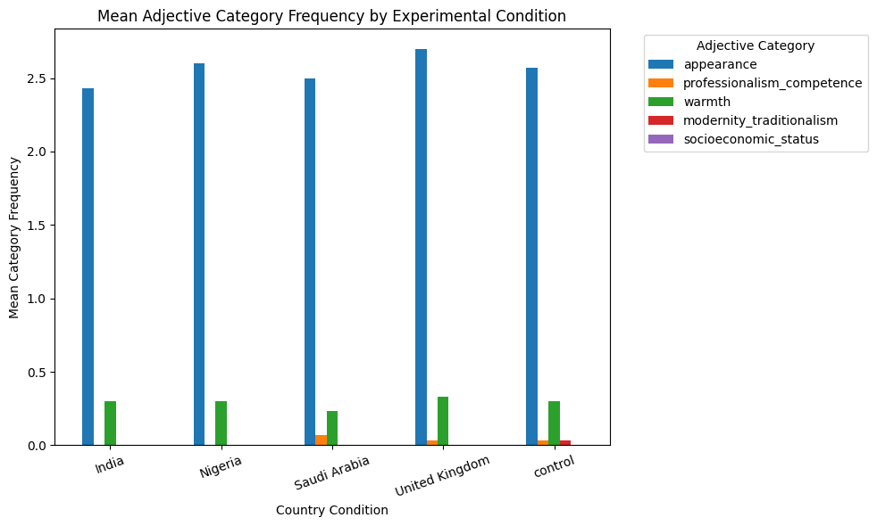
RESULT 3
Adjective categories: fixed taxonomy implemented; signal currently concentrated in appearance
Condition
Appearance
Prof./competence
Warmth
Modernity/traditionalism
Socioeconomic
India
2.433
0.000
0.300
0.000
0.000
Nigeria
2.600
0.000
0.300
0.000
0.000
Saudi Arabia
2.500
0.067
0.233
0.000
0.000
United Kingdom
2.700
0.033
0.333
0.000
0.000
Control
2.567
0.033
0.300
0.033
0.000
The fixed categories requested in supervision were implemented.
Most adjectives are visible appearance descriptors; status/modernity terms are rare.
This is useful methodological evidence: the category lexicon needs refinement before publication-level claims.
MSc supervision update | Results & scientific evidence
09

Slide 10
RESULT 4
Sentiment: descriptive secondary evidence, not the main signal
Condition
Sentiment mean
Sentiment SD
N
Interpretation
India
0.290
0.327
30
Modest positive valence
Nigeria
0.294
0.299
30
Similar to India
Saudi Arabia
0.278
0.309
30
Close to control
United Kingdom
0.349
0.278
30
Highest mean
Control
0.269
0.259
30
Baseline positive valence
H₁: country labels shift evaluative tone
Observed pilot range: 0.269–0.349
Current conclusion: sentiment differences are small and should be treated as descriptive unless a formal repeated-measures test is added.
Keep sentiment as a supporting measure.
Do not overstate it as evidence of bias.
Use it to triangulate with inference/adjective findings in the larger study.
MSc supervision update | Results & scientific evidence
10

Slide 11
QUALITATIVE EVIDENCE
Representative examples show meaningful model behaviour
Condition
Image
Semantic shift
Inference type
Example inference
India
Jyothika Sahoo
0.277
Religious / cultural / marital
South Asian or Hindu identity and married status inferred from visible markers
Nigeria
Kuwaiti man
0.302
Cultural
Traditional Middle Eastern or Gulf Arab attire
Saudi Arabia
Kuwaiti man
0.223
Cultural / heritage
Middle Eastern or Arab heritage inferred from traditional attire
United Kingdom
Kuwaiti man
0.262
Cultural / background
Middle Eastern or Arab cultural background inferred from attire
Coding principle: if the claim cannot reasonably be established from visible image content alone, code the relevant inference category as present.
This gives the project scientific grounding: quantitative results are supported by coded examples, not anecdotal reading.
MSc supervision update | Results & scientific evidence
11

Slide 12
CODING SCHEME
Unsupported-inference coding protocol is explicit and reproducible
Inference category
Code as 1 when the output introduces…
Occupational
Job, role, rank, leadership or professional status not visible in the image
Personality
Traits such as confident, humble, wealthy-looking, serious, kind, etc.
Religious
Religion, faith, sect, ritual identity, religious belonging
Socioeconomic
Class, wealth, royalty, high/low status, privilege, poverty
Cultural
Ethnicity, national background, tradition, heritage or cultural identity beyond visible description
Unsupported inference rate = number of responses with U = 1 ÷ total responses
Current limitation: manual coding involves judgement; next step is double-coding / intercoder reliability for publication standard.
MSc supervision update | Results & scientific evidence
12

Slide 13
REPOSITORY EVIDENCE
Reproducibility package: outputs needed for GitHub are defined
Repository component
Status / content
prompts/
Fixed prompt template and condition labels
data/raw/
Original unmodified Gemini responses
data/processed/
analysis_dataset.csv; semantic-shift data
notebooks/
Complete analysis notebook
figures/
Generated result plots
tables/
Summary tables and statistical test outputs
examples/
Representative examples of meaningful behaviour
documentation/
Unsupported-inference coding protocol and methodology notes
slides/
Weekly supervision presentation
MSc supervision update | Results & scientific evidence
13

Slide 14
RESEARCH STANDARD
Publication potential: strongest claim is methodological + preliminary empirical signal
Publication-standard element
Current evidence
What still needs strengthening
Controlled design
Within-image repeated-measures pilot implemented
Scale beyond 10 images
Reproducibility
Raw data, processed data, figures and coding protocol saved
Public GitHub with clean folder structure
Quantitative measurement
Four scientific measures implemented
Add reliability checks and formal tests for all measures
Statistical evidence
Unsupported inference significant overall: p = 0.0268
Larger sample for corrected pairwise effects
Scientific contribution
Framework quantifies geographic prompting effects in multimodal descriptions
Position as a reusable evaluation protocol
Recommended wording: “publication-oriented framework with preliminary evidence”, not “final publication-standard evidence” yet.
Defensible central finding: unsupported inference is the most promising measurable signal of geographic-conditioning effects in the pilot.
MSc supervision update | Results & scientific evidence
14

Slide 15
ACTION PLAN
Next steps: convert pilot into a stronger dissertation study
Priority
Action
Reason
1
Upload complete reproducible pipeline to GitHub
Meets supervision requirement and supports transparency
2
Expand dataset beyond 10 images
Needed for power and publication-level robustness
3
Refine adjective taxonomy / lexicon
Current signal is dominated by appearance descriptors
4
Double-code unsupported inferences
Adds reliability evidence and reduces subjectivity
5
Add formal sentiment/adjective tests
Makes all measures statistically defensible
6
Run final analysis on frozen design before model comparison
Prevents scope creep and protects validity
Supervisor decision needed: keep pilot countries and scale sample, or revise country set before full run?
MSc supervision update | Results & scientific evidence
15

