Slide 1

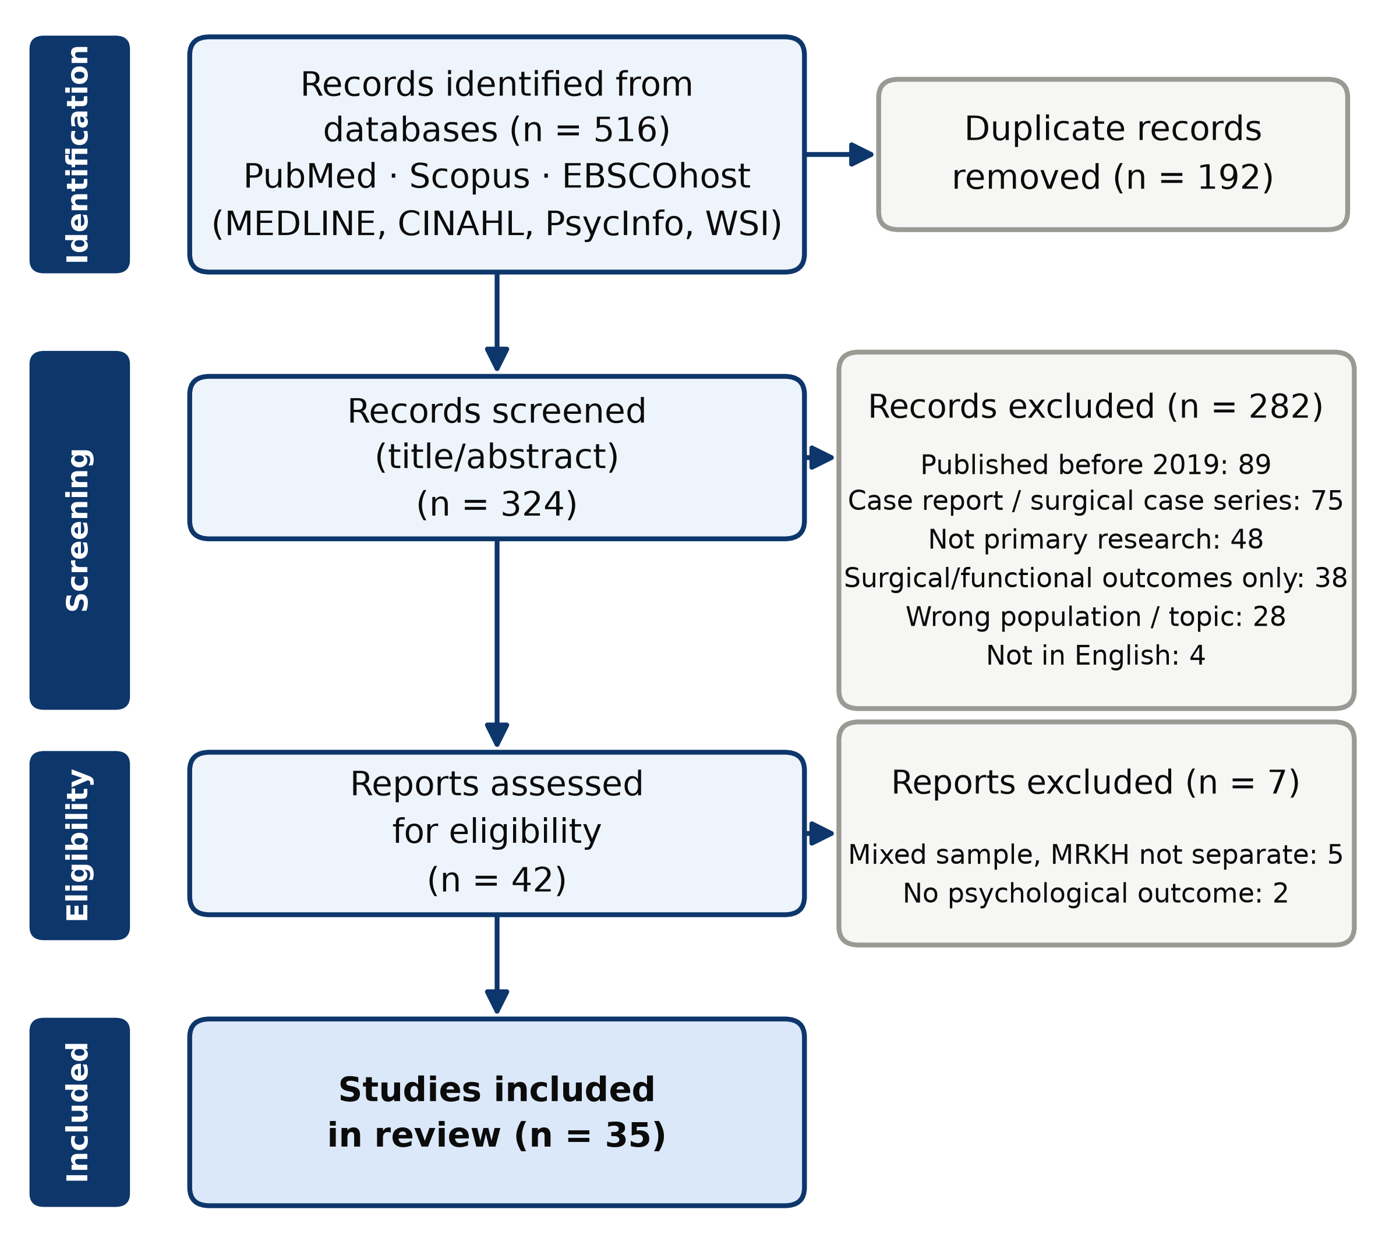
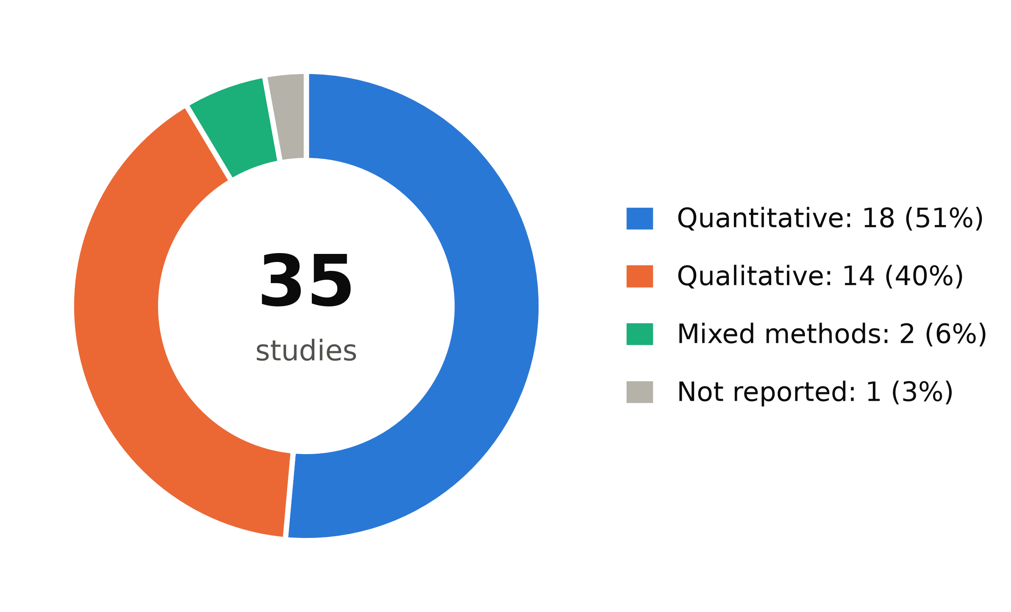
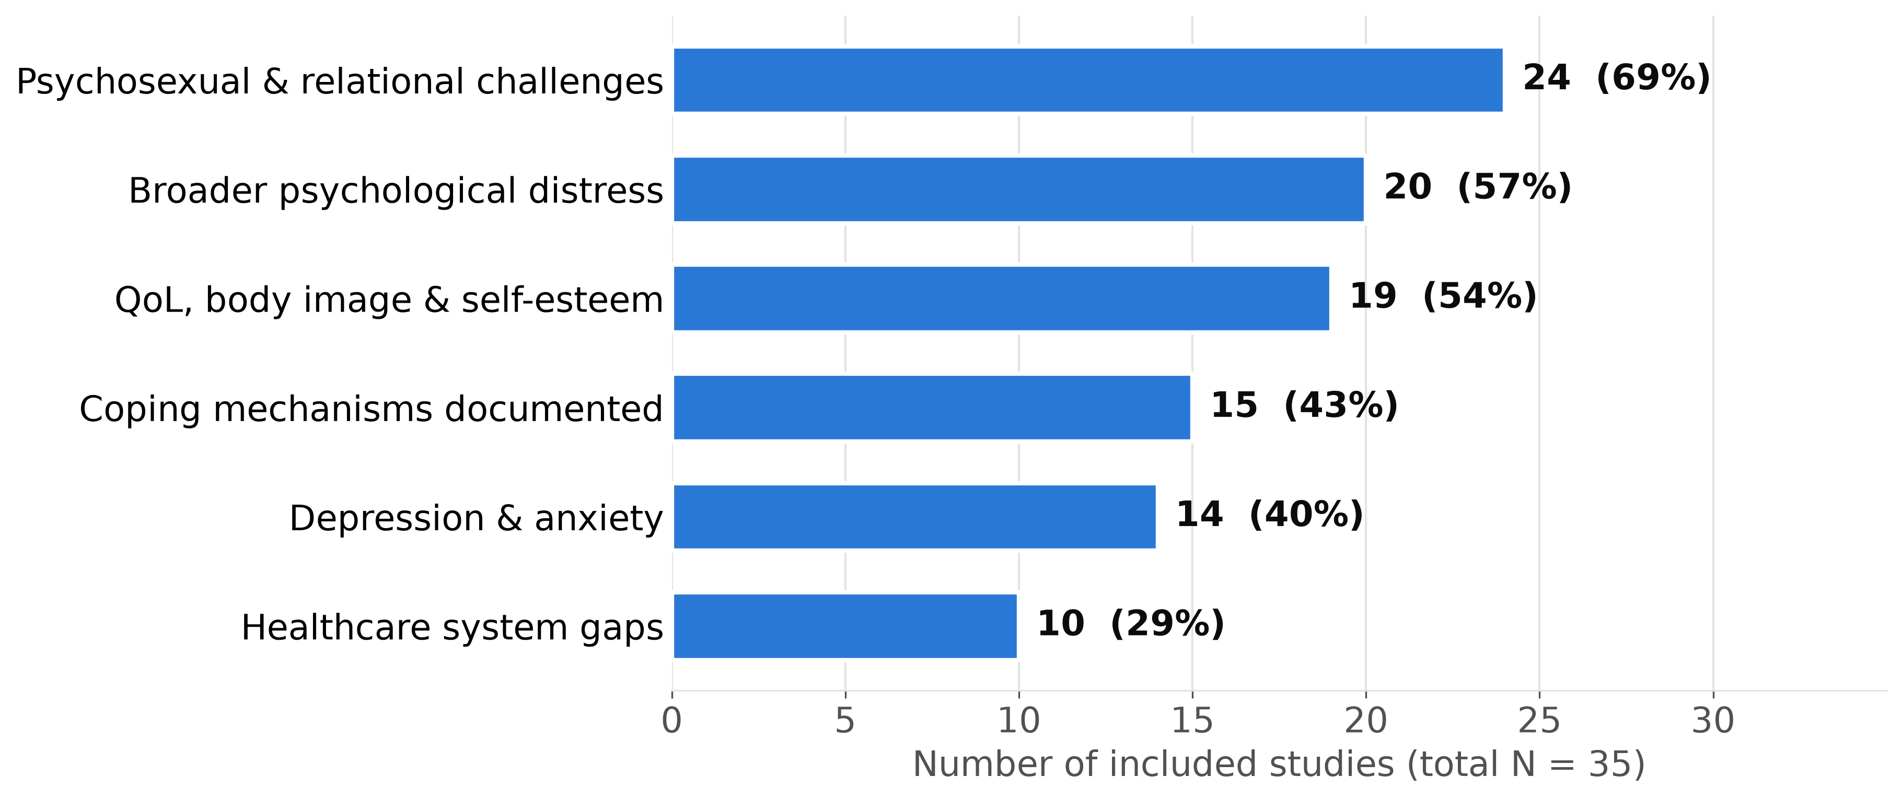
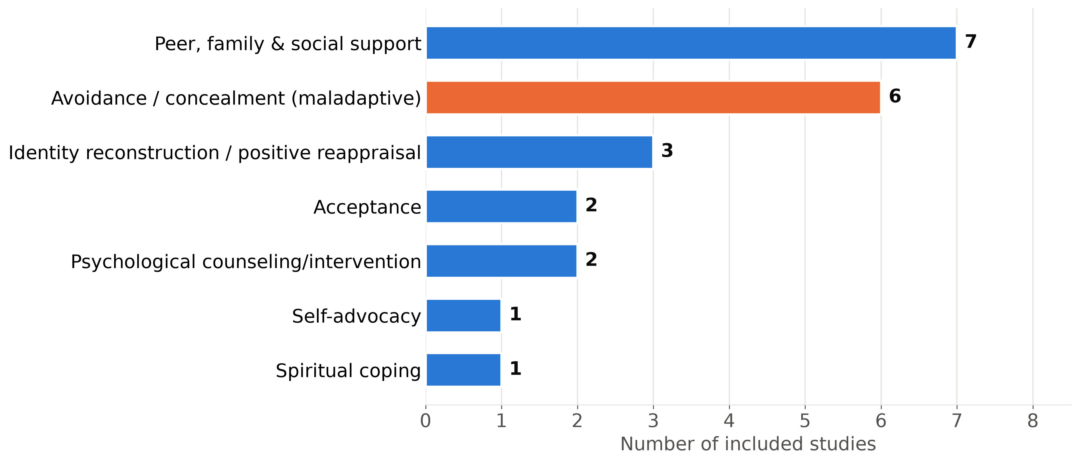
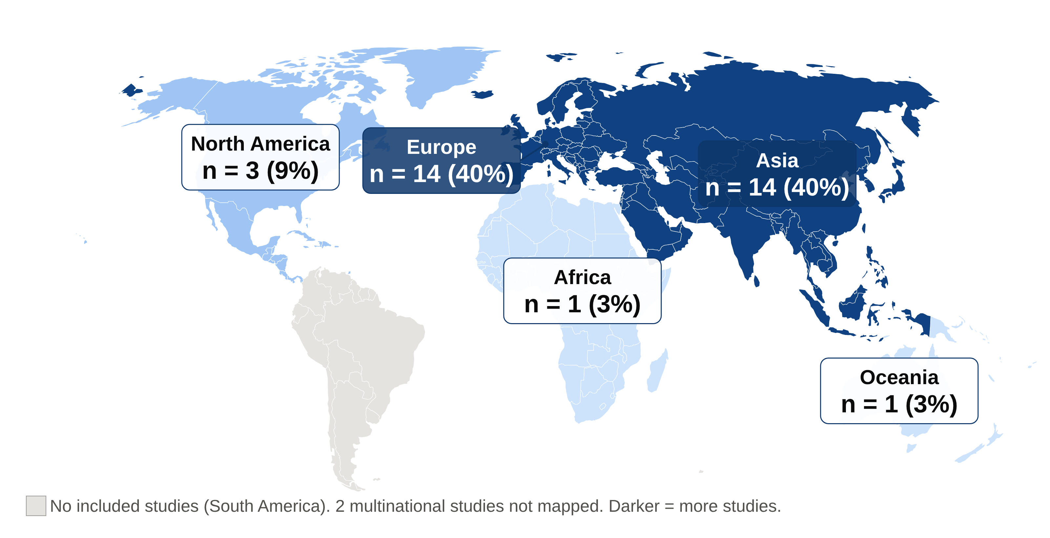
MENTAL HEALTH AND PSYCHOSOCIAL OUTCOMES AMONG INDIVIDUALS WITH
MAYER-ROKITANSKY-KÜSTER-HAUSER (MRKH) SYNDROME: A SCOPING REVIEW
Ifeoluwanimi P. Shobayo, BSc, MSPHc, Paul Okojie, PhD, Robyn Anderson, PhD
Department of Public and Community Health, Liberty University
Abstract
Results, Discussion, Conclusion, and Limitations
Background: Mayer-Rokitansky-Küster-Hauser (MRKH) syndrome is a rare congenital condition (1 in 4,500–5,000 female births) characterized by uterovaginal agenesis in individuals with a 46,XX karyotype. Usually diagnosed in adolescence, it affects fertility, sexuality, and identity, yet its mental health consequences remain insufficiently synthesized.
Methods: Scoping review (Arksey & O'Malley; PRISMA-ScR) of PubMed, Scopus, and EBSCOhost databases (MEDLINE, CINAHL, APA PsycInfo, Women's Studies International), January 2019–March 2026.
Results: Of 516 records, 35 studies were included. Psychosexual and relational challenges were most frequent (n = 24), followed by psychological distress (n = 20), reduced QoL, body image, and self-esteem (n = 19), and depression and anxiety (n = 14). Coping was documented in 15 studies, mostly peer support; healthcare gaps in 10.
Conclusion: MRKH-related psychosocial burden is substantial yet under-integrated into care. Psychosocial screening, psychosexual counseling, and peer support belong in MRKH care pathways.
Key Findings: 35 studies from 2019–2026 were included (18 quantitative, 14 qualitative, 2 mixed-methods), with samples of 5 to 616 participants (Figures 1–5).
• Psychosexual and relational (69%): lower sexual esteem and more negative genital self-image than controls, even after neovagina creation.^{10,11}
• Psychological distress (57%): shock, grief, shame, and secrecy at diagnosis; the diagnostic process itself was described as upsetting and potentially traumatizing.^{12,13}
• QoL, body image, and self-esteem (54%): impaired mental health–related quality of life,¹⁴ and higher distress with lower self-esteem than population norms.¹⁵
• Depression and anxiety (40%): depressive symptoms in 75.2% of 141 Chinese patients;¹⁶ anxiety in 37.7% and depression in 32.5% of 77 Malaysian women.¹⁷ Findings were mixed: uterus transplant candidates in France showed few symptoms.¹⁸
• Coping (43%): peer and online support most common; avoidance and concealment also frequent, and one study traced a shift from avoidance to empowerment.¹⁹ Only 2 intervention studies were found, both reporting benefit.^{20,21}
• Healthcare gaps (29%): delayed diagnosis, providers unfamiliar with MRKH, and patients forced to self-advocate.^{22,23}
Discussion
Findings echo earlier evidence of distress and reduced quality of life in MRKH^{3,5} and extend prior reviews by mapping coping and health-system gaps. Psychosexual concerns dominate the recent literature, whereas depression and anxiety were measured in fewer than half of studies. Evidence is concentrated in Europe (14) and Asia (14); 1 study came from Africa and none from South America, where expectations about fertility and marriage may shape experiences differently.
Conclusion
MRKH affects far more than reproductive anatomy. Psychosexual difficulties, emotional distress, and low self-esteem were widely reported, yet depression and anxiety were measured in fewer than half of studies, and coping relied mostly on peers or concealment rather than structured care. Mental health screening, psychosexual counseling, and peer support should become standard in multidisciplinary MRKH care, not an afterthought, and research must reach underrepresented regions.
Limitations: English-language database literature from 2019–2026 only, without grey literature; many small, single-center samples; heterogeneous designs and measures; possible overlapping samples; 5 studies assessed from abstracts only; no quality appraisal, and counts show how often outcomes were studied, not their prevalence.
Introduction, Objective, and Research Question
Figure 1. PRISMA-ScR flow diagram: 516 records identified, 324 screened, 42 assessed for eligibility, and 35 included.
Figure 2. Study designs: 18 quantitative (51%), 14 qualitative (40%), 2 mixed-methods, and 1 not reported.
Introduction
MRKH syndrome is the congenital absence of the uterus and upper vagina in individuals with a 46,XX karyotype and functioning ovaries, affecting about 1 in 4,500–5,000 female births.^{1,2} It is usually diagnosed in adolescence during evaluation of primary amenorrhea,¹ a sensitive period for identity, sexuality, and relationships. Earlier studies linked MRKH with psychological distress, anxiety, and reduced quality of life,^{3–5} and guidelines recommend psychosocial counseling as part of care.¹ Prior reviews focused on psychological and sexual outcomes;^{6,7} coping and healthcare system gaps have not been mapped across the growing recent literature. Mapping this evidence can guide psychosocial care, provider training, and research priorities.
Objective
To map mental health and psychosocial outcomes, coping mechanisms, and healthcare system gaps reported in studies of individuals with MRKH published 2019–2026.
Research Question
What mental health outcomes and coping mechanisms are reported among individuals with MRKH syndrome, and what healthcare system gaps exist?
Methods
Public Health Implications and Future Work
METHOD | DESCRIPTION
Design | Scoping review using Arksey & O'Malley's five-stage framework⁸ and PRISMA-ScR reporting guidance.⁹ Framed by population (individuals with MRKH), concept (mental health, coping, care gaps), and context (any setting). No quality appraisal, consistent with scoping methodology.
Search | PubMed; Scopus; EBSCOhost (MEDLINE, CINAHL, APA PsycInfo, Women's Studies International). January 2019–March 2026; exported March 29, 2026. Terms combined MRKH and Müllerian agenesis with mental health, psychosocial, and coping concepts.
Eligibility | Included: English-language primary quantitative, qualitative, or mixed-methods studies reporting psychological outcomes or coping in MRKH; mixed samples only if MRKH results were reported separately or ≥80% had MRKH. Excluded: reviews, case reports, and studies of surgical, anatomical, or fertility outcomes only.
Screening & Analysis | 516 records; 192 duplicates removed; 324 titles and abstracts screened; 42 assessed; 35 included (Figure 1). Data were charted from full texts (30 of 35 studies; abstracts for the rest): design, country, sample, outcomes, coping, and healthcare gaps; synthesized with frequency counts and thematic grouping into 6 domains (Figure 3).
Figure 3. Psychosexual and relational challenges were the most frequently reported outcome (24 of 35 studies); depression and anxiety were the least often assessed of the four outcome domains (14 of 35). Studies could report more than one domain.
Public Health Implications
• Integrate psychosocial screening and support into MRKH diagnostic pathways¹
• Build multidisciplinary teams that include psychology and social work
• Pair vaginal lengthening treatment with psychosexual counseling
• Train providers in sensitive, non-stigmatizing communication
• Expand peer support networks, including online communities
Future Research
• Longitudinal studies using validated mental health measures
• Trials of psychosocial interventions delivered in routine care
• Studies in Africa, South America, and other low-resource settings
References
Paste QR code here
(5.53 × 5.53 in; links to the full reference list)
Figure 4. Coping mechanisms in 15 studies: peer, family, and social support was most common (7), followed by avoidance and concealment (6).
Figure 5. Europe and Asia contributed 14 studies each, Africa and Oceania 1 each, and South America none (2 multinational studies not mapped).

