Slide 1

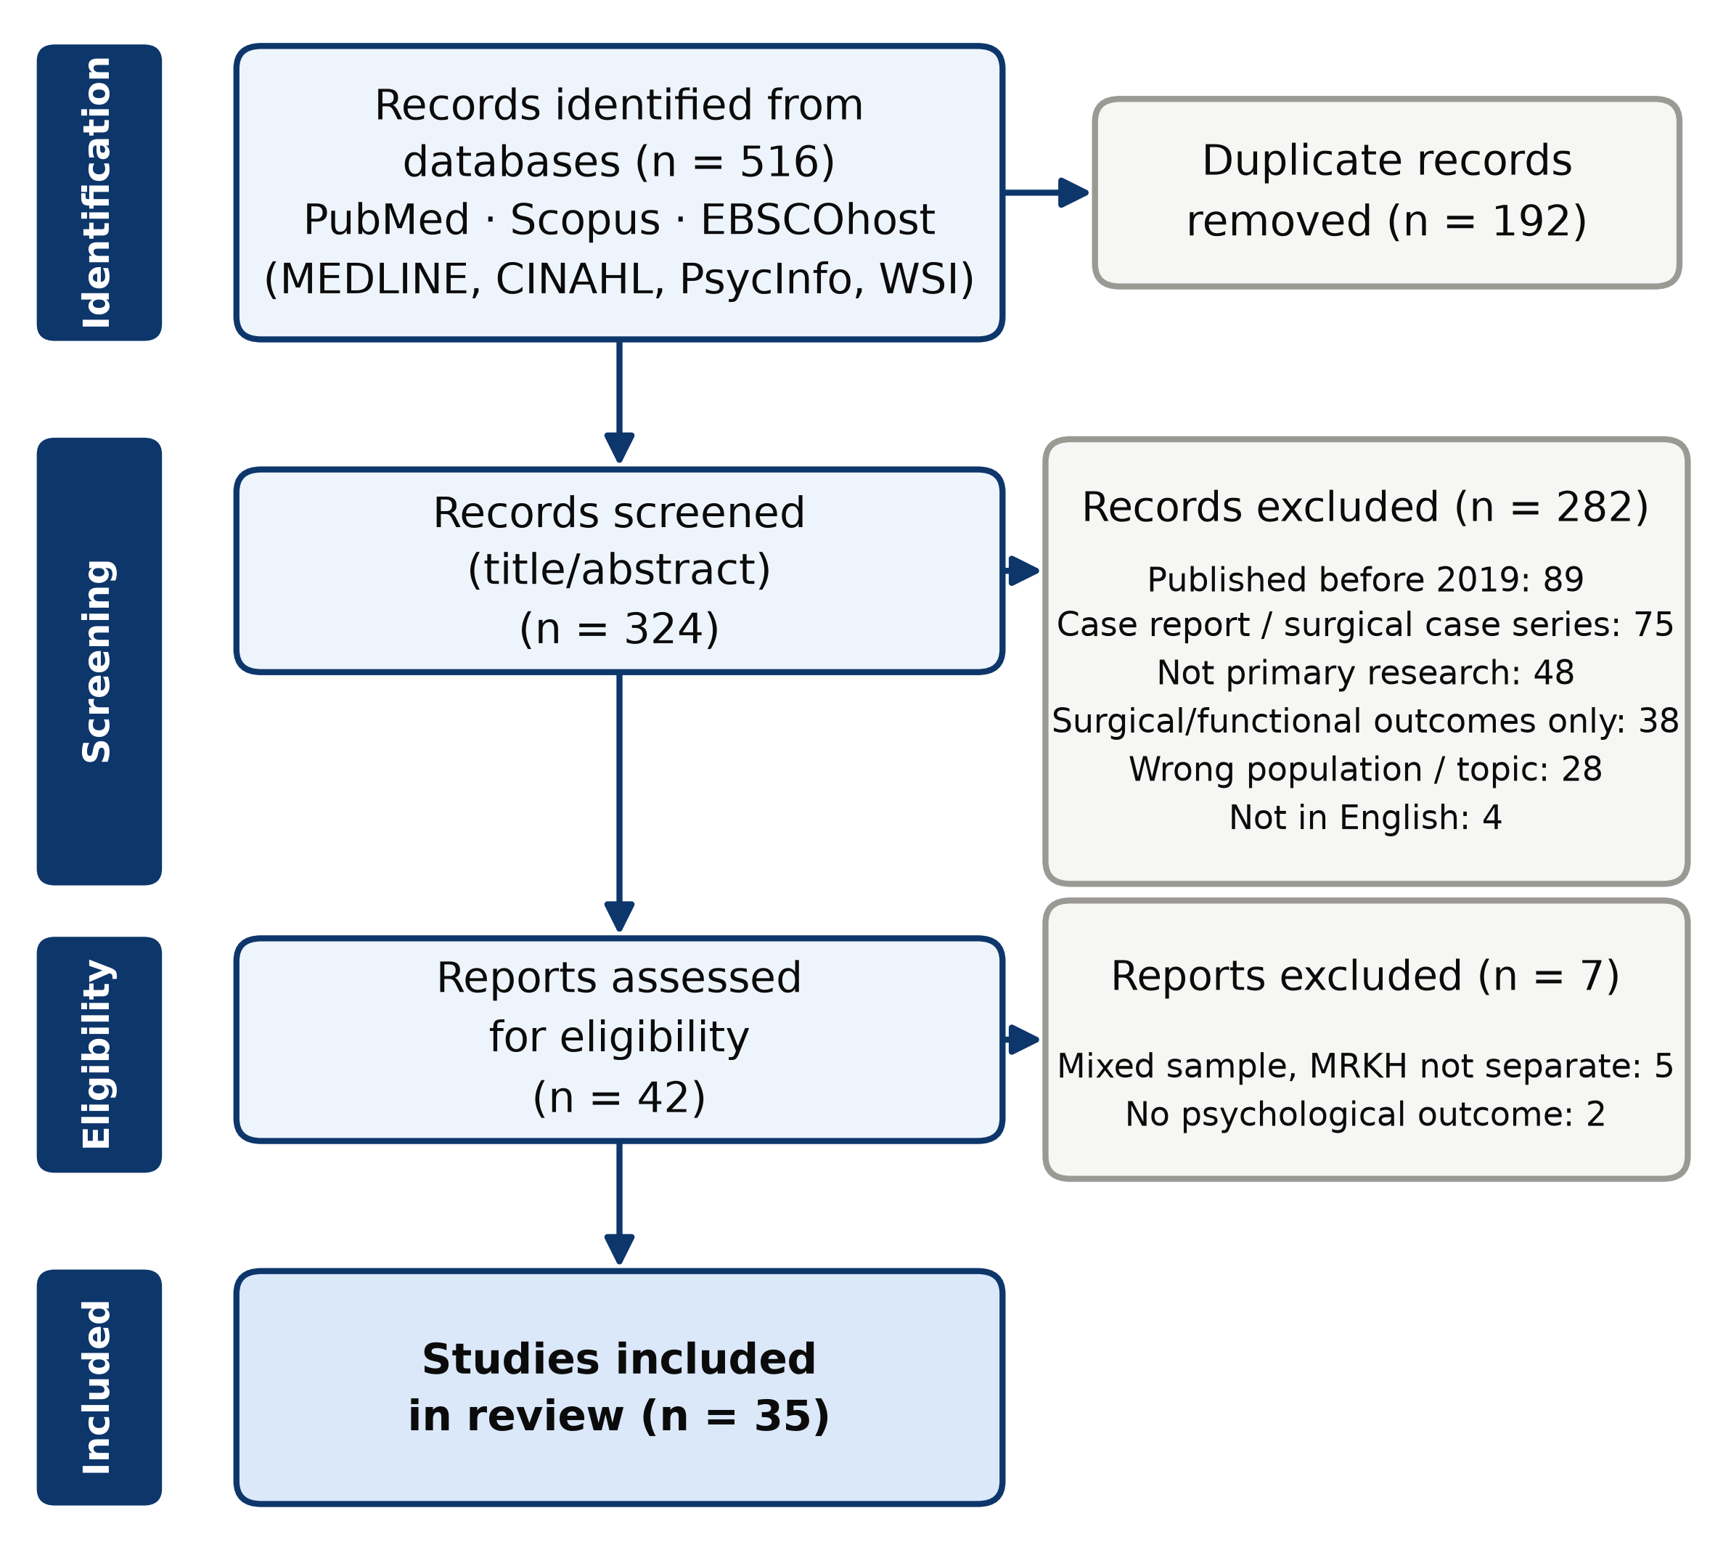
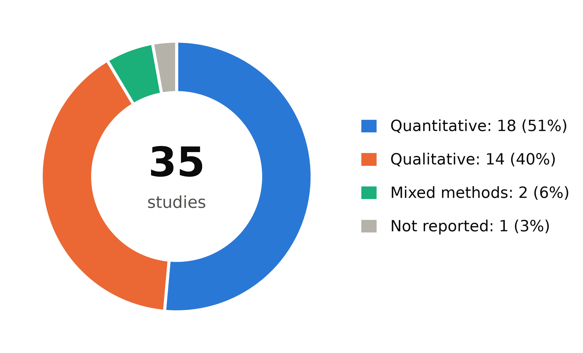
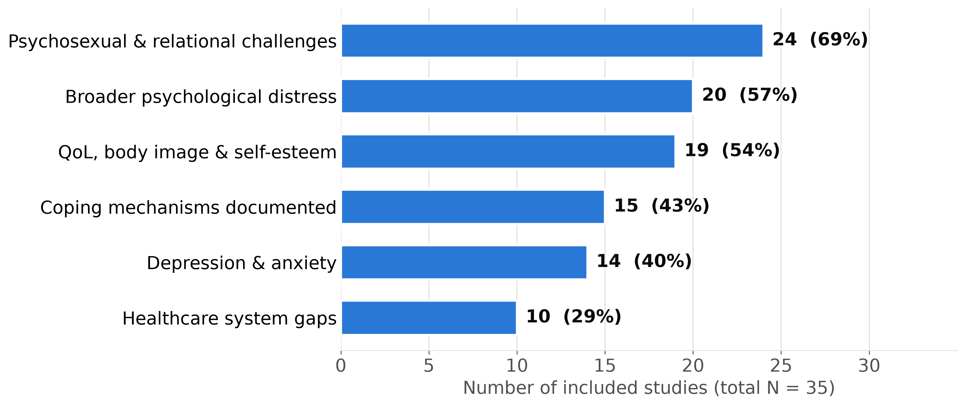
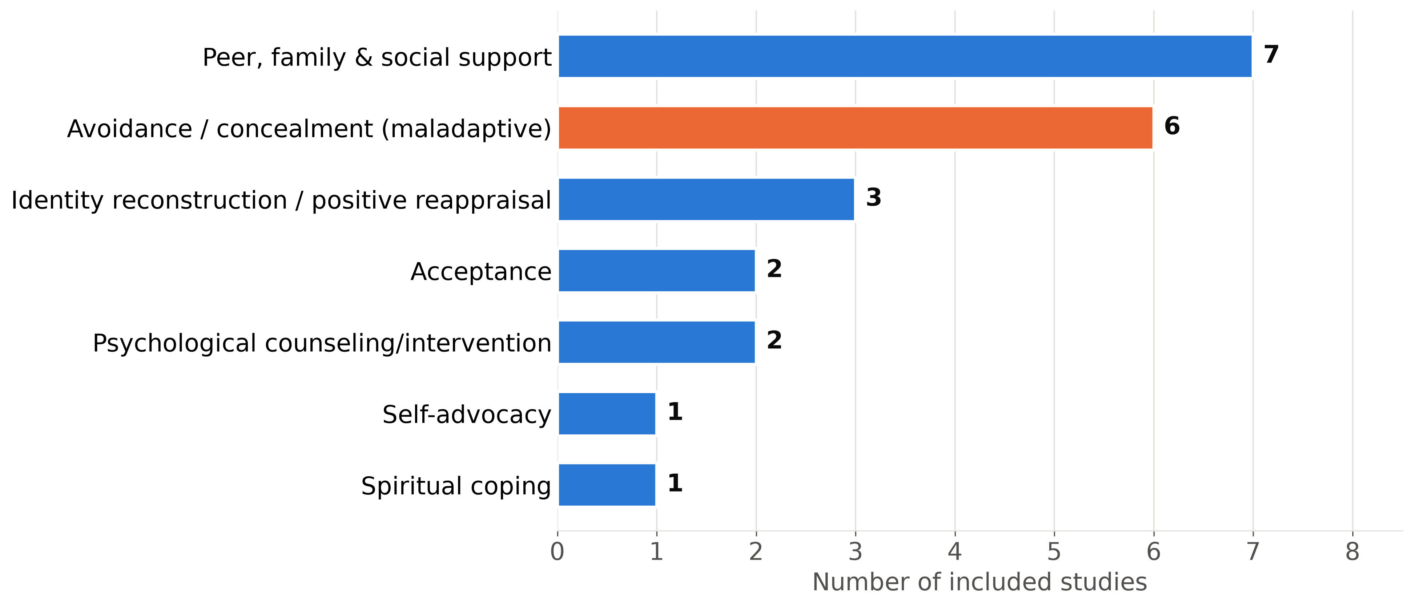
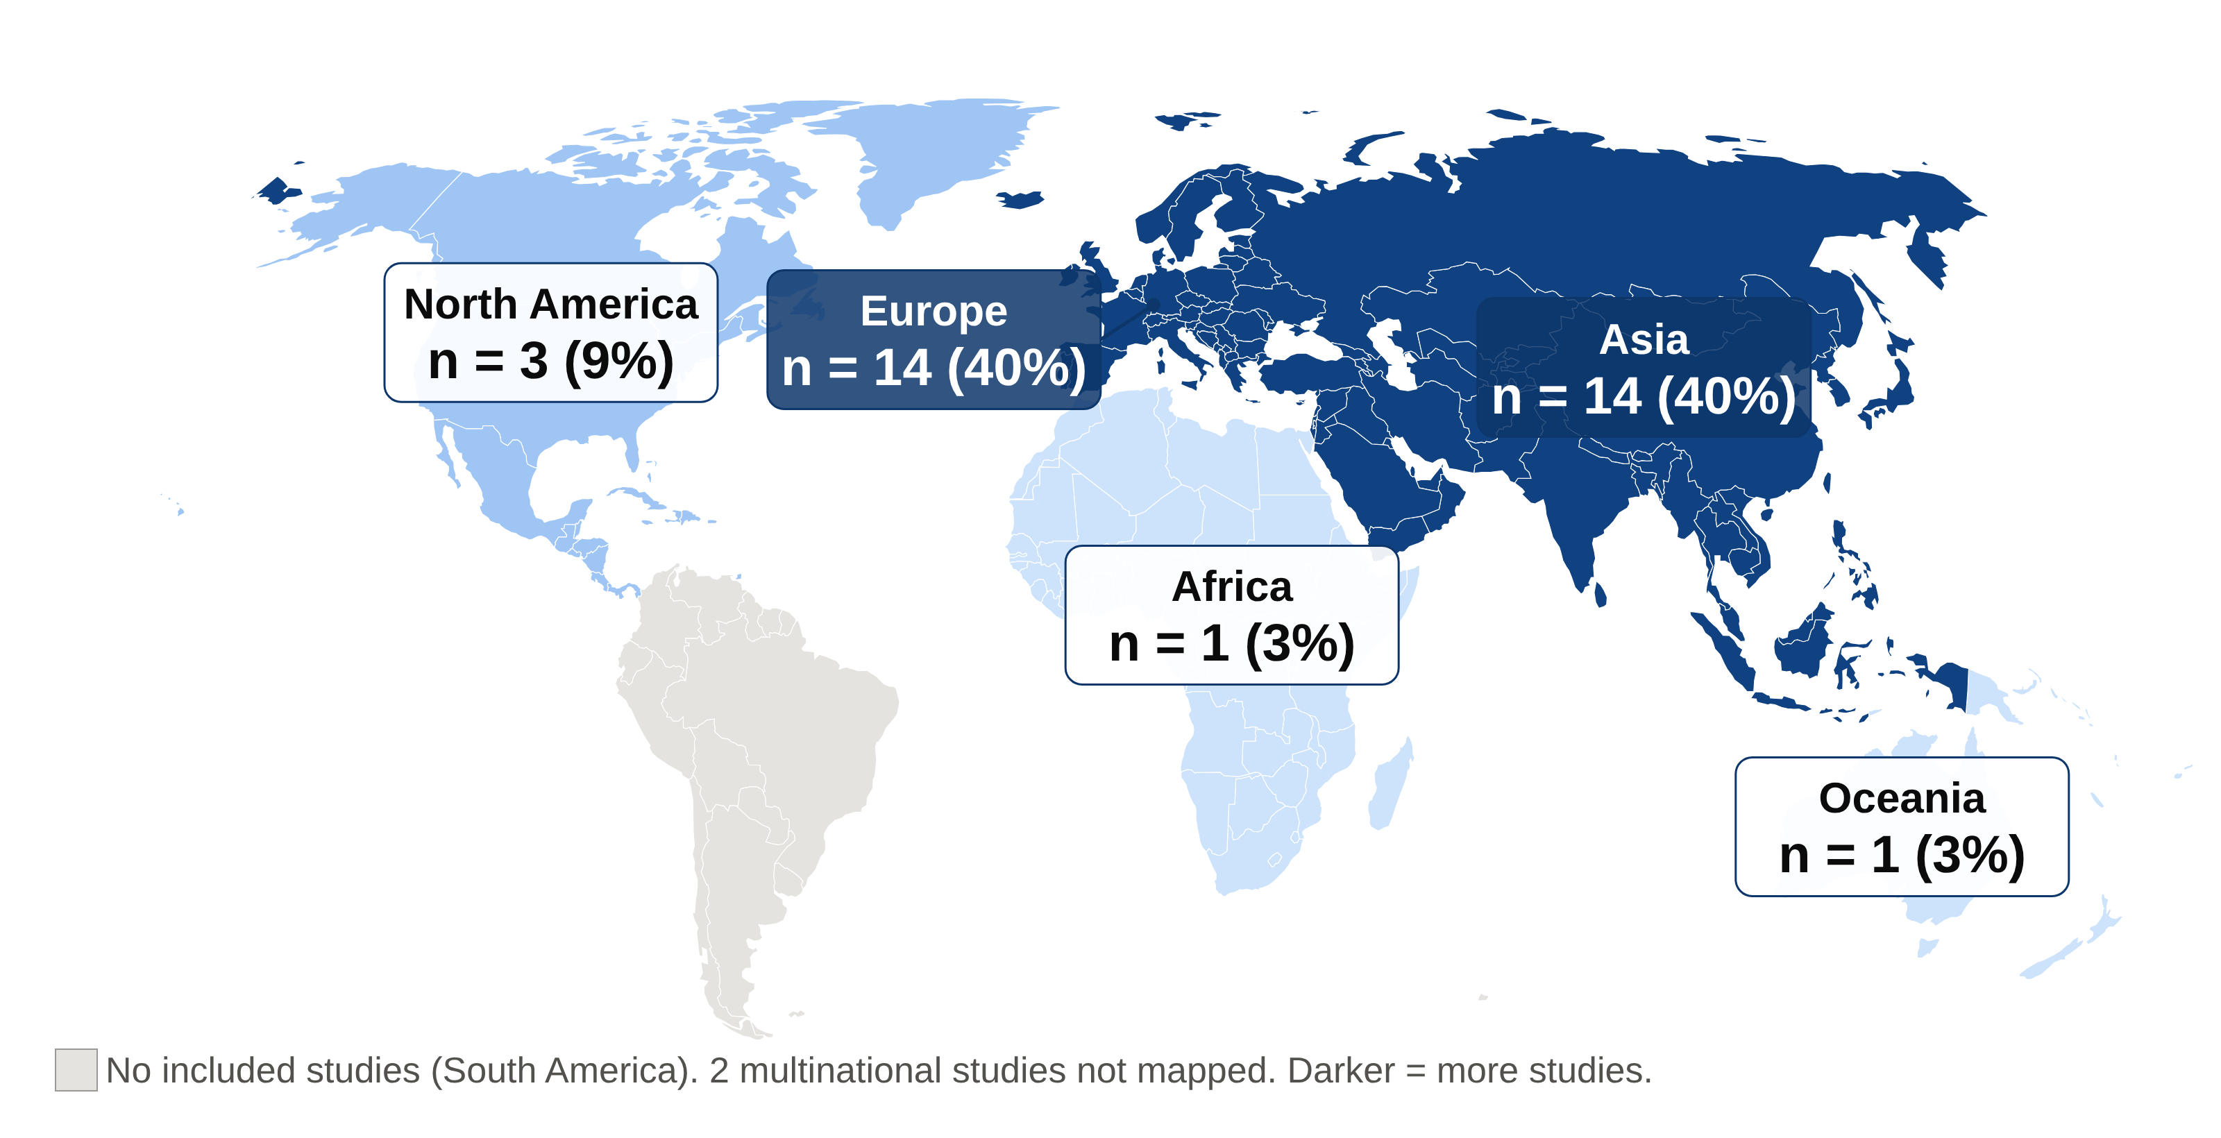

MENTAL HEALTH AND PSYCHOSOCIAL OUTCOMES AMONG INDIVIDUALS WITH
MAYER-ROKITANSKY-KÜSTER-HAUSER (MRKH) SYNDROME: A SCOPING REVIEW
Ifeoluwanimi P. Shobayo, MSPHc, Tahirou Diallo, MD, MPHc, Chelsea Mazonde, MPHc, Fadzai Nyarugwe, MSPHc, Oluwatosin Oduneye, MD, MPH, MSPH, Dangpa Wndji Nana, MD, MPH, Robyn Anderson, MS, MPH, PhD
Abstract
Results, Discussion, Conclusion, and Limitations
Background: Mayer-Rokitansky-Küster-Hauser (MRKH) syndrome is a rare congenital condition (1 in 4,500–5,000 female births) characterized by uterovaginal agenesis in individuals with a 46,XX karyotype. Usually diagnosed in adolescence, it affects fertility, sexuality, and identity, yet its mental health consequences remain insufficiently synthesized.
Methods: Scoping review (Arksey & O'Malley; PRISMA-ScR) of PubMed, Scopus, and EBSCOhost databases (MEDLINE, CINAHL, APA PsycInfo, Women's Studies International), January 2019–March 2026.
Results: Of 516 records, 35 studies were included. Psychosexual and relational challenges were most frequent (n = 24), followed by psychological distress (n = 20), reduced QoL, body image, and self-esteem (n = 19), and depression and anxiety (n = 14). Coping was documented in 15 studies, most often peer support (7) and avoidance or concealment (6); healthcare gaps in 10.
Conclusion: MRKH affects far more than reproductive anatomy. Mental health screening, psychosexual counseling, and peer support should become standard in multidisciplinary MRKH care, and research must reach underrepresented regions.
Results
Out of the 516 records, 35 studies (2019–2026; 5 to 616 participants) met inclusion criteria: 18 quantitative, 14 qualitative, 2 mixed-methods, and 1 not reported (Figures 1–2). Most came from Europe and Asia (14 each); none came from South America (Figure 5).
Psychosexual and relational challenges were the most frequently reported outcome (24 of 35 studies; Figure 3), including lower sexual esteem and more negative genital self-image than controls.^{10,11} Psychological distress was reported in 20 studies, with shock, shame, and secrecy at diagnosis and a diagnostic process described as potentially traumatizing.¹² Quality of life, body image, and self-esteem were reported in 19, including lower self-esteem than population norms.¹³ Depression and anxiety were assessed least often (14 studies), with mixed results: moderate-to-severe depressive symptoms in 34.0% of 141 Chinese patients¹⁴ and anxiety in 37.7% of 77 Malaysian women,¹⁵ but few symptoms among French uterus transplant candidates.¹⁶
Coping was documented in 15 studies, most often peer and online support (7) and avoidance or concealment (6) (Figure 4). Healthcare system gaps, reported in 10 studies, included delayed diagnosis, providers unfamiliar with MRKH, and patients having to advocate for themselves.
Discussion
Findings echo earlier evidence of distress and reduced quality of life in MRKH^{3,5} and extend prior reviews by mapping coping and health-system gaps. Psychosexual concerns dominate the recent literature, whereas depression and anxiety were measured in fewer than half of studies. Only 2 studies tested interventions, both reporting benefit.^{17,18} Evidence came mostly from Europe and Asia, with little from Africa and none from South America, where expectations about fertility and marriage may shape experiences differently.
Conclusion
MRKH affects far more than reproductive anatomy. Psychosexual difficulties, emotional distress, and low self-esteem were widely reported, yet depression and anxiety were measured in fewer than half of studies, and coping relied mostly on peers or concealment rather than structured care. Mental health screening, psychosexual counseling, and peer support should become standard in multidisciplinary MRKH care, not an afterthought, and research must reach underrepresented regions.
Limitations
English-language database literature from 2019–2026 only; no grey literature
Many small, single-center samples; heterogeneous designs and measures
Possible overlapping samples; 5 studies assessed from abstracts only
No quality appraisal; counts show how often outcomes were studied, not prevalence
Introduction, Objective, and Research Question
Figure 1. PRISMA-ScR flow diagram: 516 records identified, 324 screened, 42 assessed for eligibility, and 35 included.
Figure 2. Study designs: 18 quantitative (51%), 14 qualitative (40%), 2 mixed-methods, and 1 not reported.
Introduction
MRKH syndrome is the congenital absence of the uterus and upper vagina in individuals with a 46,XX karyotype and functioning ovaries, affecting about 1 in 4,500–5,000 female births.^{1,2} It is usually diagnosed in adolescence during evaluation of primary amenorrhea, a sensitive period for identity, sexuality, and relationships. Earlier studies linked MRKH with psychological distress, anxiety, and reduced quality of life,^{3–5} and guidelines recommend psychosocial counseling as part of care.¹ Prior reviews focused on psychological and sexual outcomes^{6,7}; coping and healthcare system gaps have not been mapped across the growing recent literature. Mapping this evidence can guide psychosocial care, provider training, and research priorities.
Objective
To map mental health and psychosocial outcomes, coping mechanisms, and healthcare system gaps reported in studies of individuals with MRKH published 2019–2026.
Research Question
What mental health outcomes and coping mechanisms are reported among individuals with MRKH syndrome, and what healthcare system gaps exist?
Methods
Public Health Implications and Future Work
METHOD | DESCRIPTION
Design | Scoping review using Arksey & O'Malley's five-stage framework⁸ and PRISMA-ScR reporting guidance.⁹ Framed by population (individuals with MRKH), concept (mental health, coping, care gaps), and context (any setting). No quality appraisal, consistent with scoping methodology.
Search | PubMed; Scopus; EBSCOhost (MEDLINE, CINAHL, APA PsycInfo, Women's Studies International). January 2019–March 2026; exported March 29, 2026. Terms combined MRKH and Müllerian agenesis with mental health, psychosocial, and coping concepts.
Eligibility | Included: English-language primary quantitative, qualitative, or mixed-methods studies reporting psychological outcomes or coping in MRKH; mixed samples only if MRKH results were reported separately or ≥80% had MRKH. Excluded: reviews, case reports, and studies of surgical, anatomical, or fertility outcomes only.
Screening & Analysis | 516 records; 192 duplicates removed; 324 titles and abstracts screened; 42 assessed; 35 included (Figure 1). Data were charted from full texts (30 of 35 studies; abstracts for the rest): design, country, sample, outcomes, coping, and healthcare gaps; synthesized with frequency counts and thematic grouping into 6 domains (Figure 3).
Figure 3. Psychosexual and relational challenges were the most frequently reported outcome (24 of 35 studies); depression and anxiety were the least often assessed of the four outcome domains (14 of 35). Studies could report more than one domain.
Public Health Implications
Integrate psychosocial screening and support into MRKH diagnostic pathways
Build multidisciplinary teams that include psychology and social work
Pair vaginal lengthening treatment with psychosexual counseling
Train providers in sensitive, non-stigmatizing communication
Expand peer support networks, including online communities
Future Research
Longitudinal studies using validated mental health measures
Trials of psychosocial interventions delivered in routine care
Studies in Africa, South America, and other low-resource settings
References
Figure 4. Coping mechanisms in 15 studies: peer, family, and social support was most common (7), followed by avoidance and concealment (6).
Figure 5. Europe and Asia contributed 14 studies each, Africa and Oceania 1 each, and South America none (2 multinational studies not mapped).

