Slide 1

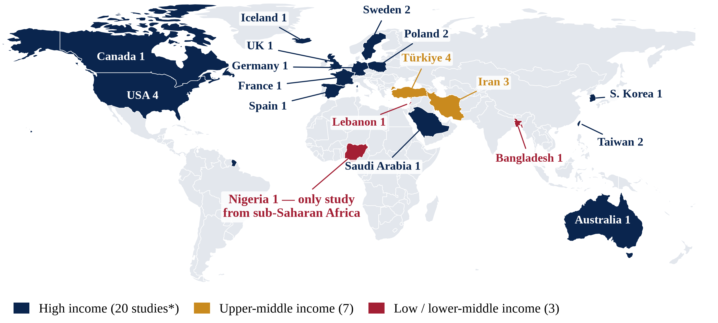

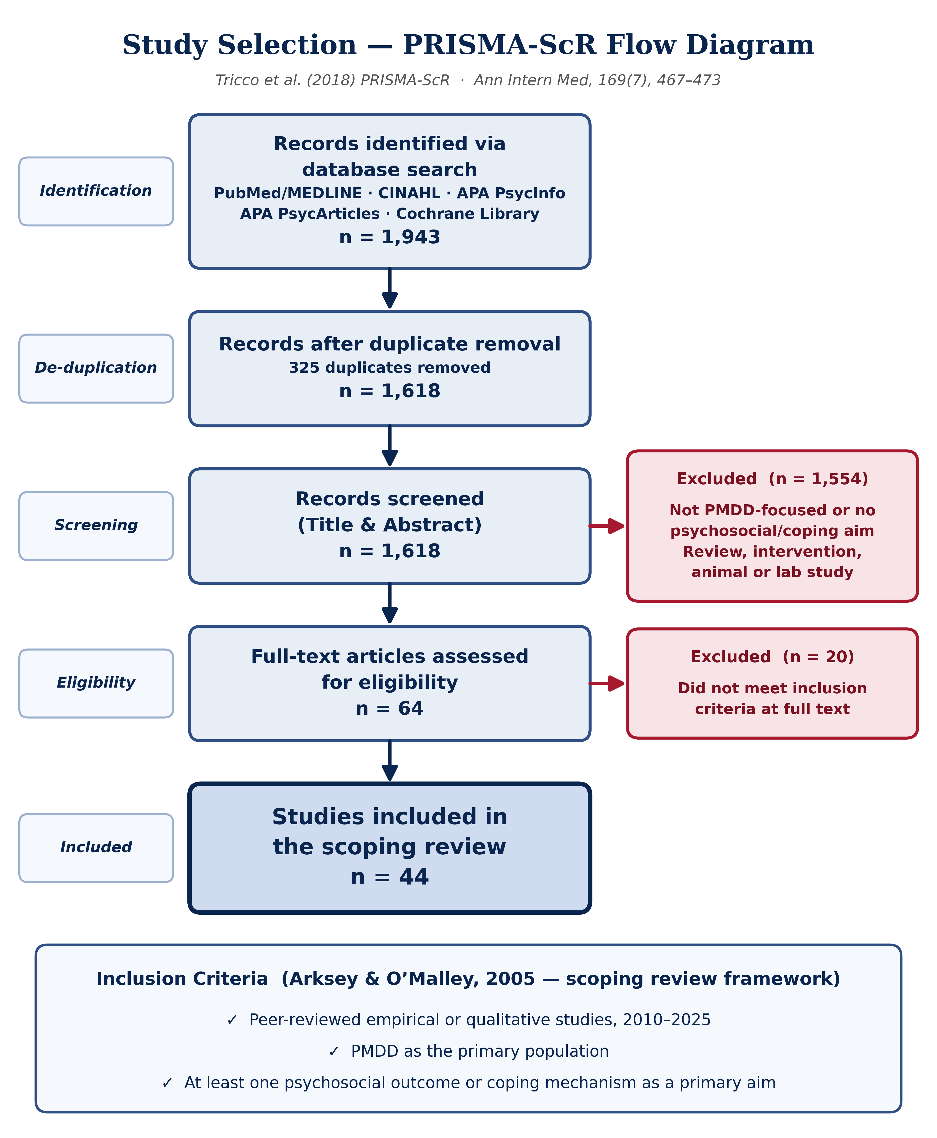
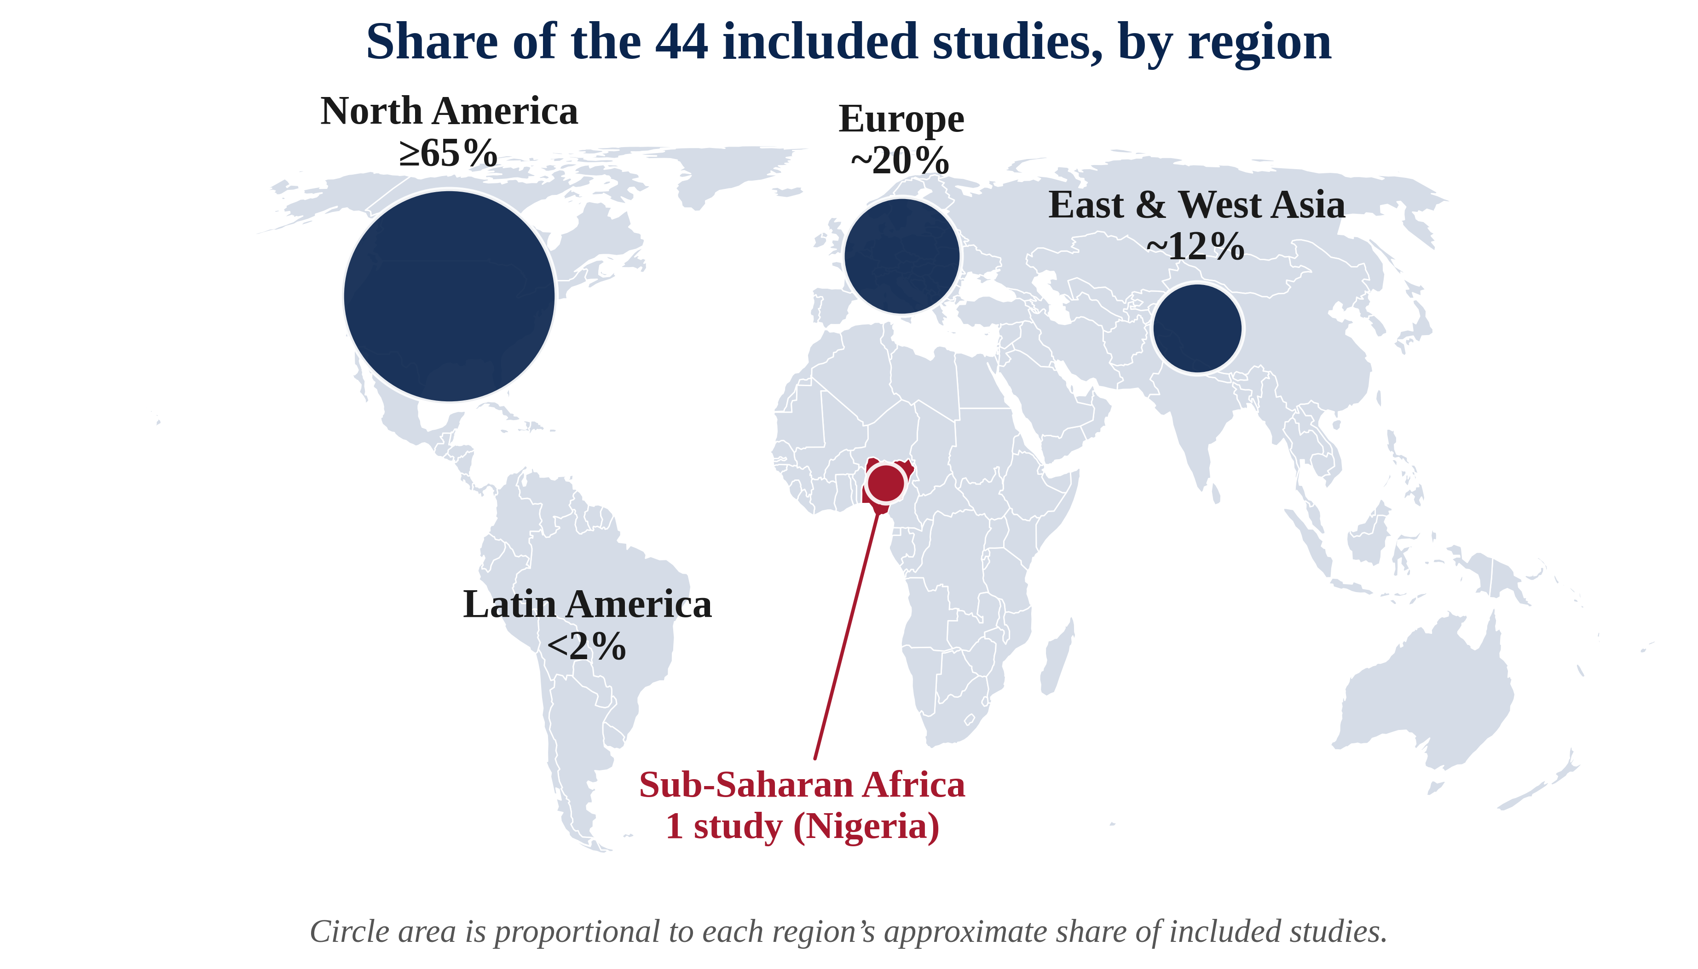
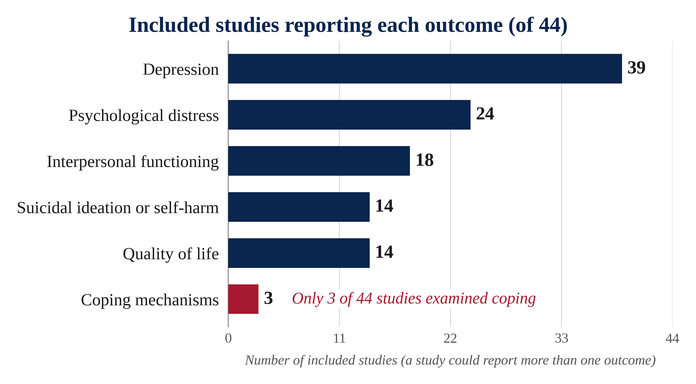
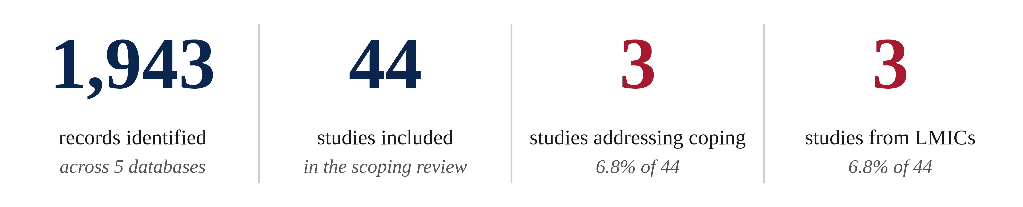
PSYCHOSOCIAL OUTCOMES AND COPING MECHANISMS AMONG WOMEN WITH PREMENSTRUAL DYSPHORIC DISORDER: A GLOBAL SCOPING REVIEW
Ifeoluwanimi P. Shobayo, MSPH, Chelsea R. Mazonde, MPH, Marylyn O. Oduneye, MSPH, Tahirou Diallo, MSPH, Fadzai G. Nyarugwe, MSPH, Cynthia C. Ilechukwu, MSPH
Abstract
1,943
records identified
across 5 databases
44
studies included
in the scoping review
3
studies addressing coping
6.8% of 44
3
low/lower-middle-income studies
6.8% of 44
Results, Discussion, Conclusion, and Limitations
Background: Premenstrual dysphoric disorder (PMDD) is a DSM-5 depressive disorder affecting an estimated 31 million women and girls worldwide.¹ This scoping review examined psychosocial outcomes and coping mechanisms among women with PMDD and assessed the geographic distribution of the evidence.
Methods: Following Arksey and O’Malley’s framework and PRISMA-ScR guidance, we searched PubMed/MEDLINE, CINAHL, APA PsycInfo, APA PsycArticles and the Cochrane Library for peer-reviewed studies published 2010–2025. Eligible empirical and qualitative studies had PMDD as the primary population and at least one psychosocial outcome or coping mechanism as a primary aim.
Results: The search identified 1,943 records; 1,618 remained after deduplication and 44 studies met the inclusion criteria. Depression was most documented (n=39), followed by psychological distress (n=24), interpersonal functioning (n=18), suicidal ideation or self-harm (n=14) and quality of life (n=14). Only three studies examined coping mechanisms. Only three studies (6.8%) originated from low- and lower-middle-income countries, including one from Nigeria.
Conclusions: Evidence on PMDD’s psychosocial burden is growing but geographically concentrated in high-income countries, revealing a critical LMIC evidence gap.
Keywords: premenstrual dysphoric disorder; psychosocial outcomes; coping mechanisms; LMICs; scoping review
Results
The database search identified 1,943 records. After 325 duplicates were removed, 1,618 records were screened by title and abstract; 64 were assessed for eligibility, 20 were excluded, and 44 studies were included (Figure 1). Most (61%) were published in 2022–2025 (Figure 4).
Depression was the most documented outcome (n=39); one nationwide cohort found a 2.6-fold higher risk of later depression after a PMDD diagnosis.¹³ Psychological distress (n=24), interpersonal functioning (n=18), suicidal ideation or self-harm (n=14) and quality of life (n=14) followed. Only three studies examined coping mechanisms, such as peer support shared in online PMDD communities¹⁴ (Figure 2).
Twenty studies came from high-income countries and seven from upper-middle-income countries (Türkiye, Iran); only three (6.8%) came from low- and lower-middle-income countries—Bangladesh,¹⁵ Lebanon¹⁶ and Nigeria,¹⁷ the only study from sub-Saharan Africa (Figure 3).
Discussion
PMDD research consistently documents depression, distress, relationship difficulties and suicidality.⁴⁻⁷ Patients describe misdiagnosis and uneven provider knowledge,¹⁸˒¹⁹ yet coping remains largely unexamined.
Conclusion
PMDD carries a well-documented psychosocial burden, especially depression, distress and suicidality, yet how women cope has received little attention, and evidence from low-income settings and Africa is nearly absent. Culturally responsive screening, integrated mental and reproductive health services, and Africa-centered research investment are needed to make this burden visible to health systems.
Limitations
Search scope: studies outside the five databases or the 2010–2025 period may have been missed.
Study differences: variation in design and outcome definitions limits direct comparison.
Coding overlap: a study could address more than one outcome, so counts should not be summed.
Geographic coverage: few studies from low- and lower-middle-income countries limit conclusions about those settings.
Identification
Records identified via database search
PubMed/MEDLINE · CINAHL · APA PsycInfo
APA PsycArticles · Cochrane Library
n = 1,943
De-duplication
Records after duplicate removal
325 duplicates removed
n = 1,618
Introduction, Objective, and Research Question
Screening
Records screened
(title and abstract)
n = 1,618
Excluded (n = 1,554)
Not PMDD-focused or no psychosocial/
coping aim; review, intervention,
animal or laboratory study
Introduction: PMDD is a recurring, hormone-linked mood disorder in which irritability, mood swings, depressed mood and anxiety emerge in the late luteal phase and remit after menses begin. It is classified as a depressive disorder in DSM-5² and recognized in ICD-11.³ Using prospectively confirmed diagnoses, community prevalence is about 1.6%, roughly 31 million women and girls worldwide.¹ PMDD has been linked with suicidal ideation and attempts,⁴˒⁵ strained romantic relationships⁶ and reduced quality of life.⁷ Premenstrual symptoms are also common across Africa, where pooled premenstrual syndrome prevalence reaches 47%,⁸ yet it remains unclear how women with PMDD cope or where the evidence has been generated.
Objective: To map psychosocial outcomes and coping mechanisms reported among women with PMDD and identify geographic gaps in the published literature.
Research Question: What psychosocial outcomes and coping mechanisms have been reported in studies of women with PMDD published between 2010 and 2025, and how are these studies distributed across geographic settings?
Eligibility
Records assessed for eligibility
(title and abstract)
n = 64
Excluded (n = 20)
Did not meet
inclusion criteria
Included
Studies included in
the scoping review
n = 44
Figure 1. Study Selection Flow Diagram. Adapted from PRISMA-ScR.¹¹
Figure 4. Included Studies by Publication Period. 27 of 44 studies (61%) were published in 2022–2025.
Methods
Inclusion Criteria (Arksey & O’Malley, 2005 — scoping review framework)
✓ Peer-reviewed empirical or qualitative studies, 2010–2025
✓ PMDD as the primary population
✓ At least one psychosocial outcome or coping mechanism as a primary aim
Public Health Implications and Future Work
Category | Description
Study Design | Scoping review guided by Arksey and O’Malley’s framework⁹ with Levac et al.’s refinements,¹⁰ reported using PRISMA-ScR.¹¹
Databases | PubMed/MEDLINE, CINAHL, APA PsycInfo, APA PsycArticles and Cochrane Library.
Publication Years | 2010–2025.
Inclusion Criteria | Peer-reviewed empirical or qualitative studies with PMDD as the primary population and at least one psychosocial outcome or coping mechanism as a primary aim.
Exclusion Criteria | Animal studies, laboratory research, reviews, interventions and non-peer-reviewed publications.
Screening Process | 1,943 records identified; 325 duplicates removed; 1,618 records screened by title and abstract; 64 assessed for eligibility; 44 studies included.
Evidence Mapping | Included studies categorized by psychosocial outcome, coping mechanism, publication year and geographic setting (country and World Bank income group¹²).
Figure 2. Psychosocial Outcomes Reported in the 44 Included Studies. A study could report more than one outcome, so counts should not be summed.
Public Health Implications
Screen for suicide risk: ask about suicidal thoughts when women present with severe premenstrual mood symptoms.⁴˒⁵
Integrate care: embed PMDD screening in sexual and reproductive, school and university health services.
Train providers: improve recognition to reduce misdiagnosis and delayed care.¹⁸
Address coping needs: ask how women manage symptoms and connect them with peer and professional support.¹⁴
Future Work
Confirm PMDD prospectively using validated daily ratings.¹˒²⁰
Prioritize low-income and African settings, including qualitative studies of stigma and coping.
Validate screening tools in African languages and test coping-focused interventions.
6.8%
of included studies (3 of 44) came from low- and lower-middle-income countries
20 high-income · 7 upper-middle-income
Sub-Saharan Africa: 1 study (Nigeria)
References
Figure 3. Country Setting and World Bank Income Group of Included Studies. Map shows the 30 studies with an identifiable country setting; income groups follow the World Bank FY2027 classification.¹² The other 14 used online or multinational samples or had no single mappable setting in the available records. *Includes Hong Kong (1).
KEY TAKEAWAY PMDD’s psychosocial burden is well documented in high-income countries, yet nearly invisible in low-income settings and sub-Saharan Africa.

