Slide 1

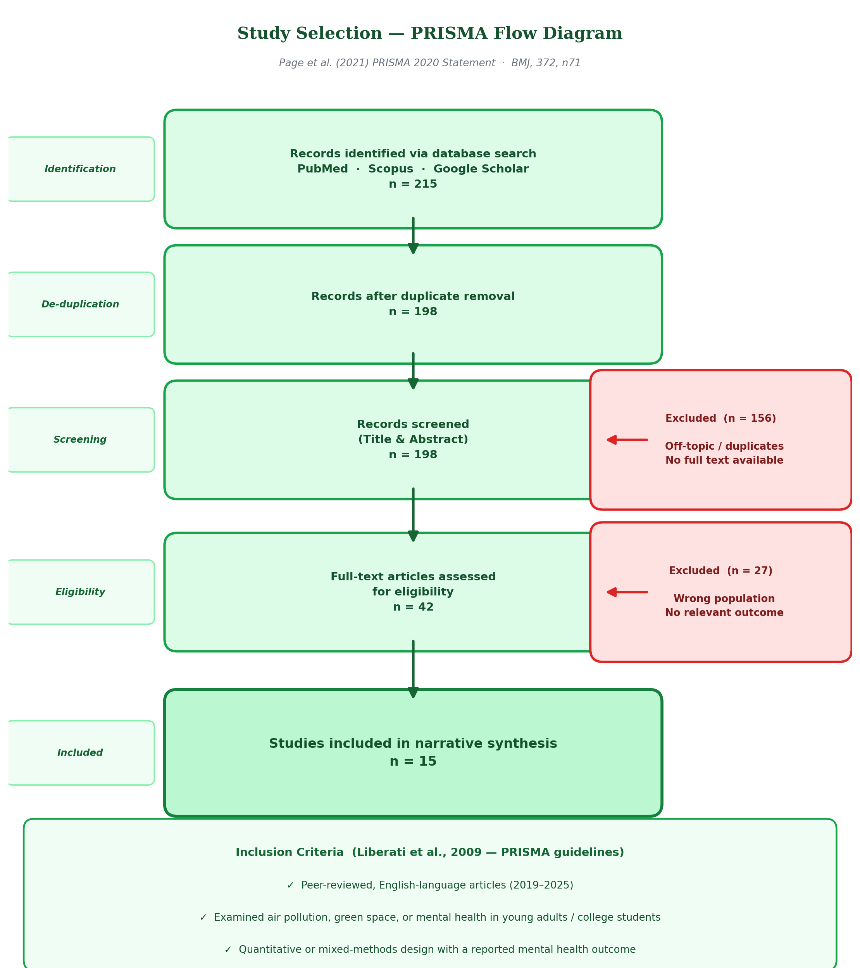
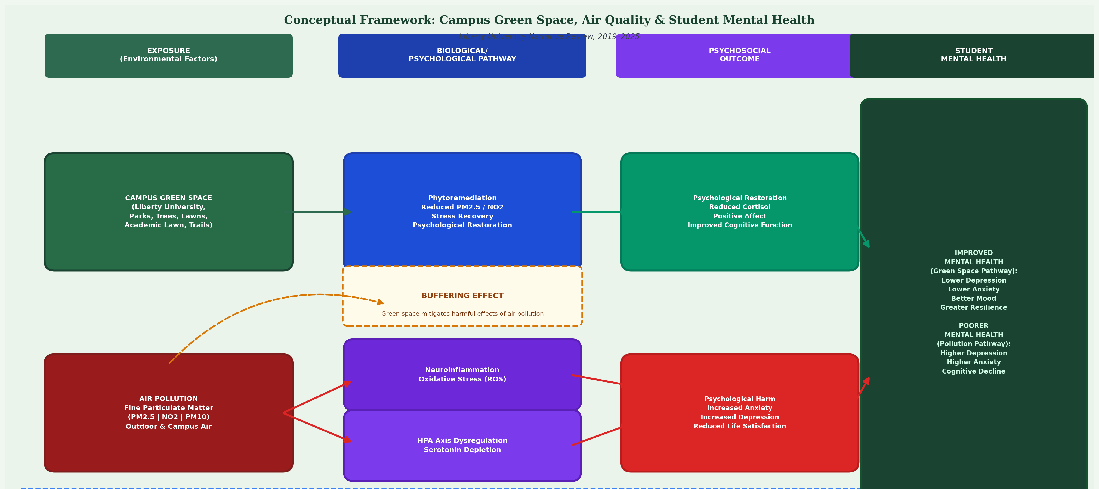
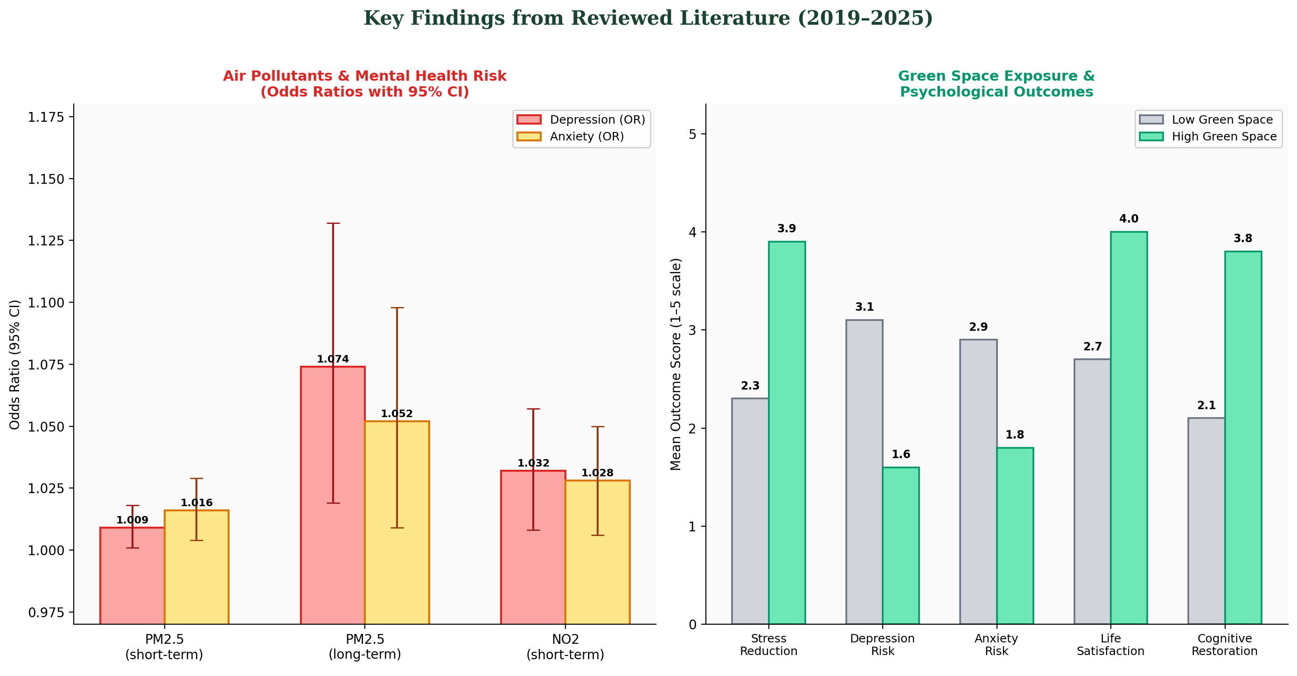
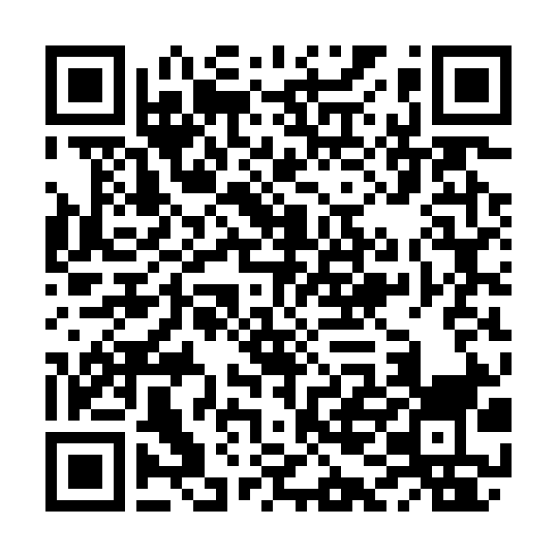
Psychosocial Outcomes and Coping Mechanisms Among Women with
Premenstrual Dysphoric Disorder: A Global Scoping Review
Ifeoluwanimi P. Shobayo, BSc, MSPHc
Abstract
Fig 1: PRISMA-ScR Flow of Records
Fig 2: Psychosocial Domains Examined (n = 85 studies)
Results
Background: Premenstrual dysphoric disorder (PMDD) is a DSM-5 depressive disorder affecting an estimated 1.6% of women and girls (~31 million) worldwide, yet its psychosocial burden—especially in low- and middle-income countries (LMICs)—has not been mapped.
Methods: Scoping review (Arksey & O'Malley; PRISMA-ScR) of seven databases, 2010–2025: peer-reviewed empirical studies with PMDD as the population and a psychosocial outcome or coping mechanism as a primary aim.
Results: 1,801 records yielded 85 studies. Depression (n = 28), mood/emotion regulation (n = 18), psychiatric comorbidity (n = 18), distress (n = 16), suicidality (n = 13) and functioning (n = 13) dominated; coping was studied in 7. Two-thirds of studies came from high-income countries; 3 came from sub-Saharan Africa.
Conclusions: Evidence is growing but geographically concentrated, relies on provisional diagnoses and rarely examines coping or lived experience.
Keywords: PMDD; psychosocial outcomes; coping; suicidality; LMICs; sub-Saharan Africa
Identification
Records identified from databases
(n = 1,801)
CINAHL Ultimate: 974
APA PsycInfo: 649
MEDLINE Ultimate: 145
Women's Studies International: 15
APA PsycArticles: 8
PubMed/MEDLINE: 6
Cochrane Database of Systematic Reviews: 4
Growing evidence: 49% of studies published since 2020; 56% cross-sectional, only 3 qualitative.
Diagnosis: only 24% confirmed PMDD with prospective daily ratings; 42% used provisional screening.
Suicidality: PMDD linked with suicidal ideation (OR 2.22) and attempts (OR 2.10) in a US national sample; 72% lifetime active ideation and 34% attempts in a global PMDD sample.
Depression: 2.6-fold higher risk of later depression in a Taiwanese national cohort.
Quality of life & relationships: lower QoL (Sweden, n = 17,284) and more relationship disruption (IRR 1.22).
Trauma & adversity: adverse childhood experiences were linked to PMDD in Iceland and Japan (aOR 5.61 for ≥4 ACEs).
Coping: only 7 studies—mostly self-medication (analgesics, cannabis) or maladaptive styles.
Geography: 67% high-income; 5 studies (6%) from low/lower-middle-income countries; 3 (3.5%) from sub-Saharan Africa; 1 LMIC study used prospective diagnosis.
Screening
Records after duplicates removed
(n = 1,459)
Duplicates removed (n = 342)
Records screened
(title, abstract, subject terms)
(n = 1,459)
Records excluded (n = 1,374)
PMDD not primary population: 491
Outside 2010–2025: 457
Reviews/commentaries: 170
Other ineligible formats: 106
Non-English: 65
Intervention studies: 28
Laboratory/biological: 22
No psychosocial/coping aim: 15
Instrument validation: 11
Animal studies: 9
Introduction and Research Question
PMDD is a severe, hormone-linked mood disorder in which irritability, mood swings, depressed mood and anxiety recur in the late luteal phase and remit after menses begin. It is classified as a depressive disorder in DSM-5 and recognised in ICD-11.
Using prospectively confirmed diagnoses, community prevalence is about 1.6%—roughly 31 million women and girls (Reilly et al., 2024)—and premenstrual symptoms are common across Africa (pooled PMS prevalence 47%; Andualem et al., 2024).
Because symptoms recur every month, PMDD can affect mental health, relationships, school and work. This evidence is scattered across disciplines, and it is unclear where in the world it has been generated.
Research Question
What psychosocial outcomes and coping mechanisms have been documented among women with PMDD, and how is this evidence distributed across global settings—particularly LMICs and sub-Saharan Africa?
Included
Studies included
(n = 85)
Eligibility judged on titles, abstracts and subject terms; full-text review ongoing. Source: authors’ screening of database exports.
Discussion and Conclusion
Studies may address more than one domain. Source: authors’ charting of included studies.
Evidence on PMDD’s psychosocial burden is expanding and consistent—depression, suicidality, impaired functioning and reduced quality of life—but it is concentrated in high-income countries, relies on provisional diagnoses and rarely examines coping or lived experience.
In sub-Saharan Africa the burden is largely undocumented: no study examined suicidality, quality of life or coping. Culturally responsive screening, integration of PMDD into sexual, reproductive and mental health services, and Africa-centred research investment are needed.
85
studies included
(2010–2025)
67%
from high-income
countries
3
studies from
sub-Saharan Africa
24%
confirmed PMDD with
prospective ratings
Methods
Fig 3: Studies by World Bank Income Group (FY2027)
Fig 4: Studies by World Bank Region
Category | Description
Study design | Scoping review (Arksey & O'Malley, 2005; Levac et al., 2010), reported per PRISMA-ScR (Tricco et al., 2018).
Databases | CINAHL Ultimate, APA PsycInfo, APA PsycArticles, MEDLINE Ultimate, Women’s Studies International, PubMed, Cochrane Library.
Years & language | 2010–2025; English.
Inclusion | Peer-reviewed empirical studies; PMDD (provisional or confirmed) as the defined population; ≥1 psychosocial outcome or coping mechanism as a primary aim.
Exclusion | Animal, laboratory/biological, intervention, review, instrument-validation, case-report and non-peer-reviewed formats; PMS-only samples.
Screening & charting | Deduplication (DOI + title); title/abstract screening with logged reasons; charted design, country, World Bank income group (FY2027), PMDD ascertainment and 13 psychosocial domains.
Limitations
Eligibility judged on titles/abstracts; full-text review ongoing.
English only; African Journals Online and grey literature not searched.
Many studies combined PMS and PMDD or used provisional diagnoses.
Future Work
Prospectively confirmed PMDD studies in LMICs and sub-Saharan Africa.
Qualitative research on stigma, lived experience and coping.
Validate PMDD tools in African languages.
References
1. Reilly TJ et al. J Affect Disord. 2024;349:534-540.
2. Andualem F et al. Front Psychiatry. 2024;15:1338304.
3. Arksey H, O'Malley L. Int J Soc Res Methodol. 2005;8(1):19-32.
4. Tricco AC et al. Ann Intern Med. 2018;169(7):467-473.
5. Pilver CE et al. Soc Psychiatry Psychiatr Epidemiol. 2013;48(3):437-446.
6. Eisenlohr-Moul T et al. BMC Psychiatry. 2022;22. doi:10.1186/s12888-022-03851-0
7. Li DJ et al. Asian J Psychiatr. 2023;79:103355.
8. Wang Q et al. JAMA Netw Open. 2025;8(9):e2533823.
9. Westermark V et al. J Affect Disord. 2024;364:132-138.
Full list of 85 included studies: see manuscript and supplementary file.
Orange = LMICs (21 studies, 25%); only 5 from low/lower-middle-income countries.
Sub-Saharan Africa: Ethiopia (n = 2), Nigeria (n = 1). Europe & Central Asia includes Türkiye.

