Slide 1

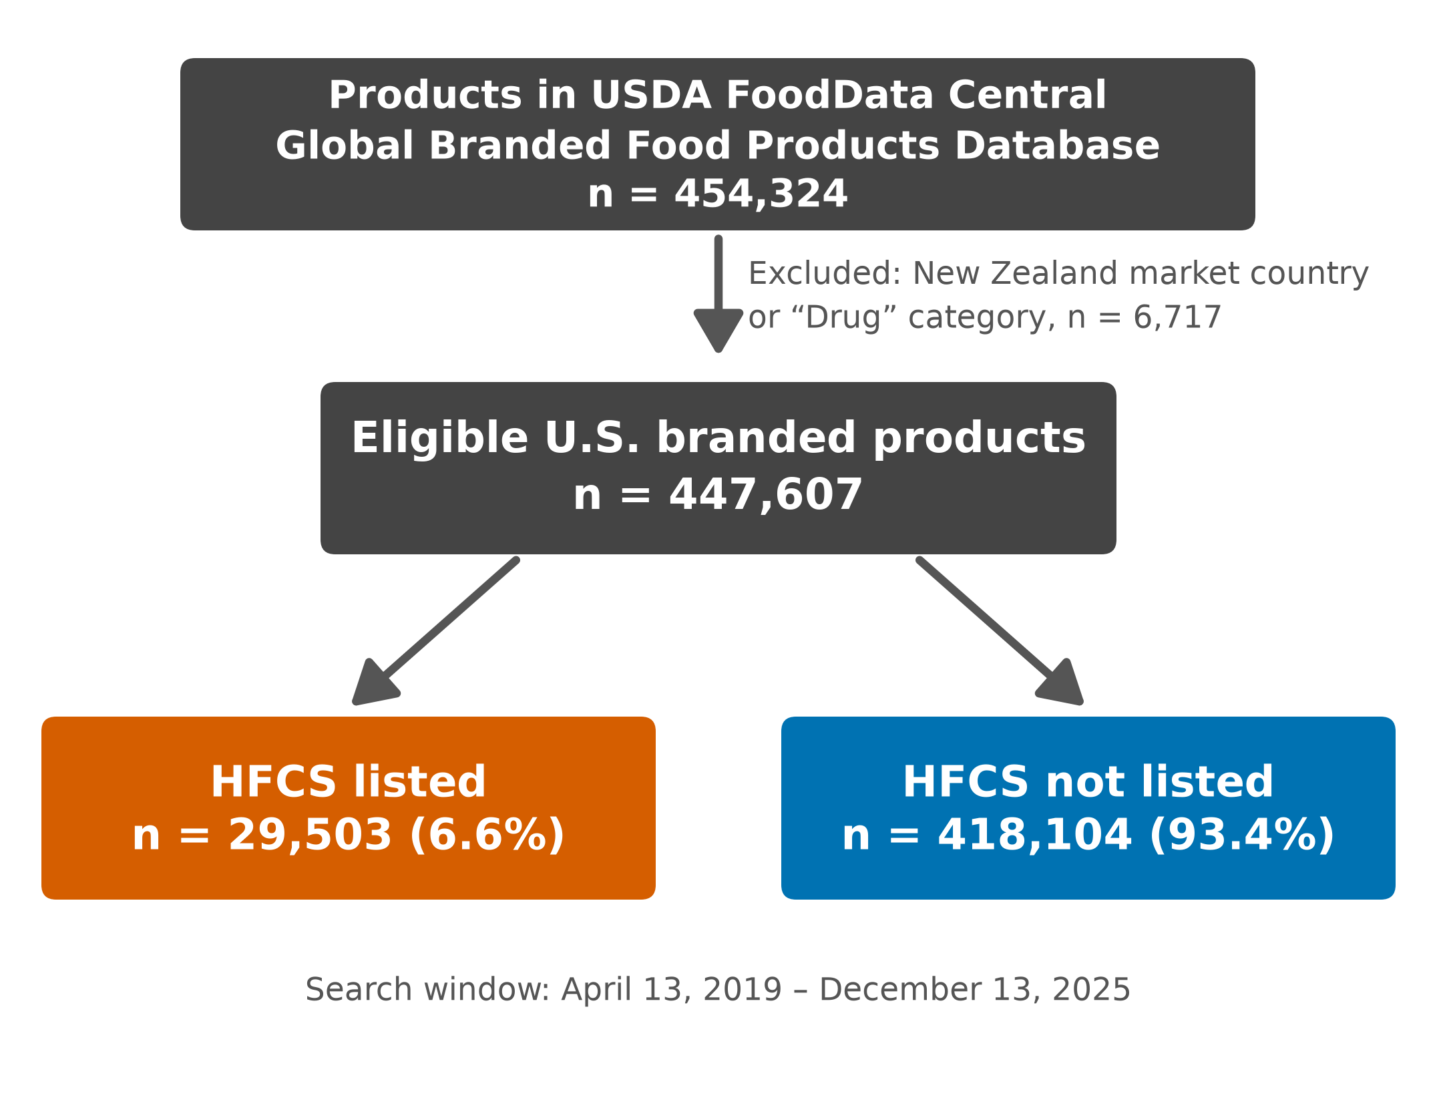
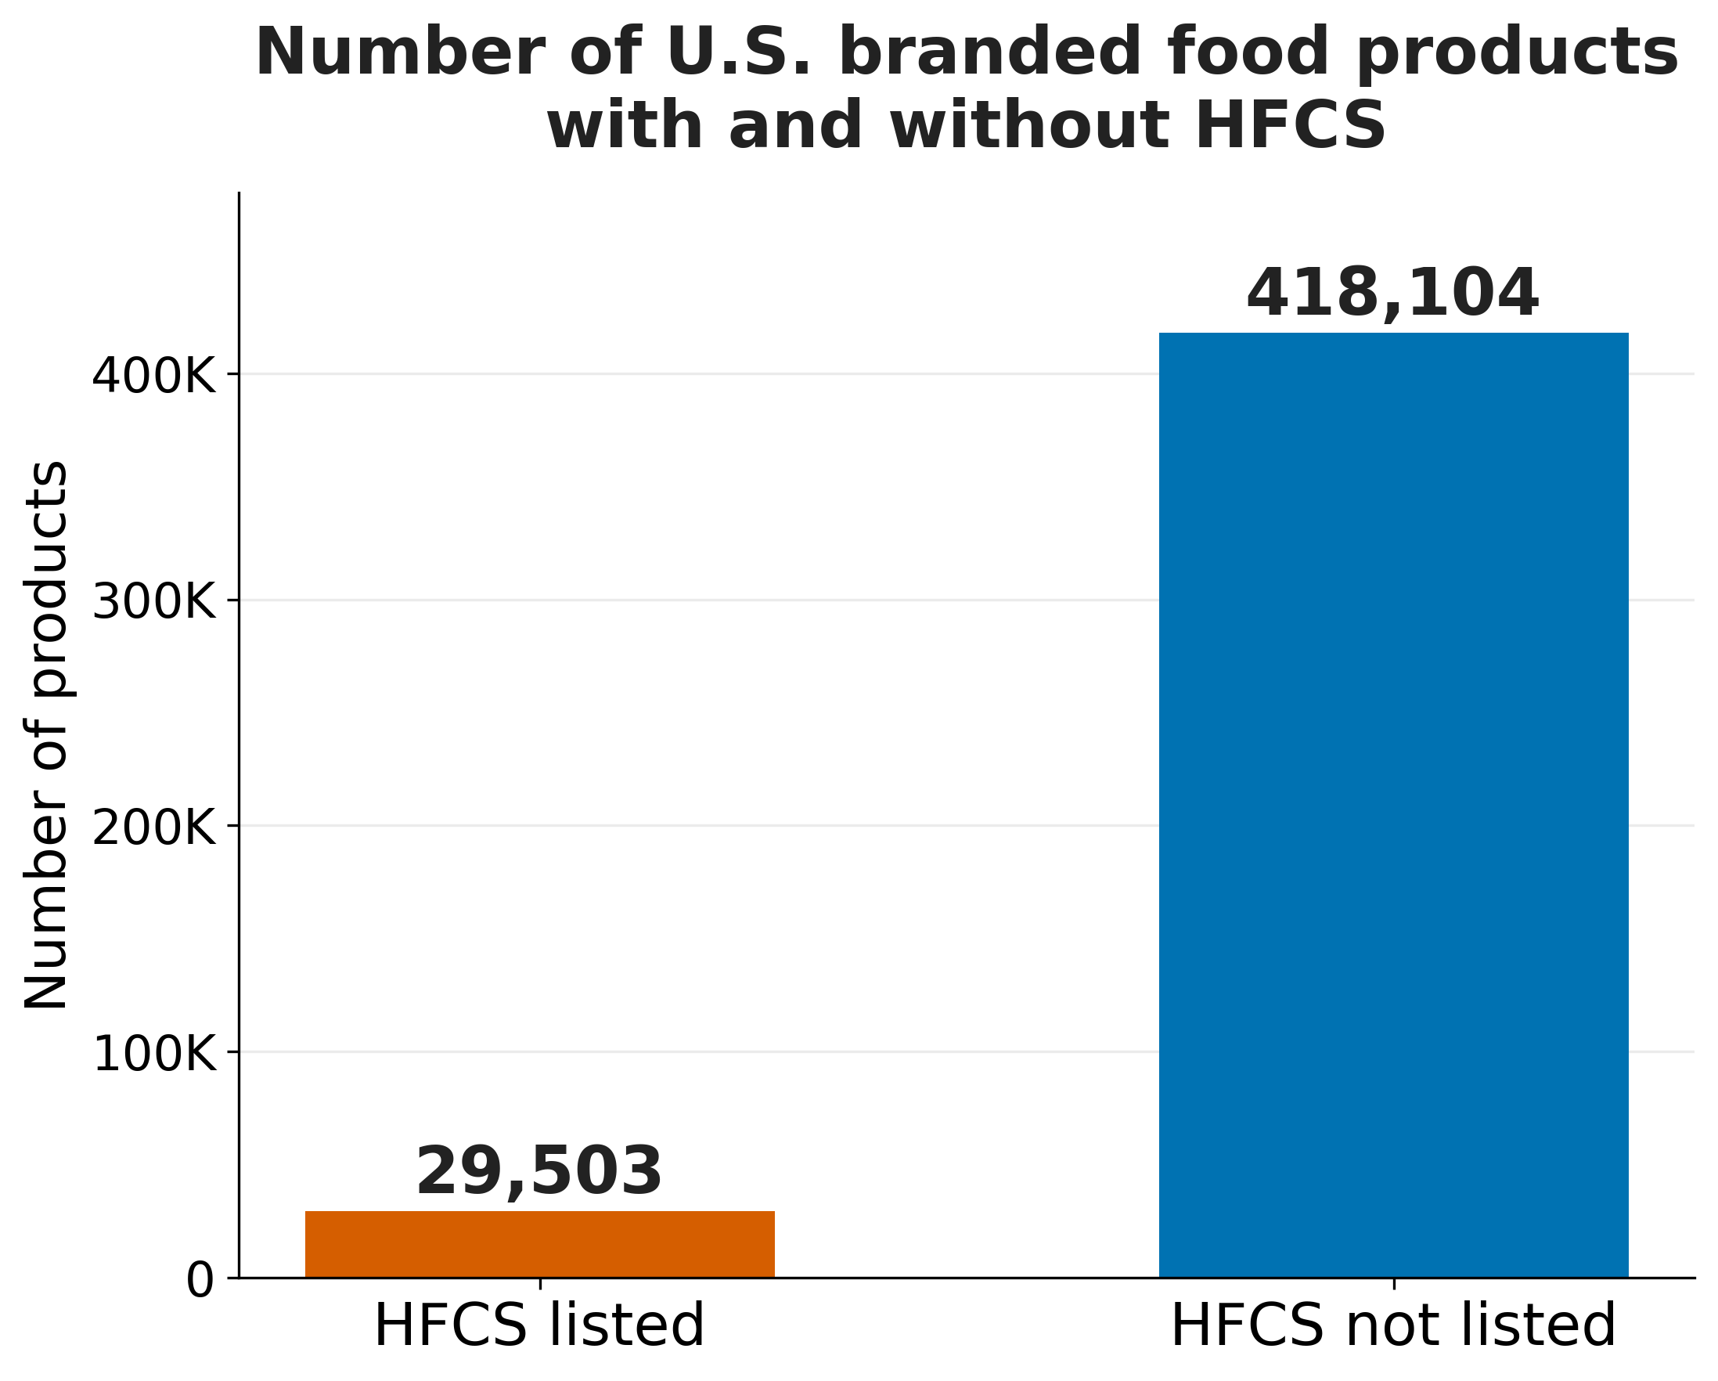
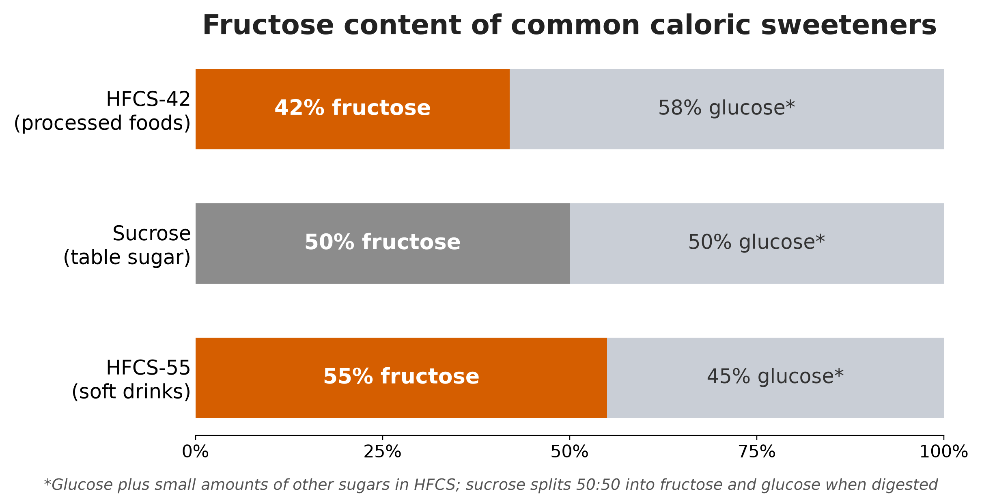
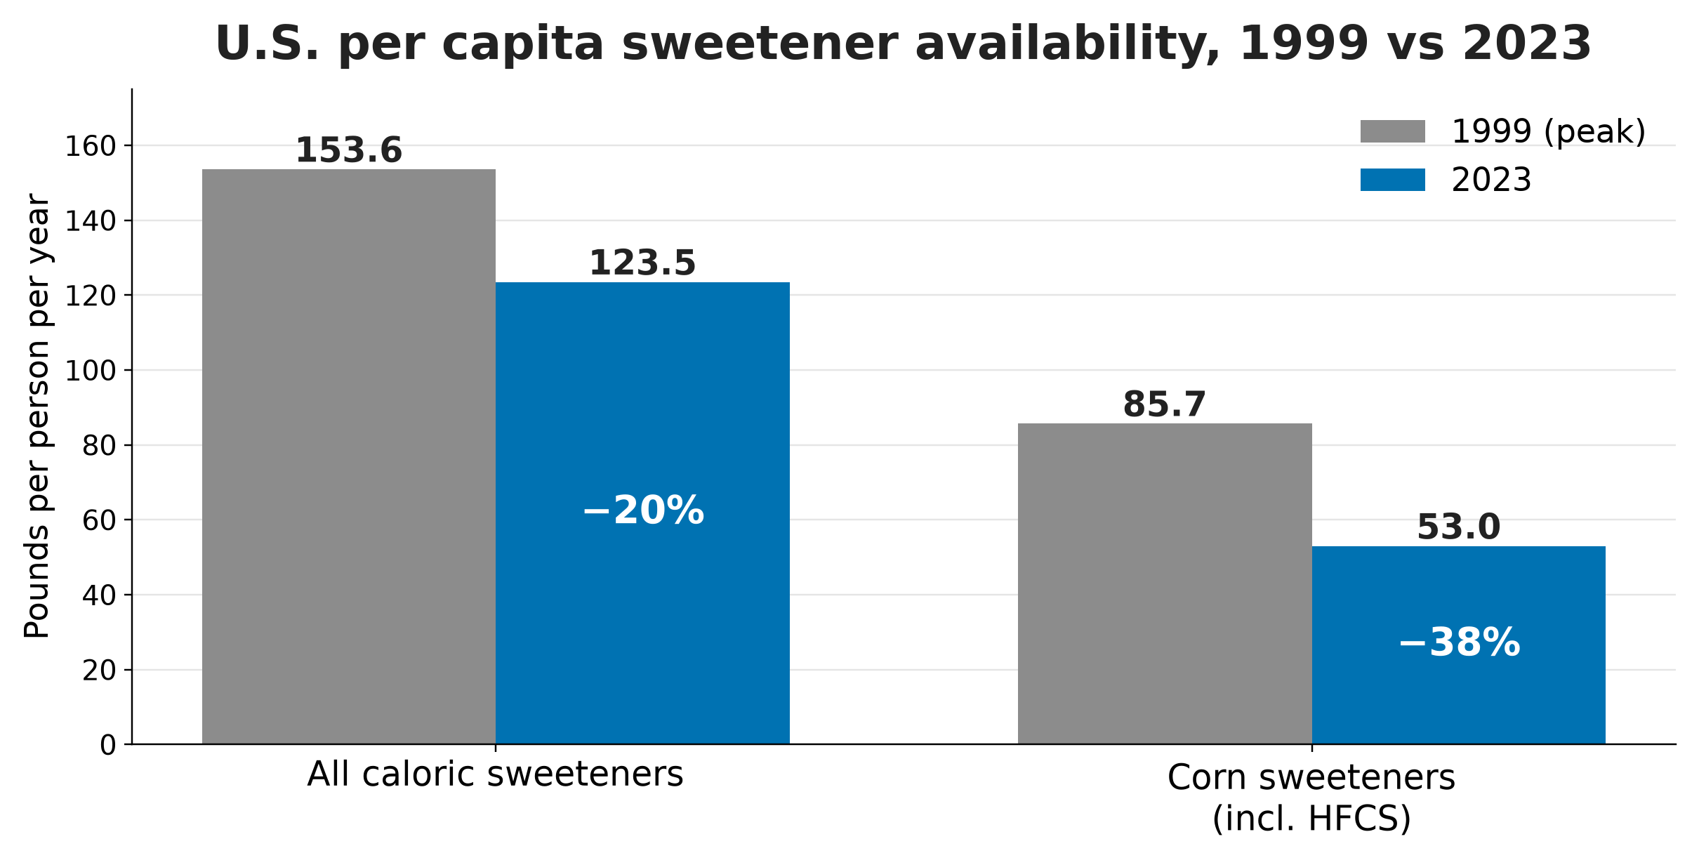
PREVALENCE OF HIGH-FRUCTOSE CORN SYRUP IN THE U.S. BRANDED FOOD SUPPLY:
A CROSS-SECTIONAL ANALYSIS OF THE USDA GLOBAL BRANDED FOOD PRODUCTS DATABASE
[Author Name, Credentials; Author Name, Credentials; Author Name, Credentials]
[Department], Liberty University
Abstract
454,324
products identified
USDA GBFPD, 2019–2025
447,607
eligible U.S. products
after 6,717 excluded
29,503
list HFCS
as an ingredient
6.6%
of branded products
about 1 in 15
Results, Discussion, Conclusion, and Limitations
Background: High-fructose corn syrup (HFCS) is a widely used caloric sweetener in the U.S. food supply, but product-level data on its prevalence are limited. Ingredient lists do not specify amounts, and nutrient databases do not distinguish among types of added sugars.
Objectives: To estimate the prevalence of HFCS as a listed ingredient in U.S. branded food products and to establish a reproducible baseline for future surveillance.
Methods: We conducted a retrospective, cross-sectional, descriptive analysis of the USDA FoodData Central Global Branded Food Products Database (GBFPD), covering products published between April 13, 2019, and December 13, 2025. The primary outcome was the proportion of eligible products listing HFCS as an ingredient. We used descriptive statistics (counts and percentages).
Results: Of 454,324 products identified, 447,607 were eligible for analysis. HFCS was listed as an ingredient in 29,503 products (6.6%), or about 1 in 15. The remaining 418,104 products (93.4%) did not list HFCS.
Conclusions: HFCS remains present in roughly 30,000 U.S. branded food products. Because we measured prevalence by product count rather than weighted by sales or intake, and could not quantify HFCS per product, these findings do not directly measure population exposure. They provide a reproducible baseline for monitoring reformulation and market change. Future work should link ingredient data to sales-weighted datasets and stratify by food category and trade channel.
Keywords: high-fructose corn syrup; added sugars; branded foods; FoodData Central; food supply surveillance
Results
Of 454,324 products identified, 6,717 were excluded, leaving 447,607 eligible U.S. branded products (Figure 1). HFCS was listed in 29,503 products (6.6%), about 1 in every 15; 418,104 (93.4%) did not list HFCS (Figure 2). Excluded records made up 1.5% of all products identified.
Discussion
HFCS appeared in a minority of products, yet its presence in nearly 30,000 items shows it remains embedded in the U.S. food supply. A 6.6% product share is not low exposure: counts are not sales-weighted, and HFCS may cluster in high-consumption foods such as sweetened beverages, desserts, and condiments. HFCS use grew rapidly after the 1970s,⁴ and although per capita corn sweetener availability has fallen 38% since its 1999 peak (Figure 4),¹⁰ HFCS remains common. Ultra-processed foods supply 89.7% of energy from added sugars in the U.S. diet,¹¹ and sugar-sweetened beverages are linked to weight gain in children and adults.¹² HFCS and sucrose have similar metabolic effects at equal intake,¹³ so total added sugar is the core concern.
Conclusion
HFCS is listed in 6.6% of U.S. branded food products, nearly 30,000 items. This reproducible baseline supports surveillance of HFCS and added sugars, evaluation of reformulation, and policy efforts to reduce added sugar.
Limitations
• Presence only: no amount per product or intake; counts are not sales-weighted
• Industry-supplied data: quality and completeness vary by contributor
• Search terms: words need not be adjacent (possible over-count); other names such as “glucose-fructose syrup” are missed (possible under-count)
• Item-level records: package sizes counted separately; some products may be discontinued
Introduction, Objective, and Research Question
Introduction
High-fructose corn syrup (HFCS) is a caloric sweetener made by enzymatically converting cornstarch into free fructose and glucose, used widely in soft drinks, baked goods, ready-to-eat meals, and condiments.^{1,2} Common blends are HFCS-55, mainly in soft drinks, and HFCS-42, mainly in processed foods.³ Low cost linked to domestic corn production drove its adoption in the U.S. food supply.⁴ HFCS-sweetened beverages increase liver fat and reduce insulin sensitivity,⁵ and excess free fructose may affect gut and metabolic health.⁶ The 2025–2030 Dietary Guidelines state that no amount of added sugars is recommended as part of a healthy diet.⁷ Yet ingredient lists do not give HFCS amounts, and nutrient databases do not separate types of added sugar, so product-level HFCS data are limited.
Objective
To estimate the prevalence of HFCS as a listed ingredient in U.S. branded food products and establish a reproducible baseline for future surveillance.
Research Question
What proportion of U.S. branded food products list HFCS as an ingredient?
Figure 1. Product Selection Flow. Products published in the USDA Global Branded Food Products Database, April 13, 2019–December 13, 2025.
Figure 2. U.S. Branded Food Products With and Without HFCS (N = 447,607). HFCS was listed in 29,503 products (6.6%).
Public Health Implications and Future Work
Public Health Implications
• Use ingredient-level surveillance to track HFCS and added sugars in branded foods
• Target reformulation where HFCS is concentrated
• Inform procurement standards in food service and child nutrition programs
• Support consumer education on reading ingredient lists
• Align monitoring with the 2025–2030 Dietary Guidelines⁷ and added-sugar labeling¹⁴
Future Work
• Link ingredient data to sales-weighted or scanner data to estimate exposure
• Stratify prevalence by food category and trade channel
• Compare HFCS with other added sugars in the same database
• Repeat over time and validate a random sample of records
Methods
METHOD | DESCRIPTION
Design & Data Source | Retrospective, cross-sectional, descriptive analysis of the USDA FoodData Central (FDC) Global Branded Food Products Database (GBFPD): 400,000+ branded and private-label products, supplied by industry and updated monthly.^{8,9}
Search & Eligibility | FDC published date April 13, 2019 (earliest available) to December 13, 2025 (search date). Trade channels: grocery, convenience, mass merchandising, food service, vending, online, military, child nutrition programs, and none. Excluded: “Drug” category and New Zealand market (n = 6,717).
HFCS Identification | Ingredients field searched for “High” AND “Fructose” AND “Corn” AND “Syrup” (all four terms required).
Outcome & Analysis | Proportion of eligible products listing HFCS as an ingredient; counts and percentages in Microsoft Excel.
Figure 3. Fructose Content of HFCS and Sucrose. HFCS-42 and HFCS-55 bracket the 50% fructose of table sugar.³
Figure 4. U.S. Per Capita Sweetener Availability, 1999 vs 2023. USDA Economic Research Service data; corn sweeteners include HFCS, glucose syrup, and dextrose.¹⁰
Public Health Context
57.9%
of U.S. energy intake comes from ultra-processed foods¹¹
89.7%
of energy from added sugars comes from ultra-processed foods¹¹
21.1%
of calories in ultra-processed foods come from added sugars, vs 2.4% in processed foods¹¹
≤10 g
added sugars per meal under the 2025–2030 Dietary Guidelines⁷
References
Ultra-processed food data: NHANES 2009–2010
Paste QR code here
(4.3 × 4.3 in; links to the full AMA reference list)
KEY TAKEAWAY About 1 in 15 U.S. branded food products still lists high-fructose corn syrup, a reproducible baseline for tracking added sugar in the food supply.

