Slide 1
Polarization Pipeline
Filtermen:
Steve Berul
David D'Alessandro
Andrew Deck

Slide 2
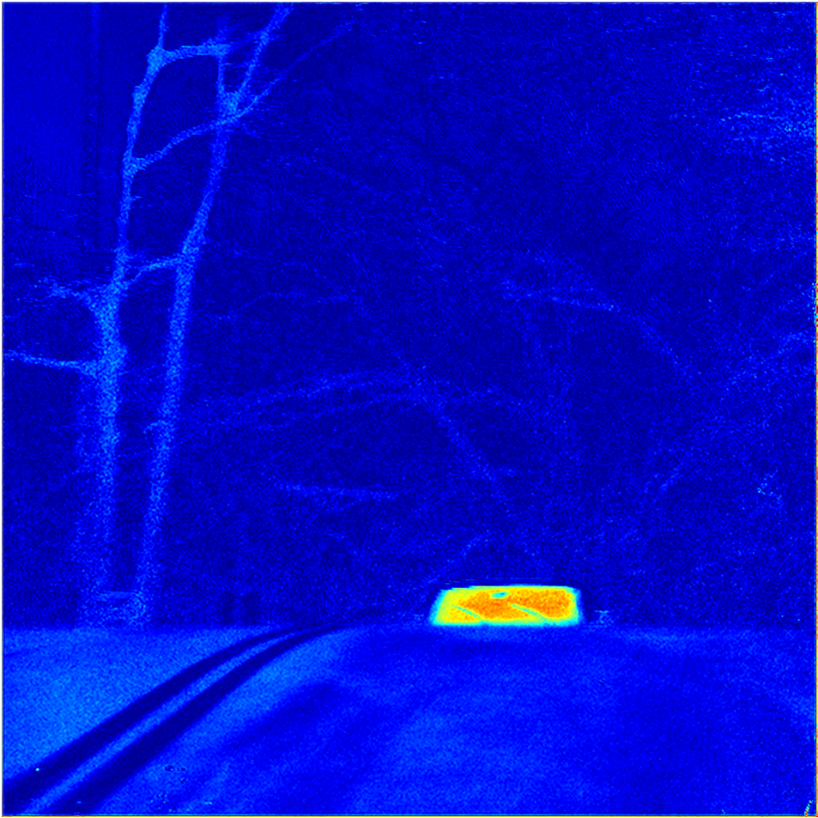
Background
Viktor Gruev

Slide 3
Motivation
Currently on CPU
Drains battery life
Battery runs out before air tanks

Slide 4
Where We Come In
Our task:
Create polarized pipeline to be deployed on FPGA using ScalaPipe
Time trial individual kernels to determine bottlenecks in pipeline
Suggest best architecture for pipeline given bottlenecks

Slide 5
Where We Come In
Data Throughput
1920x1080 frames
30 frames/second
62.2 M pixels/second
FPGA assumptions
Virtex 7
Best case clock rate: 700 Mhz

Slide 6
Pipeline Structure
Border Extension
Interpolation
Stokes Parameter Calculation
Degree of Linear Polarization
Angle of Linear Polarization
HSV Generator
HSV->RGB Image Converter

Slide 7
Border Extension
88 | 12 | 230 | 96
45 | 50 | 40 | 87
77 | 98 | 130 | 167
75 | 32 | 150 | 112

Slide 8
Border Extension
50 | 45 | 50 | 40 | 87 | 40
12 | 88 | 12 | 230 | 96 | 230
50 | 45 | 50 | 40 | 87 | 40
98 | 77 | 98 | 130 | 167 | 130
32 | 75 | 32 | 150 | 112 | 150
98 | 77 | 98 | 130 | 167 | 130

Slide 9
Border Extension
Inputs:
Image Data – UNSIGNED32
Outputs:
Image Data – UNSIGNED32
Timing:
7.8 cycles/pixel
42.9 frames/second

Slide 10
Interpolation
50 | 45 | 50 | 40 | 87 | 40
12 | 88 | 12 | 230 | 96 | 230
50 | 45 | 50 | 40 | 87 | 40
98 | 77 | 98 | 130 | 167 | 130
32 | 75 | 32 | 150 | 112 | 150
98 | 77 | 98 | 130 | 167 | 130
I(0)
I(45)
I(90)
I(135)

Slide 11
Interpolation
Inputs:
Image Data – UNSIGNED32
Outputs:
Interpolated Intensities – Vector(FLOAT32, 4)
Timing:
226.8 cycles/pixel
1.5 frames/second

Slide 12
Interpolation
Suggested Optimizations:
Parallelization
Integer interpolation
Loss of accuracy
Increase in speed
Parallelization
21 instances of kernel necessary as is
Integer Interpolation
Timing:
50.8 cycles/pixel
6.6 frames/second
5 instances necessary

Slide 13
Stokes Parameters
S0 = I(0) + I(90)
S1 = I(0) – I(90)
S2 = I(135) - I(45)
I(0)
I(45)
I(90)
I(135)
S0
S1
S2

Slide 14
Stokes Parameters
Inputs:
Interpolated Intensities – Vector(FLOAT32, 4)
Outputs:
Stokes Parameters – Vector(FLOAT32,3)
Timing:
23.9 cycles/pixel
14.1 frames/second

Slide 15
Degree of Linear Polarization
DoLP =
S0
S1
S2
DoLP

Slide 16
Degree of Linear Polarization
Inputs:
Stokes Parameters – Vector(FLOAT32, 3)
Outputs:
Degree of Linear Polarization – FLOAT32
Timing:
115.9 cycles/pixel
2.9 frames/second

Slide 17
Angle of Polarization
AoP =
S0
S1
S2
AoP

Slide 18
Angle of Polarization
Inputs:
Stokes Parameters – Vector(FLOAT32, 3)
Outputs:
Angle of Polarization – FLOAT32
Timing:
236.5 cycles/pixel
1.4 frames/second

Slide 19
Generate HSV
Inputs:
S0 – FLOAT32
Degree of Linear Polarization – FLOAT32
Angle of Polarization – FLOAT32
Outputs:
HSV – Vector(FLOAT32, 3)
Timing:
No results yet, but not a bottleneck

Slide 20
HSV → RGB
Inputs:
HSV – Vector(FLOAT32, 3)
Outputs:
RGB – Vector(UNSIGNED16, 3)
Timing:
No results yet, but not a bottleneck

Slide 21
Suggested Architecture
AoP
.
.
.
x3
.
.
.
Interp.
Stokes
From
Camera
.
.
.
x21
.
.
.
.
.
.
x3
.
.
.
Bord.
Ext.
AoP
HSV
HSV
→
RGB
Off
Chip
DoLP
Interp.
Stokes
.
.
.
x21
.
.
.
DoLP

Slide 22
Questions Still Seeking Answer
Will this architecture fit on the FPGA?
Synthesis issues

