Slide 1
Anime Discovery, Recommendation, and Graph Intelligence
Week 10 deliverable: recommendation, ranking, and evaluation
Goal: rank anime that a user is likely to enjoy next.
Built on a reproducible catalog, interaction layer, graph relations, and feature matrices.
Week 10 adds offline recommendation evaluation and a product-level recommender design.
Main decision
Given liked/completed anime, choose the next titles to recommend.
Not claimed
This is not chronological next-watch prediction because the ratings source has no timestamps.
Core result
Personalized SVD and hybrid ranking both beat popularity-only discovery.

Slide 2
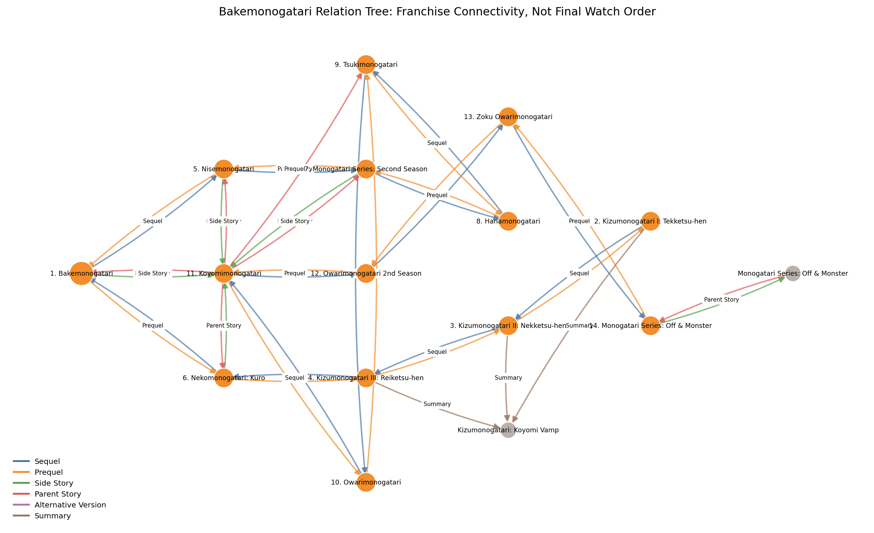
From Dataset to Recommender
The Week 10 model uses all previous project layers
Catalog layer
MAL/Jikan metadata enriched with AniDB and Shoko XML cache.
Feature layer
Numeric, categorical, text, tag, runtime, and graph-derived fields.
Interaction layer
Anonymized user-anime ratings filtered into positive interactions.
Graph layer
Recommendation edges plus typed relation edges for franchise navigation.

Slide 3
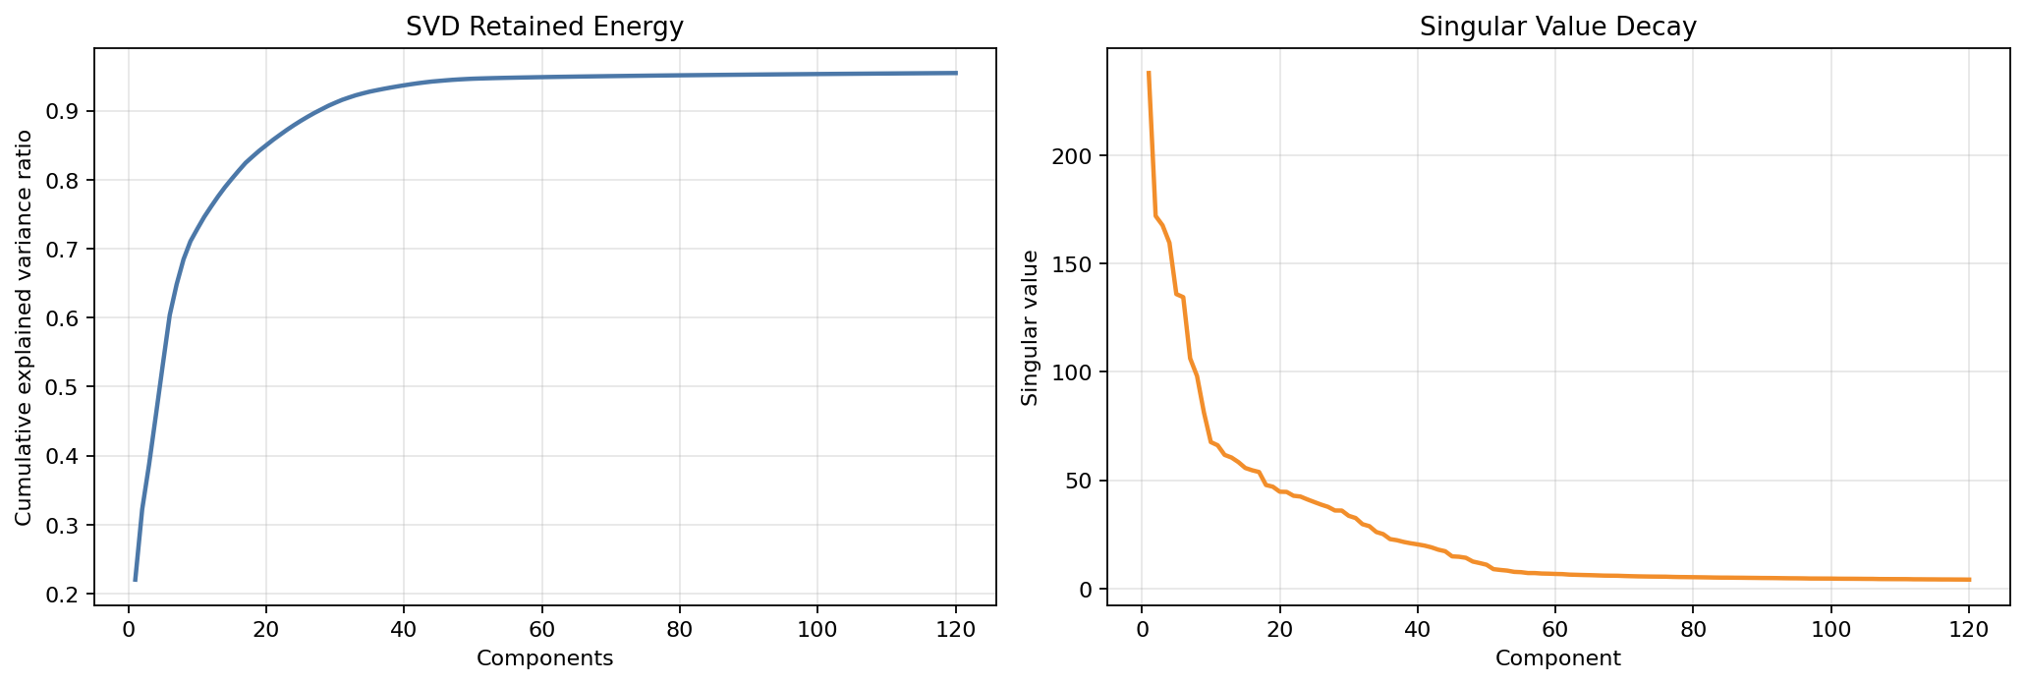
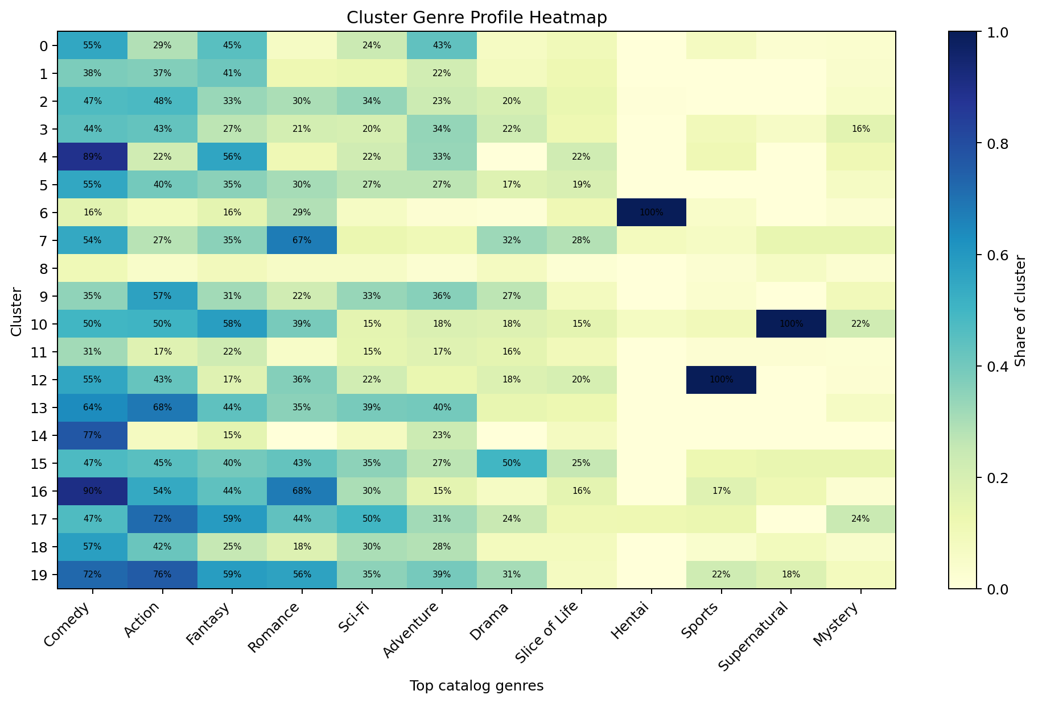
Representation and Segmentation Recap
Week 5 and Week 7 are inputs, not isolated exercises
SVD gives a compact catalog representation for similarity and clustering.
Clusters are broad discovery segments, not hard genre truth.
Density methods showed local pockets but rejected too many titles as noise.

Slide 4
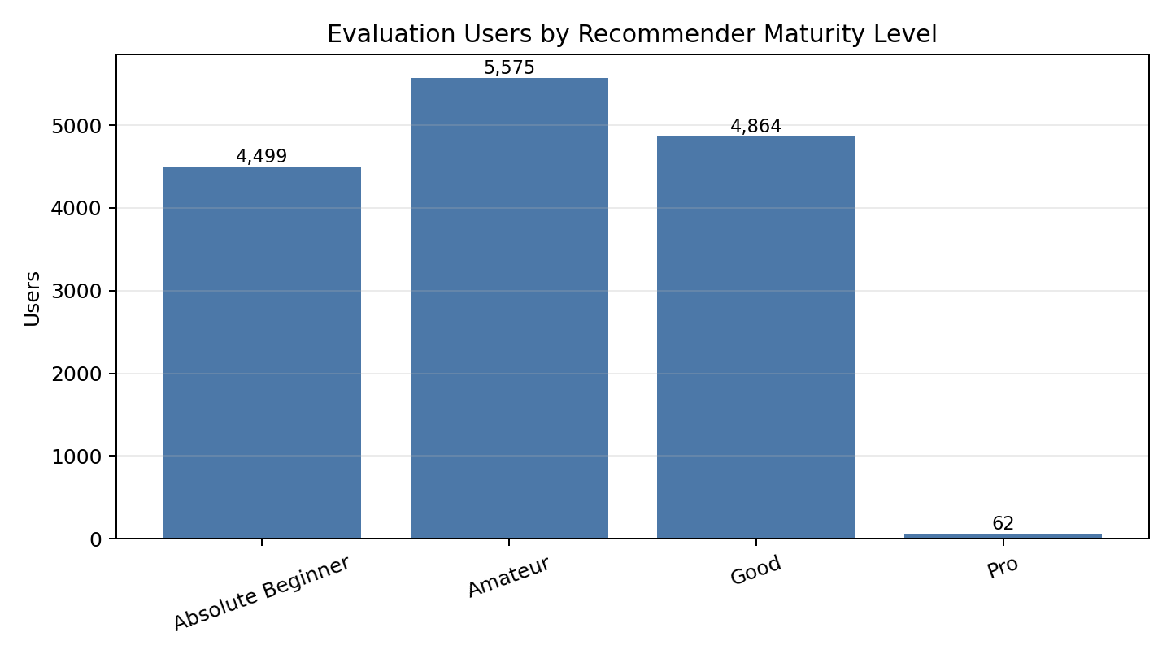
User Levels and Controls
The final recommender should adapt to user maturity
Absolute Beginner
Onboarding, genre choice, recognizable short entry points.
Amateur
Similar anime, franchise relations, high-rated anchors.
Good
Collaborative ranking plus seasonal/current exploration.
Pro
Long-tail, novelty, niche clusters, graph-aware exploration.
User controls: genre, demographic/content rating, explicit toggle, score floor, episode length, year.
Controls constrain the candidate set; ranking still decides the order.
Relations should offer franchise continuation after a main entry is selected, not blindly recommend season 3 first.

Slide 5
Evaluation Design
Ranking recovery test with a serious popularity baseline
Positive
rating >= 7
Candidate pool
8,181 anime with enough positive ratings
Evaluation users
15,000 users
Candidate list
1 held-out liked item + 100 sampled negatives
Held-out user-item pairs are removed from the training matrix.
No timestamp claims: this evaluates preference recovery, not exact next-watch sequence.
Popularity is not a strawman in anime; it reflects real discourse and entry-point behavior.

Slide 6
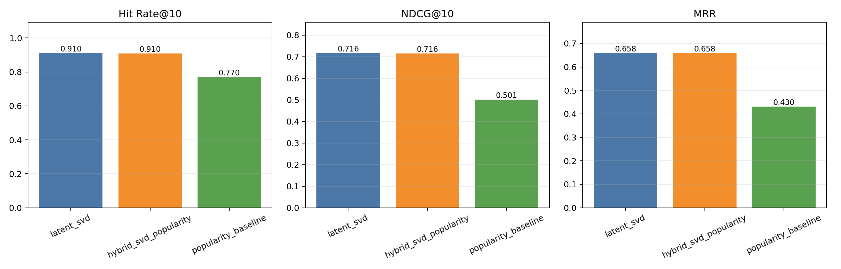
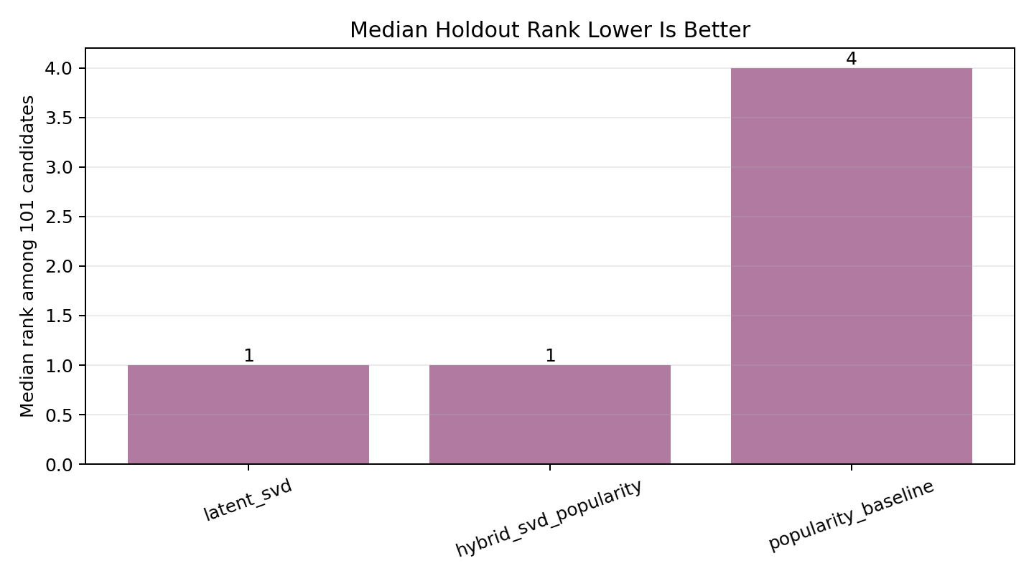
Overall Recommendation Results
Personalized models beat popularity-only discovery
method | hit_rate_at_10 | ndcg_at_10 | mean_reciprocal_rank | median_rank
latent_svd | 0.910 | 0.716 | 0.658 | 1.0
hybrid_svd_popularity | 0.910 | 0.716 | 0.658 | 1.0
popularity_baseline | 0.770 | 0.501 | 0.430 | 4.0

Slide 7
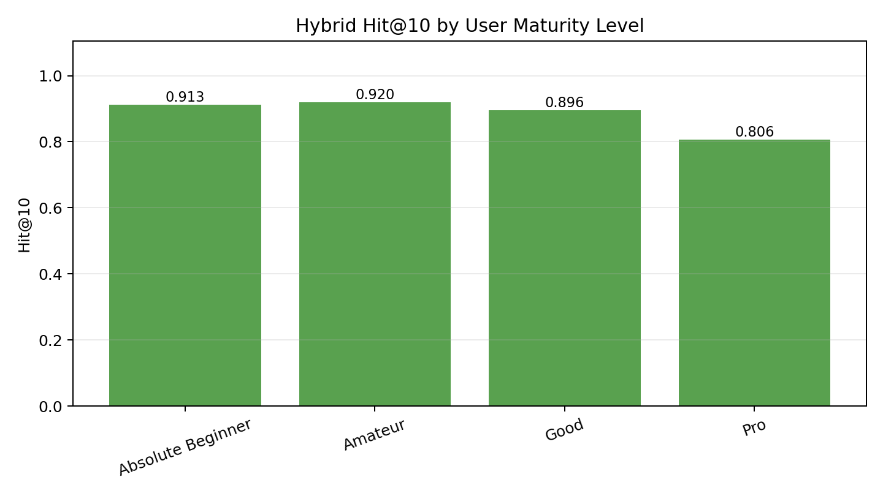
Results by User Level
The same model has different meaning for different users
user_level | evaluated_users | median_profile_size | hit_rate_at_10 | median_rank
Absolute Beginner | 4499 | 25.0 | 0.913 | 1.0
Amateur | 5575 | 90.0 | 0.920 | 1.0
Good | 4864 | 245.0 | 0.896 | 2.0
Pro | 62 | 1153.5 | 0.806 | 3.0
Amateur users perform best: enough signal, but not too much catalog saturation.
Good users are still strong but more diverse.
Pro users are rare and harder; this segment needs novelty and long-tail logic.

Slide 8
Absolute Beginner Entry Points
Cold-start pool before collaborative ranking is reliable
title | type | score | episodes | genres
Sousou no Frieren | TV | 9.26 | 28.0 | Adventure|Award Winning|Drama|Fantas y|Action|Comedy|Romance
Steins;Gate | TV | 9.07 | 24.0 | Drama|Sci-Fi|Suspense|Comedy|Romance
Koe no Katachi | Movie | 8.93 | 1.0 | Award Winning|Drama|Romance
Kimi no Na wa. | Movie | 8.82 | 1.0 | Award Winning|Drama|Sci- Fi|Comedy|Romance|Slice of Life
Fullmetal Alchemist: Brotherhood | TV | 9.11 | 64.0 | Action|Adventure|Drama|Fantasy|Sci- Fi|Comedy
Shingeki no Kyojin | TV | 8.57 | 25.0 | Action|Award Winning|Drama|Suspense|Sci- Fi|Fantasy|Adventure|Horror
Vinland Saga | TV | 8.78 | 24.0 | Action|Adventure|Drama
Violet Evergarden | TV | 8.69 | 13.0 | Drama|Action|Sci-Fi|Romance|Slice of Life
Filters out explicit titles and obvious continuation entries.
Prefers high score, high engagement, and shorter or medium-length commitments.
Used for onboarding after genre/content choices.
Example behavior
If a beginner likes Frieren or Steins;Gate, the system can then switch into similar-anime and graph-aware recommendations.

Slide 9
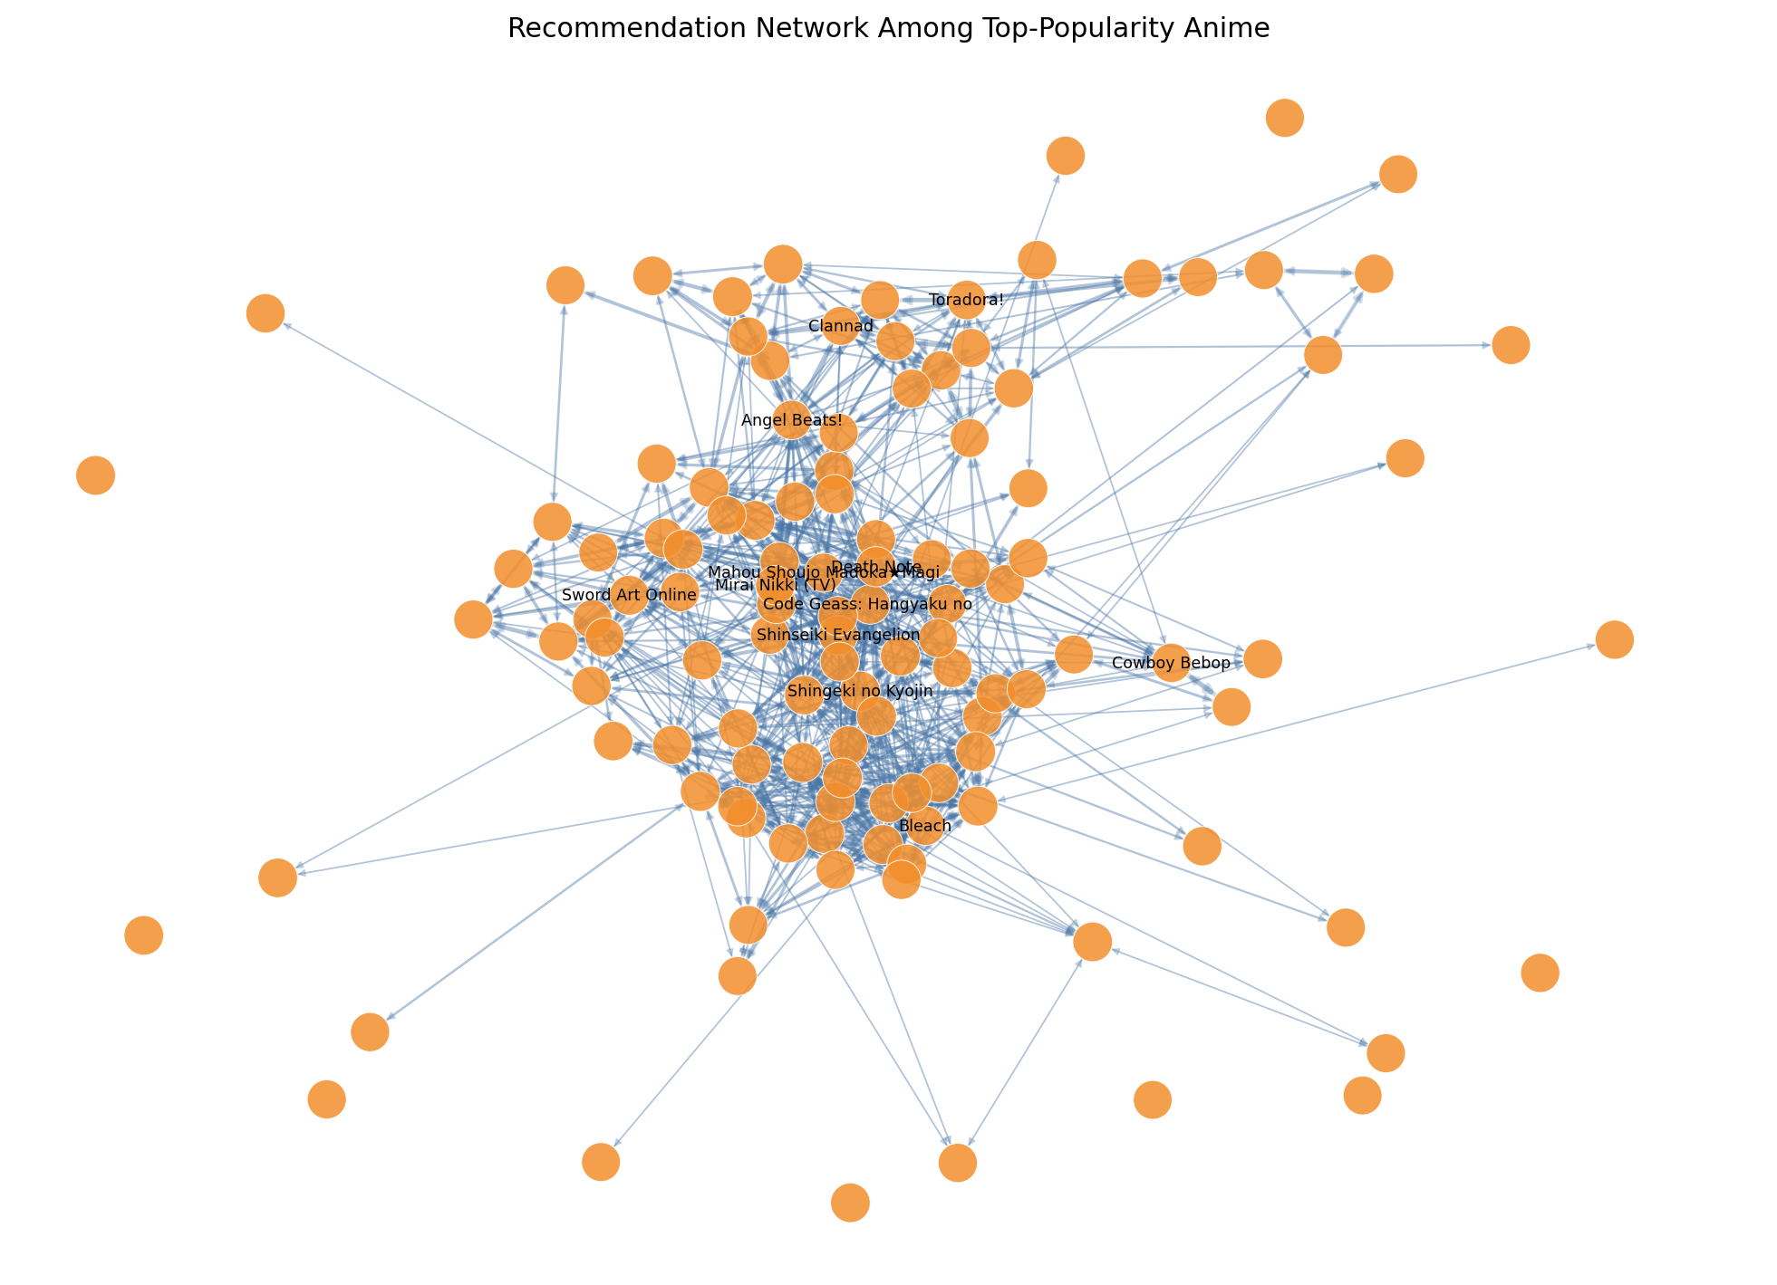
Recommendation Architecture
Use the right signal at the right moment
1. Apply user controls: genre, rating, explicit toggle, score, year, length.
2. Select maturity mode: beginner, amateur, good, or pro.
3. Generate candidates: popularity, SVD, content similarity, relation graph.
4. Rank with hybrid score.
5. Use relations for franchise navigation after an entry point is chosen.
Design rule
General discovery should favor standalone or first-entry titles. Sequels and side stories belong in a contextual continuation rail.

Slide 10
Limitations and Defense Points
What the current result supports, and what it does not
Supports: collaborative ranking improves over popularity-only recommendation.
Supports: user maturity matters; the Pro segment needs a different strategy.
Supports: relation edges are necessary for franchise-aware recommendation.
Does not prove: chronological next-watch prediction.
Does not solve yet: fresh seasonal recency, full watch-order data, or perfect MAL/AniDB split handling.
Next technical focus
Week 12 can move graph analytics from diagnostics into graph-aware reranking: centrality, relation paths, franchise entry points, and novelty constraints.

