Slide 1
Week 7: Anime Clustering and Validation
Goal: segment the anime catalog and validate whether the segments are meaningful for recommendation.
Current dataset
• 16,664 anime rows
• 32 catalog columns
• 114,523 recommendation edges
• 14,392 relation edges
Product question
Which anime are similar, which latent segments exist, and which titles should be candidates for recommendation or graph-based ranking?

Slide 2
Representation Used for Clustering
I clustered an SVD-compressed feature space because it combines numeric, categorical, tag, text, and graph-adjacent signals while reducing sparse TF-IDF noise.
Week 5 dimensionality output
Interpretation
• Strong redundancy exists
• SVD preserves richer text/tag detail
• t-SNE is used only for visualization, not validation
Method
50%
80%
90%
95%
PCA dense mixed
4
14
25
43
SVD sparse full
5
15
27
73

Slide 3
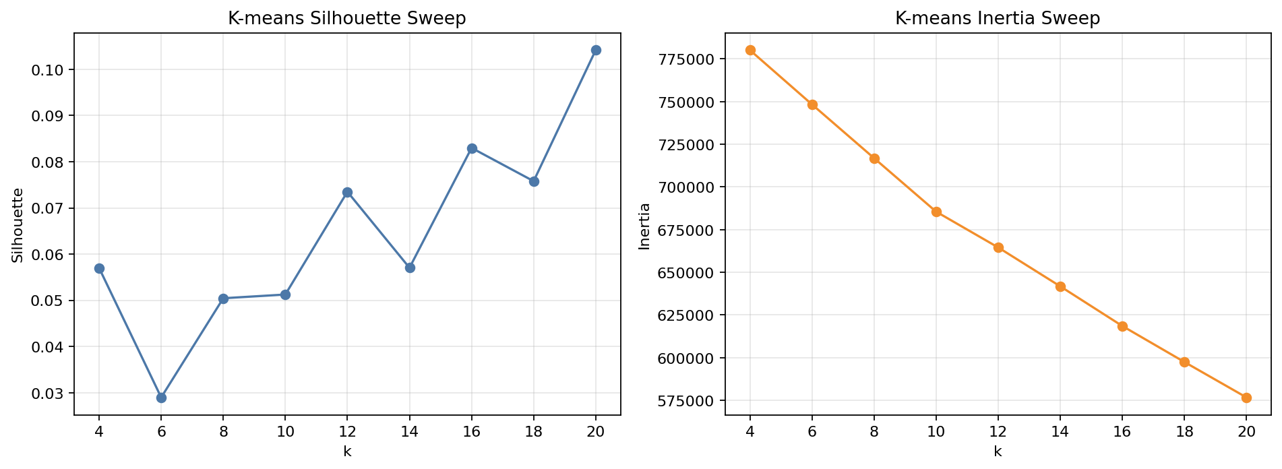
K-means Experiment: Parameter Sweep
K-means assigns every anime to a segment, but assumes roughly spherical Euclidean clusters.
Selected K values
k
sil.
DB
inertia
12
0.073
2.840
664,545
16
0.083
2.479
618,528
20
0.104
2.389
576,682
Result: k=20 is best among tested K-means settings, but silhouette remains low, so these are broad discovery segments rather than hard genre truth.

Slide 4
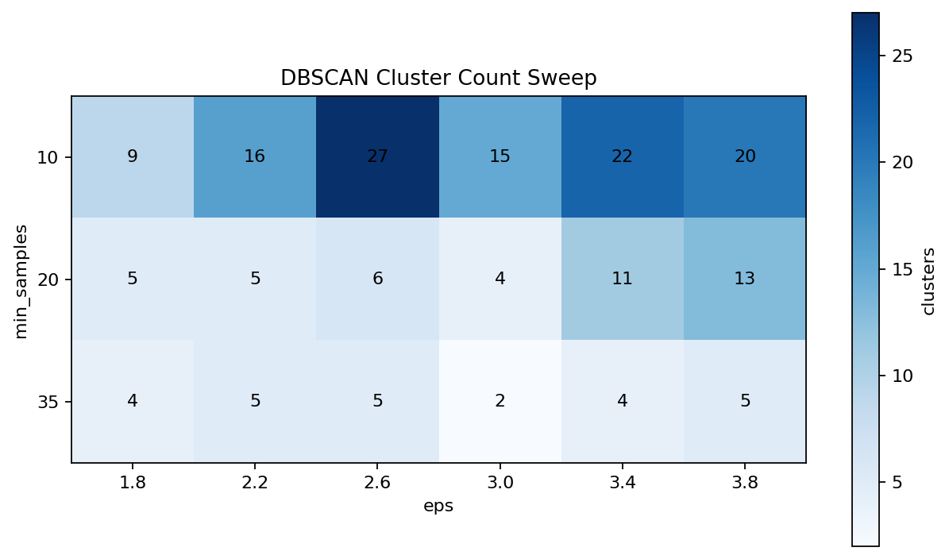
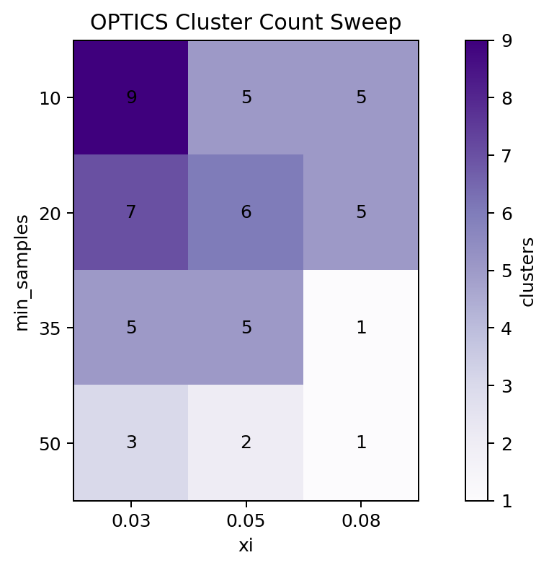
Density Methods: DBSCAN and OPTICS
Density methods reveal compact pockets, but most anime become noise under many settings.
Validation highlights
Higher silhouette is misleading when the method rejects most of the catalog as outliers.
Setting
clusters
sil.
noise
DBSCAN eps 3.0, min 35
2
0.491
90.8%
OPTICS min 50, xi .05
2
0.568
96.5%

Slide 5
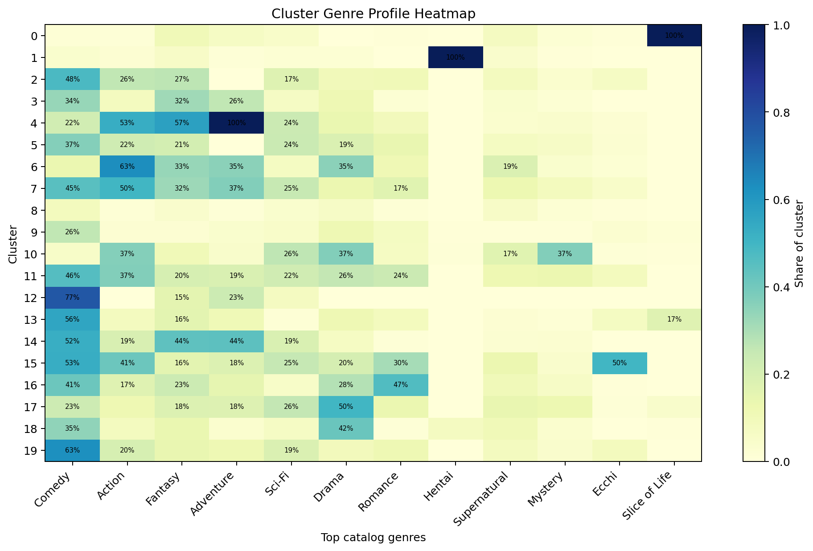
Cluster Profile Analysis
The heatmap checks whether K-means clusters have interpretable genre concentration instead of only reporting labels.
Most defensible clusters
• Clear Hentai / Slice of Life pockets
• Comedy-heavy groups
• Action/Fantasy/Sci-Fi mixtures
Weakest clusters
• Mixed multi-genre groups
• Franchise variants and specials blur boundaries

Slide 6
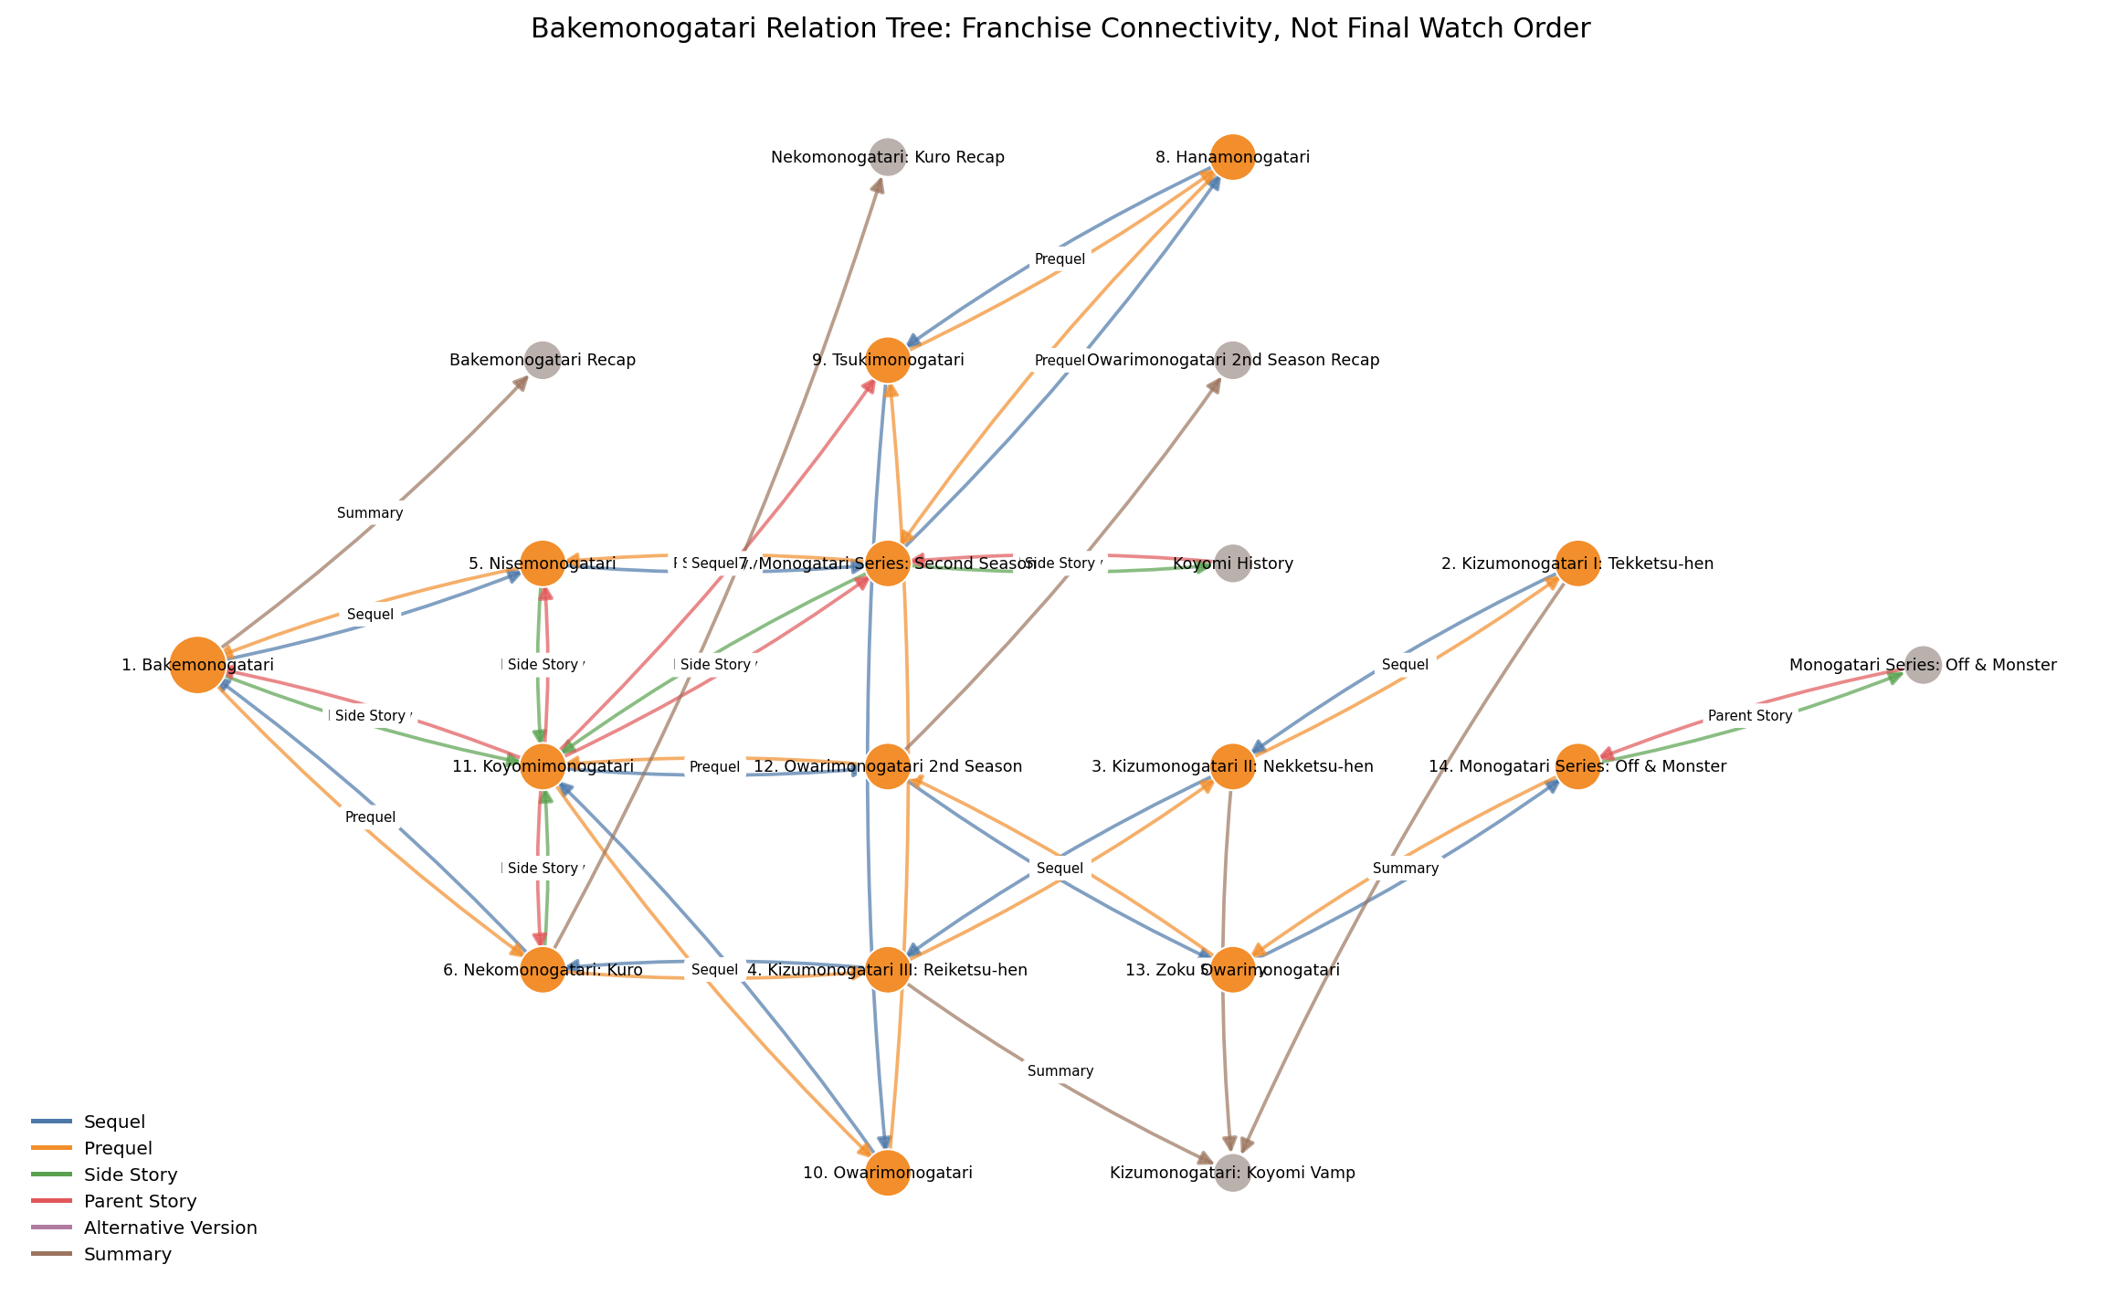
Failure Analysis and Recommendation Use
What should not be overclaimed
• K-means clusters are not hard genre truth
• t-SNE islands are not validation
• DBSCAN/OPTICS scores are limited by high noise
Operational use
• Clusters support broad discovery/cold start
• Recommendation edges capture similarity
• Relation edges prevent bad franchise order suggestions
Conclusion: useful segmentation exists, but final recommendation should combine clusters + recommendation graph + relation graph.

