Slide 1
Strategic Analysis (Q1-Q3)
Performance Gaps & Operational Recommendations
Presented to: Marcus Thorne, Regional Director

Slide 2
Executive Summary
Staffing: Universal Schedule is failing. Each city has a distinct peak hour.
Membership: Program is cost-inefficient. Members do not spend more than walk-ins.
Marketing: Current demographic targeting is flawed. Buying habits are gender-neutral.
Experience: No correlation between high spend and high satisfaction. Premium gap identified.

Slide 3
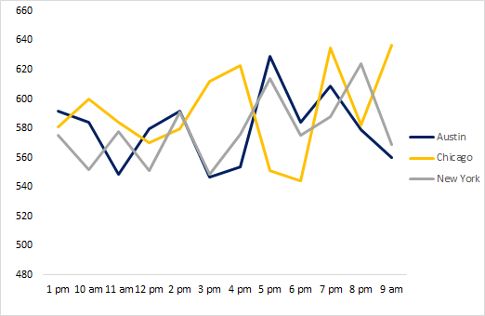
The Staffing Mismatch Crisis
INSIGHHT: Peak hours vary drastically by city.
Chicago: Morning Peak (9:00 AM)
Austin: Afternoon Peak (5:00 PM)
New York: Evening Peak (8:00 PM)
ACTION: Abandon universal rosters and Implement city-specific shift patterns immediately.

Slide 4
Membership Program Audit
INSIGHT: Loyalty program adds cost, not revenue.
Member Avg Ticket: $31,601
Normal Avg Ticket: $31,905
ACTION: The Finance Department is correct, Revamp the value proposition or discontinue the program to save operational costs.

Slide 5
Marketing Spend Efficiency
INSIGHTS: No gender divide in key categories.
- Men and Women spend equally (~$56M each) in Health & Beauty and 'Electronics'.
ACTION: Stop gender-segmented digital ads and Reallocate budget to City-based or Interest-based targeting.

Slide 6
The Premium Experience Gap
INSIGHT: High spenders are not delighted.
$80k+ transactions rate us the same (6.9/10) as $20k transactions.
ACTION: Investigate service protocols for high-value purchases. VIP treatment is currently ineffective.

Slide 7
The Premium Experience Gap 2
INSIGHT: Correlation between Spend and Rating is near zero.

Slide 8
STRATEGIC RECOMMENDATIONS
IMMEDIATE: Decentralize scheduling authority to local Branch Managers.
SHORT TERM: Pause 'Member' acquisition campaigns while auditing benefits.
SHORT TERM: Unify marketing creative for 'Health & Beauty' (remove gendered messaging).
. Launch 'White Glove' service pilot for transactions over $50k to boost VIP satisfaction.

