Slide 1

Javascript Essential
Introduction to javascript

Slide 2
Content
Statements
Syntax
Comment
Variable (Let, Var, Const)
Operator
Data Types
Function & Objects
String & Methods
Number & methods
Comparison & Conditions
Switch, Break & Loops
RegEx
Scope & this

Slide 3
What can JS do in web pages?
JS can be used to handle, and verify, user input, user actions, and browser actions:
Things that should be done every time a page loads
Things that should be done when the page is closed
Action that should be performed when a user clicks a button
Content that should be verified when a user inputs data
And more ...

Slide 4
Examples of what JS can do
Javascript can change HTML content
document.getElementById("demo").innerHTML = "Hello JavaScript“
JavaScript can change HTML attribute values.
document.getElementById('myImage').src='light-bulb.gif‘
document.getElementById("demo").style.fontSize = "35px"
document.getElementById("demo").style.display = "none“
document.getElementById("demo").style.display = "block";

Slide 5
Where to place JS code in HTML
JavaScript in <head>
JavaScript in <body>
External file: myScript.js

Slide 6
JavaScript Statements
JavaScript statements are composed of:
Values, Operators, Expressions, Keywords, and Comments.
Semicolon at the end of each executable statement (disputable).
JavaScript ignores multiple spaces.
JavaScript statements can be grouped together in code blocks, inside curly brackets {...}.

Slide 7
JS Syntax
JavaScript syntax is the set of rules, how JavaScript programs are constructed
Strings, value, Operator, assignment, expression,
JS is case- sensitive
JS and camel casing
Comments
Code after // or between /* */ are treated as comment

Slide 8
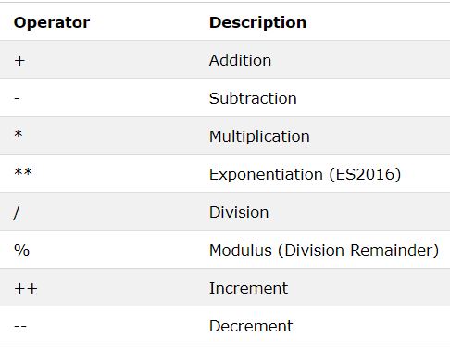
Operators
The assignment operator (=) assigns a value to a variable
The addition operator (+) adds numbers
The multiplication operator (*) multiplies numbers.

Slide 9
JavaScript Data Types
JavaScript variables can hold many data types: numbers, strings, objects and more:
var length = 16; // Number
var lastName = "Johnson"; // String
var x = {firstName:"John", lastName:"Doe"}; // Object
Typeof Operator
string
number
boolean
Undefined
Object
function
undefined and null are equal in value but different in type:

Slide 10
JavaScript Functions
A JavaScript function is a block of code designed to perform a particular task.
A JavaScript function is executed when "something" invokes it (calls it).
function name(parameter1, parameter2, parameter3) { // code to be executed }
Different ways to declare a function
Function Declaration, Function Expression, Arrow Function, new Function

Slide 11
Object
Objects are variables too. But objects can contain many values.
var person = {firstName:"John", lastName:"Doe", age:50, eyeColor:"blue"};
Methods.
Accessing values of objects

Slide 12
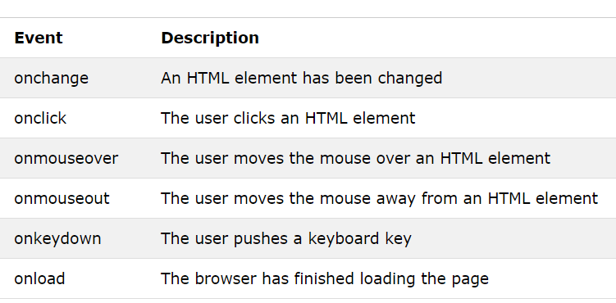
Event
HTML events are "things" that happen to HTML elements.
<button onclick="document.getElementById('demo').innerHTML = Date()">The time is</button>

Slide 13
String & methods
String Length “ string.length”
backslash escape character.
var x = "We are the so-called "Vikings" from the north.";
Finding a String in a String “indexOf(), lastIndexOf(), search() “
Extracting String Parts
slice(start, end) extracts a part of a string and returns the extracted part in a new string.
substring(start, end) is similar to slice but can not accept negative numbers.
substr(start, length) is similar to slice, the difference is that the second parameter specifies the length of the extracted part.
The replace() method replaces a specified value with another value in a string

Slide 14
toUpperCase()
The trim() method removes whitespace from both sides of a string
The charAt() method returns the character at a specified index (position) in a string
ECMAScript 5 (2009) allows property access [ ] on strings …. str[0]
A string can be converted to an array with the split() method
var txt = "a,b,c,d,e"; // String
txt.split(","); // Split on commas
txt.split(" "); // Split on spaces
txt.split("|"); // Split on pipe

Slide 15
Number and Methods
The toString() method returns a number as a string.
var x = 123;
x.toString(); // returns 123 from variable x
(123).toString(); // returns 123 from literal 123
(100 + 23).toString(); // returns 123 from expression 100 + 23
toExponential() returns a string, with a number rounded and written using exponential notation.
var x = 9.656;
x.toExponential(2); // returns 9.66e+0
toFixed() returns a string, with the number written with a specified number of decimals
toPrecision() returns a string, with a number written with a specified length
valueOf() returns a number as a number

Slide 16
Converting Variables to Numbers
Number() can be used to convert JavaScript variables to numbers
Number(true); // returns 1 Number(false); // returns 0 Number("10"); // returns 10 Number(" 10"); // returns 10 Number("10 "); // returns 10 Number(" 10 "); // returns 10 Number("10.33"); // returns 10.33 Number("10,33"); // returns NaN Number("10 33"); // returns NaN Number("John"); // returns NaN
Number(new Date("2017-09-30")); // returns 1506729600000

Slide 17
Number methods
parseInt() parses a string and returns a whole number. Spaces are allowed. Only the first number is returned
parseInt("10"); // returns 10
parseInt("10.33"); // returns 10
parseInt("10 20 30"); // returns 10
parseInt("10 years"); // returns 10
parseInt("years 10"); // returns NaN
parseFloat() parses a string and returns a number. Spaces are allowed. Only the first number is returned:
parseFloat("10"); // returns 10
parseFloat("10.33"); // returns 10.33
parseFloat("10 20 30"); // returns 10
parseFloat("10 years"); // returns 10
parseFloat("years 10"); // returns NaN

