Slide 1
Introduction to JS Contd

Slide 2
Content
Object
Function (call & apply)
HTML DOM

Slide 3
Object Contructor
Sometimes we need a "blueprint" for creating many objects of the same "type".
The way to create an "object type", is to use an object constructor function.
function Person(first, last, age, eye) {
this.firstName = first;
this.lastName = last;
this.age = age;
this.eyeColor = eye;
this.name = function() {return this.firstName + " " + this.lastName;};
}
var myFather = new Person("John", "Doe", 50, "blue");
var myMother = new Person("Sally", "Rally", 48, "green");
Adding a Method to an Object
myFather.name = function () { return this.firstName + " " + this.lastName; };
You cannot add a new method to an object constructor the same way you add a new method to an existing object.
You cannot add a new property to an object constructor the same way you add a new property to an existing object

Slide 4
Object Prototype (Prototype Inheritance)
Sometimes you want to add new properties (or methods) to all existing objects of a given type.
Sometimes you want to add new properties (or methods) to an object constructor.
function Person(first, last, age, eyecolor) {
this.firstName = first;
this.lastName = last;
this.age = age;
this.eyeColor = eyecolor;
}
Person.prototype.nationality = "English";
Person.prototype.name = function() {
return this.firstName + " " + this.lastName;
};

Slide 5
Function (call method)
With the call() method, you can write a method that can be used on different objects.
With call(), an object can use a method belonging to another object.
var person = {
fullName: function() {
return this.firstName + " " + this.lastName;
}
}
var personArgs = {
fullName: function(city, country) {
return this.firstName + " " + this.lastName + "," + city + "," + country;
}
}
var person1 = {
firstName:"John",
lastName: "Doe"
}
var person2 = {
firstName:"Mary",
lastName: "Doe"
}
person.fullName.call(person1); // Will return "John Doe“
personArgs.fullName.call(person1, "Oslo", "Norway");

Slide 6
Function ( apply() method)
With the apply() method, you can write a method that can be used on different objects.
The apply() method is similar to the call() method
var person = {
fullName: function() {
return this.firstName + " " + this.lastName;
}
}
var person1 = {
firstName: "Mary",
lastName: "Doe"
}
person.fullName.apply(person1);

Slide 7
The apply() method is very handy if you want to use an array instead of an argument list.
The difference is: The call() method takes arguments separately. & The apply() method takes arguments as an array.
var person = {
fullName: function(city, country) {
return this.firstName + " " + this.lastName + "," + city + "," + country;
}
}
var person1 = {
firstName:"John",
lastName: "Doe"
}
person.fullName.apply(person1, ["Oslo", "Norway"]);

Slide 8
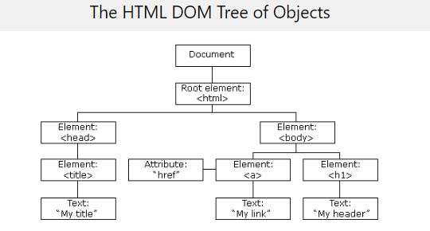
HTML DOM
With the HTML DOM (Document Object Model), JavaScript can access and change all the elements of an HTML document.
JavaScript can change all the HTML elements in the page
JavaScript can change all the HTML attributes in the page
JavaScript can change all the CSS styles in the page
JavaScript can remove existing HTML elements and attributes
JavaScript can add new HTML elements and attributes
JavaScript can react to all existing HTML events in the page
JavaScript can create new HTML events in the page
The HTML DOM can be accessed with JavaScript (and with other programming languages).
In the DOM, all HTML elements are defined as objects.
The programming interface is the properties and methods of each object.
A property is a value that you can get or set (like changing the content of an HTML element).
A method is an action you can do (like add or deleting an HTML element).

Slide 9
DOM Method
getElementById Method. The most common way to access an HTML element is to use the id of the element.
The innerHTML Property. The easiest way to get the content of an element is by using the innerHTML property.

Slide 10
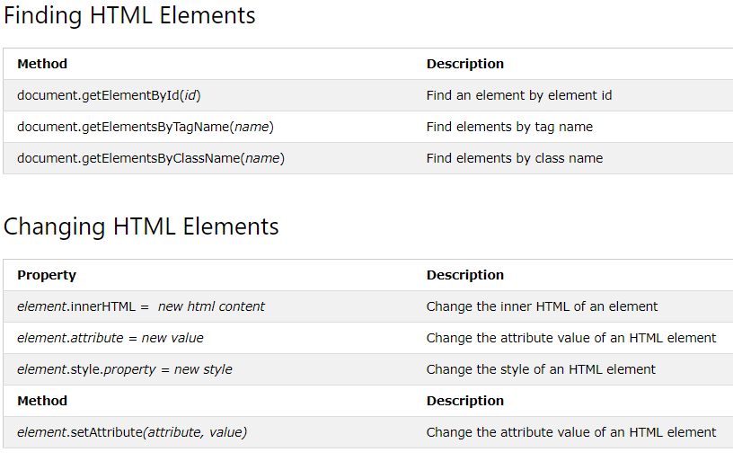
DOM Document
The HTML DOM document object is the owner of all other objects in your web page.

Slide 11
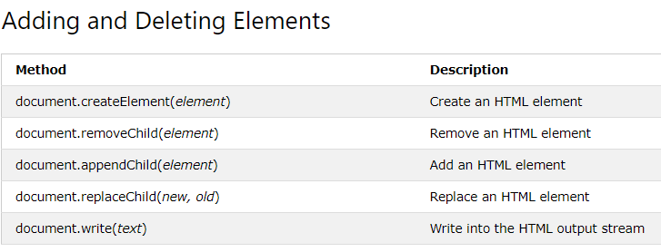
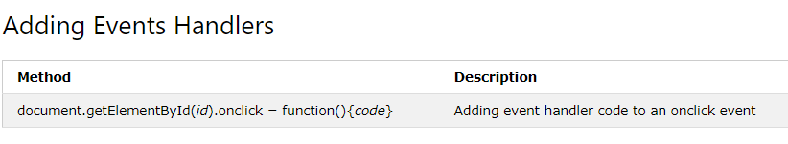
And much more. Kindly find out more…

Slide 12
JavaScript HTML DOM Elements
document.getElementById("intro")
document.getElementsByTagName("p")
document.getElementById('demo')
document.getElementsByClassName("intro");
document.querySelectorAll("p.intro");
The following HTML objects (and object collections) are also accessible:
document.anchors
document.body
document.documentElement
document.embeds
document.forms
document.head
document.images
document.links
document.scripts
document.title

