Slide 1
JavScript Intro Contd…

Slide 2
Content
For Loop
While Loop
RegEx
Error
Scope
This
Debugging
Version
JSON
Form

Slide 3
For Loop
Loops are handy, if you want to run the same code over and over again, each time with a different value.
JavaScript supports different kinds of loops:
for - loops through a block of code a number of times
for/in - loops through the properties of an object
while - loops through a block of code while a specified condition is true
do/while - also loops through a block of code while a specified condition is true
Code structure of a For loop.
for (statement 1; statement 2; statement 3) {
// code block to be executed
}

Slide 4
For / in Loop
The JavaScript for/in statement loops through the properties of an object
var person = {fname:"John", lname:"Doe", age:25};
var text = "";
var x;
for (x in person) {
text += person[x];
}

Slide 5
While Loop
The while loop loops through a block of code as long as a specified condition is true.
while (condition) {
// code block to be executed
}
The Do/ While
do {
// code block to be executed
}
while (condition);

Slide 6
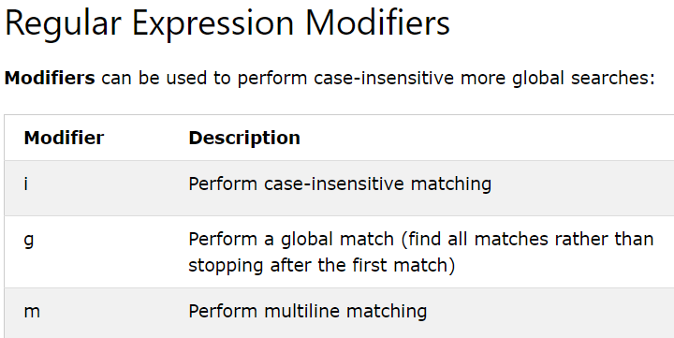
RegEx
A regular expression is a sequence of characters that forms a search pattern.
The search pattern can be used for text search and text replace operations.
Syntax = /pattern/modifiers; E.g var class = /codecenter/i;
In JavaScript, regular expressions are often used with the two string methods: search() and replace().

Slide 7
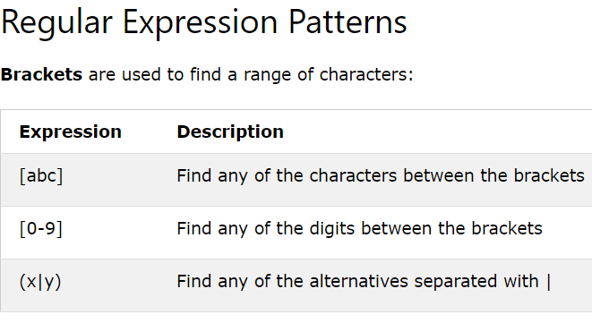
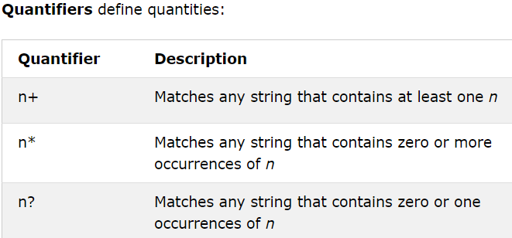
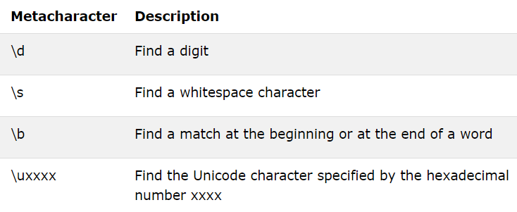

Slide 8
test() & exec()
The test() method is a RegExp expression method.
It searches a string for a pattern, and returns true or false, depending on the result.
The exec() method is a RegExp expression method.
It searches a string for a specified pattern, and returns the found text as an object.If no match is found, it returns an empty (null) object.
var pattern = /e/;
pattern.test("The best things in life are free!")
pattern.exec("The best things in life are free!")
Further Reading: https://developer.mozilla.org/en-US/docs/Web/JavaScript/Guide/Regular_Expressions

Slide 9
Errors - Throw and Try to Catch
The try statement lets you test a block of code for errors.
The catch statement lets you handle the error.
The throw statement lets you create custom errors.
The finally statement lets you execute code, after try and catch, regardless of the result.
try { Block of code to try } catch(err) { Block of code to handle errors }
The throw statement allows you to create a custom error.
throw "Too big"; // throw a text
throw 500; // throw a number

Slide 10
Scope
Scope determines the accessibility (visibility) of variables.
In JavaScript there are two types of scope:
Local scope
Global scope
Variables defined inside a function are not accessible (visible) from outside the function.
Var myName = “Dapo”
//any code here can use variable myName….myName is Global // code outside this function can NOT use carName … carName is Local
function myFunction() {
var carName = "Volvo";
// code inside this function CAN use carName
//code here can use myName.
}

Slide 11
This
The JavaScript this keyword refers to the object it belongs to.
It has different values depending on where it is used:
In a method, this refers to the owner object.
Alone, this refers to the global object.
In a function, this refers to the global object.
In a function, in strict mode, this is undefined.
In an event, this refers to the element that received the event.
Methods like call(), and apply() can refer this to any object.

Slide 12
this in a Method
var person = { firstName: "John", lastName : "Doe", id : 5566, fullName : function() { return this.firstName + " " + this.lastName; } };
In an object method, this refers to the "owner" of the method.
In the example on the top of this page, this refers to the person object.
The person object is the owner of the fullName method.

Slide 13
this in a Function (Default) & Strict Mode
In a JavaScript function, the owner of the function is the default binding for this.
So, in a function, this refers to the Global object [object Window].
function myFunction() {
return this;
}
So, when used in a function, in strict mode, this is undefined.
"use strict";
function myFunction() {
return this;
}

Slide 14
this in Event Handlers & Object Method Binding
In HTML event handlers, this refers to the HTML element that received the event
<button onclick="this.style.display='none'">
Click to Remove Me!
</button>
In object binding, this is the person object (The person object is the "owner" of the function):
var person = {
firstName : "John",
lastName : "Doe",
id : 5566,
myFunction : function() {
return this;
}
};

Slide 15
Debugging
The console.log() Method
If your browser supports debugging, you can use console.log() to display JavaScript values in the debugger window.
Setting Breakpoints
In the debugger window, you can set breakpoints in the JavaScript code.
At each breakpoint, JavaScript will stop executing, and let you examine JavaScript values. After examining values, you can resume the execution of code (typically with a play button).
The debugger Keyword
The debugger keyword stops the execution of JavaScript, and calls (if available) the debugging function.
This has the same function as setting a breakpoint in the debugger. If no debugging is available, the debugger statement has no effect.

Slide 16
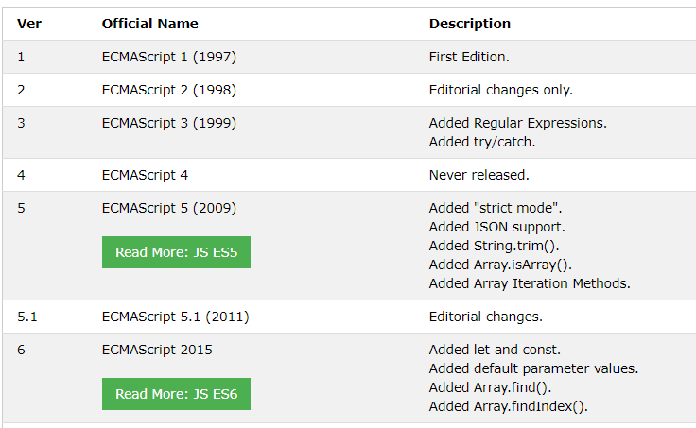
ECMAScript Versions
JavaScript was invented by Brendan Eich in 1995, and became an ECMA standard in 1997.ECMAScript is the official name of the language.From 2015 ECMAScript is named by year (ECMAScript 2015).

Slide 17
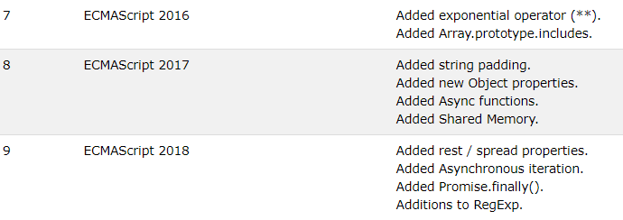

Slide 18
JSON
JSON is a format for storing and transporting data.
JSON is often used when data is sent from a server to a web page.
JSON stands for JavaScript Object Notation
JSON is a lightweight data interchange format
JSON is language independent *
JSON is "self-describing" and easy to understand
The JSON format is syntactically identical to the code for creating JavaScript objects.
You can use JavaScript built-in function JSON.parse() to convert the string into a JavaScript object
{
"employees":[
{"firstName":"John", "lastName":"Doe"},
{"firstName":"Anna", "lastName":"Smith"},
{"firstName":"Peter", "lastName":"Jones"}
]
}

Slide 19
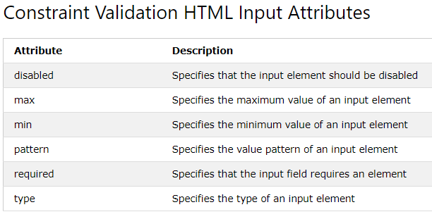
Form
HTML form validation can be done by JavaScript.
If a form field (fname) is empty, the required attribute prevents this form from being submitted

