Slide 1
Kudos Board
Cloud infrastructure
and continuous delivery
Build
Deploy
Adedokun Toluwanimi
Monitor
AltSchool Tinyuka · 3 November 2026
01
Notes:
I built a small public thank-you app for AltSchool Project 7. My focus is the delivery path: how I provisioned AWS, deployed changes and handled a failed deployment. Student ID ALT/SOE/TIN/025/0089. Sources: README.md; existing Checkpoint 1 Google Doc; docs/checkpoint3-talk.md.

Slide 2
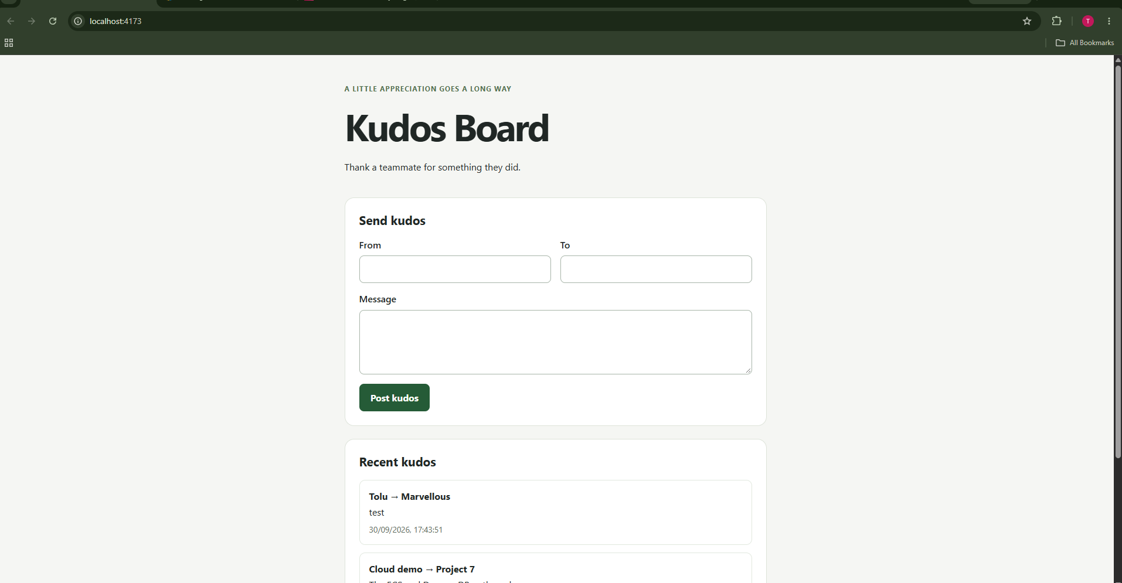
Application overview
A public recognition app
deployed on AWS
I can post a thank-you,
see the newest messages,
and reload saved posts.
My saved Checkpoint 1 frontend evidence
02
Notes:
I built a board where teammates can thank each other. My frontend submits From, To and Message. The API validates them and stores the kudos in DynamoDB. I can reload and retrieve saved posts. The screenshot is historical Checkpoint 1 evidence from a local frontend, not a currently live site. Sources: docs/evidence/01-frontend-new-kudos.png; README.md.

Slide 3
Development branches
kudos-board/frontend
My page, form and frontend assets
main
kudos-board/backend
My API and DynamoDB integration
kudos-board/testing
My automated tests and validation
Each branch keeps the full project. I use the name to keep changes focused.
03
Notes:
I created kudos-board/frontend, kudos-board/backend and kudos-board/testing from main at 13d0d49 on 3 November 2026. All three are pushed to GitHub and contain the entire project. The names identify work areas, not separate applications. They do not yet contain separate feature commits. Source: verified git branch rename and push results.

Slide 4
Change review workflow
1
2
3
4
Change
Check
Review
Merge
I work on the
relevant branch
I test and review
the diff
I open a pull
request to main
I merge the
reviewed change
PR checks and branch protection are still to be configured.
04
Notes:
My intended workflow is to make a focused change on the relevant component branch, check it locally, push it and open a pull request to main. After review, I merge it. My current workflow deploys pushes to main when Deploy is enabled. I have not added automated pull-request checks or branch protection. Source: .github/workflows/deploy.yml.

Slide 5
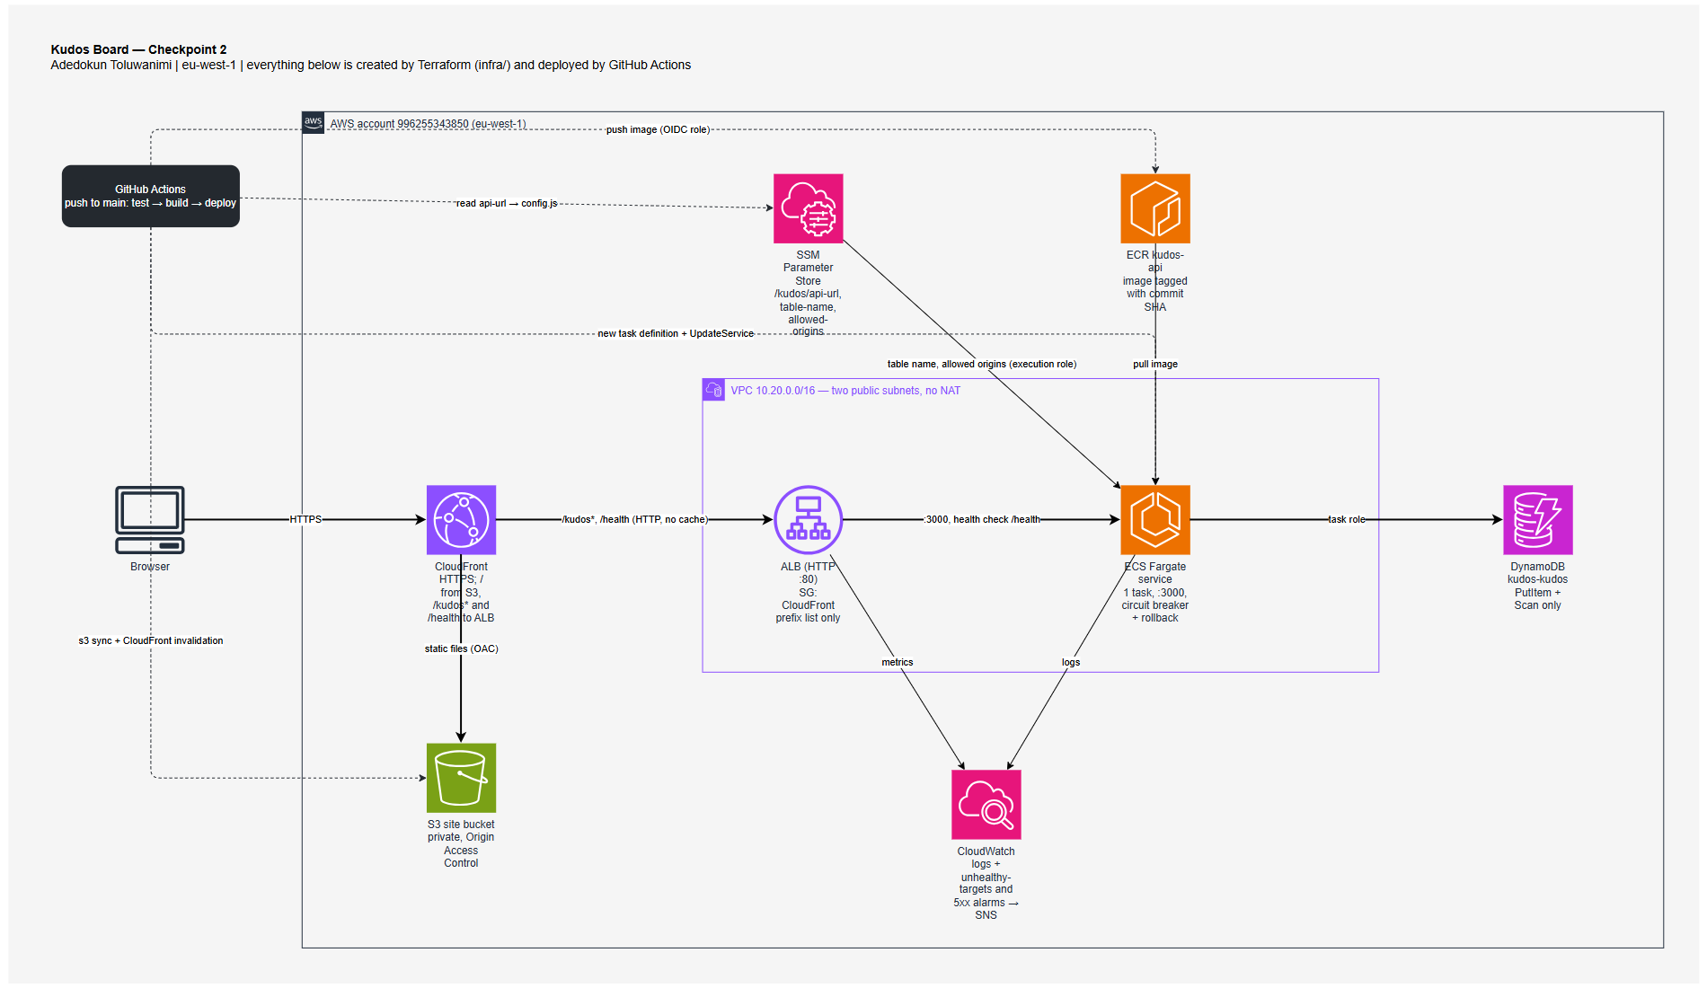
Notes:
This is my existing architecture diagram from docs/kudos-board-checkpoint2.drawio, exported without changing the source. It shows my complete Terraform and GitHub Actions design: CloudFront, private S3, ALB, ECS Fargate, DynamoDB, ECR, SSM and CloudWatch. The diagram remains labelled Checkpoint 2 because that is when I recorded this architecture. It also represents the design I restored for Checkpoint 3. The stack is currently shut down.

Slide 6
API contract
GET /health
I expose a health check for the ALB.
GET /kudos
I return the newest 50 posts.
POST /kudos
I validate and save each new message.
400 for invalid input 201 for a saved kudos
06
Notes:
My API has three routes. GET /health returns 200 and status ok. GET /kudos returns at most 50 items, newest first, after reading all DynamoDB Scan pages. POST /kudos requires nonblank from, to and message. From and to allow 50 characters each and message allows 280. I generate the ID and timestamp on the server. Valid creation returns 201 and invalid input returns 400. Sources: backend/src/app.js; backend/src/kudos-store.js; README.md.

Slide 7
CI/CD pipeline
Test
→
Backend
→
Frontend
API contract
Input validation
CORS and pagination
Docker image
ECR push
ECS deployment
SSM configuration
S3 upload
CloudFront invalidation
07
Notes:
My GitHub Actions workflow first runs npm ci and npm test. After that, it builds a Docker image, pushes the commit SHA tag to ECR, registers a task definition and waits for ECS stability. Finally it reads SSM, writes config.js, syncs the frontend to S3 and invalidates CloudFront. A failure stops later jobs. Source: .github/workflows/deploy.yml.

Slide 8
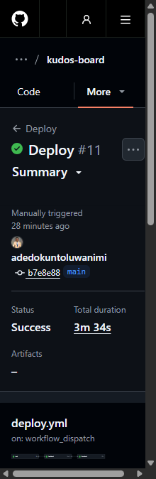
Validation and deployment evidence
My automated checks
API contract and successful posting
Invalid input returns 400
CORS response headers
DynamoDB scan pagination
I also saved a successful Deploy run from 30 October.
08
Notes:
My tests cover the API contract, valid posting and CORS, invalid input, and DynamoDB Scan pagination. I also recorded successful deployment run 41076337702 on 30 October. This saved screenshot is narrow, so I use the run link to inspect details. I do not claim that these tests prove startup works: they instantiate createApp and did not catch the wrong server listen port. Sources: backend/test/app.test.js; https://github.com/adedokuntoluwanimi/kudos-board/actions/runs/41076337702; docs/evidence/checkpoint3-deploy-run-41076337702.png.

Slide 9
Monitoring and alerting
Logs
Metrics
I read what my API wrote.
Log group: /ecs/kudos-api
I track unhealthy targets
and server errors over time.
My alarm thresholds
Unhealthy target: above 0 for 1 minute
ALB + API errors: more than 5 in 5 minutes
SNS receives my alarm and recovery notifications.
09
Notes:
I send ECS application output to /ecs/kudos-api and retain it for seven days. Logs tell me what the process wrote. Metrics give me numeric measurements over time. Alarms compare those measurements with thresholds and send state changes to SNS. Email alerts require an alarm_email value and a confirmed subscription. My unhealthy-target alarm uses Maximum UnHealthyHostCount greater than zero for one 60-second period. My error alarm triggers when combined ALB and target 5xx responses exceed five in 300 seconds. Missing data counts as not breaching. CloudWatch alerts me; ECS performs deployment rollback. Source: infra/monitoring.tf; README.md.

Slide 10
Deployment failure and recovery
8080
3000
The port I deliberately used
The port my target expected
Health checks failed. ECS rolled back.
My old healthy task kept serving requests.
10
Notes:
In Checkpoint 2 I deliberately made server.js listen on 8080 while the ALB target expected 3000. My unit tests passed because they exercised createApp. The new tasks failed health checks and the ECS circuit breaker rolled back. The old healthy task kept serving, and all 49 recorded health probes returned 200 during the observed window. My original two-minute alarm missed the brief unhealthy periods. I changed it to one minute, but a fresh ALARM screenshot is still outstanding. Sources: README.md; docs/evidence/checkpoint2-failure-probe.log; failure Actions run 38482136609; recovery run 38483865997.

Slide 11
Security, cost and ownership
Access I can explain
Costs I can control
I use OIDC and scoped IAM roles.
My S3 bucket stays private.
My historical estimate was about
$40 a month while running.
I used AI for the first app draft, then reviewed the code
and worked through the cloud deployment and failures.
11
Notes:
I use GitHub OIDC instead of stored AWS access keys. My roles are scoped to the project, the S3 site is private, and the ALB only accepts CloudFront origin-facing traffic. I used public AWS endpoints to avoid NAT gateway cost in this small demo. The repository estimate was about $40 per month always-on in eu-west-1, mainly ALB and public IPv4. This is a historical estimate, not a refreshed quote. I used AI for the first application draft and reviewed it. My write-up records the cloud engineering, pipeline, debugging and verification I owned. Sources: README.md; docs/checkpoint3-talk.md; explanation.

Slide 12
Project status and remaining work
Implementation and operational readiness
I provisioned the infrastructure, automated deployment,
and verified recovery from a failed release.
I shut the stack down after 30 October.
A fresh live demo needs restoration and verification.
12
Notes:
I completed the application, Terraform infrastructure, push-triggered deployment and the failure/recovery demonstration. On 30 October I shut down the 41-resource application stack and four-resource bootstrap stack, removed state storage and disabled Deploy. My latest screenshots show that earlier deployment, not live infrastructure today. On 3 November I created and pushed the three component branches. A future live demo needs bootstrap restoration first, then the app stack and deployment verification. I still need fresh evidence of the revised alarm firing and ECS rollback events. Sources: README.md; docs/checkpoint3-shutdown.md; Git branch push results.

