Slide 1

SPARE PARTS DEMAND FORECASTING
Weekly Demand Prediction for ACR SPARES using Machine Learning & Time Series Models

Slide 2
Problem Statement
The Challenge
Spare parts procurement is driven by gut feeling and historical averages — leading to either stockouts or excess inventory
KPCL manages hundreds of spare part SKUs across compressor models — manually forecasting demand is not scalable
Incorrect demand planning → delayed service fulfilment, increased holding costs, and dissatisfied customers
Goal Statement- Build an automated, data-driven weekly demand forecasting system for the 8 highest-priority ACR SPARES items — and deploy it as a live web application accessible to the operations team

Slide 3
Dataset Overview
Data Source & Scope
Property | Details
Source File | KPC___Despatch_Details_260924.xlsx
Business Filter | ACR SPARES model only
Item Selection | Top 8 items by order volume
Key Columns Used | OA_DATE, ITEM_CODE, QTY, MODEL, ITEM_DESCRIPTION
Total Raw Rows | ~4,769 order line records
Date Range | June 2021 → September 2024
Granularity | Aggregated to weekly level

Slide 4
The 8 Tracked Items
Priority Items under Forecast
 | Item Code | Description | Training Rows | Champion Model
1 | 082.03.110.50. | Piston KC/KCX | 1,055 | AR
2 | 082.04.030.50. | Bearing Bush Big End Con Rod KC/KCX | 1,052 | AR
3 | 082.08.000.50. | Shaft Seal Assembly KC/KCX | 973 | Prophet
4 | 336.40.401.50. | Cylinder Liner KC/KCX | 932 | AR
5 | 993.00.311.00. | Gasket Suct Strainer KC/KCX | 337 | AR
6 | 085.00.003.50. | Kirloskar Advantage Oil 20L | 243 | MA
7 | 084.19.001.50. | Gasket Set KC4 | 150 | MA
8 | 351.03.301.50. | Liner Cylinder AC70 | 27 | MA

Slide 5
Data Pipeline
From Raw Data to Weekly Series
Raw XLSX File
Column Renaming & Type Casting
Filter: MODEL = "ACR SPARES"
Select 8 Priority Items
Resample to Weekly (W) Frequency
defined by KPCL team
Train: [Jun 2021 → Dec 2023]
Train / Test Split
Fill Missing Weeks with 0
Test: [Jan 2024 → Sep 2024]

Slide 6
Feature Engineering (ML Models)
Features Created for ML Models
Feature Category | Features
Lag Features | QTY at lag 1, 2, 3, 4, 8, 12 weeks
Rolling Mean | 4-week rolling average, 12-week rolling average
Rolling Std Dev | 4-week rolling standard deviation
Temporal | Week-of-year, Month, Quarter

Slide 7
Model Competition Framework
Every Item Competes Across 3 Model Families
Classical ML
XGBoost
Random Forest
Ridge Regression
Time Series
AR (AutoRegressive)
MA (Moving Average)
ARMA
ARIMA
SARIMA
Prophet (Facebook)
Auto
Auto-SARIMA
All models evaluated on 12-week hold-out test set using RMSE (Root Mean Squared Error) Lowest RMSE = Champion Model for that item

Slide 8
Model Results (RMSE Comparison)
Champion Model Selection Results
Item | Best ML Model | Best TS Model | Champion
Piston KC/KCX | XGBoost | AR | AR
Bearing Bush | Random Forest | AR | AR
Shaft Seal Assembly | Ridge | Prophet | Prophet
Cylinder Liner | XGBoost | AR | AR
Gasket Suct Strainer | Ridge | AR | AR
Advantage Oil | XGBoost | MA | MA
Gasket Set KC4 | Ridge | MA | MA
Liner Cylinder AC70 | Random Forest | MA | MA
Time Series models outperformed ML models on most items — AutoRegressive (AR) was the most common winner, indicating strong autoregressive patterns in spare parts demand

Slide 9
MSTL Decomposition
Understanding Demand Structure with MSTL
What is MSTL?
MSTL = Multiple Seasonal-Trend decomposition using Loess
Decomposes a time series into 4 components
4 Components :
Observed — the actual weekly demand
Trend — the long-term growth or decline
Seasonal — repeating cyclic patterns (52-week period)
Residual — unexplained noise / random variation

Slide 10
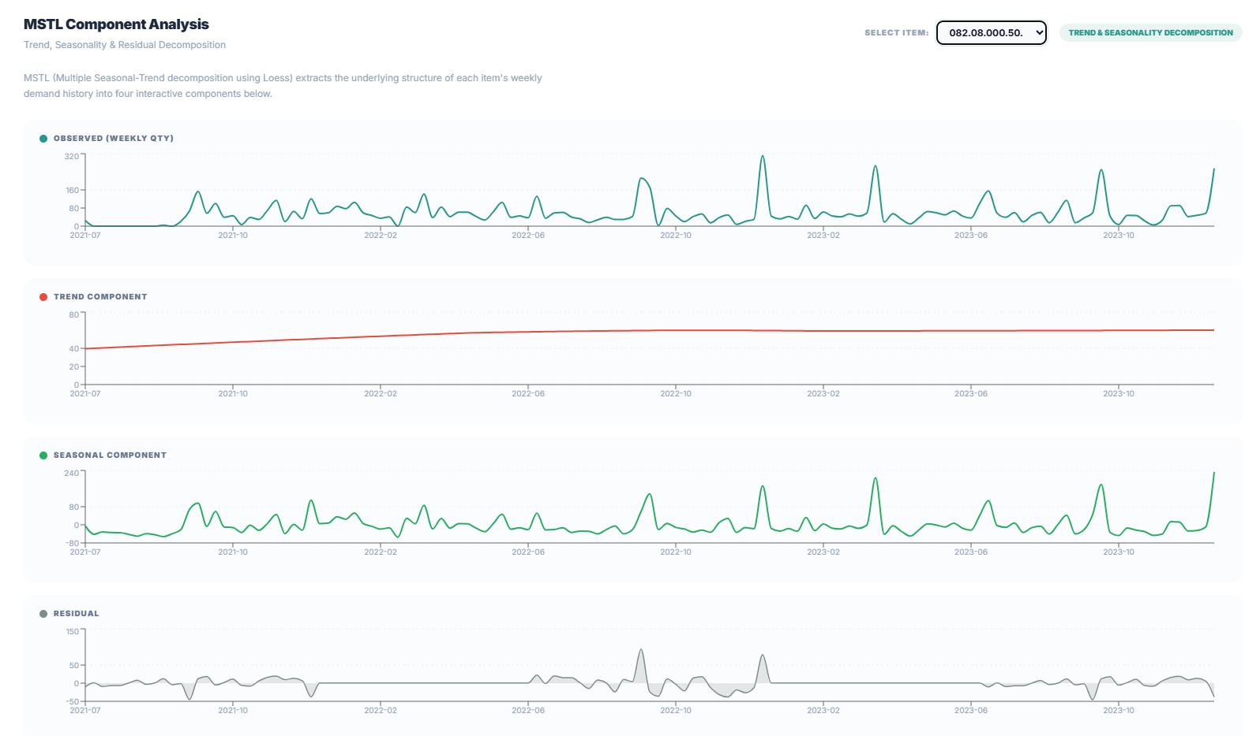
Key Finding:
Most items show a clear declining trend with seasonal spikes around mid-year likely corresponding to monsoon maintenance season

Slide 11
Web Application Overview
Live Forecasting Dashboard
4 Tabs (horizontal cards):
Home Embedded Kirloskar Analytics Dashboard — regional sales, transporter analysis, year-wise revenue & QTY trends
Analysis Interactive MSTL decomposition — select any item, see Trend + Seasonal + Residual in real time via Recharts
Forecasting Compare ML vs Time Series vs Champion model — interactive plot with confidence intervals and 12-week forecast
About Dataset documentation, methodology, champion model table, feature engineering details

Slide 12
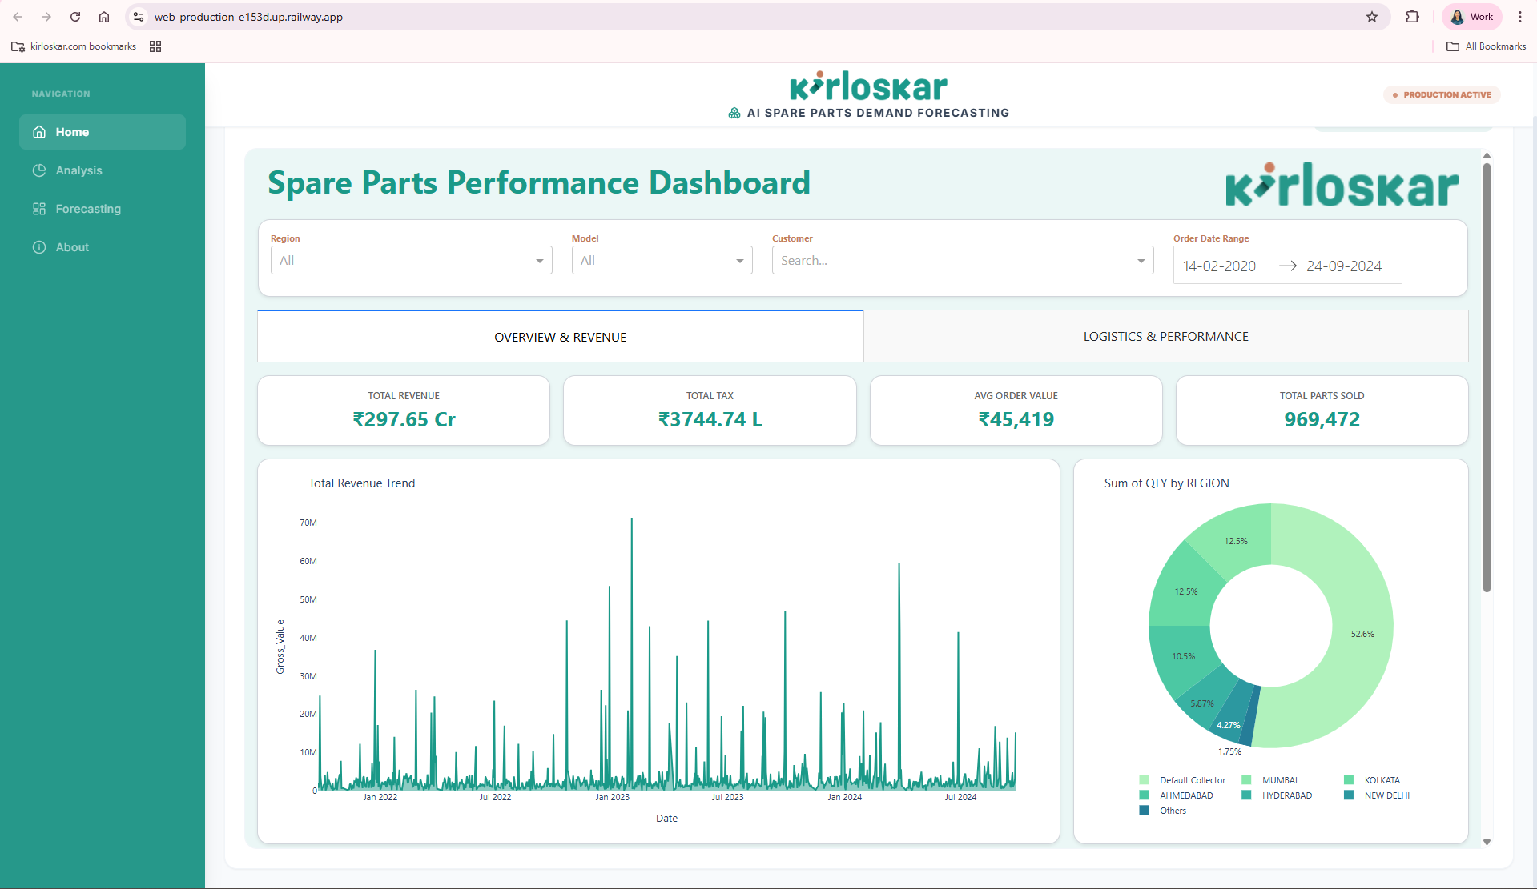
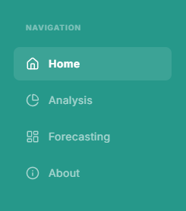

Slide 13
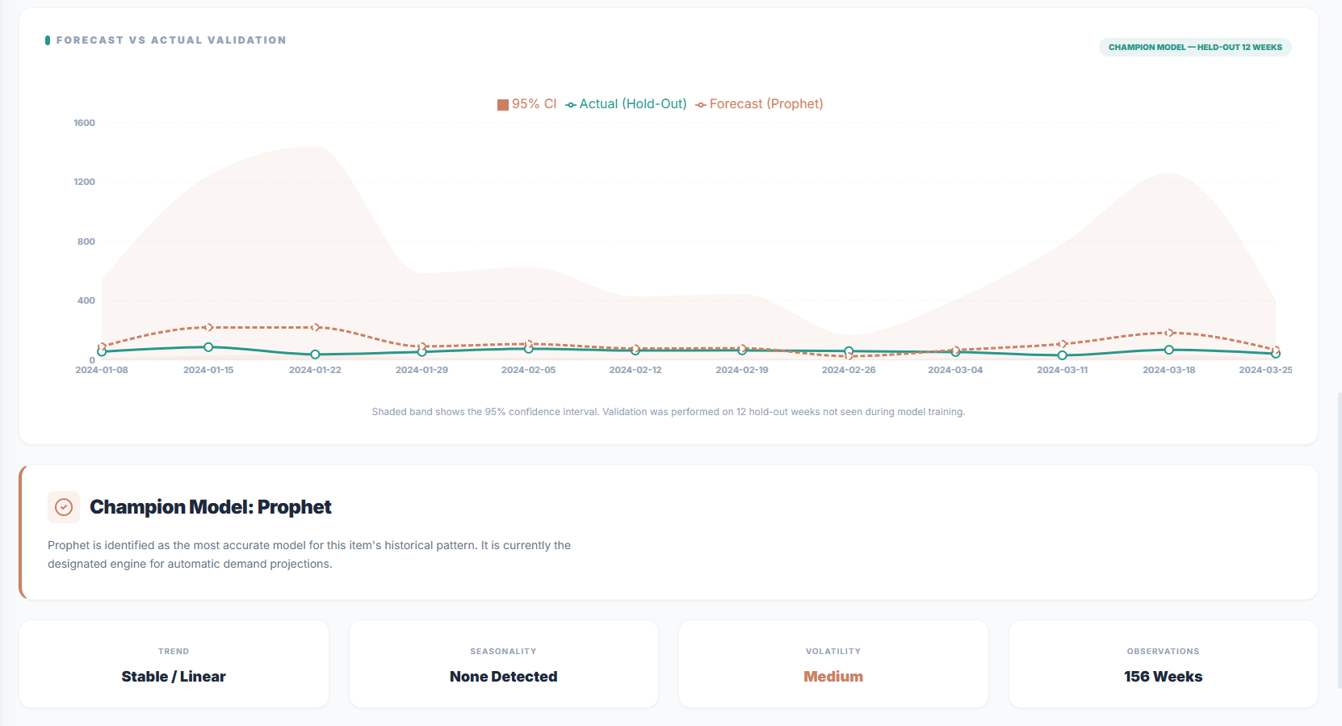
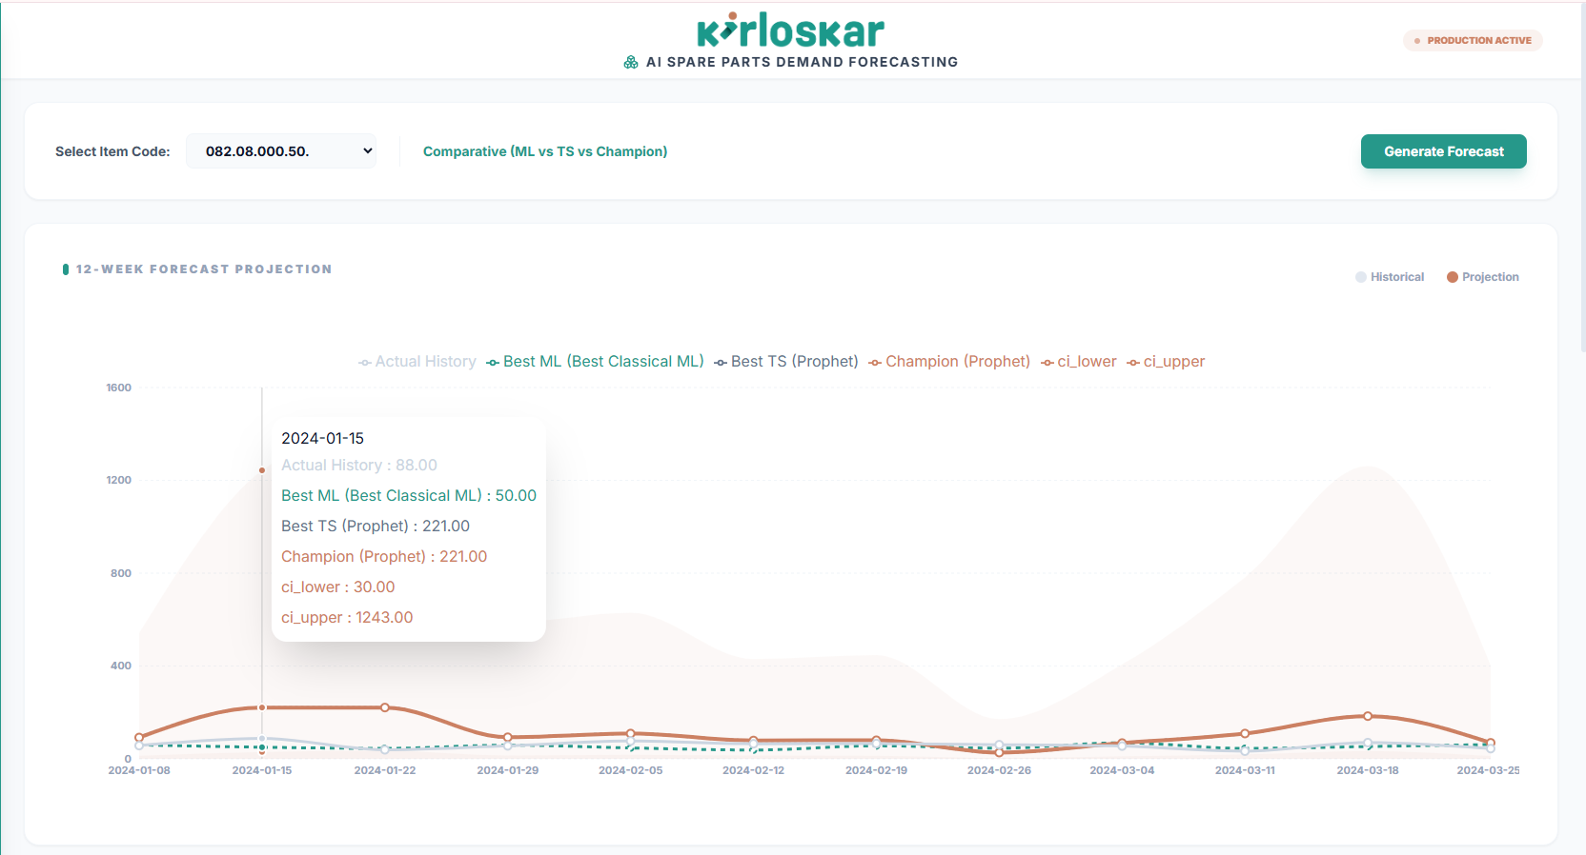

Slide 14
Technology Stack
Tech Stack
Backend:
FastAPI (REST API — Python)
Dash + Plotly (Analytics Dashboard)
statsmodels, Prophet, scikit-learn (ML/TS models)
pandas, numpy (Data processing)
Frontend:
React 18 + Vite
Recharts (Interactive charts)
Tailwind-compatible CSS
Deployment:
Railway (cloud hosting — single service monolith)
GitHub (version control + auto-deploy)

Slide 15
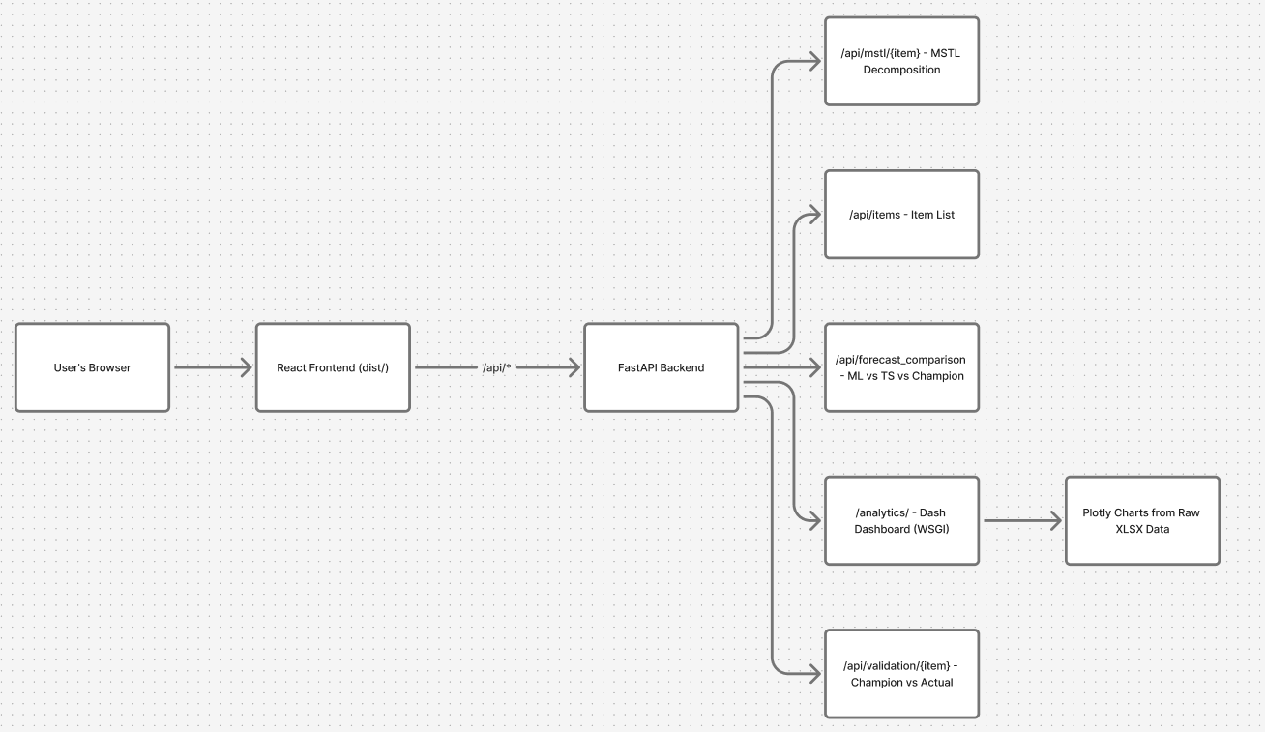
System Architecture
How It All Connects

Slide 16
Key Outputs
What the System Delivers
Output 1 — 12-Week Ahead Forecasts For each of 8 items: weekly quantity forecast with confidence intervals
Output 2 — Model Comparison Report RMSE table across all model families → identifies best model per item
Output 3 — Demand Decomposition MSTL analysis reveals hidden trends and seasonal cycles
Output 4 — Live Web App Operations team can access forecasts anytime, anywhere via the web: web-production-4bd43.up.railway.app

Slide 17
Key Findings
Insights from the Data
Demand is autoregressive — last week's demand is the strongest predictor of next week's demand (AR wins on 5/8 items)
Seasonal peaks exist — MSTL shows recurring spikes, suggesting maintenance scheduling patterns
Trend is declining for most high-volume items — potential saturation of existing installed base
Prophet excels on irregular patterns — outperforms on Shaft Seal Assembly which has sporadic bulk orders
ML models underperform on sparse items (< 300 rows) — insufficient data for lag features to be meaningful; simple MA wins

Slide 18
Challenges & Solutions
Technical Challenges Faced
Challenge | Solution
Sparse time series (27 rows for one item) | Adaptive MSTL period selection; fallback to smaller period
Missing weeks causing decomposition failure | Zero-fill reindex before MSTL
Serving Dash + React + FastAPI from one host | FastAPI WSGIMiddleware + StaticFiles mount
Cross-origin iframe issue in local dev | Vite proxy routes /analytics/ → Dash port 8050
Render ignoring Python version → builds fail | Added .python-version + runtime.txt pinning Python 3.11.9

Slide 19
Conclusion & Future Work
Summary & Next Steps
What was achieved
End-to-end ML + Time Series forecasting pipeline for 8 SKUs
Automated Champion model selection by RMSE
Live interactive web dashboard deployed on Railway
MSTL demand decomposition for strategic planning
Future Enhancements
Add more items (scale to full catalogue)
Incorporate external signals (seasons, holidays, rainfall patterns)
Real-time data sync from ERP/SAP system
Automated retraining when new data arrives
Email/WhatsApp alerts when forecast deviates significantly from plan

Slide 20
THANKYOU!!!
Live App: https://demand-forecasting-for-spare-parts.vercel.app/
GitHub: github.com/adeebanoorr/Demand-Forecasting-for-spare-parts

