Slide 1
Chatbot Backend

Slide 2
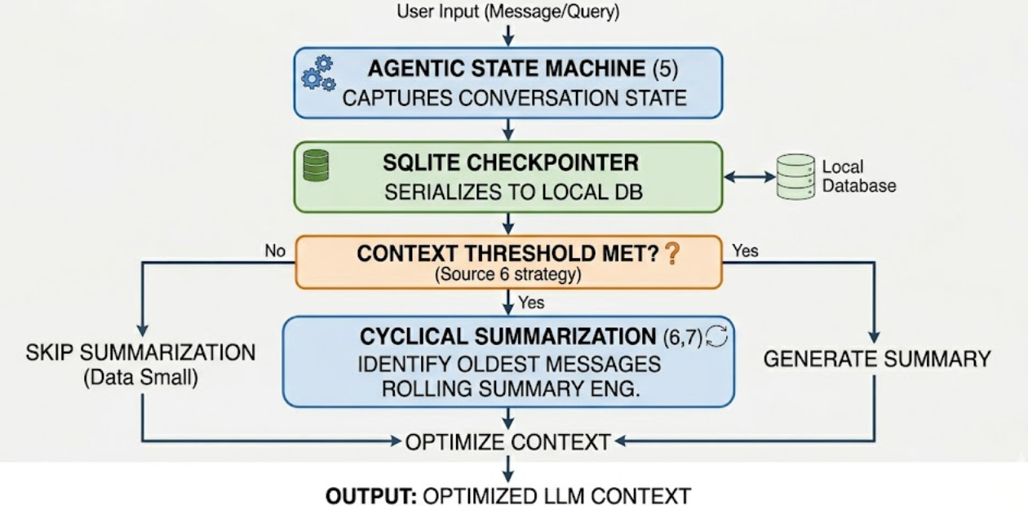
1. Context Management & Persistent Memory
How the system maintains state and optimizes the LLM context window.
Technical Explanation:
The system utilizes an Agentic State Machine to manage conversation history. It implements a Stateful SQLite Checkpointer that serializes the conversation state (messages, filters, and metadata) to a local database.
To handle the "Context Window" limit, we use a Cyclical Summarization & Trimming strategy. This process automatically identifies the oldest messages in the stack once a threshold is met, passes them through a rolling summarization engine, and replaces them with a single dense summary.
Simple Explanation:
Think of this as the bot's "Digital Notebook." It saves every conversation to a high-speed file, so it never forgets what you said yesterday. When the notebook gets too full, the bot summarizes the first few pages into one short paragraph and tears out the old pages to stay fast and focused, while still "remembering" the important details.
Notes:
ASM- is the structural "brain" of your chatbot. It is the framework that allows the AI to move through different steps of a task, making decisions at each stage until it arrives at the final answer.

Slide 3
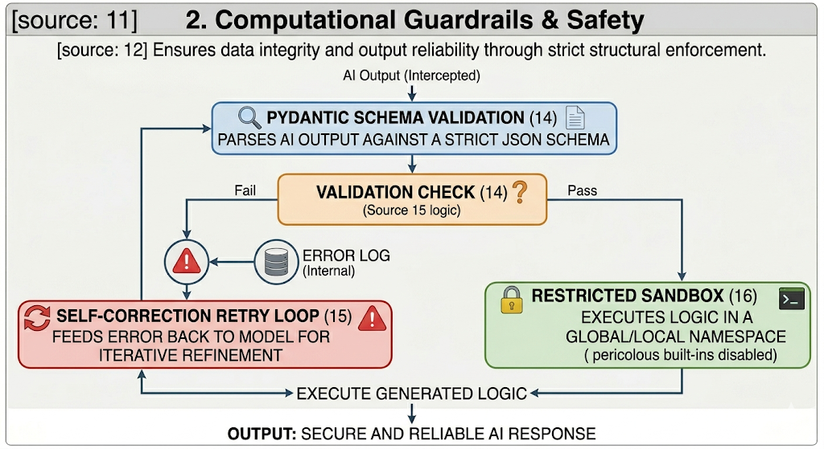
2. Computational Guardrails & Safety
Ensuring data integrity and output reliability through structural enforcement.
Technical Explanation:
Safety is enforced through Strict Pydantic Schema Validation and Runtime Sandboxing. Every output from the AI is intercepted and parsed against a rigid JSON schema. If the output fails validation (hallucinations or formatting errors), the system triggers a Self-Correction Retry Loop, feeding the error back to the model for iterative refinement.
Furthermore, the execution of generated logic occurs in a Restricted Global/Local Namespace, where dangerous system-level built-ins are explicitly disabled to prevent unauthorized system access or data mutation.
Simple Explanation:
This is the bot’s "Safety Inspector." Before the bot gives you an answer, the inspector checks if it followed the rules. If the bot made a mistake or used the wrong format, the inspector tells it to try again until it's perfect. Plus, we put the bot in a "Digital Cage" (Sandbox) where it can look at your data but can't touch or delete important system files.

Slide 4
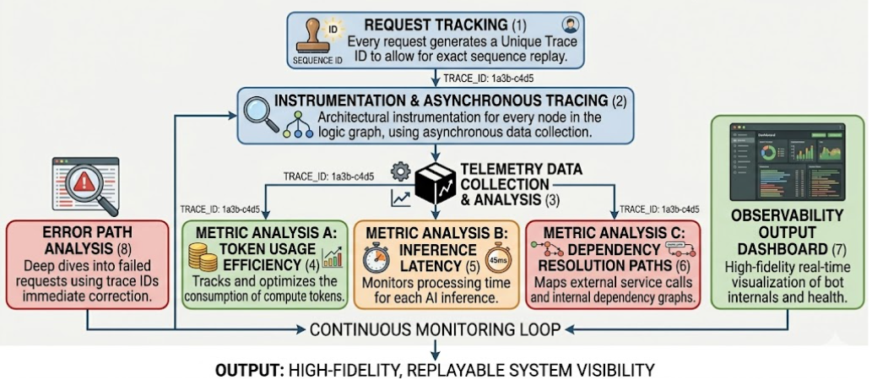
3. System Observability
Monitoring the internal decision-making process and performance metrics.
Technical Explanation:
The architecture is fully instrumented for End-to-End Telemetry. This includes Asynchronous Tracing of every node in the logic graph. We track granular metrics such as Token Usage Efficiency, Inference Latency, and Dependency Resolution paths.
Every request generates a unique Trace ID, allowing us to replay the exact sequence of logic, from the initial question parsing to the final data rendering, for debugging and performance auditing.
Simple Explanation:
This is like a "Flight Data Recorder" (Black Box) for the bot. It records every thought and action the bot takes. If something goes wrong, we can look back at the recording to see exactly what the bot was thinking, how much "brain power" (Tokens) it used, and how long it took to find the answer.

Slide 5
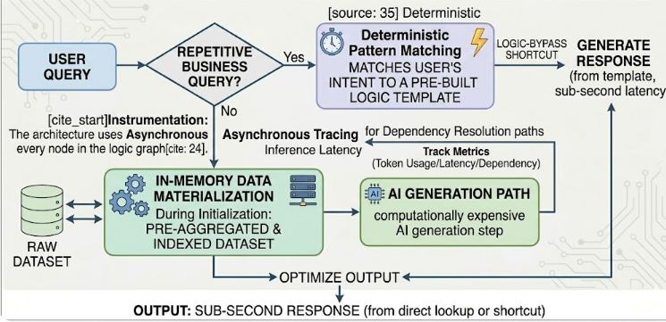
4. Data Aggregation & Logic Caching
Maximizing performance through pre-computation and pattern matching.
Technical Explanation:
To achieve sub-second response times, the system employs In-Memory Data Materialization. During the initialization phase, the raw dataset is pre-aggregated and indexed into High-Speed Hash Maps (Dictionaries) with O(1) lookup complexity.
Additionally, we use Deterministic Pattern Matching as a logic-bypass layer. For highly repetitive business queries, the system matches the user's intent to a pre-built logic template, bypassing the computationally expensive AI generation step entirely.
Simple Explanation: To make the bot lightning fast, we use "Smart Shortcuts." Instead of reading the whole data file every time, the bot sorts everything into organized folders (Indexes) when it starts up. If you ask a common question that it already knows how to answer, it skips the "Thinking" phase and goes straight to the answer, making it feel instant.

