Slide 1


Slide 2
Topics
01
Introduction of ARP
02
ARP Header
Presenter : Muhammad Usama Raheem
03
Types of ARP
Presenter : Muhammad Asad Ullah
04
Steps involve in ARP Process
Presenter : Adeeb Hassan
Presenter : Usman Fareed (bsf2003595)

Slide 3
ARP (Address Resolution Protocol)
Group Member:
Muhammad Usman Fareed : bsf2003595
Muhammad Usama Raheem : bsf2003584
Muhammad Aqib Sultan : bsf2003758
Muhammad Asad Ullah : bsf2003431
Adeeb Hassan : bsf2003459

Slide 5
Introduction of ARP:
ARP (Address Resolution Protocol) is a protocol that allows devices on a network to discover the physical address of a device based on its IP address. ARP operates at the data link layer (Layer 2) of the OSI model, which is responsible for the transmission of data across a physical network. ARP protocol is used in both IPv4 and IPv6 networks.

Slide 6
what is Arp in networking ?
ARP (Address Resolution Protocol) is a protocol used in computer networking to map a network address (such as an IP address) to a physical address (such as a MAC address).
When a device on a network wants to communicate with another device, it needs to know the physical address (MAC address) of the recipient. ARP allows the device to send a broadcast message to the network asking "Who has this IP address?" The device with that IP address responds with its MAC address, and the requesting device can then use that MAC address to send the message.

Slide 7
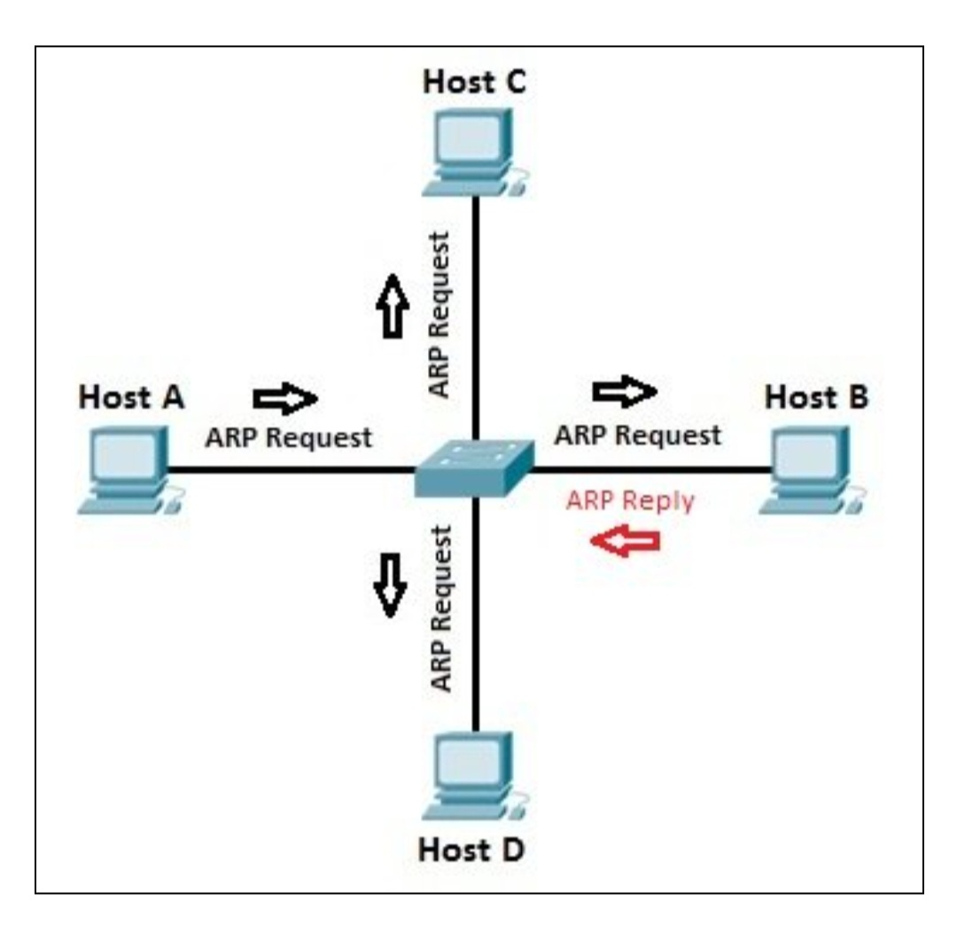
Main types of ARP messages:
ARP Request and ARP Reply: When a device needs to find the MAC address associated with an IP address, it sends an ARP Request message to the network. The device with the matching IP address will respond with an ARP Reply message that contains its MAC address.

Slide 8
Well come
Muhammad Usama Raheem : bsf2003584

Slide 9
ARP Header
Why It Is Important To Understand ARP Header?
Understanding the header of ARP is important for understanding how devices on a network communicate with each other using their MAC and IP addresses.

Slide 10
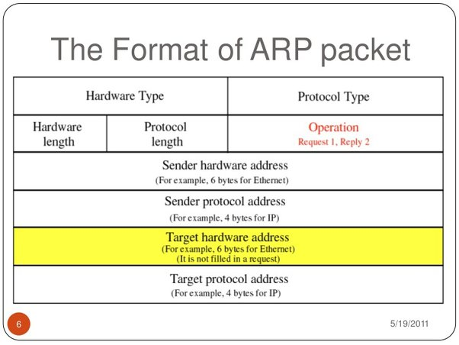
Format/Header Of ARP

Slide 11
The Header Consists of Several Fields That are Used to Identify the Sender and Target Devices, The type of Message being Sent, and the Protocol being Used. The Fields in the ARP Header Include:
Hardware type:
This field specifies the type of hardware being used, such as Ethernet or Token Ring.
Protocol type:
This field specifies the type of protocol being used, such as IPv4 or IPv6.
Hardware address length:
This field specifies the length of the hardware (MAC) address in bytes.
Protocol address length:
This field specifies the length of the IP address in bytes.

Slide 12
Operation code:
This field specifies the type of ARP message being sent, such as request or response.
Sender hardware address:
This field contains the MAC address of the device sending the message.
Sender protocol address:
This field contains the IP address of the device sending the message.
Target hardware address:
This field contains the MAC address of the device the message is intended for.
Target protocol address:
This field contains the IP address of the device the message is intended for.

Slide 13
Well come
Muhammad Asad Ullah : bsf2003431

Slide 14
Types of ARP
ARP Request: This type of ARP message is broadcasted by a device when it needs to know the MAC address of a specific IP address. The message is sent to all devices on the network, and the device with the matching IP address responds with its MAC address.
ARP Reply: This type of ARP message is sent by a device in response to an ARP request. It contains the MAC address that matches the requested IP address.
Gratuitous ARP: This type of ARP message is sent by a device to announce its own IP address and MAC address to the network, without being prompted by an ARP request. This is useful for updating the ARP cache of other devices on the network.

Slide 15
Proxy ARP: This type of ARP message is sent by a device on behalf of another device. For example, if Device A needs to communicate with Device B but doesn't know its MAC address, it can send a proxy ARP message to a router or other intermediary device, which will then respond with the MAC address of Device B.
Reverse ARP (RARP): This protocol is used to map a MAC address to an IP address. It is less commonly used today, as DHCP (Dynamic Host Configuration Protocol) has largely replaced it.

Slide 16
Steps involve in ARP Process
Adeeb Hassan: bsf2003459

Slide 17
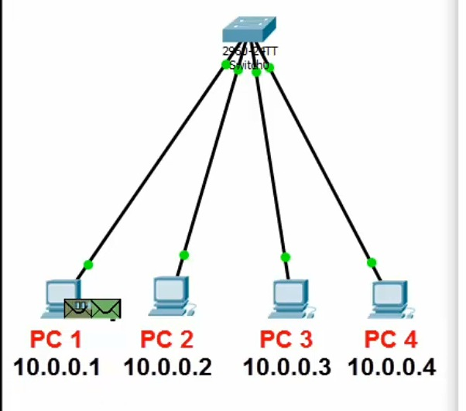
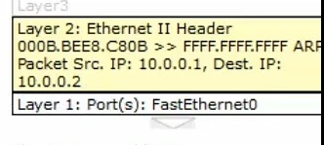
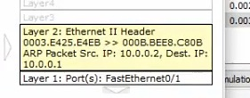

Slide 18
Steps involve in ARP
The sender knows the IP address of the target.
IP asks ARP to create an ARP request message, filling in the sender physical address, the sender IP address, and the target IP address. The target physical address field is filled with 1s
Mac address is represented as sequence of six pairs of Hexadecimal digits “FF:FF:FF:FF:FF:FF”.
The message is passed to the data link layer where it is encapsulated in a frame using the physical address of the sender as the source address and the physical broadcast address as the destination address.

Slide 19
When a network device receives an ARP request, it will check if it knows the MAC address of the requested IP address. If it does, it will send a reply with its MAC address. If it doesn't know the MAC address, it will forward the ARP request to all devices on the network, in order to see if any of them know the MAC address.
The target machine replies with an ARP reply message that contains its physical address. The message is unicast.
The sender receives the reply message. It now knows the physical address of the target machine.
The IP datagram, which carries data for the target machine, is now encapsulated in a frame and is unicast to the destination.

