Slide 1
Hospital Management System
Presented by:
Adeeb Hassan
Bsf2003459
Presented to:
Imran Abbas Kazmi (Assistant Prof. , University of Education)

Slide 2
Problem Statement:
System models the working of hospital having hospital staff and wards. Hospital staff is divided into teams of doctors , Lab technician and receptionists. Doctors may be senior or junior. Each senior doctor must leads one or more teams. Each ward is for many patients and one bed is for one patient at a time in ward. A patient can be treated by many doctors and also one doctor can treat more than one patients. Receptionist see user registration and lab technicians are responsible for testing, generating reports of samples.
.

Slide 3
Objects in Problem Statement:
Hospital
Hospital Staff
Senior Doctor
Junior Doctor
Lab Technician
Receptionist
Ward
Patient
Report

Slide 4
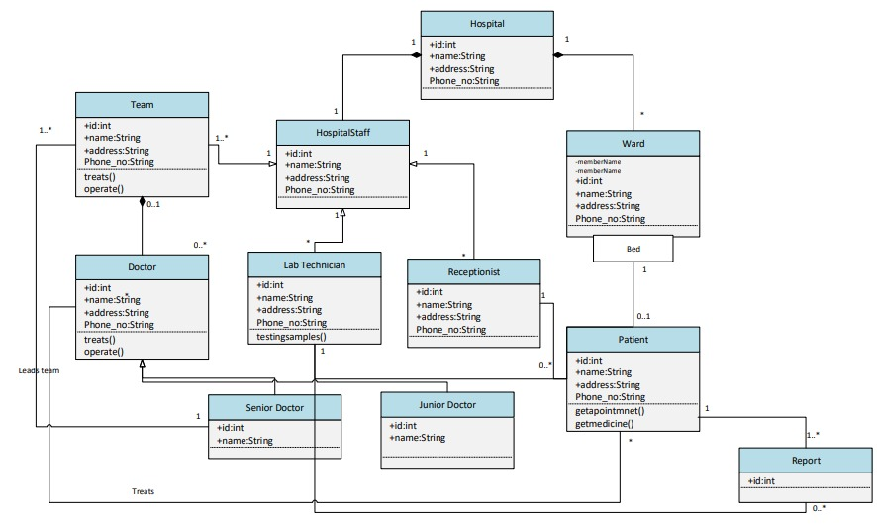

Slide 5





Symbols
Association
Inheritance
Dependency
Aggregation
Composition

Slide 6
Requirements
Functional Requirements:
FR1:System must be able to handle patient registration.
FR2:System must be able to handle patient treatment.
FR3:System must be able to handle Bill Payments.

Slide 7
Non-functional Requirements:
Maintainability
Usability
Performance
Security
Availability

Slide 8
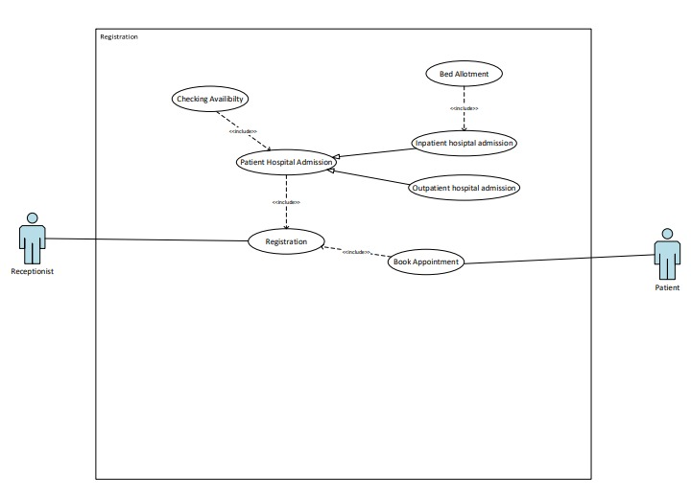
UC1

Slide 9
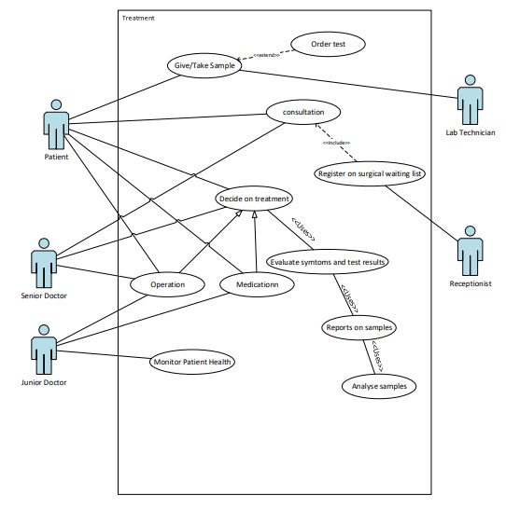
UC2

Slide 10
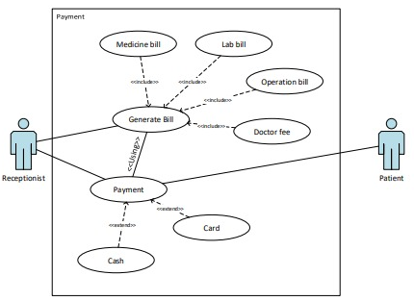
UC3
Usecase:

Slide 11
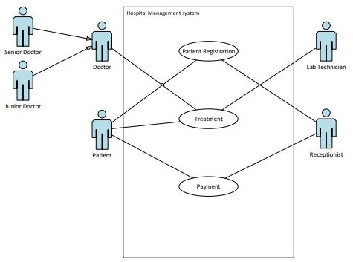
Complete Use Case:

Slide 12
STATE TRANSITION DIAGRAM

Slide 13
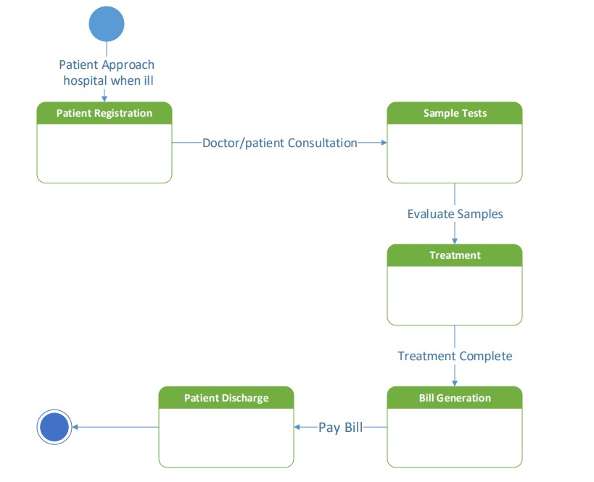

Slide 14
Data Flow Diagram
Levels:
Context level
zero level
Level 1st
Level 2nd …

Slide 15
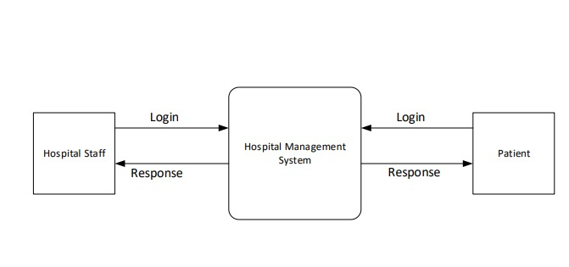
Context Level:

Slide 16
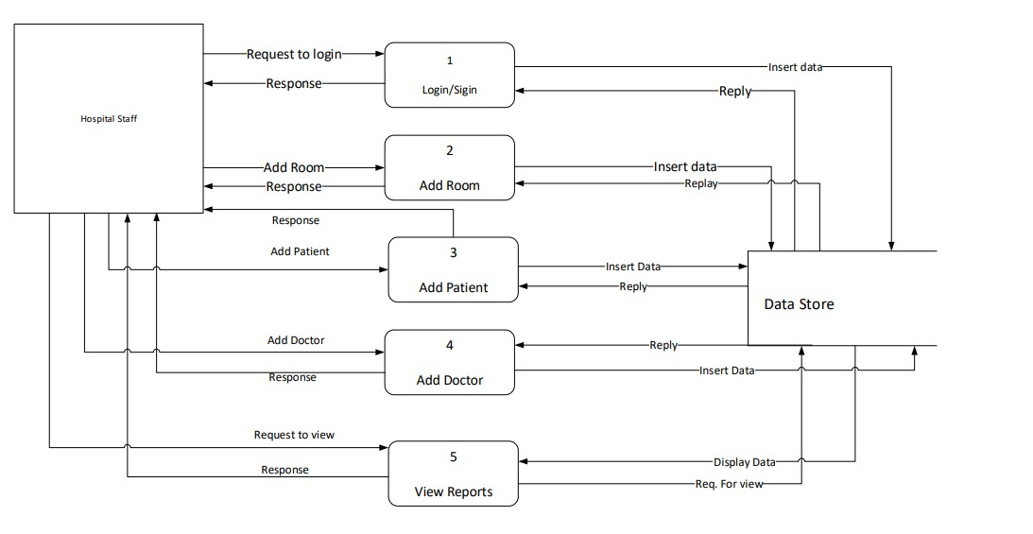
Level zero

Slide 17
THANK YOU…
Any Question?

Slide 18
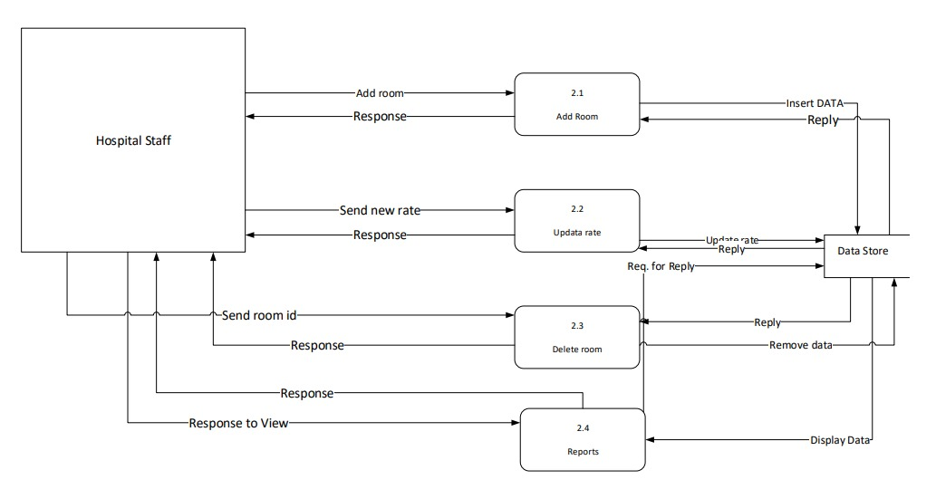
Level one:

