Slide 1
RTNS News, Registration and Management Portal

Slide 2
Group Members
Adeeb Hassan (20-UE-05014)
Aqib Sultan (20-UE-05364)
Supervisor
Ma'am Farrah Aslam
RTNS NEWS, REGISTRATION AND MANAGEMENT PORTAL

Slide 3
Outline
Problem Statement
Introduction
Objectives
Product Functions
Methodology
Implementation
Architecture Diagram
Tools and Techniques
Conclusion
RTNS NEWS, REGISTRATION AND MANAGEMENT PORTAL

Slide 4
Problem Statement
In the realm of natural sciences, staying informed about the latest trends, discoveries, and research is a perpetual challenge. Current platforms offer a fragmented experience, leaving researchers, students, and science enthusiasts endlessly searching across a disorganized digital landscape. Valuable time is squandered, and the joy of exploration is stifled as users struggle to piece together scattered information from various sources. This situation hampers the quest for knowledge and collaboration within the scientific community. The need for a unified, user-friendly, and efficient platform to bridge this information gap in the field of natural sciences is evident. This project, the RTNS (Recent Trends in Natural Sciences) Portal, is precisely the solution to this problem. We aim to revolutionize the way individuals access and engage with scientific knowledge, making it easily accessible and enjoyable for all.
RTNS NEWS, REGISTRATION AND MANAGEMENT PORTAL

Slide 5
Introduction
In this vast world of always-changing knowledge, keeping up can sometimes seem really hard. But our goal is to make this journey not just doable, but also exciting. That's why we're introducing our RTNS (Recent Trends in Natural Sciences) project—it's like a digital doorway to the interesting world of scientific discovery. Plus, we'll make the search for knowledge more easy and in less time. At RTNS, our goal is simple: to create a platform that allows you to easily discover research. Our brand and features are designed to make this possible. You can easily register and your content is safe and secure. Finding the latest information is easy with a user-friendly interface, responsive design, and quick search features. Our powerful news website keeps you up to date while managing events and reminders so you don't miss anything. Easily share findings on social media; Your feedback will influence the continued development of the portal.
RTNS NEWS, REGISTRATION AND MANAGEMENT PORTAL

Slide 6
Objectives
User-Friendly Registration System.
Secure Authentication Mechanism.
Intuitive User Interface with responsive and compatible design.
Events Enrollment
Quick Search Functionality.
Efficient Content and User Management for Administrators
Event Stakeholder Engagement
Live Streaming of Events
Notification System for Updates
Social Media Sharing Integration
Continuous Improvement via Feedback Mechanism
RTNS NEWS, REGISTRATION AND MANAGEMENT PORTAL

Slide 7
Product Functions
User Registration: Users can create accounts to access the portal's features.
User Authentication: Ensures secure user access to the platform.
Intuitive User Interface: Provides a user-friendly, responsive design for easy navigation.
Quick Content Search: Enables users to efficiently search for specific topics or articles.
Event Management: Event Organizers(Faculty) can create and manage science-related events.
Event Enrollment: Users can register for events of interest.
Event Reminders and Notifications: Sends event updates and reminders to users
CAPSTONE PROJECT TOPIC

Slide 8
Methodology
Agile methodology drives RTNS Portal development through iterative sprints, focusing on key functionalities:
User-Friendly Registration: Sprint-based improvements in account creation, profile setup, and verification processes ensure a seamless user experience.
Secure Authentication: Sprints devoted to enhancing login, password recovery, and implementing two-factor authentication for heightened security.
Event Enrollment: Sprint iterations concentrate on refining event registration methods and integrating payment options.
Quick Search Functionality: Incremental enhancements in search algorithms, usability, and relevance in each sprint.
Article Submission and Approval: Structured sprints to develop submission systems, article review processes, and user notifications for approval status.
Event Creation and Management: Iterative improvements in creating and managing events based on feedback from organizers and attendees.
RTNS NEWS, REGISTRATION AND MANAGEMENT PORTAL

Slide 9



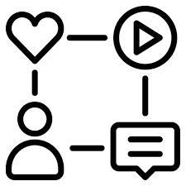





Methodology
Search and Filtering
Functionality
User Registration
and authentication
Social Media
Integration
Content Management System
User Profile and
Event Management
User Feedback
Mechanism
Stakeholders
Notification System
Content Moderation System
RTNS NEWS, REGISTRATION AND MANAGEMENT PORTAL

Slide 10
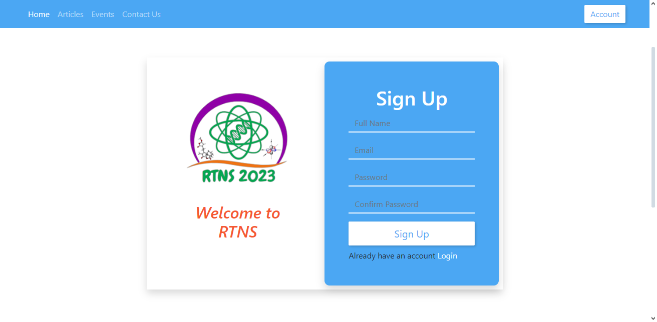
Implementation
  User Registration
RTNS NEWS, REGISTRATION AND MANAGEMENT PORTAL

Slide 11
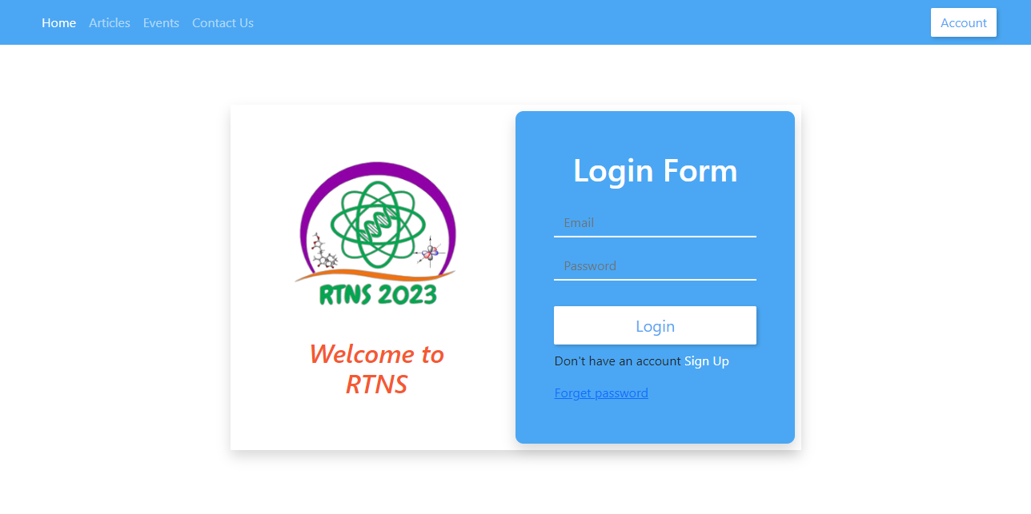
Implementation
  Login
RTNS NEWS, REGISTRATION AND MANAGEMENT PORTAL

Slide 12
Implementation
  User Profile Management
RTNS NEWS, REGISTRATION AND MANAGEMENT PORTAL

Slide 13
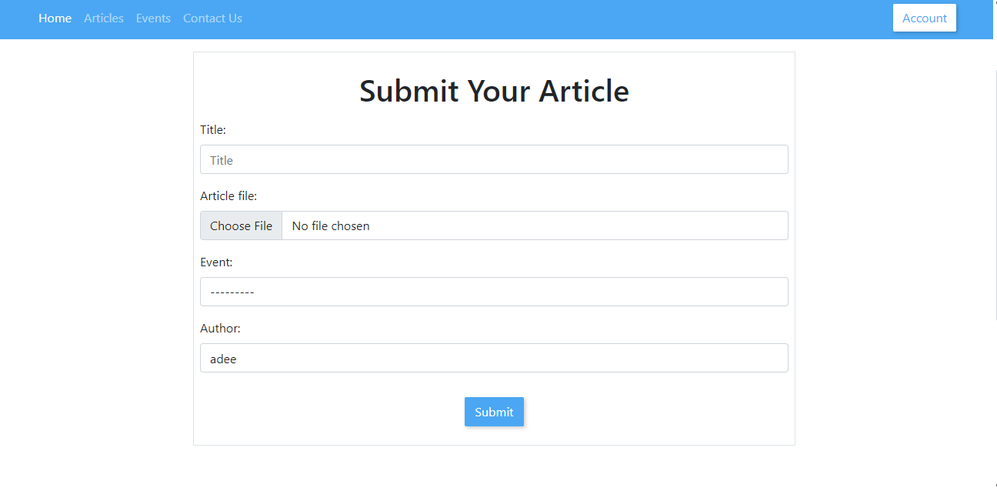
Implementation
  Article Submission
RTNS NEWS, REGISTRATION AND MANAGEMENT PORTAL

Slide 14
Implementation
  Article Approval
RTNS NEWS, REGISTRATION AND MANAGEMENT PORTAL

Slide 15
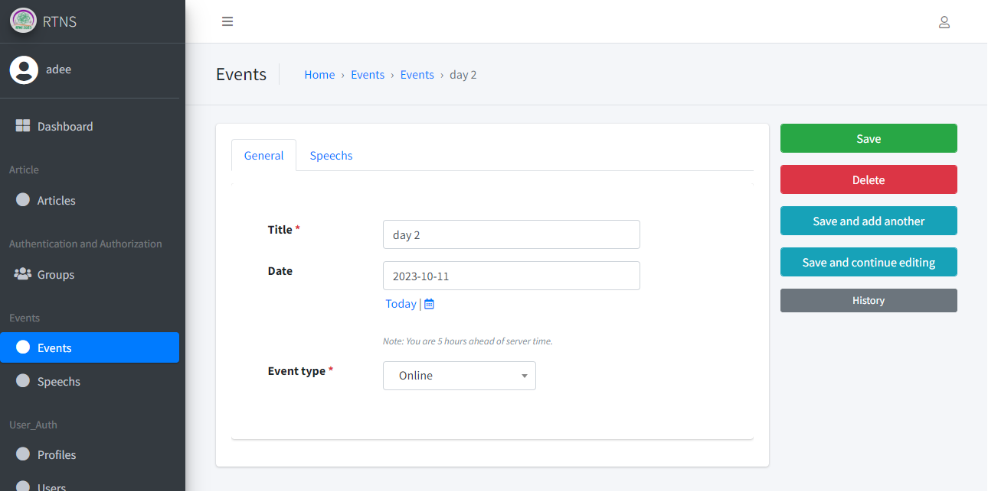
Implementation
  Event Creation and Management
RTNS NEWS, REGISTRATION AND MANAGEMENT PORTAL

Slide 16
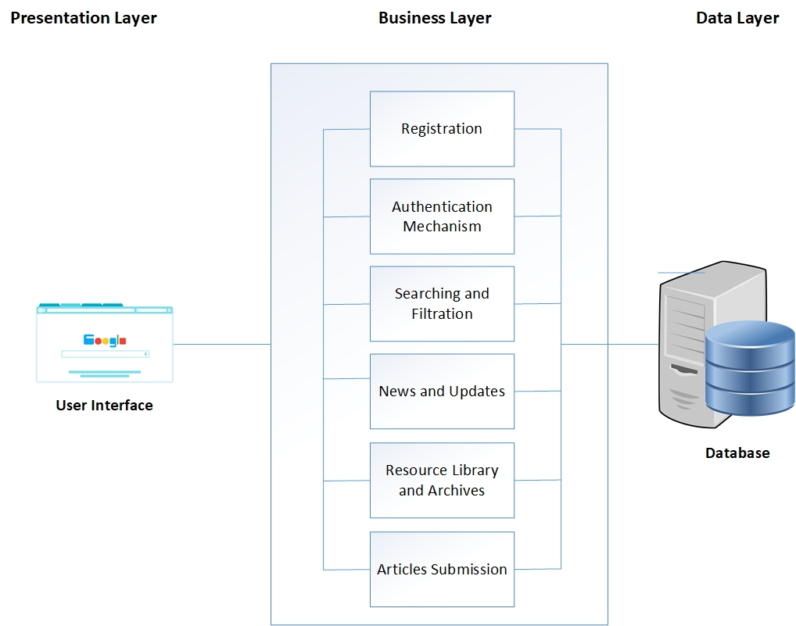
Architecture Diagram
CAPSTONE PROJECT TOPIC

Slide 17
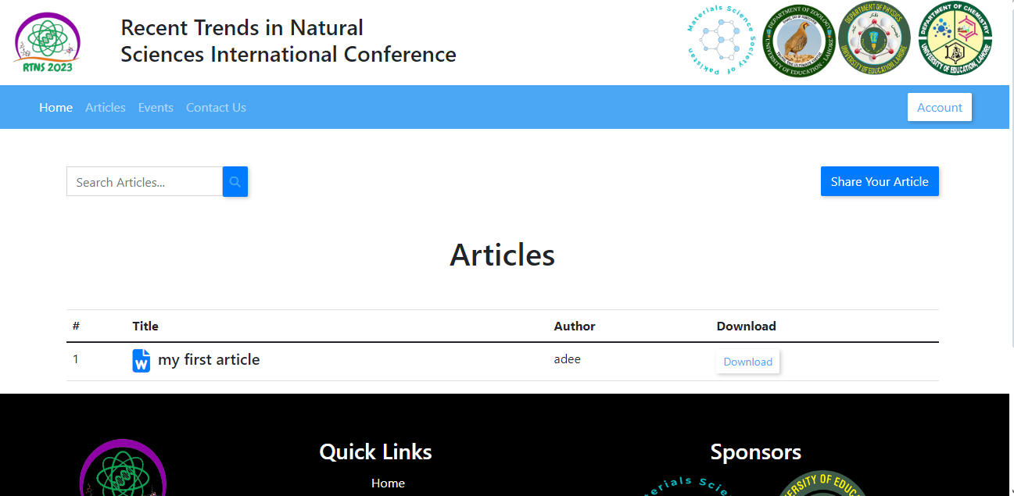
Implementation
  Content Search
RTNS NEWS, REGISTRATION AND MANAGEMENT PORTAL

Slide 18
Tools and Techniques
  Following tools and technologies will be used:
    Front-end: HTML, CSS, Bootstrap, JavaScript
    Back-end: Python(Django),JavaScript
    Designing Tools: Microsoft Visio, Figma, Adobe illustrator
    Development Tools: Visual Studio Code
    Database: MySQL
RTNS NEWS, REGISTRATION AND MANAGEMENT PORTAL

Slide 19
Conclusion
With lots of careful planning and hard work, we‘ll made a website about the cool stuff happening in science. It's like a super-easy way for scientists and people who love science to learn new things without any trouble.
RTNS NEWS, REGISTRATION AND MANAGEMENT PORTAL

