Slide 1
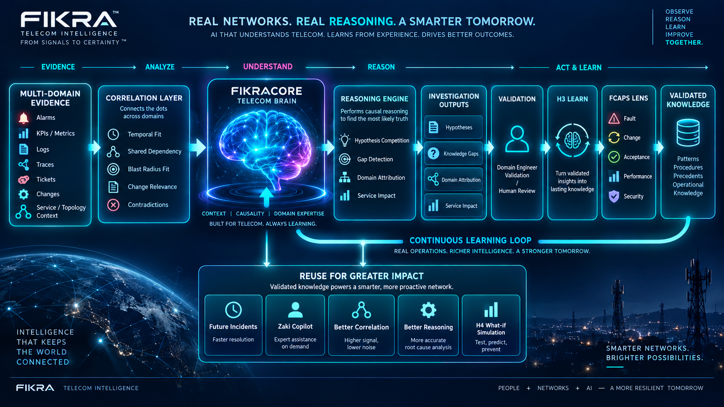
FikraCore
Telecom Intelligence for the Dark NOC
From operational evidence to explainable decisions, validated learning and reusable telecom knowledge.
EXECUTIVE PITCH
DARK NOC
TELECOM BRAIN
FikraCore
Correlation • Reasoning • Knowledge • Learning

Slide 2
The operational problem is not lack of data
WHY FIKRACORE
It is the gap between signals and a trustworthy operational decision.
01
02
03
Too many signals
Context is fragmented
Decisions need proof
Alarms, KPIs, logs, traces, changes and customer impact arrive from different systems.
The meaningful relationship across domains, services and dependencies is difficult to reconstruct.
Operations needs evidence-backed hypotheses, not the first or loudest alarm.
FikraCore creates an evidence-backed operational context before the investigation converges.

Slide 3
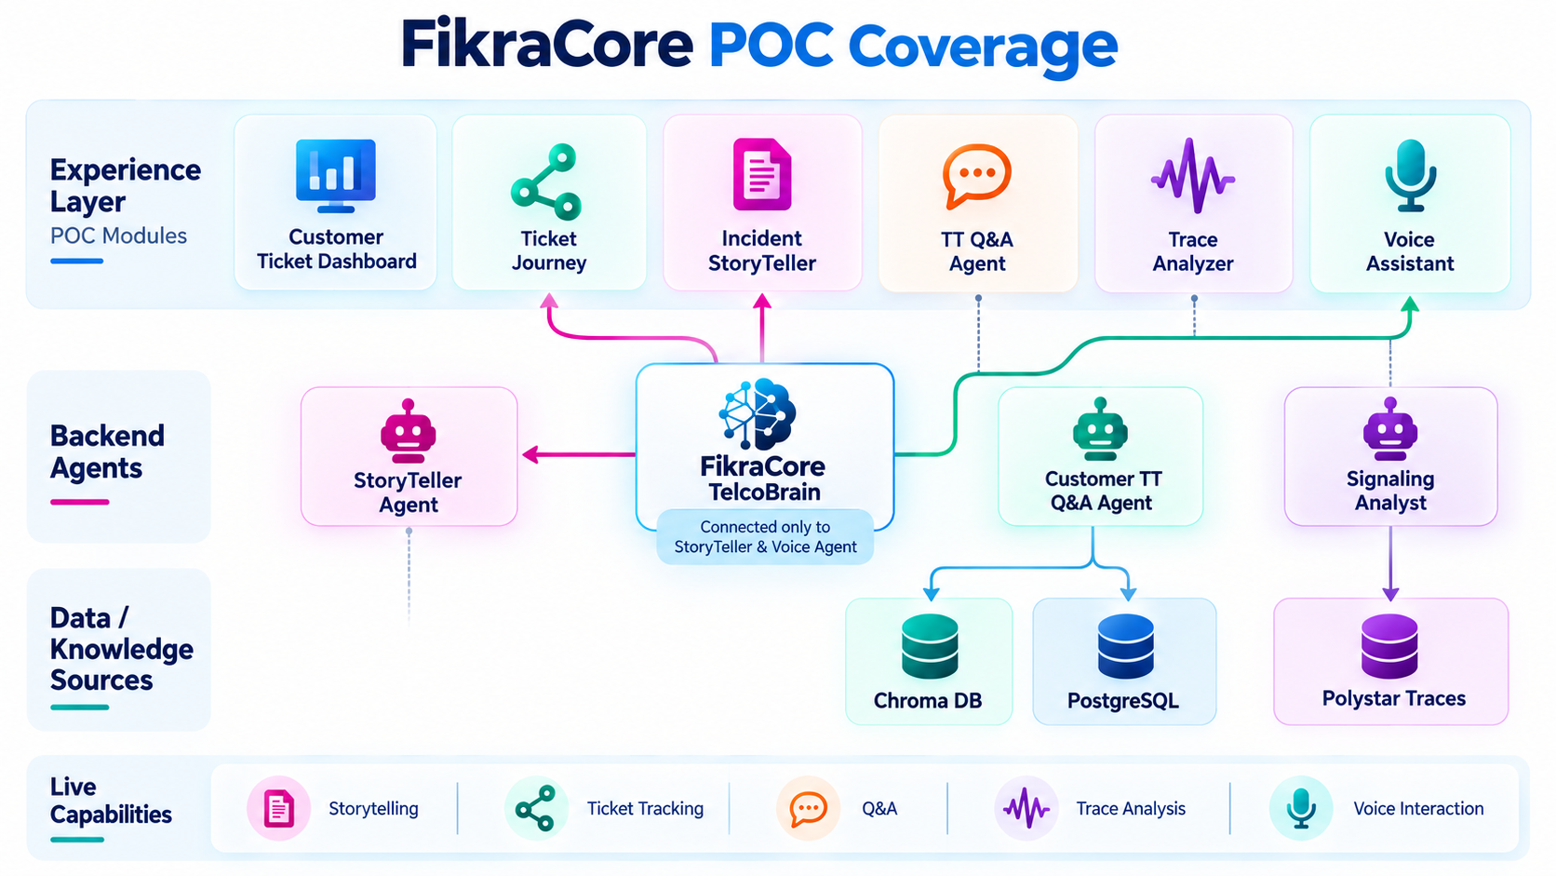
POC: the first operating layer is already visible
CURRENT POC
A focused set of customer, incident, trace and voice capabilities.
POC COVERED
1
Customer Ticket Dashboard
Centralized ticket visibility
2
Customer Ticket Journey
End-to-end ticket progression
3
Incident StoryTeller
Automatic incident narrative
4
TT Q&A Agent
Interactive trouble-ticket Q&A
5
Trace Analyzer
Polystar trace analysis
6
Interactive Voice Assistant
Voice for story + ticket journey
POC signal: the experience layer is already connected to operational intelligence.

Slide 4
Behind the experience: focused intelligent agents
POC BACKEND
Each component has a clear responsibility and data path.
CURATED INCIDENT NARRATIVE
HYBRID RETRIEVAL
TRACE ANALYZER SKILL
StoryTeller Agent
Customer TT Q&A Agent
Signaling Analyst
Traverses FikraCore TelcoBrain to generate context-aware incident stories.
Chroma for semantic retrieval + PostgreSQL for precise structured queries.
Visualizes call flows, analyzes Polystar traces and surfaces troubleshooting insight.
FikraCore TelcoBrain
Chroma + PostgreSQL
Polystar Traces
Specialized agents • clear responsibilities • shared operational context

Slide 5
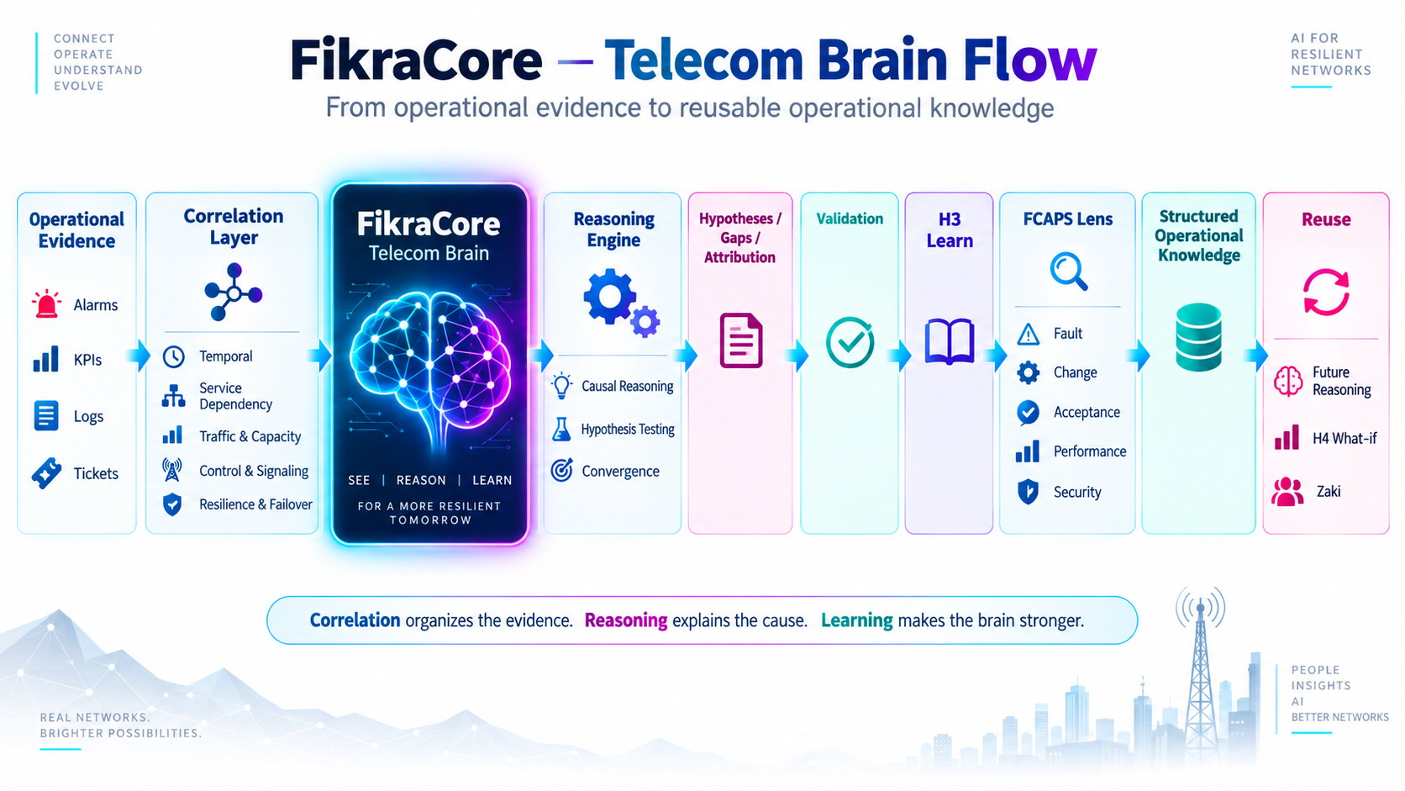
FikraCore: the Telecom Brain
FIKRACORE
Operational evidence becomes structured context, reasoning and validated knowledge.

Slide 6
The investigation follows a disciplined execution flow
EXECUTION FLOW
The backend flow remains the source of truth for the experience.
1
2
3
4
5
6
7
8
Telemetry
Correlation
Hypothesis
Hypothesis
Convergence
Domain
Evidence
Knowledge
INGESTION
LAYER
GENERATION
TESTING
+ GAP
ATTRIBUTION
+ VALIDATION
PROMOTION
The operator sees one investigation, while FikraCore performs the underlying analytical work.

Slide 7
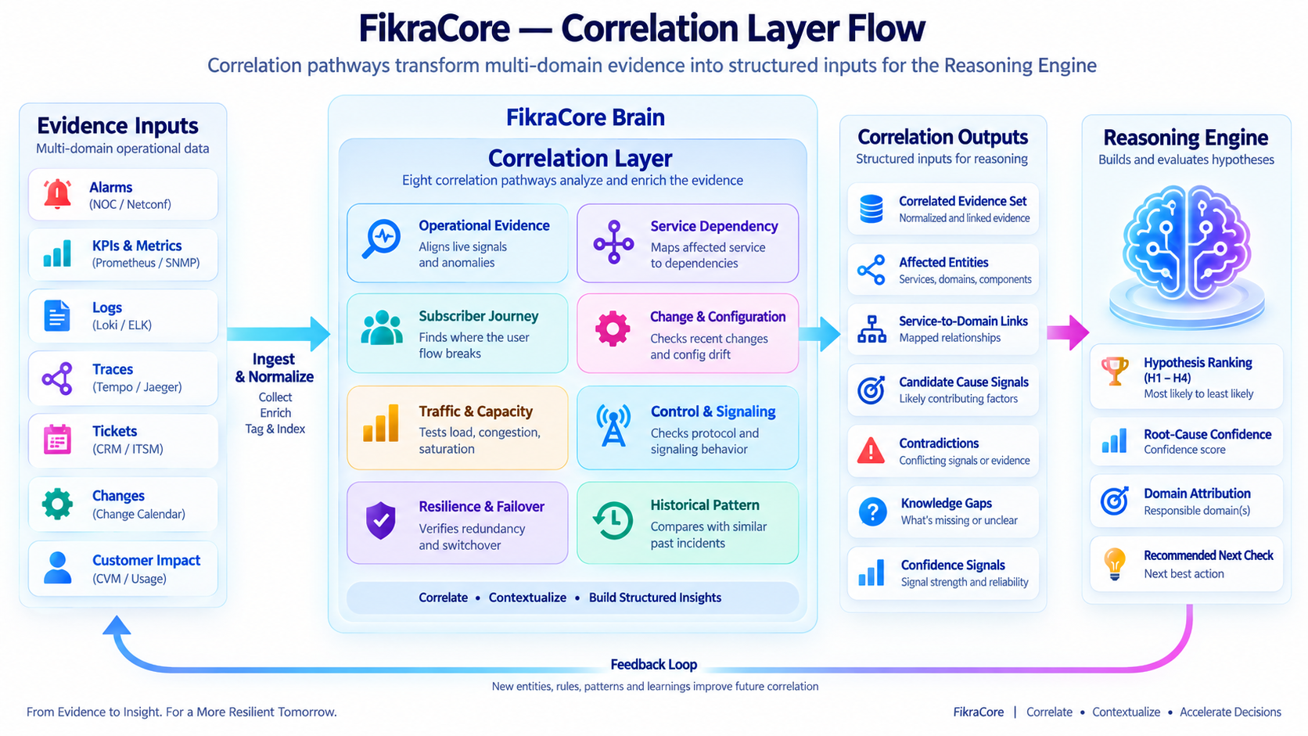
Correlation before conclusion
CORRELATION LAYER
Four dimensions turn fragmented evidence into a bounded causal envelope.
EXECUTIVE READOUT
1
Temporal & Identity
Sequence, freshness, canonicalization
2
Topological
Dependency and path relationships
3
Cross-Domain
Operational lenses across domains
4
Service & Blast Radius
Impact boundary and noise isolation
Then: hypothesis generation → testing → convergence

Slide 8
Hypothesis ranking makes the investigation explainable
RANKED HYPOTHESES
The question is not “what is the RCA?” but “how does the ranking change as evidence arrives?”
RANKED HYPOTHESES
HUMAN VALIDATION
Evidence changes rank
#1
IP Transport — Router-R21
0.82
LEADING
Evidence received
#2
Mobile Core — UPF
0.61
COMPETING
Score update
#3
RAN
0.38
COMPETING
Infrastructure
0.21
Rank movement
#4
WEAK
#5
Change
0.12
WEAK
Falsified / retained
Operator validation
Supporting • Contradicting • Missing evidence
The backend owns the ranking. Zaki explains and orchestrates the loop.

Slide 9
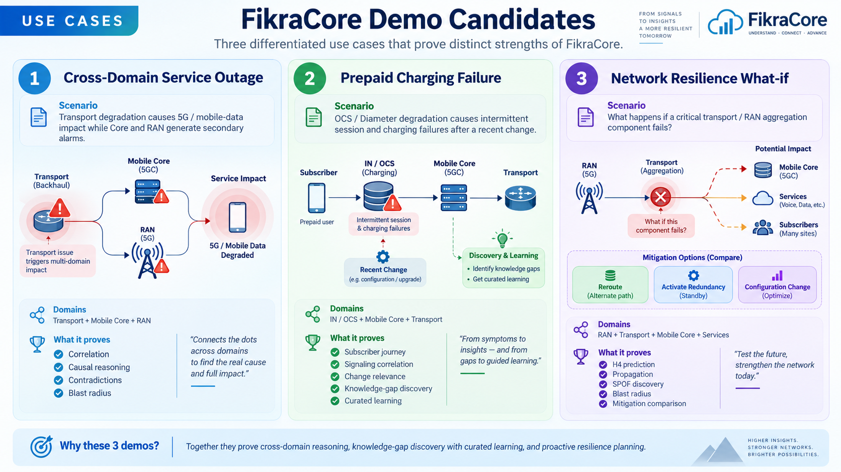
Three demonstrations. Three different strengths.
MANAGEMENT DEMOS
Designed to prove FikraCore is more than a fault-isolation demo.

Slide 10
Demo 1 — Cross-domain service outage
USE CASE 1
Transport degradation creates downstream Core and RAN symptoms.
SCENARIO
5G / mobile-data degradation
Transport
N3
Core / RAN
Customer
A transport fault masquerades as a Core or RAN problem.
fault
packet loss
symptoms
impact
Transport → N3 packet loss
Core and RAN generate secondary alarms
Management message
Healthy signals contradict false candidates
FikraCore does not choose the first or loudest alarm; it reasons across domains and evidence.
PROVES
Correlation • causal reasoning • contradictions • blast radius

Slide 11
Demo 2 — Prepaid charging failure becomes a learning loop
USE CASE 2
The system discovers a missing dependency, gets human validation and reuses the knowledge.
SUBSCRIBER REQUEST
CORE / GY
OCS
GAP
ENGINEER
Data session
Charging request
Latency / timeout
Missing relationship
Validate
Knowledge-gap moment
FikraCore cannot fully explain the observed charging propagation.
→ request next-best evidence → engineer validates → curated learning → validated knowledge returns to FikraCore
The value is not only resolving the incident — it is improving the next investigation.

Slide 12
Demo 3 — Proactive what-if / resilience
USE CASE 3
Move from reacting to an incident to testing a future failure before it happens.
WHAT IF?
AGGREGATION
RAN sites
RESILIENCE FINDING
Failure surface
A critical aggregation component fails tomorrow.
Shared dependency / SPOF
FAILURE
MPLS / transport
PREDICT
Expected failover path
Forward propagation
Affected services
PROPAGATION
Core paths
Blast radius • SPOF • resilience gap
Mitigation choices
Mitigation options
IMPACT
Services / customers
Predict • compare • reduce risk

Slide 13
The learning loop turns operational experience into reusable knowledge
LEARNING
FCAPS structures the learning context; validated knowledge returns to the brain.
INCIDENT
evidence + outcome
HUMAN CORRECTION
validate / reject
STRUCTURED EPISODE
capture what worked
FCAPS LENS
Fault • Change • Acceptance • Performance • Security
VALIDATED KNOWLEDGE
reusable in FikraCore
Domain agents learn locally • FikraCore learns globally through validated operational knowledge

Slide 14
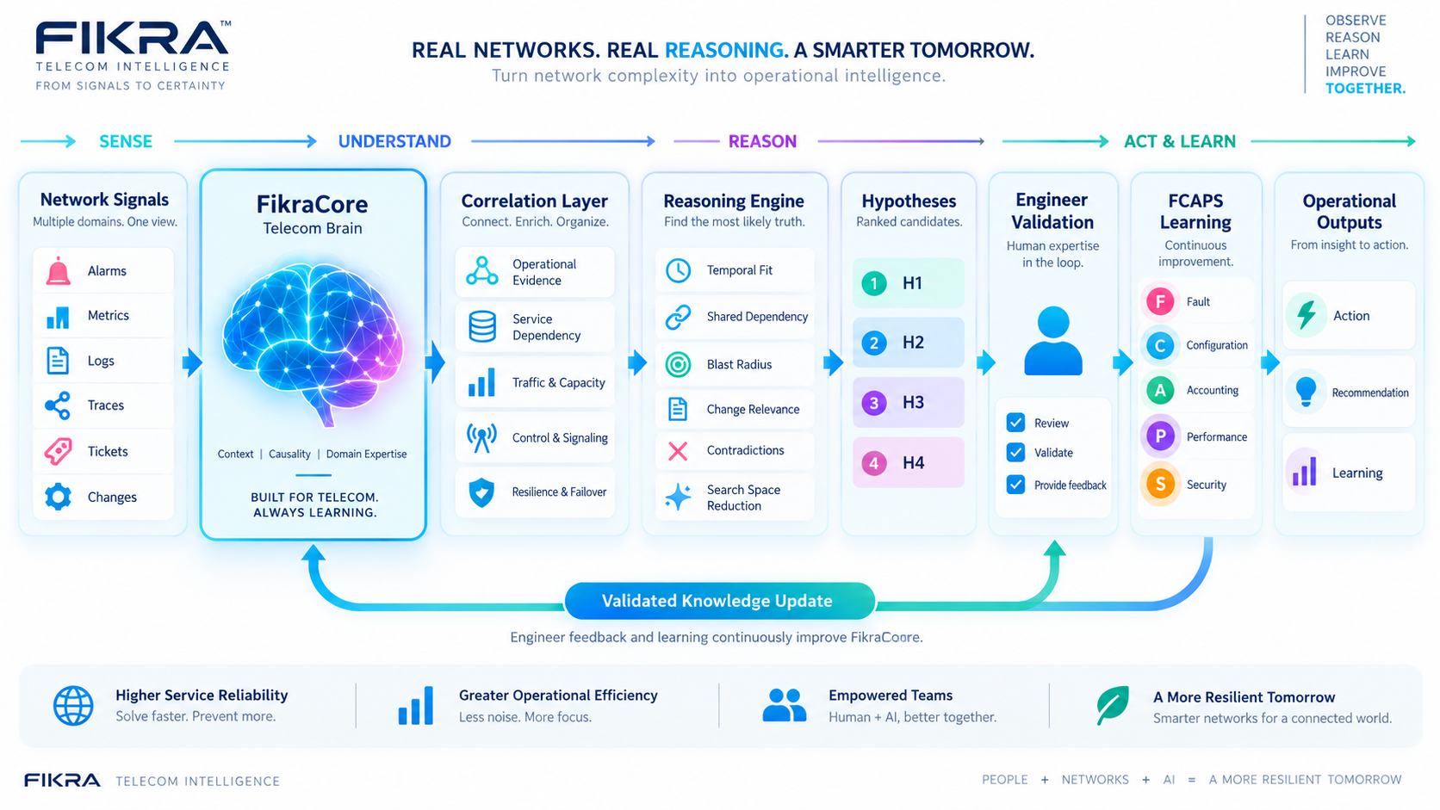
FikraCore ecosystem: a foundation that can grow
ECOSYSTEM
The pitch is intentionally modular: visible capabilities now, broader intelligence next.
TODAY
Customer + Incident + Trace + Voice experiences
INTELLIGENCE LAYER
Operational Evidence → Correlation → Reasoning → Learning
SCALE
More domains • more knowledge • more reusable skills

Slide 15
FikraCore
A Telecom Brain for the Dark NOC
Understand the evidence. Rank the hypotheses. Validate the decision. Learn from the operation.
Operational Evidence
Correlation Layer
Reasoning Engine
Validation
Validated Knowledge
FikraCore | Dark NOC
Executive pitch

