Slide 1
OPEN-SOURCE LEARNING PLATFORM · MIT
daig
DevOps Intern Bootcamp
Break it. Diagnose it. Ship it safely.
A hands-on foundation & track for Cloud · DevOps · SRE · DevSecOps · Platform Engineering
3-tier app
Kubernetes
Terraform ×3 clouds
Observability + SLOs
Vault · DevSecOps
github.com/adeelarshad414/devops-interns-proj
Instructor-led kickoff · 6-day rotation
Notes:
Welcome. This deck is the foundation + the hands-on track. The goal: by the end, interns can run the stack, break it, diagnose from real signals, fix at the right layer, and gate the fix so it cannot regress.

Slide 2
Why we learn by breaking things
Most people “learn DevOps” by watching. Then the first 2 a.m. incident hits — and none of it transfers.
THE GAP
THE DRIVING PROBLEM
Tutorials teach you to copy commands — not to diagnose a failure.
You were never allowed to break production.
You never read real signals: logs, metrics, traces, profiles.
So the knowledge doesn’t survive contact with a real incident.
The iftar spike
40 minutes before sunset in Ramadan, an entire country orders dinner in the same second.
THE ANSWER: DAIG
A real, instrumented platform that is broken on purpose.
Every fault has a symptom, a signal, and a one-command revert.
You practice the loop until it’s muscle memory.
This one problem drives every lesson: scaling, latency, back-pressure, SLOs, incident diagnosis.
daig · DevOps Intern Bootcamp
github.com/adeelarshad414/devops-interns-proj
2
Notes:
Anchor everything to the iftar spike. It makes “capacity”, “SLO”, and “back-pressure” concrete. Ask the room: what happens to your favourite food app 40 minutes before iftar?

Slide 3
The loop — repeated at every layer
You run this same five-step loop each phase, one layer deeper: Linux → containers → k8s → pipelines → security.
1
2
3
4
5
▸
▸
▸
▸
Watch it work
Break it
Diagnose
Fix at the right layer
Gate it
make up · make obs
one fault, hidden cause
logs·metrics·traces·profiles
not where it’s easiest
test · rule · policy · alert
Step 5 is the one everyone skips — and the one that matters. A fix without a gate regresses within two sprints. Every bug you close leaves behind a test, a rule, a policy, or an alert.
daig · DevOps Intern Bootcamp
github.com/adeelarshad414/devops-interns-proj
3
Notes:
Drill the loop verbally every day. “What’s the symptom? Which signal? Which layer? What gate did you leave?” The gate question is the senior-vs-mid tell.

Slide 4
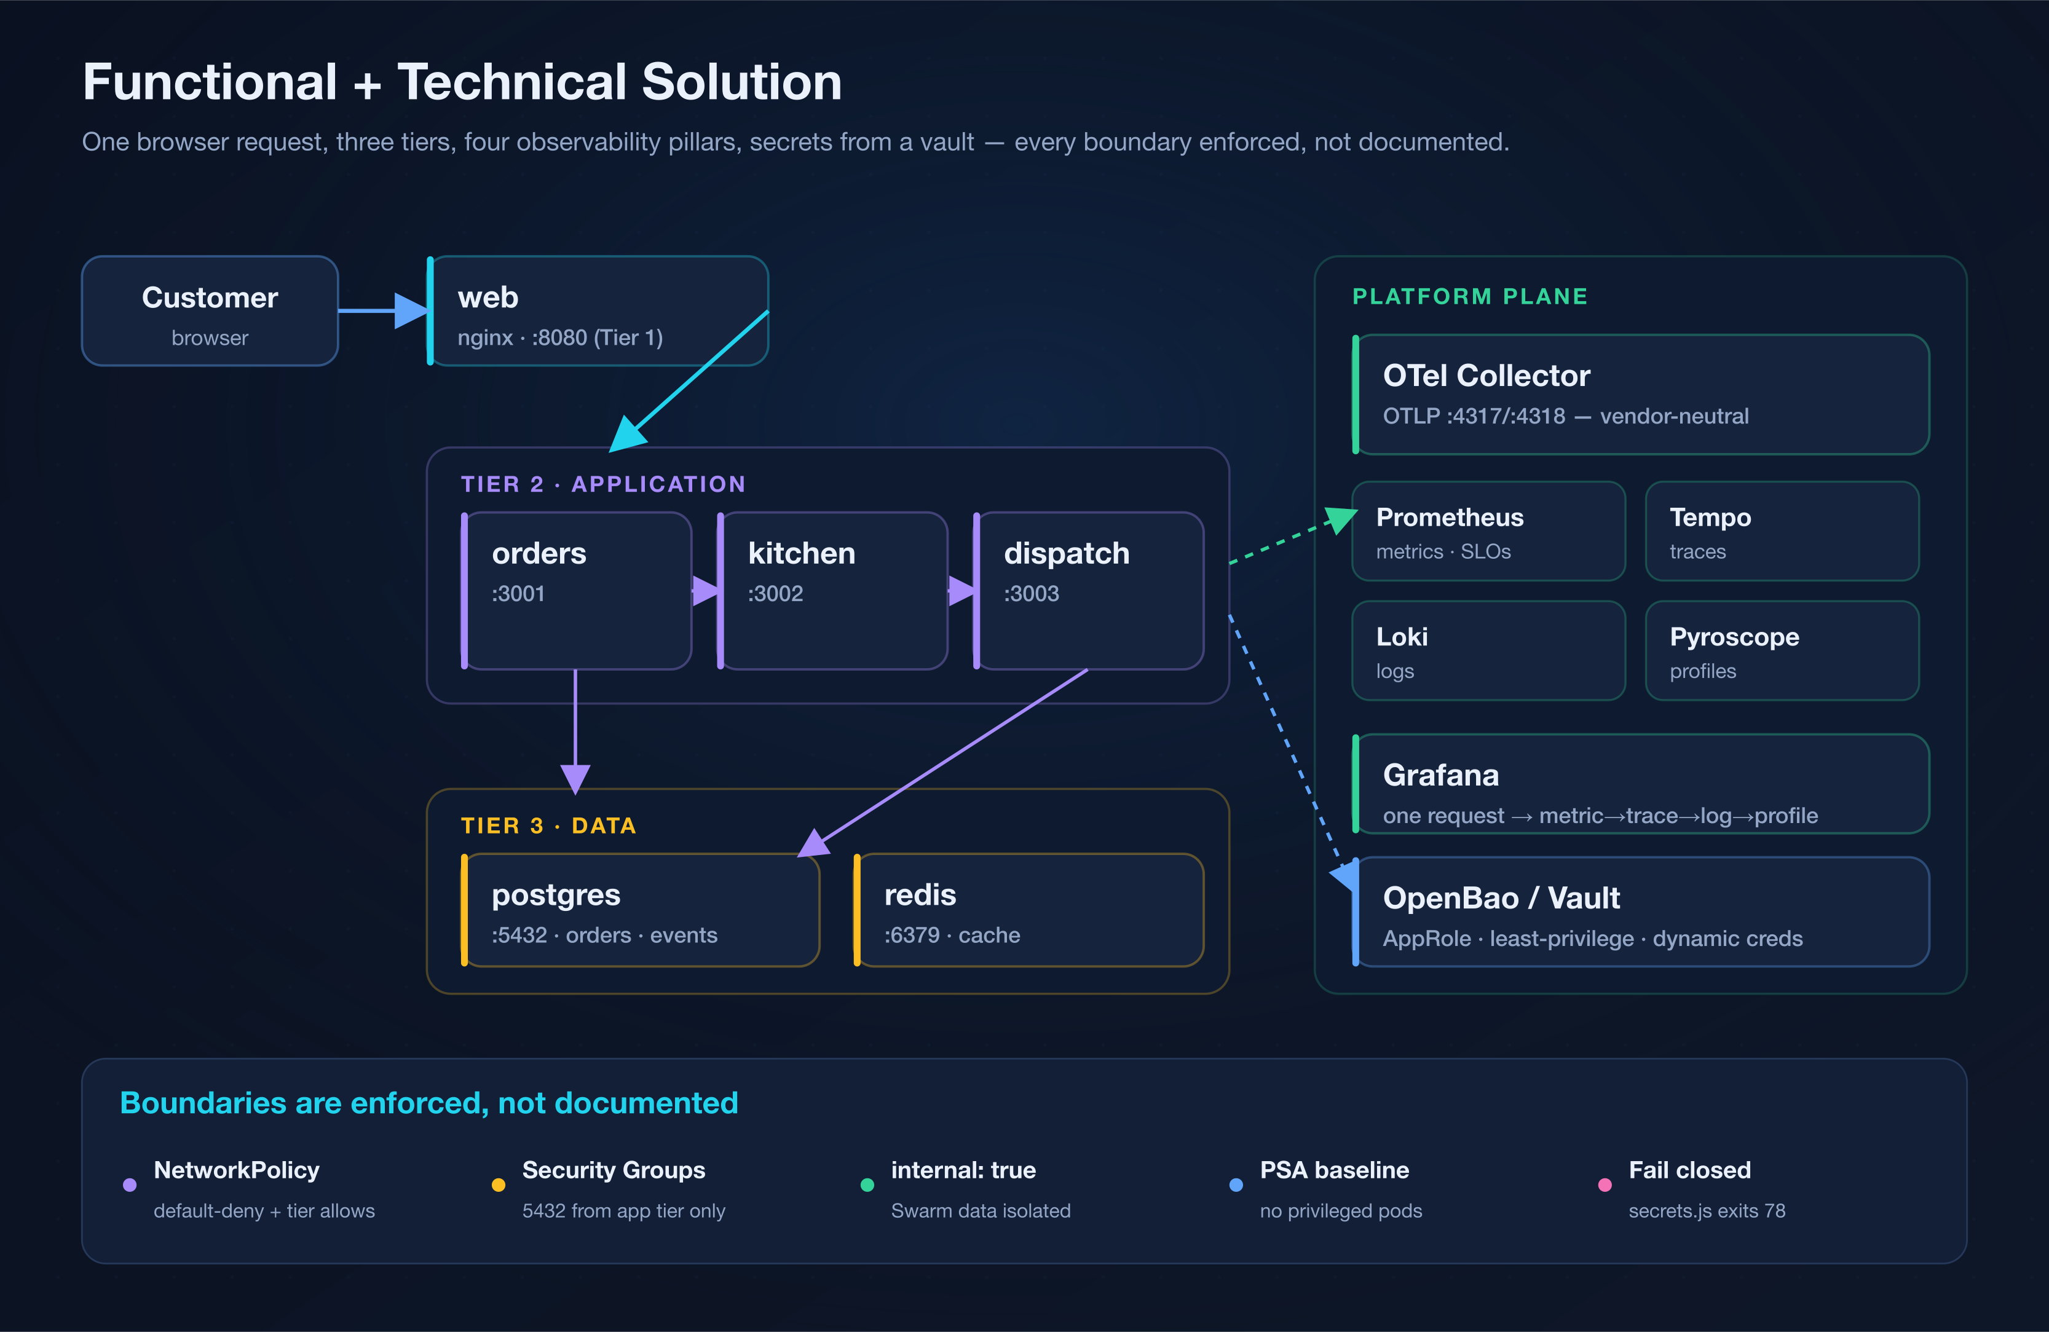
What is daig — the system you operate
A three-tier food-delivery platform: instrumented end-to-end, with every boundary enforced, not documented.
One browser request → web → orders → kitchen → dispatch → Postgres/Redis, watched by four observability pillars, with secrets from a vault.
Notes:
Walk the request path live if you can. Emphasise: NetworkPolicy / security groups / internal networks actually REFUSE cross-tier calls — the diagram is enforced, not aspirational.

Slide 5
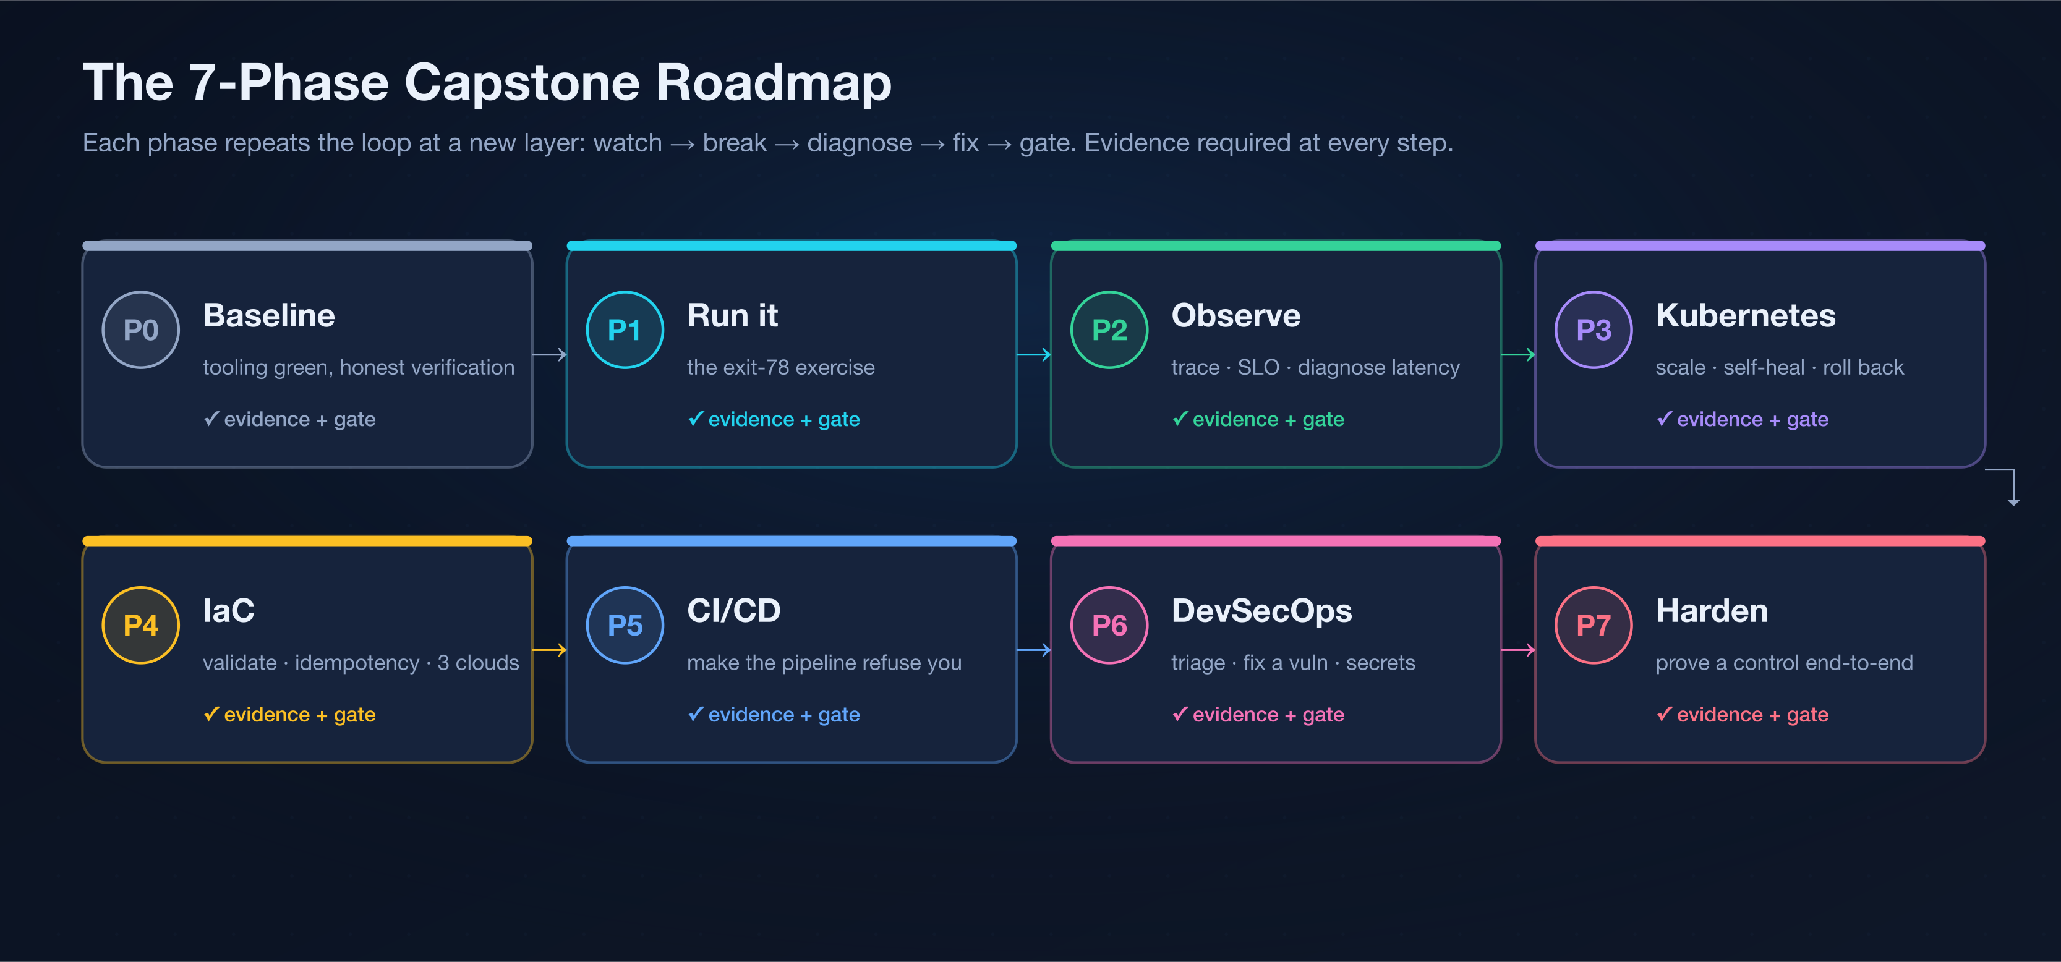
The track — a 7-phase capstone
Each phase is the loop at a new layer. You leave evidence + a gate at every step.
Do them in order — each builds on the last. Full brief in ASSIGNMENT.md; worked answers (instructor-held) in SOLUTION.md.
Notes:
This is the spine of the rotation. Print the acceptance checklist; interns tick a phase only when the evidence is in their submission/ folder.

Slide 6
Day 0 — get your hands dirty
Ten minutes to a running, verified stack. No cloud account needed.
PREREQUISITES
PROVE IT WORKS
Docker Desktop (or Docker Engine) + `make`
Node 22 (via nvm — the repo pins it in .nvmrc)
git, and a terminal you’re comfortable in
Admin rights on your laptop (containers need it)
# every tier answers
make smoke
# place a real order end-to-end
./scripts/integration-order.sh
FIRST RUN
THE EXIT-78 EXERCISE
git clone <repo> && cd devops-interns-proj
cp .env.example .env
make hooks # install the pre-commit gate
make up && make seed && make smoke
make broken
docker run --rm tkxel/daig-orders:broken
# reads: “Missing DATABASE_URL”, exits 78
Read the failure the way the platform intends — a named missing variable, not a stack trace.
daig · DevOps Intern Bootcamp
github.com/adeelarshad414/devops-interns-proj
6
Notes:
Everyone gets green on make smoke before anything else. The exit-78 exercise teaches “fail loud, fail closed” on minute one.

Slide 7
The foundation stack
Nine areas, one system. Each has concepts, a cheatsheet, and something to break — all in TRAINING.md.
1
Linux & the runtime
2
Containers & Docker
3
Compose & the 3 tiers
signals · exit codes · systemd · sockets
images · multi-stage · non-root · healthchecks
health-gated startup · overlays · volumes
4
Kubernetes
5
IaC — Terraform & Ansible
6
CI/CD
deploy · scale · self-heal · roll back
state · providers · idempotency · 3 clouds
prove → gate → ship, or refuse
7
DevSecOps & Secrets
8
Observability & SRE
9
Chaos engineering
7 gates · SBOM · signing · Vault
RED/USE · SLOs · burn-rate · the pivot
steady state · blast radius · revert
daig · DevOps Intern Bootcamp
github.com/adeelarshad414/devops-interns-proj
7
Notes:
This is the map. Every following slide is one of these boxes: the concept, the commands, and what breaks.

Slide 8
Containers & Docker
An image is an immutable, layered filesystem. The craft: small, reproducible, non-root, observable.
FOUNDATION
GET YOUR HANDS DIRTY
Multi-stage builds → a lean runtime image = smaller attack surface.
Reproducible: build from a lockfile (npm ci), never npm install.
Least privilege: a non-root USER, dropped caps, a HEALTHCHECK.
In-repo: services/*/Dockerfile — plus a “broken” target that exits 78.
docker build -f services/orders/Dockerfile -t x .
docker run --rm -p 3001:3001 x
docker logs -f <ctr> · docker history x
Gate it: add a HEALTHCHECK + non-root USER; Trivy scans the image in CI.
The senior move: ship a digest, not :latest — and never build with npm install.
★
daig · DevOps Intern Bootcamp
github.com/adeelarshad414/devops-interns-proj
8
Notes:
Show docker history to make layers real. The broken-target build is the exit-78 teaching image.

Slide 9
Docker Compose & the three tiers
Declarative multi-container topology for one host — dev, CI, and small deployments.
FOUNDATION
GET YOUR HANDS DIRTY
Health-gated startup: depends_on + condition: service_healthy.
Overlays: one base file + feature files (obs, security, vault).
Named volumes for state; resource limits so nothing starves the host.
In-repo: docker-compose.yml + 4 overlays, wired to the Makefile.
make up # the 3 tiers
make obs # + Prometheus/Grafana
make ps · make logs · make psql
make down / nuke
Gate it: validate without running: `docker compose config -q` in CI.
The senior move: wait for healthy, not started — and put a resource limit on every service.
★
daig · DevOps Intern Bootcamp
github.com/adeelarshad414/devops-interns-proj
9
Notes:
Prefer condition: service_healthy over bare depends_on — start order ≠ ready. Interns learn this the hard way when web 502s on boot.

Slide 10
Kubernetes — deploy · scale · self-heal · roll back
A declarative control loop. Its most valuable behaviour: refusing a bad deploy.
FOUNDATION
GET YOUR HANDS DIRTY
Probes: liveness (restart) never touches the DB; readiness does.
HPA owns replicas — never set both, or the autoscaler thrashes.
A bad rollout STALLS: new pods never go Ready, old ones keep serving.
In-repo: k8s/base — NetworkPolicy, PDBs, PSA, StatefulSet data tier.
kubectl apply -k k8s/base
kubectl -n daig get pods -w · get hpa
kubectl -n daig rollout undo deploy/orders
Gate it: default-deny NetworkPolicy + a PodDisruptionBudget per workload.
The senior move: let the platform refuse a bad deploy — never override the stall.
★
daig · DevOps Intern Bootcamp
github.com/adeelarshad414/devops-interns-proj
10
Notes:
The rollback demo is the CrowdStrike lesson: set a bad image, watch the rollout stall, then undo. The platform refused to complete a broken deploy — no outage.

Slide 11
IaC — Terraform & Ansible
Describe infrastructure as reviewable, repeatable, destroyable code.
FOUNDATION
GET YOUR HANDS DIRTY
Terraform: declarative; diff desired vs state; pin providers.
Read the plan before every apply — plan is the review, apply is the merge.
Ansible: idempotent — run twice, the second run is all “ok”.
In-repo: infra/{aws,gcp,azure} — deliberately parallel; ansible/ roles.
terraform -chdir=infra/aws init -backend=false
terraform -chdir=infra/aws validate
ansible-playbook -i .../hosts.yml site.yml # run 2×
Gate it: remote state + locking before two people touch the same infra.
The senior move: read the plan before the apply; destroy the stack at end of day.
★
daig · DevOps Intern Bootcamp
github.com/adeelarshad414/devops-interns-proj
11
Notes:
“Concepts identical, only the nouns change” across the three clouds. Destroy at the end of every day — managed Postgres is the line item people forget.

Slide 12
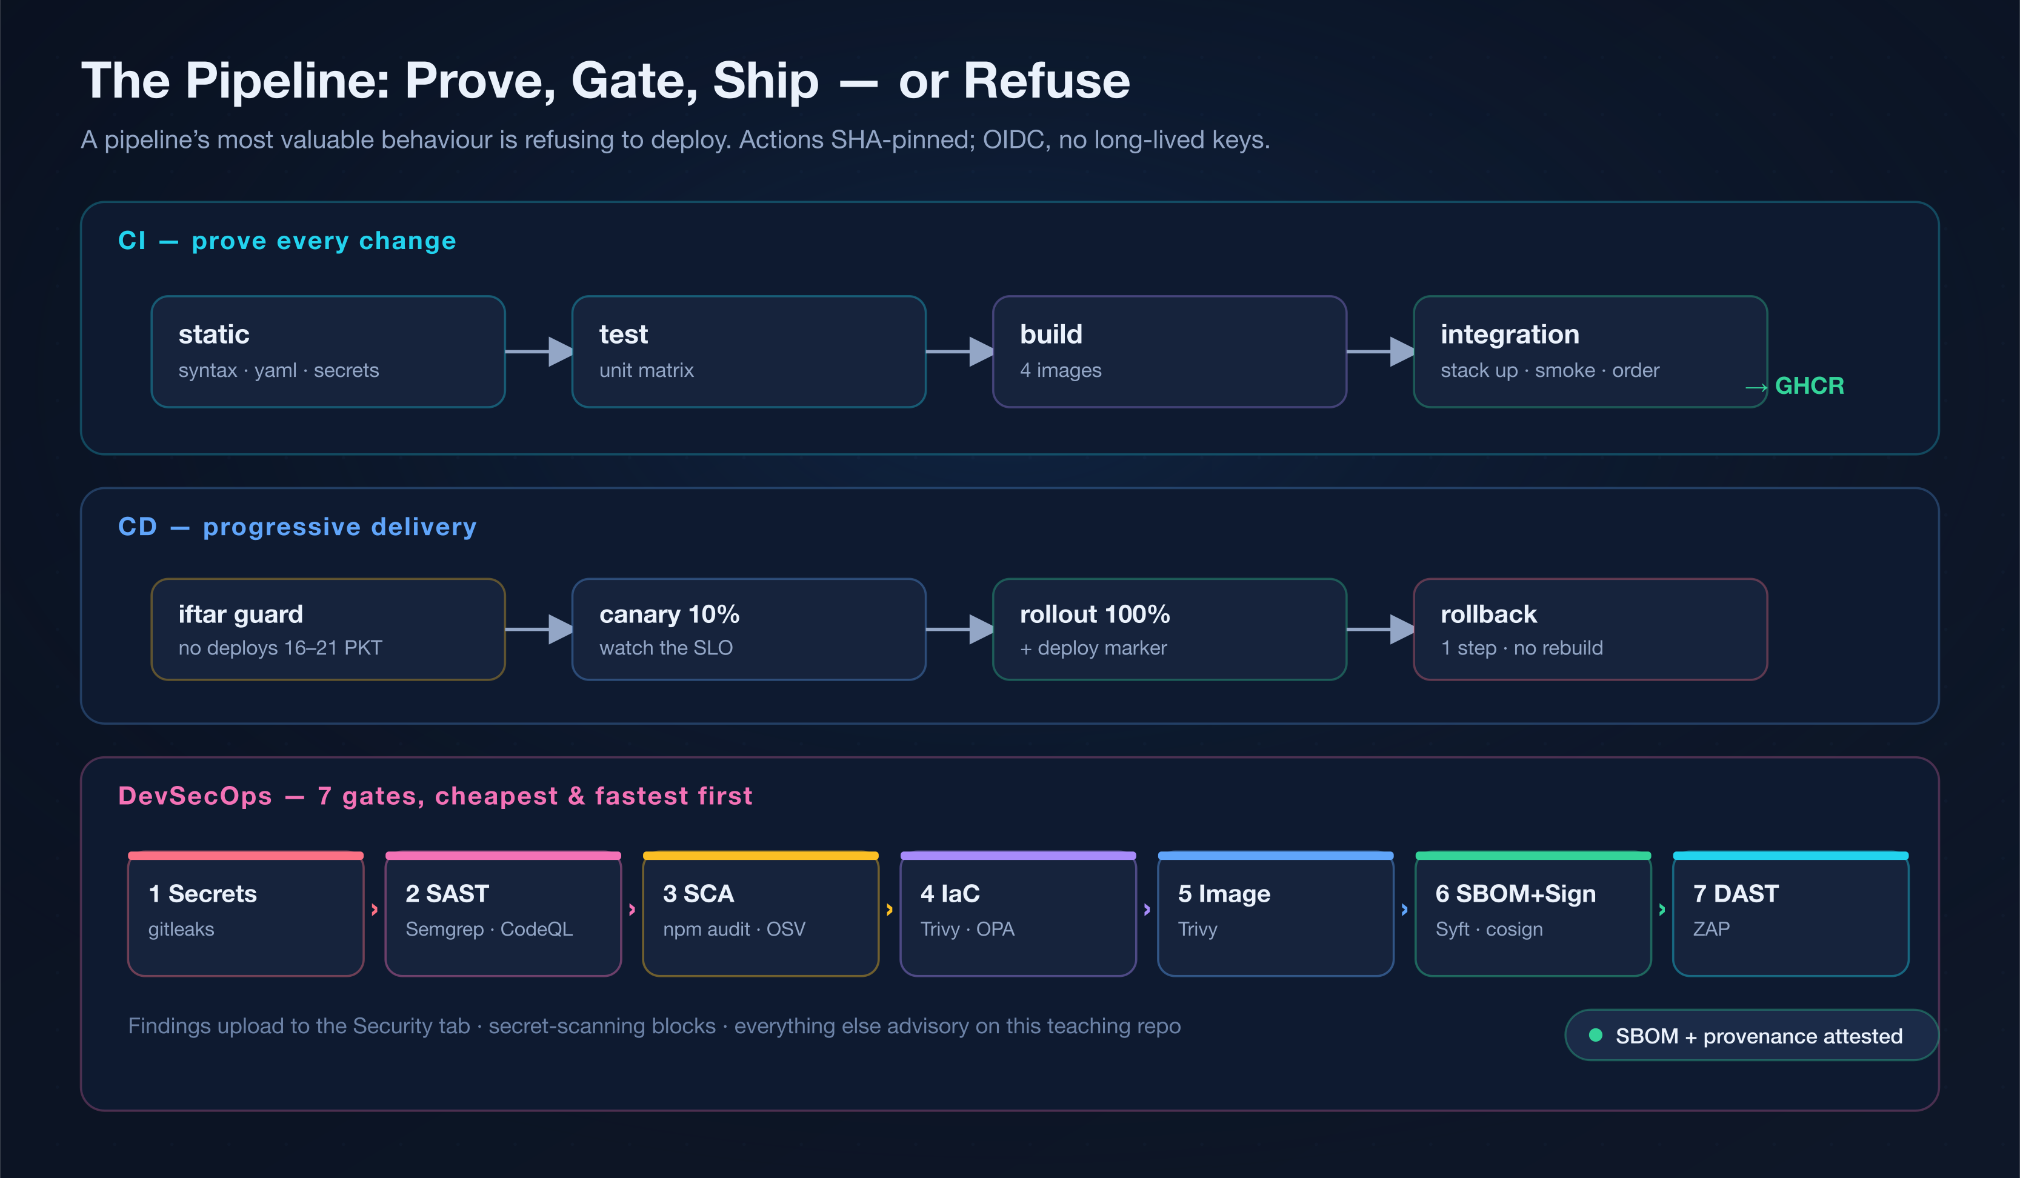
CI/CD — the pipeline that refuses to ship broken code
Its most valuable behaviour is saying no. Actions SHA-pinned; OIDC, no long-lived keys.
CI (prove) → progressive CD (canary → rollout → 1-step rollback) → 7 DevSecOps gates. Break a test → the build refuses to ship.
Notes:
Live demo: break services/orders/test on a branch, open a PR, watch build + integration refuse. Then fix, watch green, merge. That IS the lesson.

Slide 13
DevSecOps & Secrets
Security as gates in the pipeline, cheapest-and-fastest first — plus secrets that fail closed.
FOUNDATION
GET YOUR HANDS DIRTY
7 gates: secrets → SAST → SCA → IaC → image → SBOM+sign → DAST.
Fail on high+ severity, not every low finding — or the gate gets ignored.
Vault/OpenBao: AppRole, least-privilege policies, dynamic short-TTL creds.
secrets.js exits 78 rather than silently falling back to env vars.
make scan # full toolchain
make insecure-on # enable planted vulns
./chaos/day6-security.sh verify
make vault-up && make vault-app
Gate it: sign images (cosign) + keep the SBOM; write the deny policy down.
The senior move: triage the finding, then leave the rule that catches it next time.
★
daig · DevOps Intern Bootcamp
github.com/adeelarshad414/devops-interns-proj
13
Notes:
Triage, don’t just make it green. The IDOR vuln is the one no scanner finds — that’s why code review still exists.

Slide 14
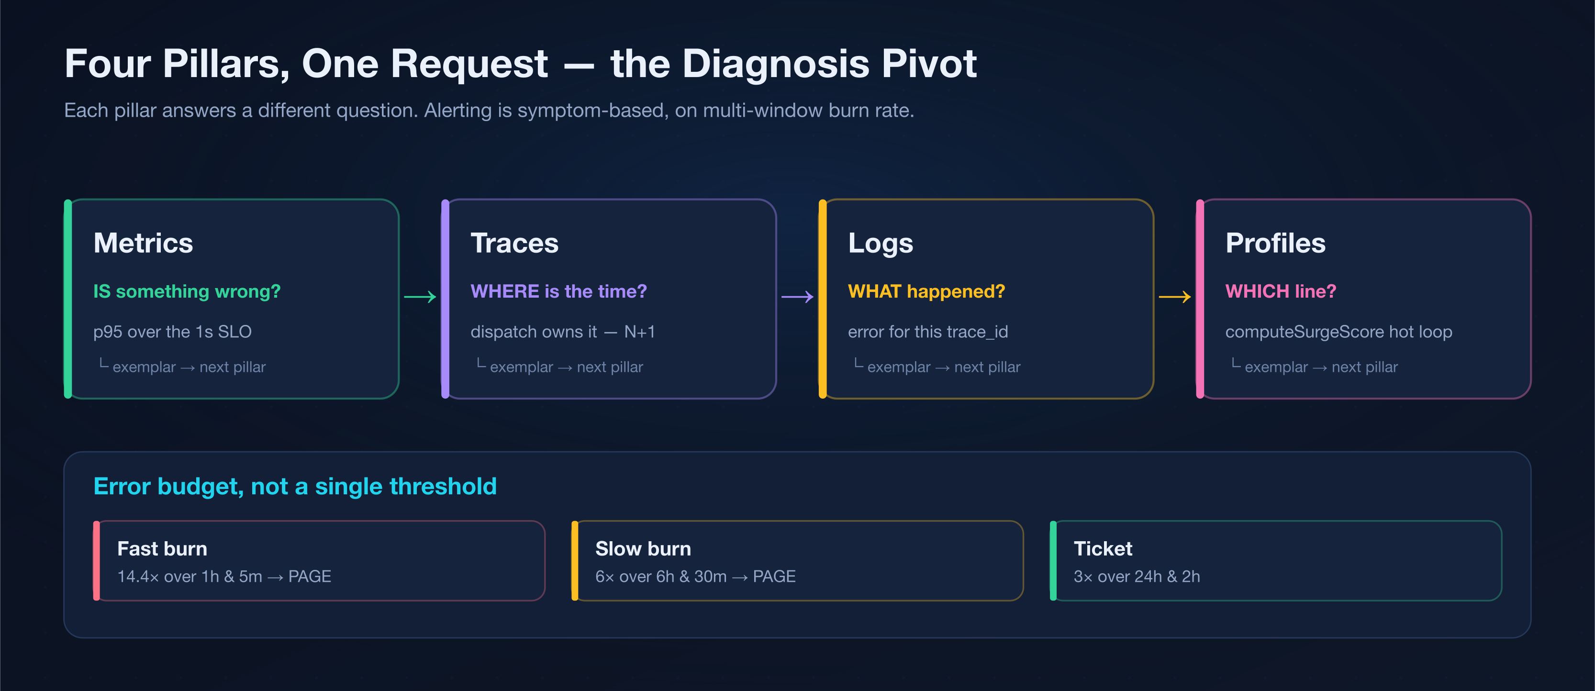
Observability & SRE — four pillars, one request
Each pillar answers a different question. The skill is the pivot between them.
Metric (is it wrong?) → Trace (where?) → Log (what?) → Profile (which line?). Alert on symptoms, page on multi-window burn rate.
Notes:
Run the Day-4 latency chaos and walk the pivot live: p95 over SLO → trace shows dispatch N+1 → profile shows kitchen’s hot loop. No single pillar sees both.

Slide 15
Chaos engineering — break it safely
Inject one fault, with a bounded blast radius and a one-command revert. Find weakness before it finds you.
FOUNDATION
GET YOUR HANDS DIRTY
State a steady-state hypothesis: p95 < 1s, errors < 0.1%.
Inject ONE fault; observe whether steady state holds.
If nothing lights up, your observability has a gap — that’s a finding too.
In-repo: chaos/day1…day6 — each a clear symptom + a fix/revert.
./chaos/day1-network.sh break · … fix
./chaos/day3-crashloop.sh break
./chaos/day4-latency.sh break
./chaos/day6-security.sh break · verify
Gate it: the gate is the alert/policy that catches this fault next time.
The senior move: know the revert before you break — if nothing alerts, that is the bug.
★
daig · DevOps Intern Bootcamp
github.com/adeelarshad414/devops-interns-proj
15
Notes:
Always know the revert before you break anything. Faults mutate throwaway daig-chaos-* containers, not the primary stack.

Slide 16
The 6-day rotation
A suggested cadence. Each day = one pass around the loop at a new layer.
Day 1
Day 2
Day 3
Linux · Git · Containers
IaC · the cloud
Compose → Kubernetes
run the stack · read exit-78 · first image
terraform validate · idempotency · one cloud
tiers · deploy · scale · self-heal · rollback
Day 4
Day 5
Day 6
CI/CD · Observability
DevSecOps · Secrets
Chaos · Demo day
pipeline refuses · trace the latency spike
7 gates · fix a vuln · Vault dynamic creds
break · diagnose · gate · present the fix
daig · DevOps Intern Bootcamp
github.com/adeelarshad414/devops-interns-proj
16
Notes:
Five days if you must, but DevSecOps needs its own day. Day 6 demo: each intern presents one incident they diagnosed and the gate they left.

Slide 17
How you’re assessed
Evidence over assertion. Capture proof for every task in a submission/ folder.
Correctness
Diagnosis
Right layer
the fix actually resolves the symptom
found from signals, not guesswork
fixed where it belongs, not where it’s easy
Gating
Evidence
Communication
left a test / rule / policy / alert
the artifact is in submission/ and legible
can explain WHY — answers the checkpoint
The rule: don’t “make it green” without understanding it. daig is broken on purpose — the point is the diagnosis and the gate, not a clean terminal.
daig · DevOps Intern Bootcamp
github.com/adeelarshad414/devops-interns-proj
17
Notes:
Reward “how did you know?” over lucky guesses. A fix without a gate is incomplete. Full rubric + checkpoint questions in ASSIGNMENT.md / SOLUTION.md.

Slide 18
YOUR MAP FOR THE WEEK
Break it. Diagnose it.
Ship it safely.
TRAINING.md
the handbook — concepts, cheatsheets, guidelines
Now go
make a mess.
ASSIGNMENT.md
the 7-phase capstone + acceptance checklist
Clone it. Run it.
Break it. Fix it.
Gate it.
SOLUTION.md
worked answers (instructor-held)
roadmap.sh/devops
the what-to-learn map — daig is the do-it companion
MIT · runs on a laptop
github.com/adeelarshad414/devops-interns-proj
Notes:
Send them off. First task after this deck: everyone gets make smoke green and runs the exit-78 exercise. Questions welcome all week — but try to break it first.

