Slide 1

Department of Computer Science and Engineering,Indian Institute of Technology, Tirupati,India.
Enhancing Privacy in Text Data: A Metric-Differential
Privacy Approach.
Supervisor
Dr. Srinivas Padmanabhuni
Adeel Ahmad Khan
CS22M102

Slide 2
Enhancing Privacy in Text Data: A Metric-Differential Privacy Approach.
Motivation
Large Language Models (LLMs) saw a substantial upsurge in interest in 2023.
By December 2022, ChatGPT alone had over 57 million users worldwide, according to Statista.
With 100 million users active every week, this number climbed to around 120 million by January 2023 and then to 180.5 million by April 2024.
According to a research by springapps.com, LLMs will be used by about 750 million apps by 2025.
The LLM market is expected to experience substantial growth, with a projected CAGR of 79.80% between 2024 and 2030.
The market is anticipated to reach a value of USD 259.82 billion by 2030, up from USD 1.59 billion in 2023.
The requirement for data unique to NLP business demands will inevitably rise as a result of the need to fine-tune models.
The 2024 Global Threat Intelligence Report from Flashpoint states that over 17 billion personal records were compromised in 2023, accounting for a 34.5% increase in reported data breach events.

Slide 3


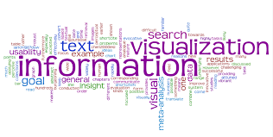



Unsanitized Data
Sanitized Data

Slide 4
Enhancing Privacy in Text Data: A Metric-Differential Privacy Approach.
Introduction
1
2
3
Advancements in Computer Technology has enabled the vast digital collection and storage of data
This leads to a growing capacity for personal data collection
However, data collection and sharing raise ethical concerns, including privacy, security, and intellectual property rights
PRIVACY - Privacy relates to personal information that a person would not wish others to know without authorization, and to a person’s right to be free from the attention of others (UN Declaration of Human Rights, 1948).
Privacy issues can cause damage to individuals social and economic standing.

Slide 5





Enhancing Privacy in Text Data: A Metric-Differential Privacy Approach.
Introduction
“Differential Privacy : You will not be affected adversely or otherwise, by allowing your data to be used in any study or analysis, no matter what other studies, datasets or information sources are available.” – Cynthia Dwork.
Goal of Differential Privacy is that different types of statistical analysis does not compromise privacy.
Intuition - We limit how much the output can change if we change the data of a single individual in the database.
Dataset
(N entries)
D
Sum(D)
IF SUM(D)=SUM(D¹⁾
Protected
ElSE SUM(D)!=SUM(D¹⁾
Neighbour
Dataset
(N-1 entries)
Unprotected
Sum(D¹)

Slide 6
Enhancing Privacy in Text Data: A Metric-Differential Privacy Approach.
Introduction.
In order to avoid data leaks, we add a controlled amount of statistical noise to obscure the data contributions from individuals in the data set.
By the Law of Large Numbers in probability and statistics, it is seen that when the average of these statistically collected data is taken, the noise cancels out and the average obtained is near to the true average (average of the data without adding noise (random number)) .
Differential privacy is not a property of databases, but a property of queries.
It helps provide the OUTPUT Privacy i.e., how much insight can someone gain on the input by reverse engineering from the output.
The use of differential privacy is a careful tradeoff between privacy preservation and model utility/accuracy.

Slide 7
Enhancing Privacy in Text Data: A Metric-Differential Privacy Approach.
Terminology
Epsilon ε:Epsilon is a parameter in a differentially private algorithm that quantifies the level of privacy protection. It is a measure of the maximum allowable influence of an individual’s data on the analysis’s outcome.
Privacy Leakage: The amount of information about an individual that can be inferred from the output of a query in a database using differentially private algorithm is referred to as privacy leakage.
Privacy Budget :The privacy budget represents the total amount of privacy that can be consumed across these analyses while still ensuring overall privacy.
Example :- If you have a privacy budget of 1 and use epsilon values of 0.1 for two different analyses, the total privacy cost is 0.2, leaving 0.8 for future analyses.
Adjacent Datasets: Two datasets are considered adjacent if one can be obtained from the other by adding, removing, or modifying a single individual’s data.
Plausible deniability: It refers to the ability to deny with credibility that a specific individual’s data was included in the dataset used for analysis.

Slide 8
Enhancing Privacy in Text Data: A Metric-Differential Privacy Approach.
Do we really need it?
Encryption alone cannot protect the individual’s data Privacy as de-anonymization is possible.
Example : De-anonymization of the Netflix Prize Dataset.
An adversary who knows only a little bit about an individual subscriber can easily identify this subscriber’s record in the dataset.
Using the Internet Movie Database (IMDb) as the source of background knowledge, it was possible to successfully identify the Netflix records of known users who rated movie both on Netflix and IMDB, uncovering their apparent political preferences and other potentially sensitive information.

Slide 9
Enhancing Privacy in Text Data: A Metric-Differential Privacy Approach.
Metric-Differential Privacy.
Metric Differential Privacy (m-DP) extends differential privacy to settings where data is in a metric space, preserving privacy while allowing for meaningful distance-based computations.
m-DP adds noise to the distance function between data points to ensure that the distance between points in the dataset does not reveal individual data points.
Noise is added based on the sensitivity of the distance function, defined as the maximum change in distance when a single data point is added or removed.
Noise is typically drawn from a distribution ensuring differential privacy, such as the Laplace or Gaussian distribution.
A mechanism satisfies (ε, δ)-m-DP if for all datasets D and D′ that differ in one element, and for all measurable sets S of metric values, Pr[M(D) ∈ S] ≤ e^ε · Pr[M(D′) ∈ S] + δ.

Slide 10
Enhancing Privacy in Text Data: A Metric-Differential Privacy Approach.
Definition
A randomized mechanism M satisfies (ε, δ )-m-DP if for all datasets D and D′ that differ in one element, and for all measurable sets S of metric values
Pr[M(D) ∈ S] ≤ eε · Pr[M(D′) ∈ S] + δ
where:
• ε (epsilon) is the privacy parameter that controls the amount of noise added to the distance function.
• δ (delta) is the probability that the mechanism deviates from the desired privacy guarantee.

Slide 11
Enhancing Privacy in Text Data: A Metric-Differential Privacy Approach.
Mechanism.
We employ dχ -privacy, an extention of m-DP, to define privacy based on distinguishability between inputs, allowing for more distinguishable output distributions based on input separation.
Our Mechanism replace original word x with perturbed word x^(x hat) = M(x) using a carefully crafted probability distribution to preserve semantic meaning while hiding user identity.
Processing Steps:
  Map text into high-dimensional vector space using word embeddings.
  Add noise to vector representation.
  Project noisy vector back to obtain perturbed word, ensuring semantic preservation.

Slide 12
Enhancing Privacy in Text Data: A Metric-Differential Privacy Approach.
Algorithm.
Input – A string x of length l.
Output – A string 𝑥^ of length l.
Privacy Mechanism: Uses a dχ -privacy mechanism 𝑀:𝑋→𝑋 to privatize 𝑥, where 𝑋=𝑊^ℓ is the space of all strings of length ℓ containing words in a dictionary 𝑊.
Metric Considered: The metric between strings is obtained using a word embedding model 𝜑:𝑊→𝑅^n , where 𝑑(𝑥,𝑥′)=∑𝑖=1ℓ∥𝜑(𝑤𝑖)−𝜑(𝑤𝑖′)∥ and ∥⋅∥ indicates the Euclidean norm on 𝑅^n.
Noise Density: The density of the noise, 𝑁N, is 𝑝𝑁(𝑧)∝exp⁡(−𝜖∥𝑧∥) where 𝜖 is the mechanism’s privacy parameter.

Slide 13
Enhancing Privacy in Text Data: A Metric-Differential Privacy Approach.
Algorithm.
Implementation:
  Compute the embedding 𝜑(𝑤) of each word 𝑤 in 𝑥.
  Add random noise 𝑁 to obtain perturbed embedding 𝜑^=𝜑(𝑤)+𝑁.
  Find the top 5 nearest neighbors to the perturbed embedding.
  Generate a random number between 1 and 5 (inclusive).
  Choose the nearest neighbor at the index corresponding to the generated random number from the list of nearest neighbors.
  Choose nearest neighbor at index r as ˆw.
  Replace w with ˆw .

Slide 14
Enhancing Privacy in Text Data: A Metric-Differential Privacy Approach.
Plausible Deniability Statistics.
Plausible Deniability refers to the probability of accurately deducing the original input from a sample obtained from the privatization mechanism.
The original word should have a low probability of being released unaltered.
LDP requires almost every possible outcome for a perturbed word, whereas dχ -privacy allocates sufficient probability to words similar to the original to protect its identity.
Metrics Considered:
  Effective support of the output distribution 𝑆𝑤:the number of possible output words for an input word 𝑤.
  Probability 𝑁𝑤=Pr[𝑀(𝑤)=𝑤] of not changing the input word 𝑤.
  For (almost) all words in 𝑊, a setting of ε that allows plausible deniability should have a large 𝑆𝑤 and a small 𝑁𝑤​.

Slide 15
Enhancing Privacy in Text Data: A Metric-Differential Privacy Approach.
Modification and its implications.
Our Modification:
  Steps 5 to 8 of the algorithm are modified.
  Instead of selecting the nearest neighbor, we choose from the top 5 nearest neighbors.
  A random number between 1 and 5 is generated to select the neighbor.
Effects:
  Decreases the value of 𝑁𝑤=Pr[𝑀(𝑤)=𝑤] for each word.
  Increases the plausible deniability provided by the algorithm.
  Enhances the privacy guarantee of the mechanism by introducing more variability in the selection process.

Slide 16
Enhancing Privacy in Text Data: A Metric-Differential Privacy Approach.
Noise Addition
Start by sampling a vector-valued random variable 𝑣=[𝑣1,...,𝑣𝑛]from a multivariate normal distribution to introduce noise.
Use the multivariate normal distribution formula: 𝑝(𝑥;𝜇,Σ)=1(2𝜋)𝑛/2∣Σ∣1/2exp⁡(−12(𝑥−𝜇)𝑇Σ−1(𝑥−𝜇)) where :
Σ is the identity matrix representing the covariance matrix,.
𝜇 is centered at the origin, and 𝑛 is the dimensionality of the word embedding.
Normalize the vector 𝑣 to ensure it is inside the unit ball.
Take a magnitude sample 𝑙 from the distribution of Gamma.
Use the Gamma distribution formula: 𝑝(𝑥;𝑛,𝜃)=𝑥𝑛−1𝑒−𝑥/𝜃Γ(𝑛)𝜃^𝑛​, where 𝜃=1/𝜖, and Γ is the gamma function.
Calculate 𝑙𝑣 as the output of a noisy vector sample at privacy parameter 𝜖ϵ.

Slide 17
Enhancing Privacy in Text Data: A Metric-Differential Privacy Approach.
Who’s using Differential Privacy?(S.O.T.A)
RAPPOR - Google used local differential privacy to collect data from users, like other running processes and Chrome home pages.
Private Count Mean Sketch (and variances) - Apple used local differential privacy to collect emoji usage data, word usage and other information from iPhone users (iOS keyboard).
The US Bureau of Census will use differential privacy to sanitize the data of 2020 census before publication.

Slide 18
Enhancing Privacy in Text Data: A Metric-Differential Privacy Approach.
Experimental Setup.
We demonstrated the trade-off between privacy and utility across various ϵ values at:
Classifier: Naive Bayes classifier.
Evaluation metric: classification accuracy.
Training Time:
  Model trained on partial training set of 15,000 privatised reviews.
  Tested on last 10,000 reviews from the test set.
Test Time:
  Model trained on partial training set of 15,000 non-privatised reviews.
  Tested on last 10,000 reviews from privatised test set.

Slide 19
Enhancing Privacy in Text Data: A Metric-Differential Privacy Approach.
Baseline Model
Conducted sentiment analysis on the IMDB review dataset.
Used a Naive Bayes Classifier.
Trained on the first 15,000 reviews of the training set.
Tested on the last 10,000 reviews of the test set.
Achieved an accuracy of 85.11%.

Slide 20
Enhancing Privacy in Text Data: A Metric-Differential Privacy Approach.
Experiment 1
Objective 1 :-To implement our algorithm on the IMDB dataset, employing GloVe (50d) for privatization, and then assess its accuracy in a downstream machine learning task focusing on binary sentiment analysis.
Input :-IMDB dataset consisting of 25,000 reviews for training and 25,000 reviews for testing.
Embedding : GloVe(50d) ,refer to table 1 for details.
Output -:
The difference in accuracy between the Baseline model and Training time accuracy is approximately 4%, which decreases to 3.7% with increasing values of 𝜖.
In contrast, the difference between Baseline accuracy and Test time accuracy is 10.8%, decreasing to 8.7% as the value of 𝜖 increases.
This trend confirms that utility increases as privacy guarantee decreases.

Slide 21
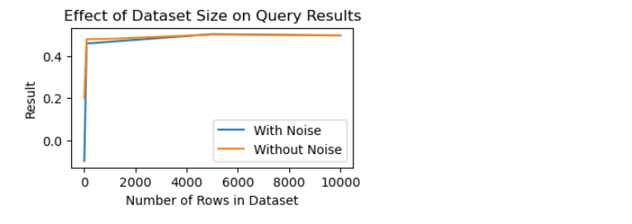
A Differential Approach To Privacy
Experiment 1
Result 1 :-

Slide 22
A Differential Approach To Privacy
Experiment 2
Objective 2 :-To privatize the IMDB dataset using GloVe(300d) embeddings and evaluate the accuracy of the privatized dataset in sentiment classification on both Training time and Test time configurations.
Input :- IMDB dataset consisting of 25,000 reviews for training and 25,000 reviews for testing.
Output :-
The difference in accuracy between the Baseline model and Training time accuracy is significant at 23.83%, which decreases to 2.96% with increasing values of 𝜖.
In contrast, the difference between Baseline accuracy and Test time accuracy is 30.79%, decreasing to 7.34% as the value of 𝜖 increases.
This trend confirms that utility increases as privacy guarantee decreases.

Slide 23
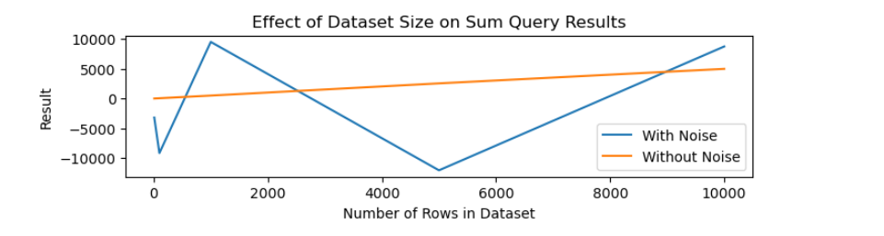
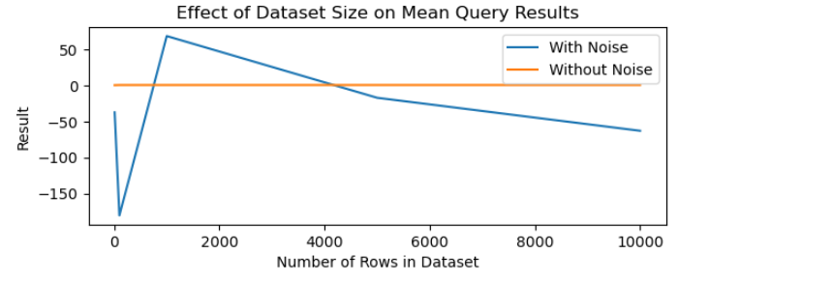
A Differential Approach To Privacy
Experiment 2
Result 2 :- Outputs of Global Differential Privacy does not depends on size of dataset.

Slide 24
A Differential Approach To Privacy
Experiment 3
Objective 3: To draw the epsilon vs accuracy plot showing the relationship between accuracy and epsilon for both GloVe (50d) and GloVe (300d) embeddings, visualizing the trade-off between privacy and utility and comparing it with the accuracy of the baseline model.
Input: Various values of 𝜖 and the corresponding accuracies for training and test times.
Output :-
For both GloVe (50d) and GloVe (300d), the test time accuracies are lower than the training time accuracies, indicating that the models perform better when trained on the privatized data compared to when trained on non-privatized data.
The accuracies generally increase with higher epsilon values, indicating that as the privacy guarantee decreases, the utility of the models increases as expected.
The accuracies of GloVe (300d) are generally higher than those of GloVe (50d), suggesting that the 300-dimensional embeddings capture more nuanced semantic information than the 50-dimensional embeddings.

Slide 25
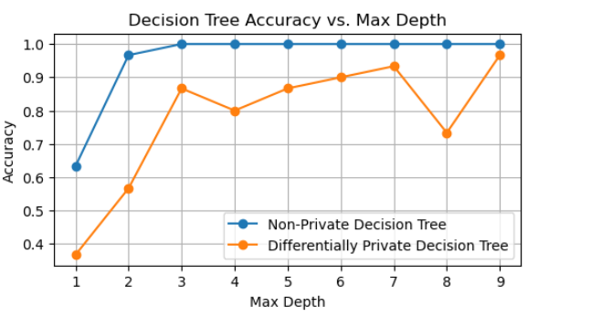
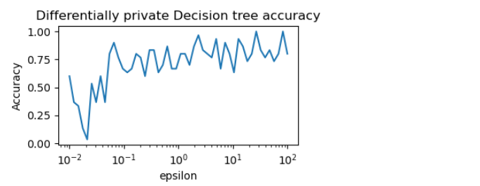
A Differential Approach To Privacy
Experiment 3
Result 3 :-
The accuracy of Private Decision Tree increases with increase in maxdepth.
With increase in values of epsilon, accuracy of Private Decision Tree increases.
There is a tradeoff between accuracy and Privacy Leakage in DPDT.

Slide 26
A Differential Approach To Privacy
Conclusion.
The proposed algorithm offers increased privacy at the expense of reduced utility, making it suitable for privatizing information or data.
A clear trade-off between privacy and utility is observed, where higher epsilon values result in higher accuracies but lower privacy guarantees.
GloVe (300d) embeddings generally outperform GloVe (50d) embeddings in terms of accuracy.

Slide 27
Future Direction
Future work can include evaluating the impact of our modifications on the values of 𝑁𝑊 to quantify the improvement in privacy more effectively.
Furthermore, assessing the performance of this algorithm on other embeddings such as ELMo, Gilbert, etc., will help understand its suitability and limitations.

Slide 28
Timeline
TASK | AUG 23 | SEP 23 | OCT 23 | NOV 23 | DEC 23 | JAN 24 | FEB 24 | MAR 24 | APR 24 | MAY 24
Review of PPDM Techniques.
Implementing LDP,GDP and DPDT
Extending DP to NLP.
Submission of thesis for publication.
REPROT WRITING
Final MTP Presentation.
Work done

Slide 29
A Differential Approach To Privacy
References
T. O.Feyisetan, B.Balle and T.Diethe (2019). Privacy- and utility-preserving textual analysis via calibrated multivariate perturbations. Proceedings of the 13th International Conference on Web Search and Data Mining.
K. M.E. Andrés, N.E.Bordenabe and C.Palamidessi (2012). Geo-indistinguishability: differential privacy for location-based systems. Proceedings of the 2013 ACM SIGSAC conference on Computer & communications security.
R. V.Bindschaedler and C.A.Gunter (2017). Plausible deniability for privacy-preserving data synthesis. ArXiv, abs/1708.07975.
N. K.Chatzikokolakis, M.E.Andrés and C.Palamidessi, Broadening the scope of differential privacy using metrics. In International Symposium on Privacy Enhancing Technologies. 2013.
5) K. C.Dwork, F.McSherry and A.D.Smith (2006). Calibrating noise to sensitivity in
private data analysis. J. Priv. Confidentiality, 7, 17–51.and 18 more.

Slide 30

???????????????

Slide 31

THANK YOU

