Slide 1
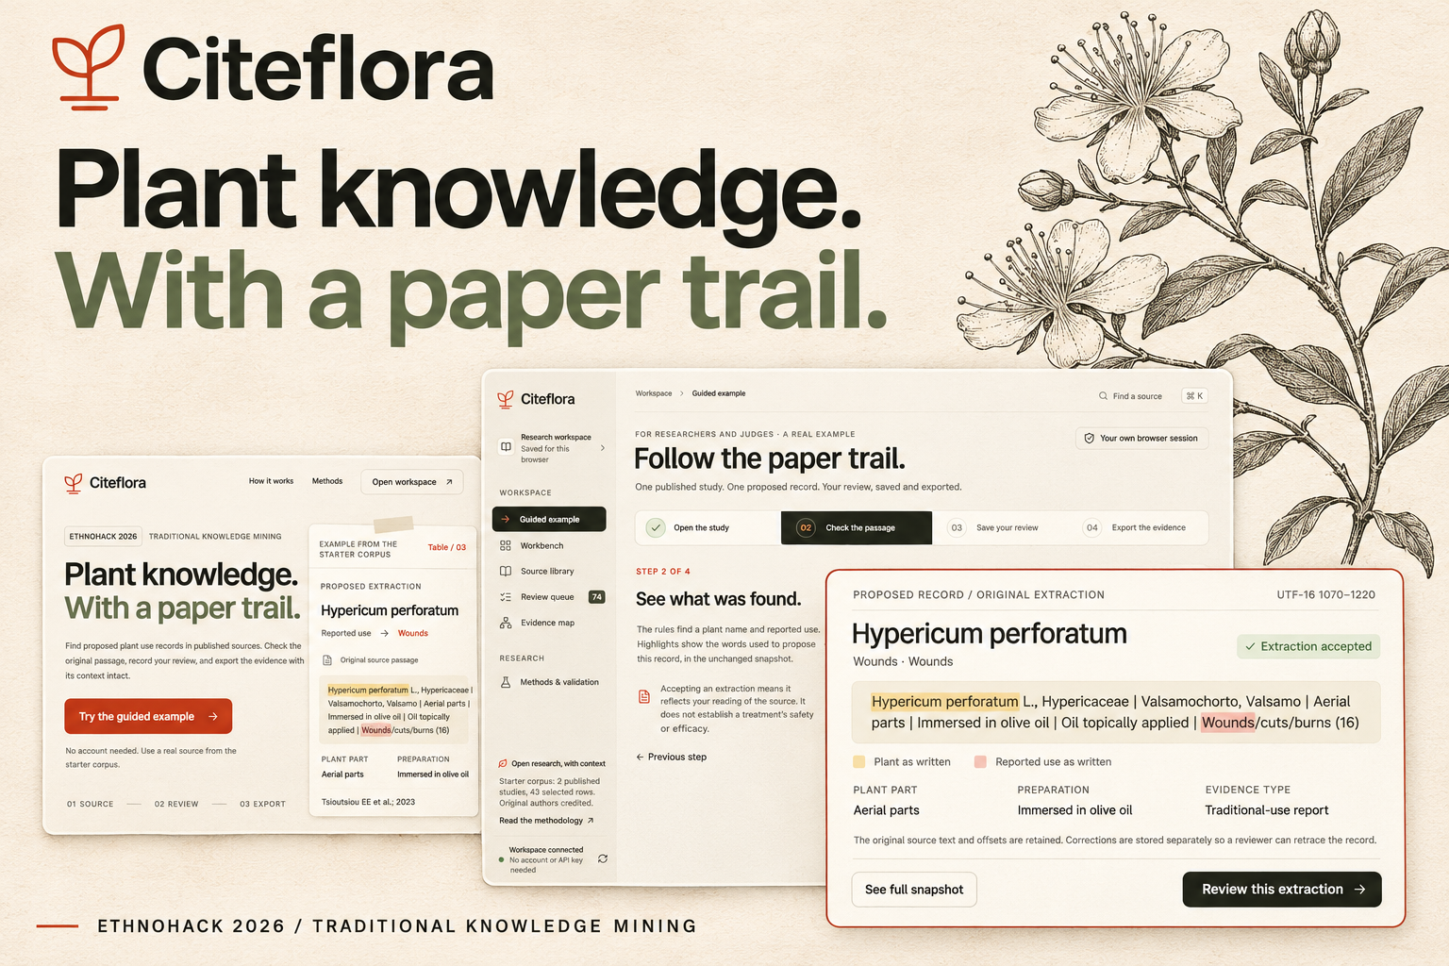
EthnoHack 2026
Citeflora
Plant knowledge.
With a paper trail.
A research workspace for
published plant use records
Notes:
Track 1: Traditional Knowledge Mining. Citeflora proposes candidate extractions from published reports, preserving source context. It does not provide treatment advice or clinical validation. Artwork generated with imagegen using the actual interface as a reference. Significant ChatGPT/Codex assistance contributed to research, implementation, design and verification. Human team members must review the submission and confirm their individual contributions.

Slide 2
Plant-name ambiguity
“Mint”
Possible candidates in the current lexicon
Mentha spicata
A source can preserve a name
without identifying a species.
Mentha longifolia
Mentha × piperita
Citeflora keeps that uncertainty
visible during review and export.
Identity requires contextual evidence.
Citeflora
2
Notes:
Problem context: Kew Medicinal Plant Names Services, https://www.kew.org/science/our-science/science-services/medicinal-plant-names-services. The mint example is a developer-authored illustration of bounded candidate handling, not a botanical determination. The three candidates are defined in lib/engine.mjs. An exact string match alone does not establish historical identity.

Slide 3
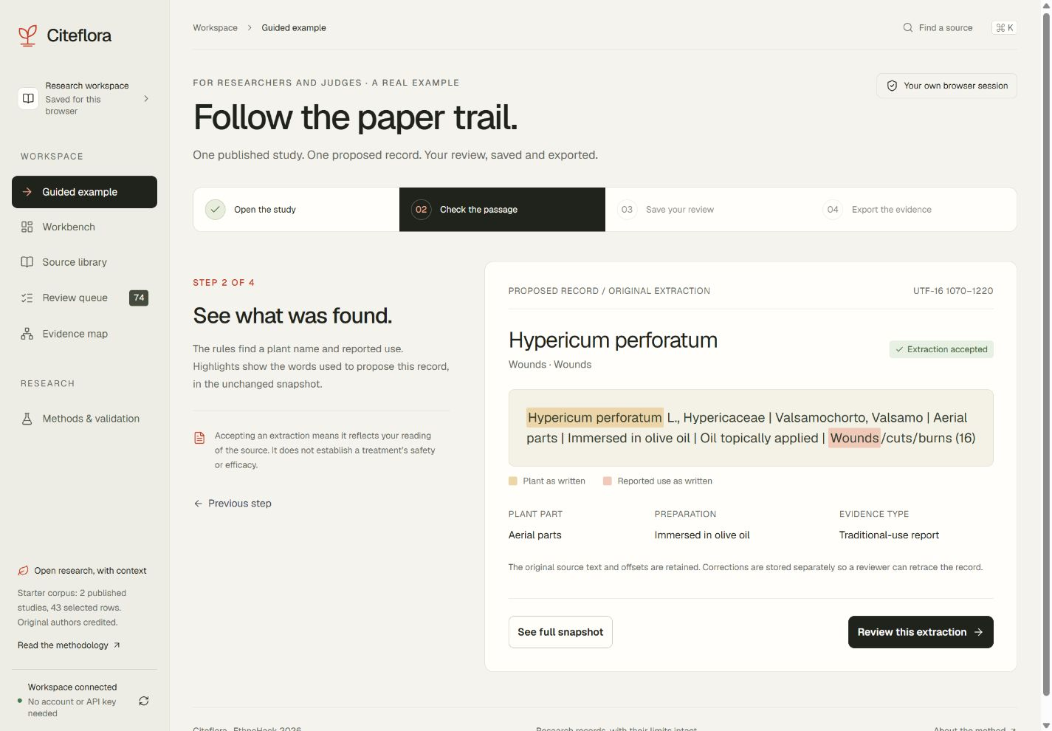
A guided path through one real record
The guided example
1. Open the study
2. Check the passage
3. Save your review
4. Export the evidence
Original text remains unchanged.
Citeflora
3
Notes:
Actual hosted application screenshot captured during production verification, November 2026. Starter corpus: data/corpus.json. Frontiers DOI https://doi.org/10.3389/fphar.2023.1225580 and MDPI DOI https://doi.org/10.3390/plants13101379. Both retain original author credit and CC BY terms in source records. One developer QA review appears in this screenshot. It does not represent domain-expert or clinical validation.

Slide 4
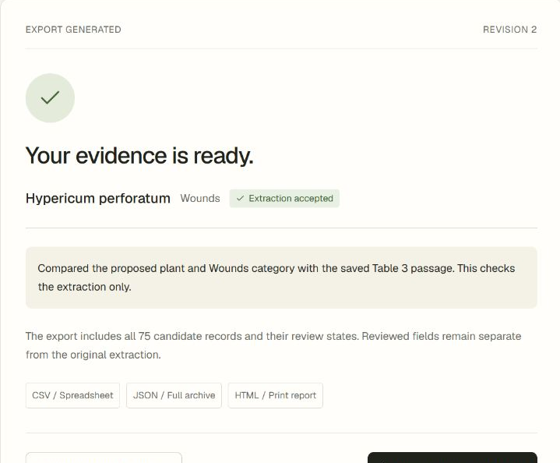
Saved reviews travel with the export
Researchers inspect the quote,
record their decision, and export
the evidence with its citation.
The export keeps the original text,
review status, and recorded note.
Acceptance checks the extraction.
Clinical validity remains unassessed.
Citeflora
4
Notes:
Actual saved review and generated CSV export from the Vercel application after a real D1 write. Source: Tsioutsiou EE, Cheilari A, Aligiannis N (2023), DOI https://doi.org/10.3389/fphar.2023.1225580, selected Table 3 row. The note is explicitly a developer QA extraction check. Taxonomy comes from the dated GBIF reference file, provider record https://api.gbif.org/v1/species/3189486. GBIF score describes name matching only. Reviewer corrections are separate from original extraction fields.

Slide 5
Architecture and evidence flow
Vercel workspace
Next.js and React
Vercel API bridge
Origin and cookie checks
Cloudflare Worker
Session, rules and review
Evidence downloads
CSV, JSON and HTML
GBIF and Europe PMC
Dated and live references
D1 database
Sources and reviews
Source hashes and review revisions remain available in exports.
Citeflora
5
Notes:
Implementation references: app/workspace.tsx, lib/server.ts, lib/engine.mjs, lib/external.ts, db/schema.ts, worker/index.ts. Next.js 16 and React 19 on Vercel, with an authenticated same-origin API bridge to the standalone Cloudflare Worker and D1 persistent storage. Six D1 tables: workspaces, sessions, sources, claims, audit, rate_limits. Writes enforce same-origin JSON and session-scoped SQL. Known names use 24 dated GBIF references; other names use live requests. Europe PMC search attempts the live API, with a labelled one-paper catalogue fallback. Visitors need no account or API key. Operators configure the paired server-only proxy secret in Vercel and the Worker.

Slide 6
A bounded, attributed starter corpus
Published source | Selected rows | Candidates
Pelion skin-use study, 2023 | 21 | 49
Hajira study, 2024 | 22 | 26
Total | 43 | 75
18 source-reported taxa
75 / 75 exact passage spans
Integrity checks establish traceability. Scientific accuracy still needs independent evaluation.
Citeflora
6
Notes:
Values reproduced by node scripts/evaluate.mjs. Sources: Tsioutsiou EE, Cheilari A, Aligiannis N (2023), DOI https://doi.org/10.3389/fphar.2023.1225580, Table 3 selected 21 rows; Jabeen T et al. (2024), DOI https://doi.org/10.3390/plants13101379, Table 2 selected 22 rows. CC BY attribution remains in source metadata. The 18 taxa are source-reported identities. The 75 candidates are engine outputs, not expert-confirmed medicinal facts. 60 positive association groups are reported associations, with DOI deduplication and filtering of negative, uncertain, rejected and unassigned records.

Slide 7
Verification and current limits
Verified in this build | Current limit
50 regression and API checks pass | Developer-authored fixtures
75 source spans and both digests match | A small two-paper starter corpus
Hosted review and export verified | Browser session, no team accounts
Production dependency scan: 0 known advisories
Four moderate build-tool findings remain. No independent scientific validation.
Citeflora
7
Notes:
Verification: outputs/tests-final.txt, 50 passing developer-authored tests; TypeScript no-emit check; full configured ESLint check; standard Next.js and standalone Worker builds; scripts/evaluate.mjs source-span and digest checks. Browser verification uses the actual preview and hosted D1 services. Actual browser viewport checks at 390, 1280 and 1440 CSS px show no horizontal body overflow. Hosted checks reject cross-workspace writes, stale revisions and cross-origin writes. Production dependency audit reports zero known advisories; full toolchain audit reports four moderate findings and no high or critical findings. Some development-tool patches were too new for the retained minimum-release-age policy. These are time-bounded scan results, not proof of security. No domain-expert validation, load test, cross-browser matrix or measured extraction accuracy benchmark has been completed.

Slide 8
Next evaluation and access
Next: independent evaluation with
ethnobotany and pharmacognosy researchers
Broader language coverage and community-governed permissions
will require research partnerships and explicit consent.
Try the workspace
citeflora.vercel.app
github.com/adeelfalaksher900-creator/citeflora
Citeflora
8
Notes:
Live application: https://citeflora.vercel.app. Source repository: https://github.com/adeelfalaksher900-creator/citeflora. Proposed next work is not implemented: domain-expert evaluation with ethnobotany/pharmacognosy researchers, multilingual historical-name coverage, community-governed permissions, interoperable evidence schemas and team accounts. No user study or expert endorsement is claimed. Official EthnoHack track/rules: https://ethnohack2026.devpost.com/rules. Significant AI assistance is disclosed in the README and prepared Devpost story. Individual human contributions and Discord registration status remain for the team to verify.

