Slide 1



Application of Linear Algebra in Control Charts for Process Monitoring
PREDICTING DEATH EVENTS FROM CLINICAL DATA USING STATISTICAL CONTROL CHARTS
Presented By: Hamza Motiwala
Ahmed Bilal Nazim
Muhammad Adeel

Slide 2
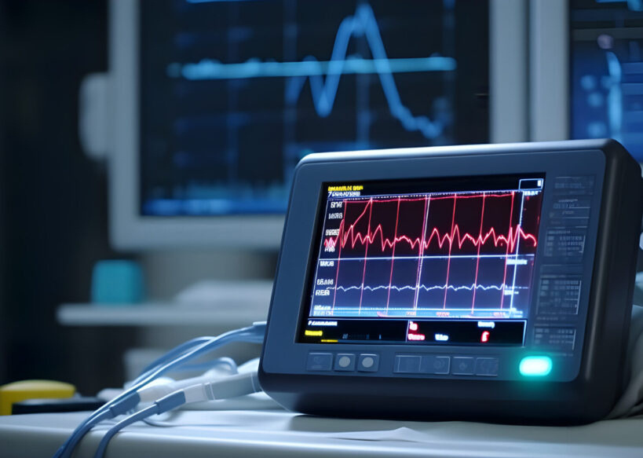

Introduction
OBJECTIVES: | Analyze relationships using covariance matrices
 | Monitor trends with control charts
 | Visualize data with SVD
Heart failure is a critical global health issue. Early detection of high-risk patients can improve survival rates.

Slide 3
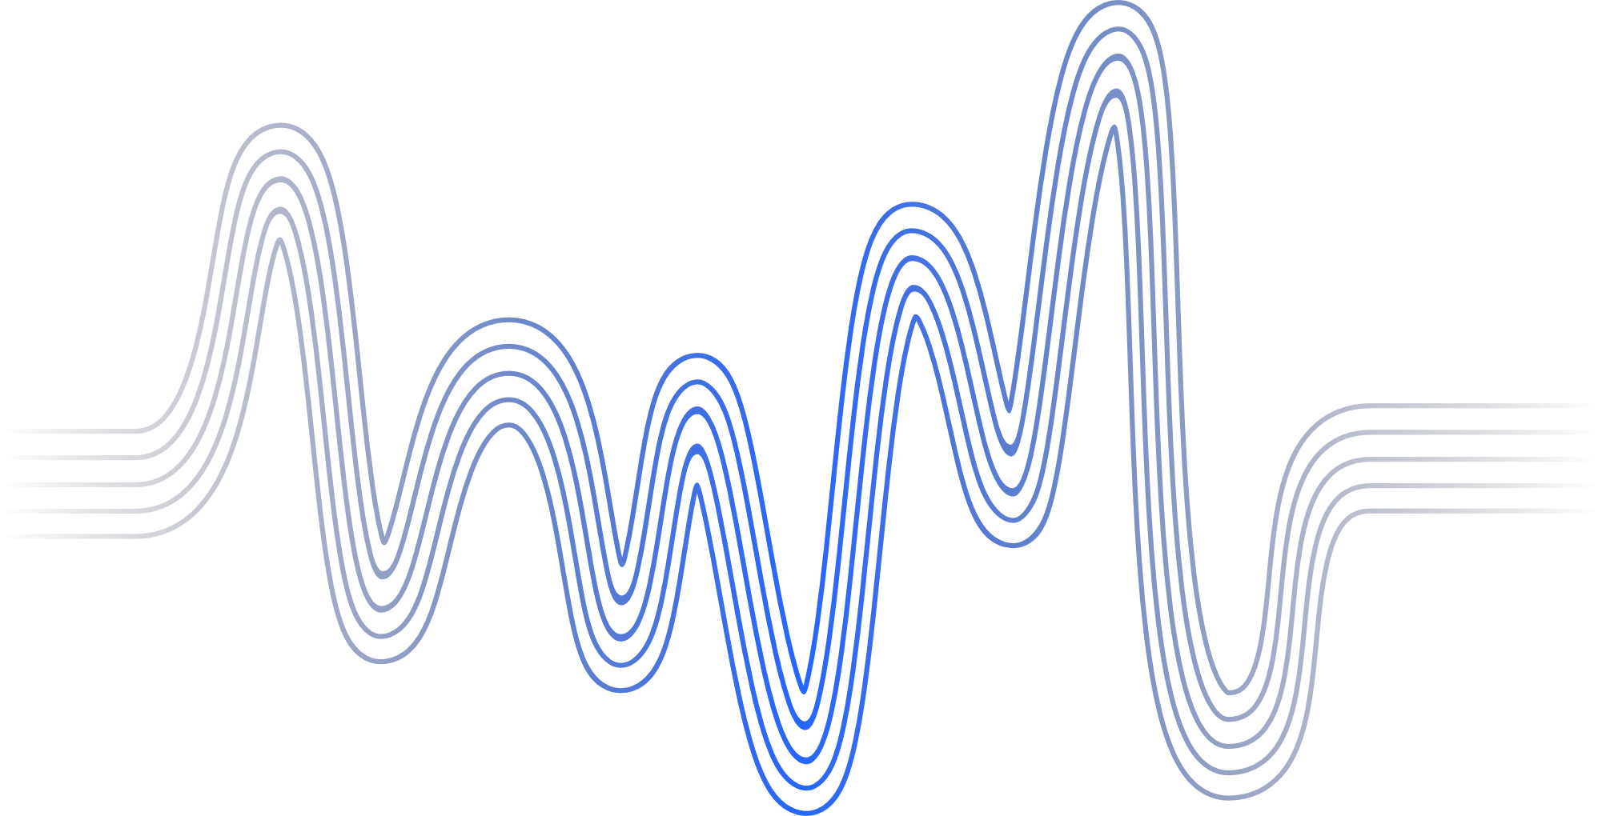
DATASET AND FEATURES
Key Features: | Age
 | Serum Creatinine
 | Ejection Fraction
 | Serum Sodium
 | Target: DEATH_EVENT (0: Alive, 1: Dead)
Significance: | These features are critical for identifying mortality risks.
Clinical data of heart failure patients.

Slide 4




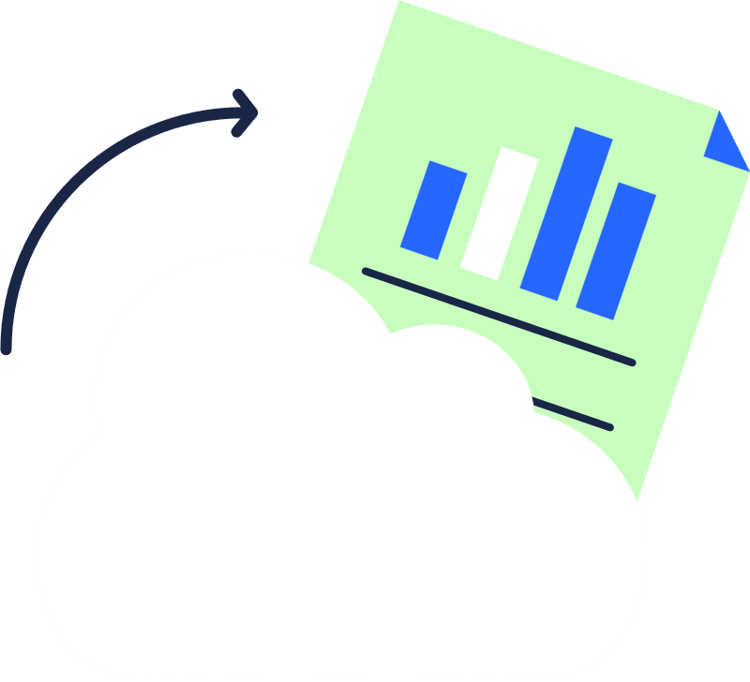
METHODOLOGY
DATA PROCESSING | COVARIANCE ANALYSIS | CONTROL CHARTS | DIMENSIONALITY REDUCTION
Cleaned missing values, standardized features. | Explored relationships between variables. | Monitored trends and variability. | Used SVD for cluster visualization.

Slide 5
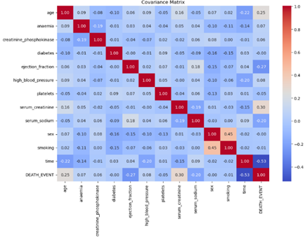
Covariance Analysis
Purpose: Identify key relationships in the data.
Findings:
Serum Creatinine vs. Mortality: Strong positive correlation (0.30).
Ejection Fraction vs. Mortality: Negative correlation (-0.27).
Survival Time vs. Mortality: Negative correlation (-0.53).

Slide 6
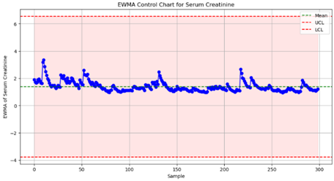
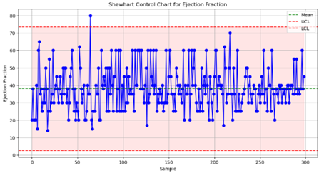
CONTROL CHARTS
Parameters Monitored:
Platelets: Variability trends.
Serum Creatinine: Kidney health indicators.
Ejection Fraction: Cardiac efficiency.
Key Insights:
Trends in control charts highlighted areas needing clinical attention.
Back to Agenda

Slide 7
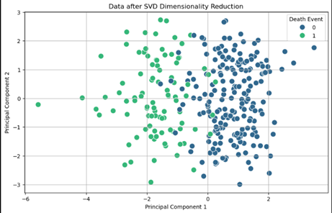
Back to Agenda
DIMENSIONALITY REDUCTION
SVD APPLICATION:
Reduced high-dimensional data to two components.
KEY RESULT:
Clear clusters separating survivors and non-survivors.

Slide 8

Key Results
CONTROL CHARTS PROVIDE ACTIONABLE INSIGHTS FOR MONITORING.
SERUM CREATININE AND EJECTION FRACTION ARE CRITICAL PREDICTORS.
SVD CONFIRMS VISUAL CLUSTERING OF SURVIVAL OUTCOMES.

Slide 9


DISCUSSION
Implications:
Improved patient monitoring through identified predictors.
Early intervention opportunities for high-risk patients.
Future Work:
Use machine learning for enhanced predictions.
Expand analysis to larger, diverse datasets.

Slide 10
Conclusion
CONTROL CHARTS AND SVD ARE EFFECTIVE TOOLS FOR MONITORING AND ANALYSIS.
SERUM CREATININE AND EJECTION FRACTION ARE STRONG MORTALITY PREDICTORS.
FUTURE INTEGRATION OF ML CAN ENHANCE PREDICTIVE ACCURACY.

Slide 11


References
MONTGOMERY, D. C. (2009). | Introduction to Statistical Quality Control. John Wiley & Sons.
JOLLIFFE, I. T. (2011). | Principal Component Analysis. Springer.
ROUSSEEUW, P. J., & LEROY, A. M. (2003). | Robust Regression and Outlier Detection. Wiley.
UCI MACHINE LEARNING REPOSITORY: | Heart Failure Dataset Description.

Slide 12
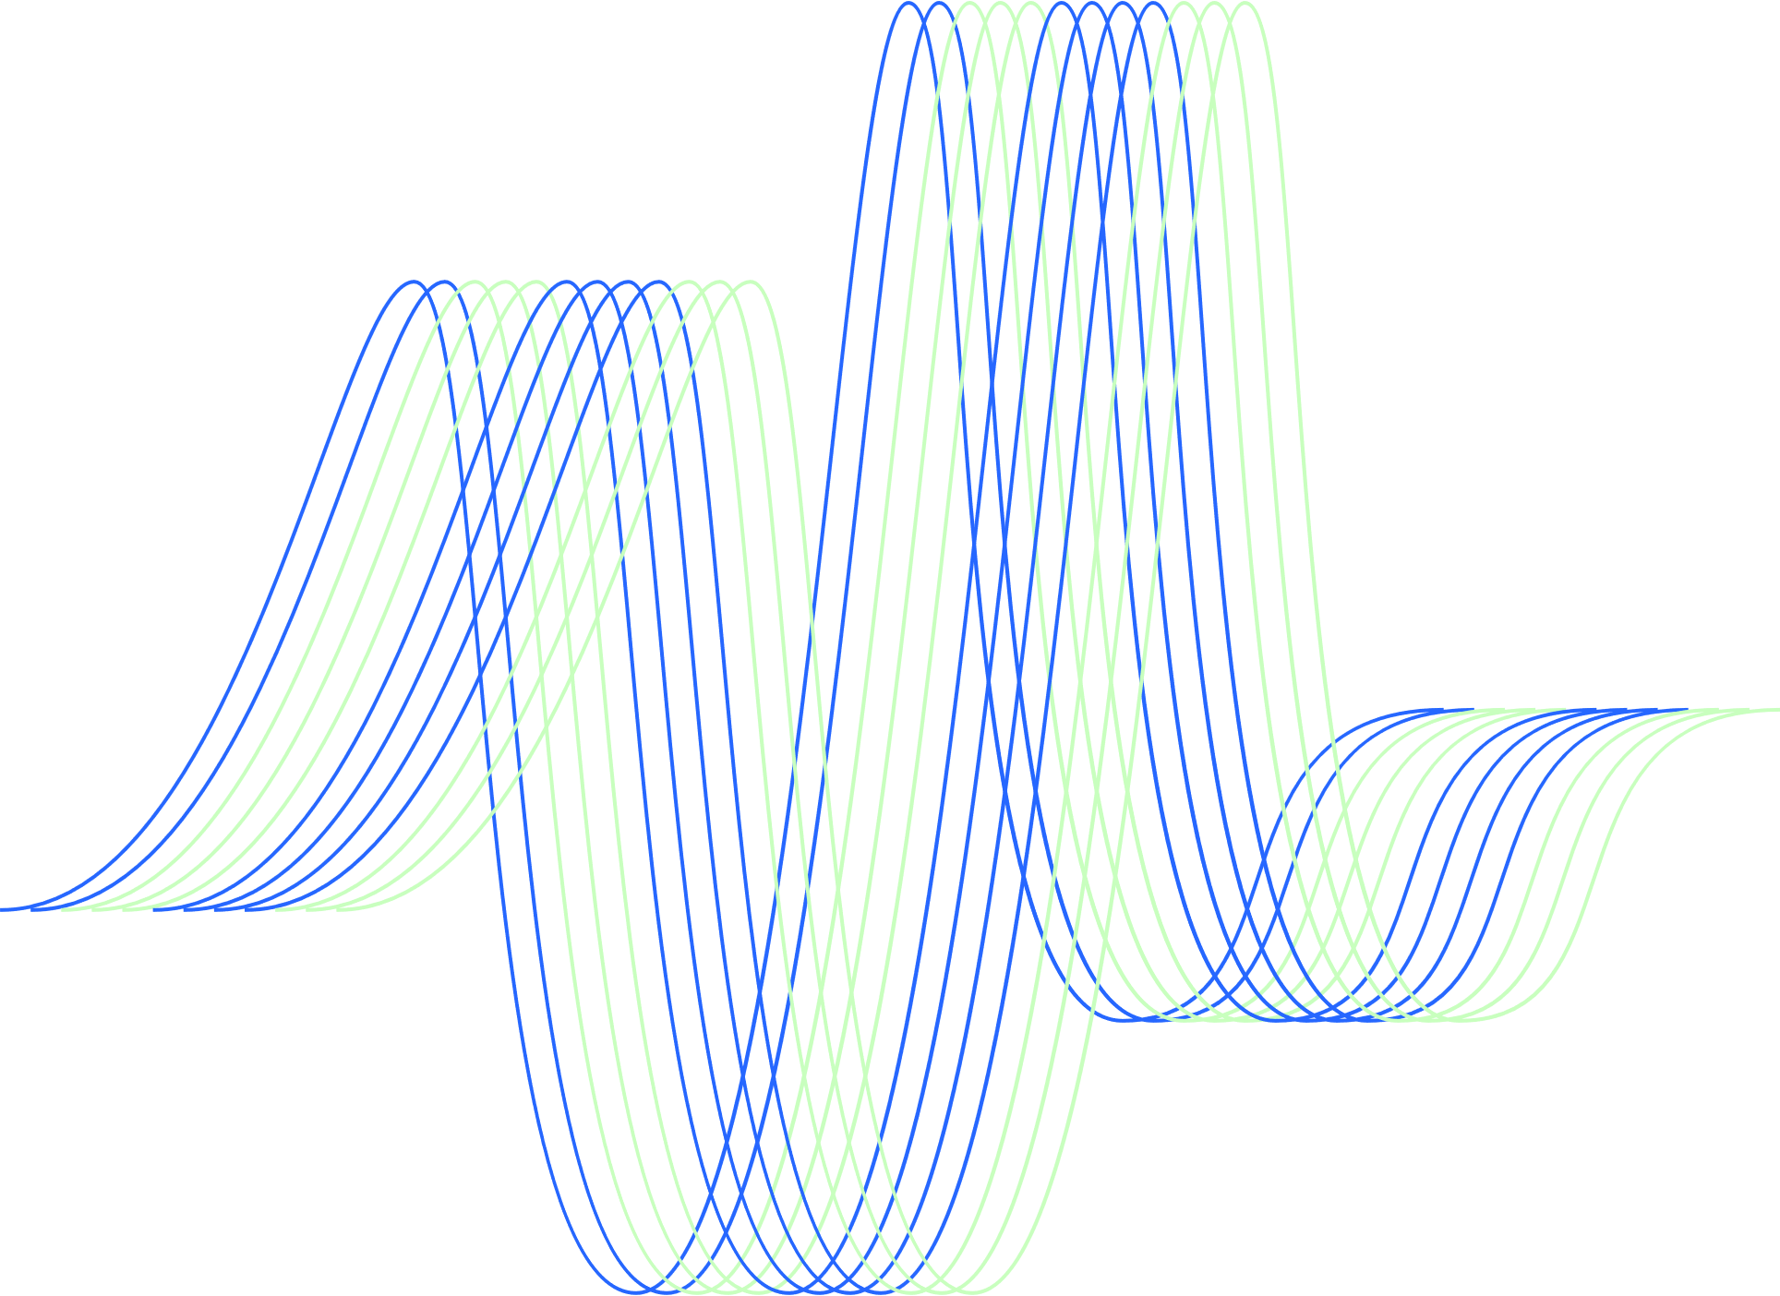
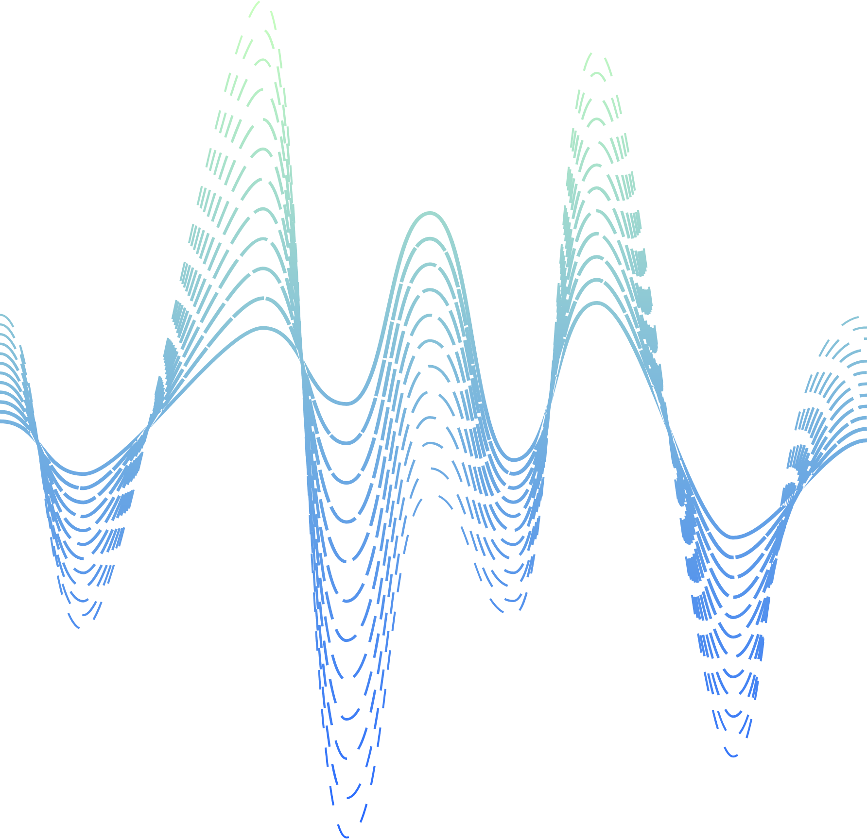
Thank You!

