Slide 1
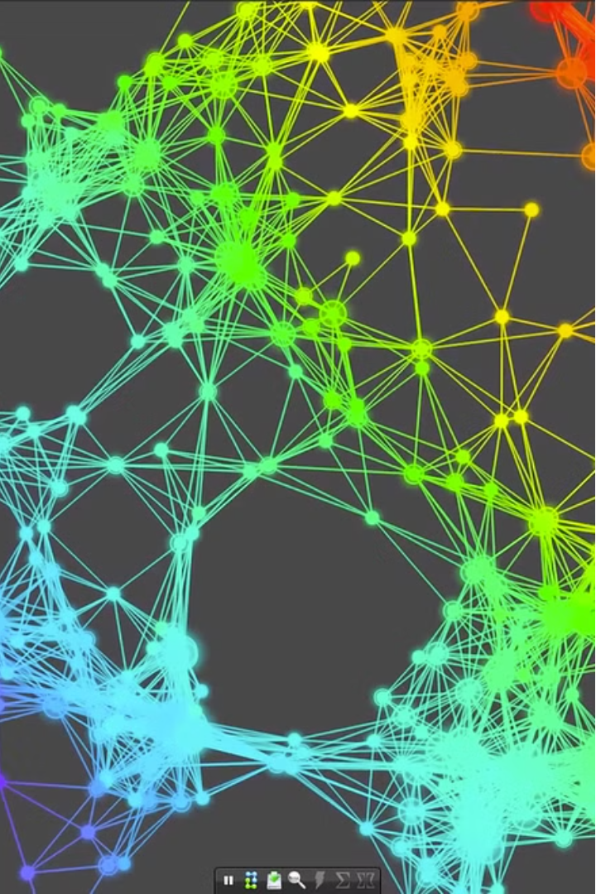
Coordinate Descent Optimization
A powerful optimization algorithm known for its simplicity and scalability, making it particularly effective in high-dimensional settings.
Group Members:
Muhammad Adeel - 2022331
Nauman Ali Murad - 2022479
Hasan Rais - 2022212
Hamza Zaidi - 2022379

Slide 2

Coordinate Descent Algorithm
An optimization algorithm that iteratively updates one coordinate (or dimension) of a vector at a time while keeping the other coordinates fixed. This process continues cyclically until convergence is achieved.
Features
Iterative Updates
Cyclic Updates
Scalability
The algorithm focuses on one coordinate at a time.
It updates the coordinates in a fixed, cyclic order.
Handles high-dimensional problems efficiently.

Slide 3
Applications of Coordinate Descent
Convex Optimization
Machine Learning
Limitations
Effective in solving large-scale convex problems
Used in Lasso regression and support vector machines
May converge slowly or struggle with non-convex problems

Slide 4
About The Dataset
Chosen Dataset: ‘candy-data.csv’ from Kaggle.
1
Diverse Attributes
2
Continuous Variables
Chocolate, fruit, caramel, peanuts, nougat, crisped rice
Sugar and price percentiles

Slide 5
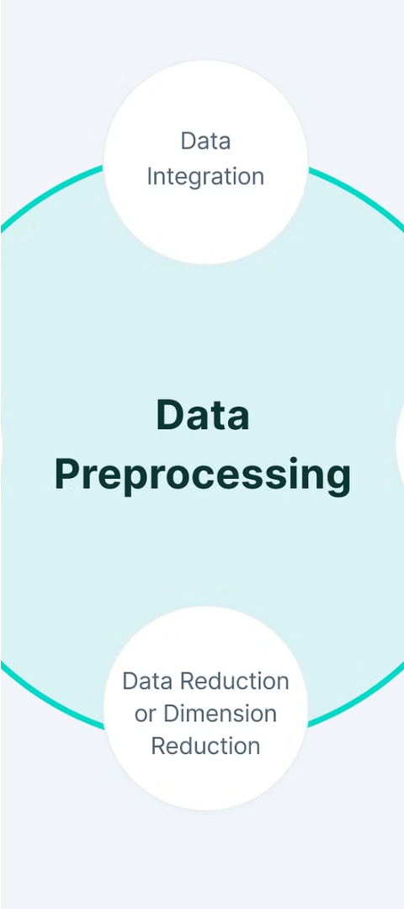
Data Preprocessing
Feature Engineering
Train-Test Split
One-hot encoding categorical features.
Removing irrelevant columns.
Reserving 20% of data for testing
Standardization
Applied StandardScaler for feature uniformity.

Slide 6
Coordinate Descent Implementation
1
Defining Functions
Sigmoid function for logistic regression,
log-loss function for model evaluation.
2
Error Calculation
Initialized weights, computed initial log-loss,
iteratively updated model parameters.
3
Comparison and Loss Tracking
Evaluating against Logistic Regression model
Enhanced CD algorithm to track and visualize loss over iterations

Slide 7
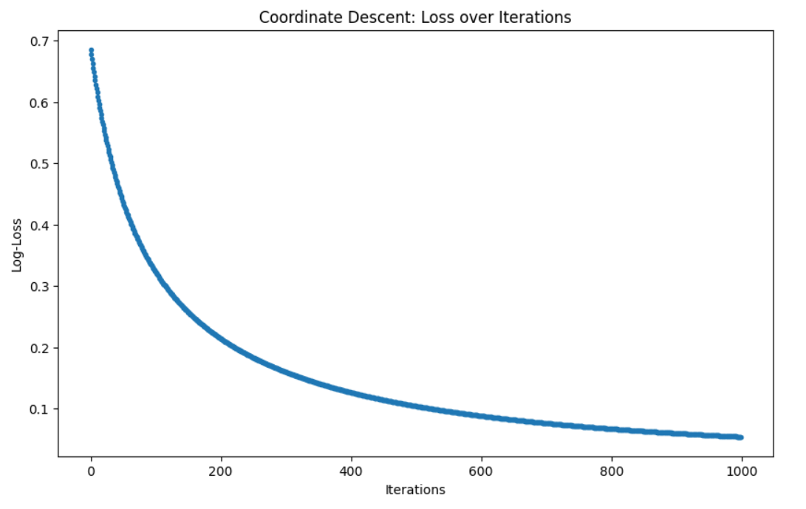
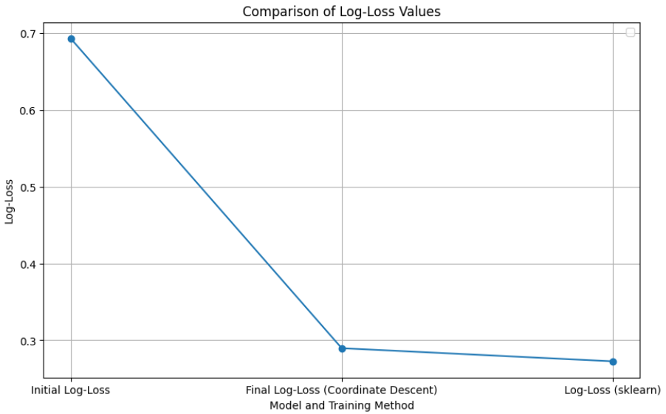
Optimization Comparison
Coordinate Descent
Comparison of Optimization Methods
Initial Log-Loss with zero weights: 0.693
Final Log-Loss after Coordinate Descent: 0.289
Initial Log-Loss with zero weights: 0.693
Final Log-Loss after Coordinate Descent: 0.289
Final Log-Loss after Gradient Descent: 0.272

Slide 8



Limitations and Future Work
Slow Convergence
No Step Size
Non-Convex Problems
Coordinate Descent may converge slowly
Coordinate Descent does not have step size
Coordinate Descent may struggle with non-convex problems

Slide 9
Conclusion
Effectiveness
CD is effective for high-dimensional datasets
Limitations
Slower convergence and no step size
Future Research
Focus on enhancing convergence properties and adaptive step size strategies

