Slide 1



Bay Area Real Estate Unveiled: A Data-Backed Perspective

Slide 2
Who we are?
Adeel Nasir
Kranthi kumar Irala
Azmat Ahmed Shaik
Karthikeyan Velusamy
Srilekha Matam
Chandana kandula
Aparajita Srinivasan
Dhruvish Manishbhai Chanchad

Slide 3
What’s our agenda today?
Introduction
01
Data-Source
02
Data
03
Insights from the data
04
Predictive analysis
05
3

Slide 4
Introduction
01
The San Francisco Bay Area, often referred to as the 'Tech Capital of the World,’ or ‘Silicon Valley’ encompasses a diverse range of cities and communities surrounding the iconic San Francisco Bay. This region is renowned for its innovation, cultural richness, and stunning landscapes
Silicon Valley's real estate market is defined by its global tech hub status, marked by high property values driven by the strong demand from tech professionals and executives.
02

Slide 5
Continuation…
The presence of major tech giants like Google and Apple in the region exerts a significant influence, creating robust demand for housing near tech campuses, affecting both home prices and rental rates
03
Silicon Valley's real estate landscape is characterized by diversity in property types, offering everything from luxurious homes in prestigious neighborhoods to ambitious urban redevelopment projects
04

Slide 6
What was our aim?

Slide 7

Rent Vs Sale properties comparison of various cities in bay area
Affordability Assessment
Investment Potential
ROI Calculation
Comparison between Downtown vs Suburban properties
Finding about the comparison between sales and rental properties in downtown vs suburban would shed some light on the actual demand vs supply dynamics in the real estate market
Zip-code wise real Estate analysis
Hyperinflation analysis
Economic indicators
Demand-supply dynamics

Slide 8
Where did we get our data?

Slide 9

Data Source
Based in Seattle, Redfin Corporation provides residential real estate brokerage and mortgage origination services. The company operates in more than 100 markets in the United States and Canada. The company has a 0.80% market share in the United States by number of units sold and has approximately 2,000 lead agents.

Slide 10
How was our data looks like?

Slide 11
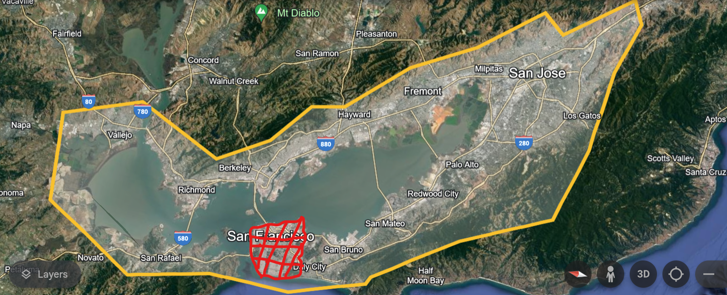
Data
Total 19 cities ( Entire Bay area except San Francisco)
Where are our data from?

Slide 12
Data Source
We scrapped Sales and Rental properties using beautiful soup library
Raw data | Sales | Rental
# of Rows | 2404 | 1997
# of Columns | 19 | 17

Slide 13
Data Source
After cleaning the data our final data-source had the following size
Cleaned Data | Sales | Rental
# of Rows | 1937 | 1289
# of Columns | 11 | 8

Slide 14
Data
What Sales & Rental data have common ?
Column
Price
Beds
Baths
Area_Sqft
City
Zip

Slide 15

Data
Where both Sales & Rental data differs?
Rental
Column
Property Type
Community
Lot_Size_Sqft
EMI (est)
Price/Sqft
HOA Dues
Sales
Column
# of Parking
# of In-Unit Aminities
# of Community Aminities

Slide 16
Dataset description
Community
Area of the property location
City
Property location in which city
Baths
Number of Bathrooms
Beds
Number of Bedrooms
Price
Total price of the property
Area_sqft
The total area of the property
Property Type
Type of property
Built year
Property built year
EMI
Equated Monthly Instalment of the property
Style
Style of the property built
4

Slide 17
Date Cleaning (to be filled by adeel)
Step 1
01
Step 4
03
04
Step 2
05
Step 5
Step 3
03
Step 7
06

Slide 18
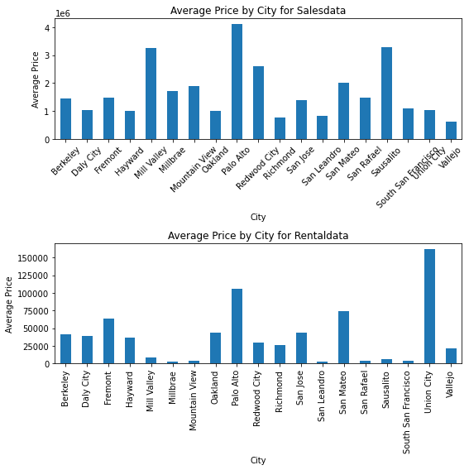
Data Visualization
Add visualizatioontent here

Slide 19
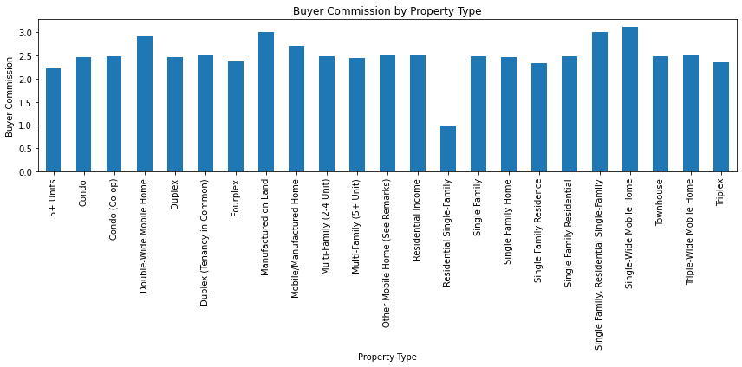
Add visualization content here

Slide 20
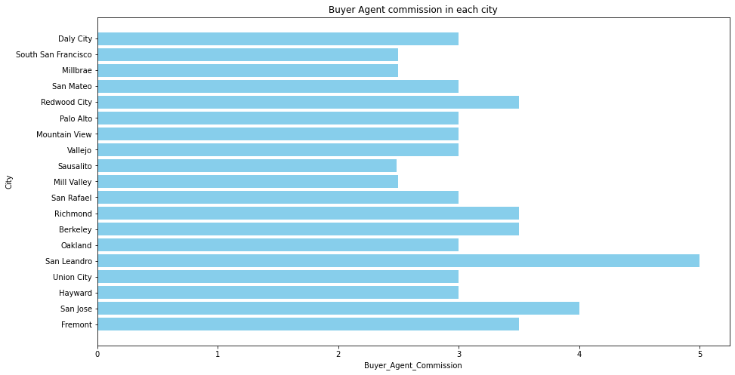

Slide 21
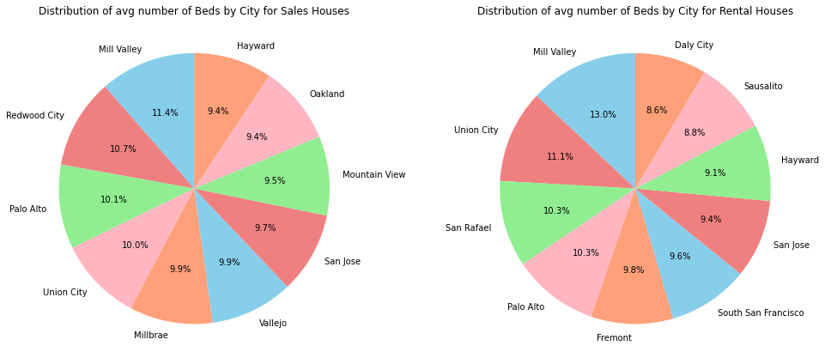

Slide 22
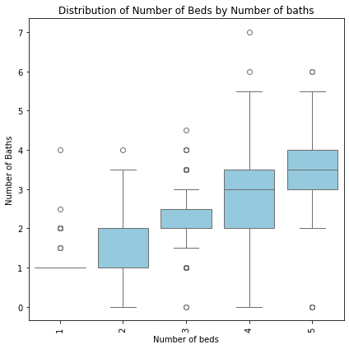

Slide 23
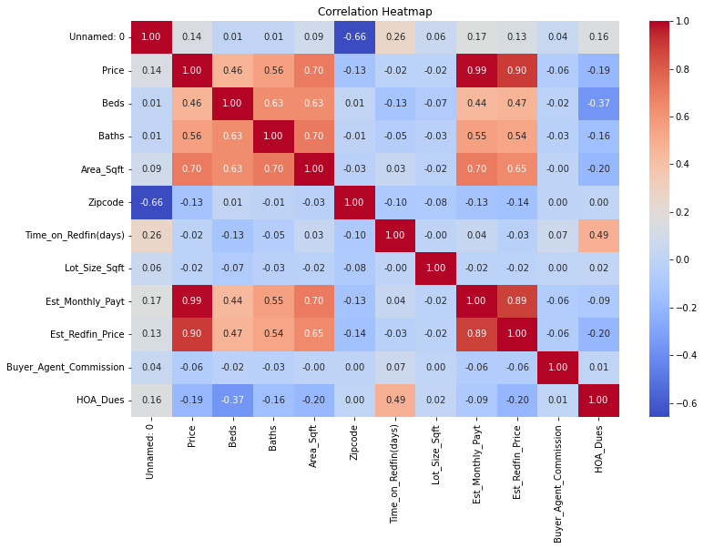

Slide 24
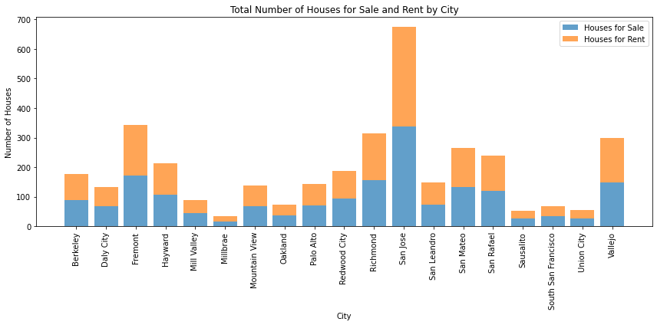

Slide 25
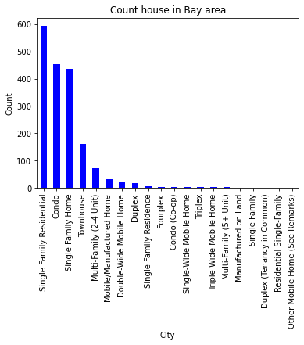

Slide 26
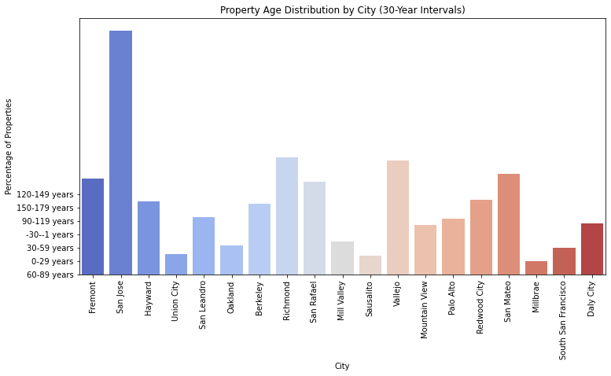

Slide 27
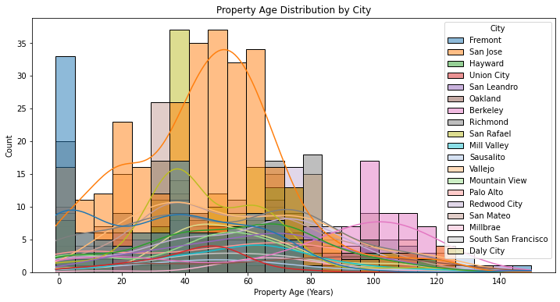

Slide 28
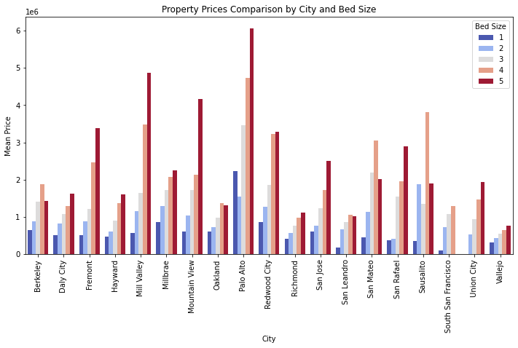

Slide 29
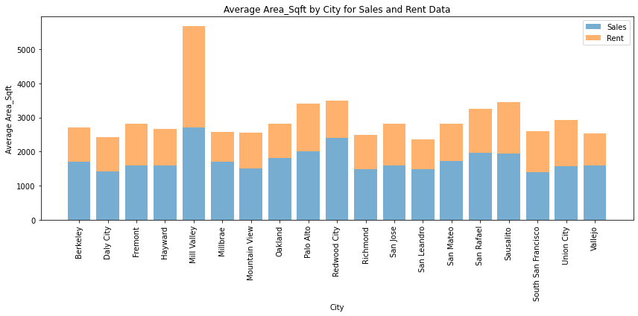

Slide 30
Prediction Analysis
Defining numerical and categorical column
Splitting data into test and train data using sklearn
01
Steps
02
We use StandardScaler to scale the data. Then, we created a linear regression model and Decision Tree
03
04
We have predicted the values and calculated the ME, RMSE, and MAE to make inferences

Slide 31
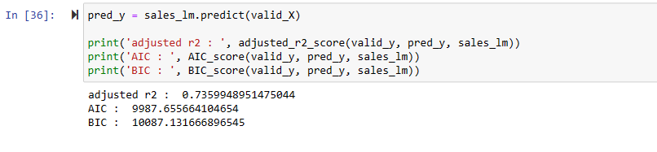
Linear Regression model

Slide 32
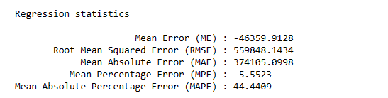
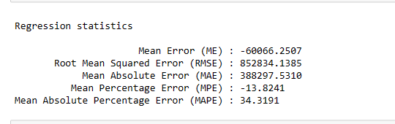
Error – Linear Regression model
Error – Decision Tree Regression model

Slide 33
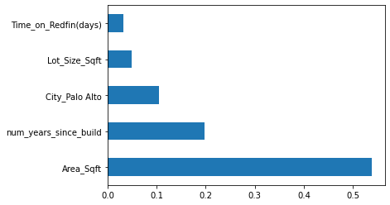
From the above plot, we see that Area is the most important factor in terms of determining the price of the house followed by the years it was built

Slide 34

Summary
34

Slide 35




Thank you

