Slide 1
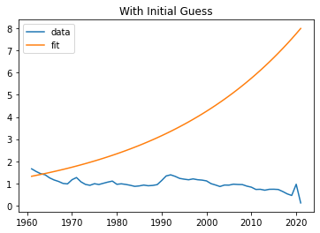
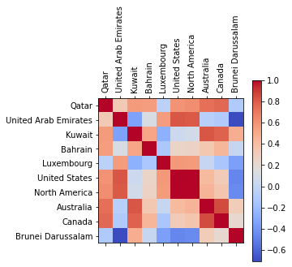
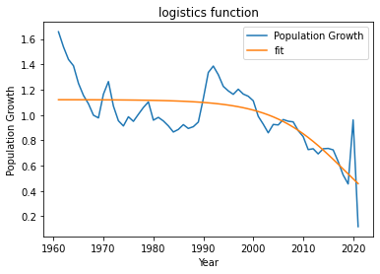
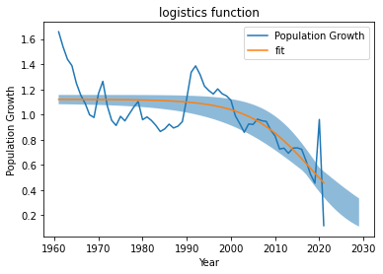
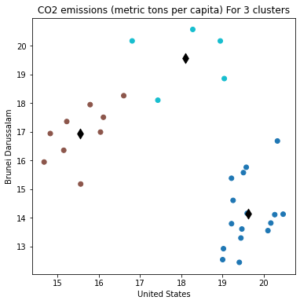
Analysis of USA and Brunei Darussalam CO2 emission and USA Population Growth (%) Prediction Author: Muhammad Adeel Riasat
Introduction:
This task involved performing k-means clustering on two countries, USA and Brunei Darussalam, using the scikit-learn library in Python. The k-means clustering algorithm was used to group similar data points together based on their similarities in various features. Additionally, population growth for the USA was also estimated using the curve_fit method from the scipy library. The curve_fit method allowed us to fit a logistic function to the population data and make predictions about future population growth. Overall, this task involved exploring different data analysis techniques in Python to gain insights into population growth and country-level data clustering.
Summary
First I found top 10 countries with highest CO2 emissions the which can be seen in below heat map. As columns which are highly +ive or –ve correlated are not best for clustering so I choose USA and Brunei Darussalam. Then I observed the population growth (%) for USA to predict the population growth for USA. From this analysis we can also check weather the population growth has any effect of CO2 emission or not.
Fitting:
The analysis on USA population growth has been performed, and the predicted results have been obtained using curve_fit function and the logistic function model. Error ranges have also been calculated for the predicted results, and the fill_between function has been used to visualize the uncertainty in the predicted results. The analysis suggests that the population growth for USA is expected to slow down over the next few decades, but it will still continue to grow, albeit at a slower pace.
Results:
Based on the analysis, it was found that the best result for clustering can be achieved using three centers. This implies that the data can be divided into three distinct groups or clusters that exhibit similar characteristics. The clustering algorithm used likely relied on various metrics to determine the optimal number of clusters, such as the elbow method or silhouette analysis.
In conclusion, the analysis involved two main aspects: clustering using k-means algorithm for USA and Brunei Darussalam, and predicting population growth for the USA using curve_fit.
For the clustering analysis, the k-means algorithm was applied to identify similar patterns and group data points based on certain features. This allowed for a better understanding of the characteristics and similarities between the two countries.
In the population growth analysis, curve_fit was utilized to estimate the future population growth for the USA. The logistic function model was fitted to the population data, enabling predictions about future trends.
Overall, these analytical techniques contributed to a deeper understanding of the data, allowing for insights into the clustering patterns of the countries and predictions about the future population growth.

