Slide 2
First step
Cleaning the src files.
Reportwebvitals
Index.js (cleaning)
Remove Index.css
Installation - Chakra UI (chakra-ui.com)

Slide 5
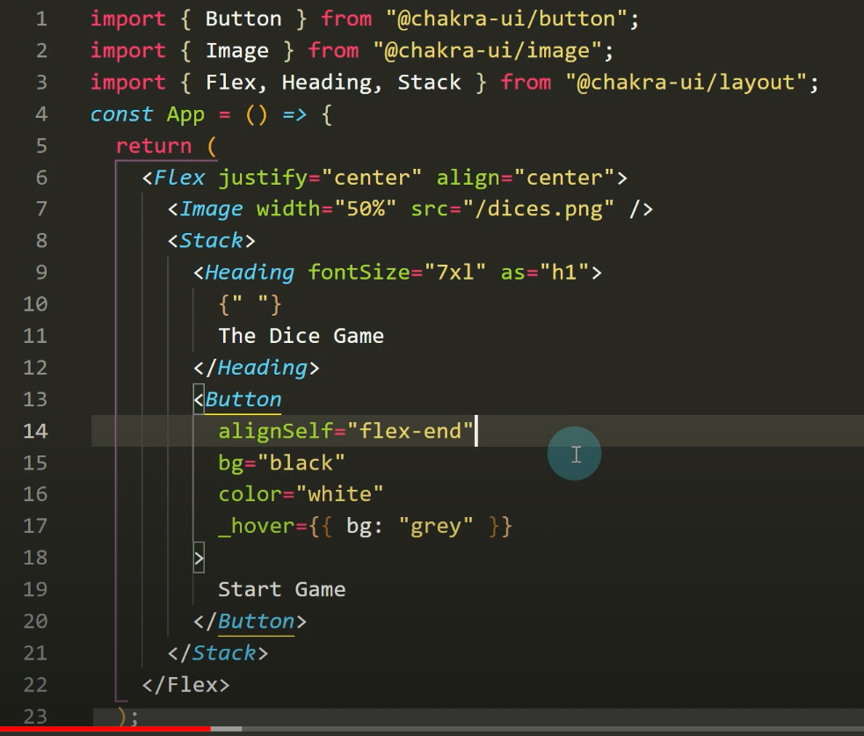

Slide 6
