Slide 1

Securing Wireless Vehicle Communications
HB-RPVAM: Hybrid Reputation-Based Blockchain & Proxy Authentication Model
Adeem Azad (2705207A)

Slide 2
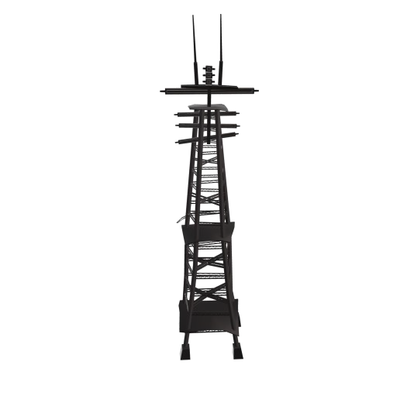


Why Secure Wireless Vehicle Communications?
Vehicles exchange critical real-time data:
Collision avoidance
Emergency braking alerts
Traffic congestion notifications
Cyber security threats can lead to:
Impersonation and data theft
Accidents and severe safety risks
Traditional methods struggle at large scale
RSU
Impersonation Attack
Message Exchange
Replay Attack
Eavesdropping
Vehicle
Attacker

Slide 3
Current Gaps in State of the Art
PKI-Based Authentication (Public Key Infrastructure)
Heavy certificate overhead
Blockchain Based Authentication
High latency & gas costs
ID-MAP (Identity-based Message Authentication scheme using Proxy vehicles)
Lacks robust trust mechanism

Slide 4
Introducing HB-RPVAM (Hybrid Reputation-Based Blockchain & Proxy Vehicle Authentication Model)
Reputation-driven dynamic trust score
Efficient Proxy batch verification (O(log n))
Blockchain with Layer 2 scalability (Low cost, High speed)
Advanced AI-driven anomaly detection

Slide 5
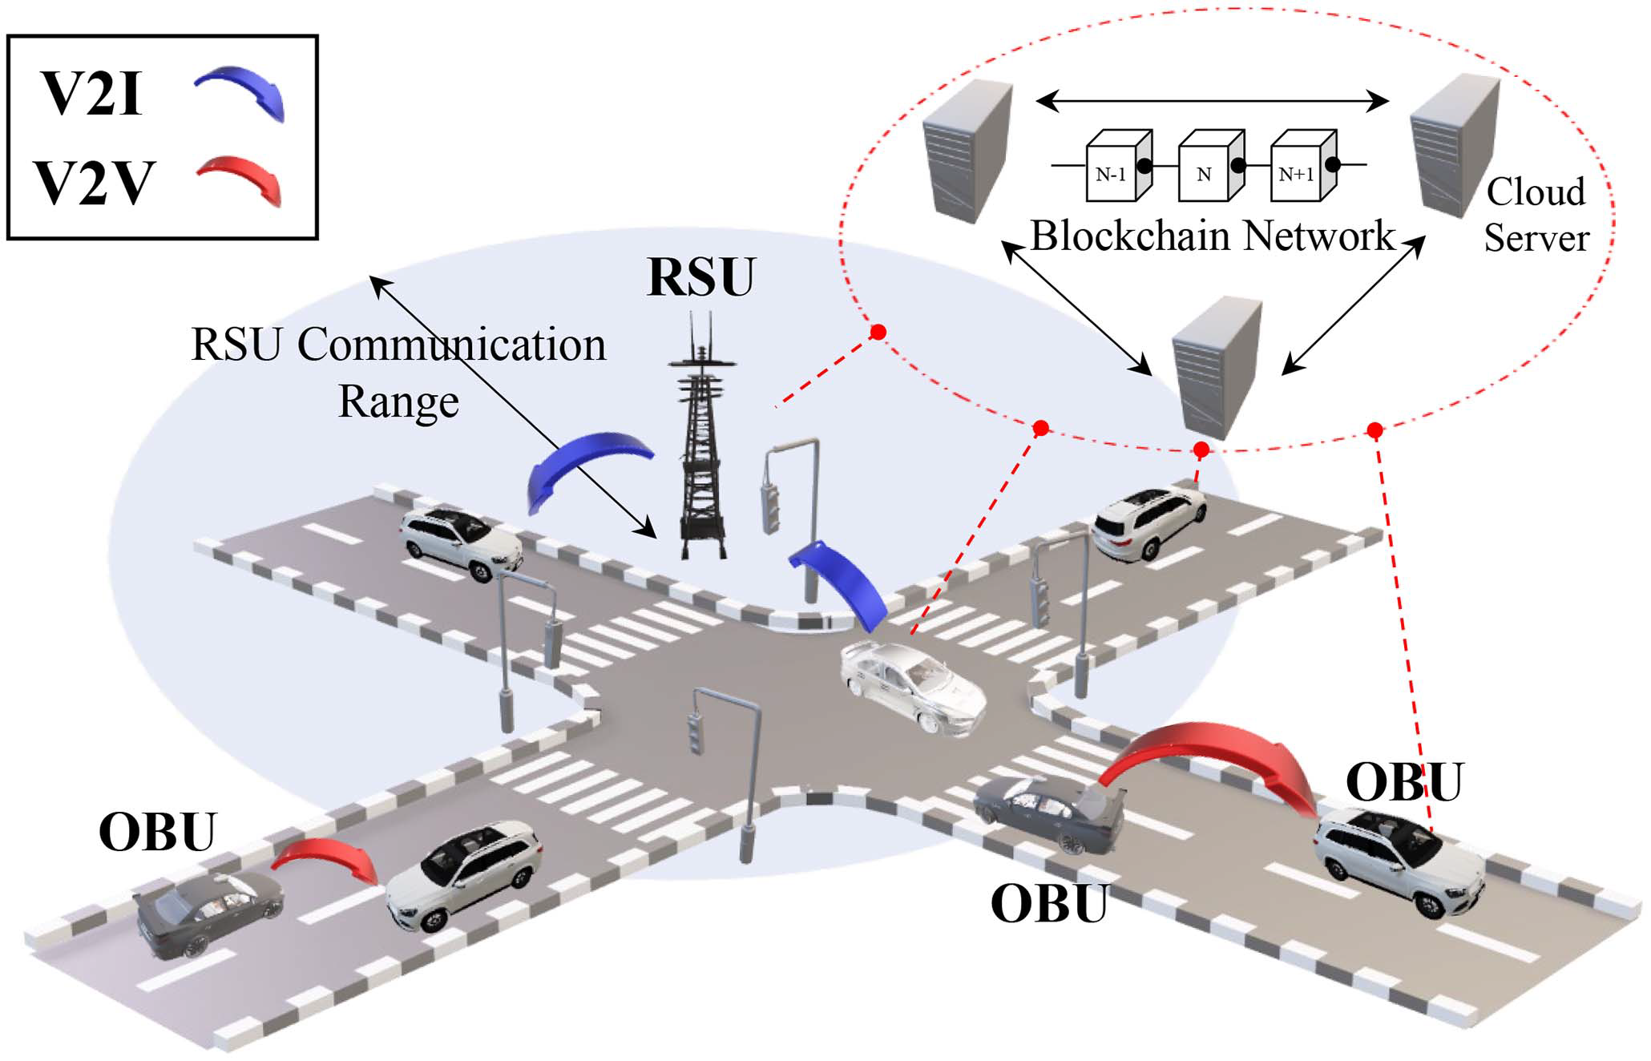
System Architecture
Trusted Authority (TA)
Vehicles (OBUs)
Proxy Vehicles
Roadside Units (RSUs)
Blockchain (Smart Contracts)
AI Scoring Module
Fig 1: System architecture modelling

Slide 6
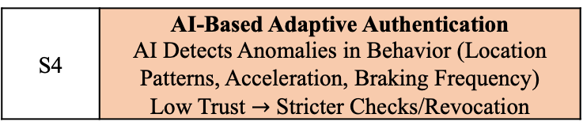
Workflow Overview
Start
S1 | Vehicle Registration TA assigns ID & Reputation Scores (R0) Generates ECC Pairs Stores Reputation on Blockchain
Vehicle Registration
Proxy-Based Batch Authentication
Blockchain Trust Management
Adaptive AI Authentication
S2 | Proxy Based Authentication Vehicles Sign Messages (ECDSA) Trusted Proxies Verify Batch
S3 | Blockchain Trust Management RSU Verifies & Updates Reputation Efficient Bulk Storage of Updates
S4 | AI-Based Adaptive Authentication AI Detects Anomalies in Behavior (Location Patterns, Acceleration, Braking Frequency) Low Trust $→$ Stricter Checks/Revocation
End
Fig 2: Flowchart of the proposed scheme

Slide 7
Implementation
LabVIEW: real-time cryptographic verification
Hyperledger Fabric: secure blockchain-based reputation tracking
AI Module: Neural network-based anomaly detection
Scalability Tests: Simulations for 100-1000 vehicles

Slide 8
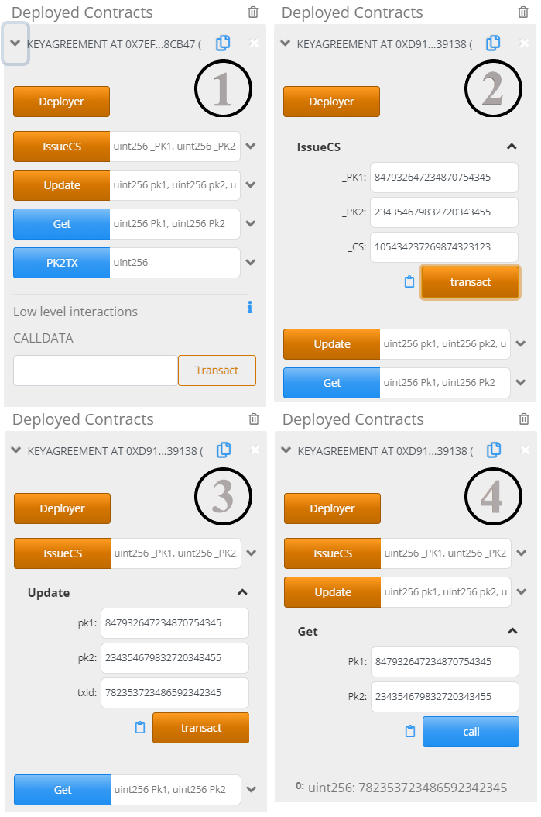
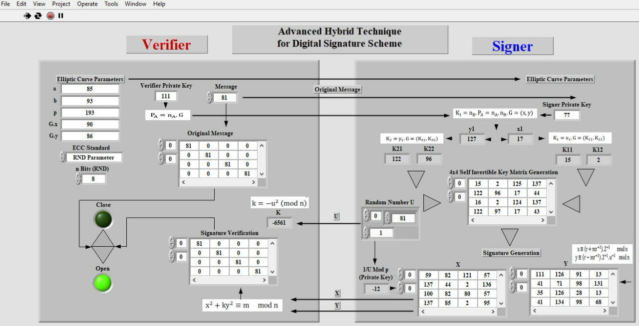
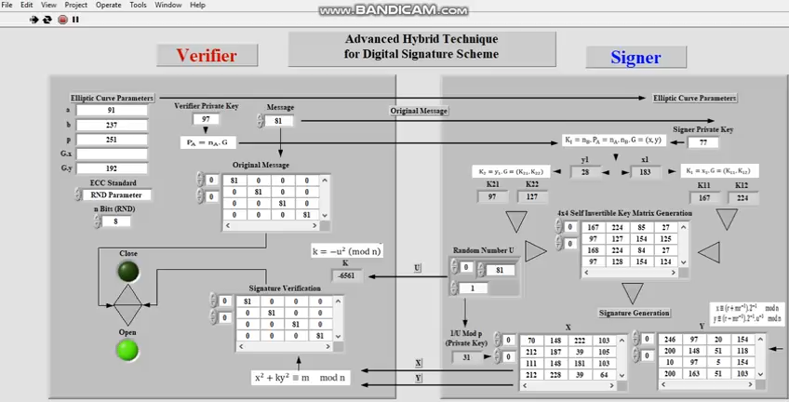
Simulation
Fig 3: LabView simulation for cryptographic verification
Fig 4: An example of Blockchain
Smart contract functionality

Slide 9
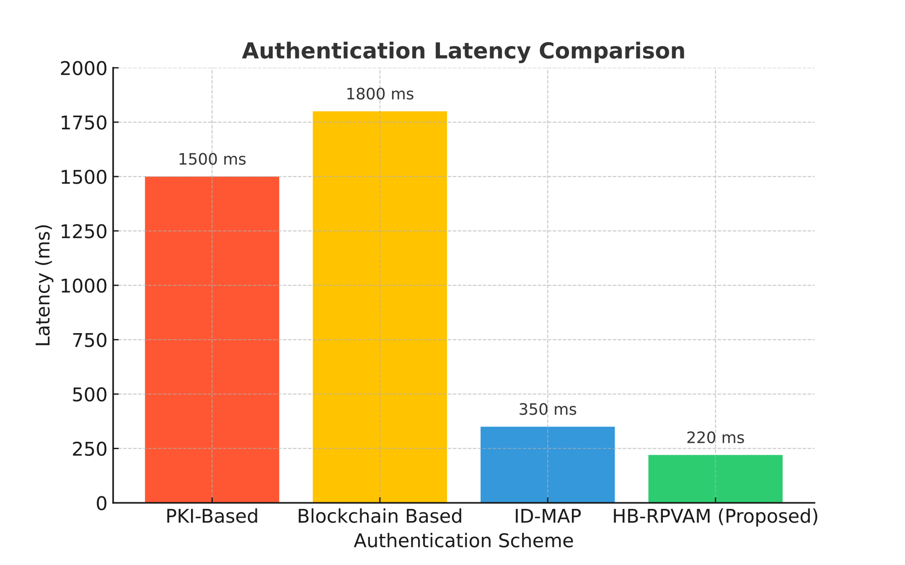
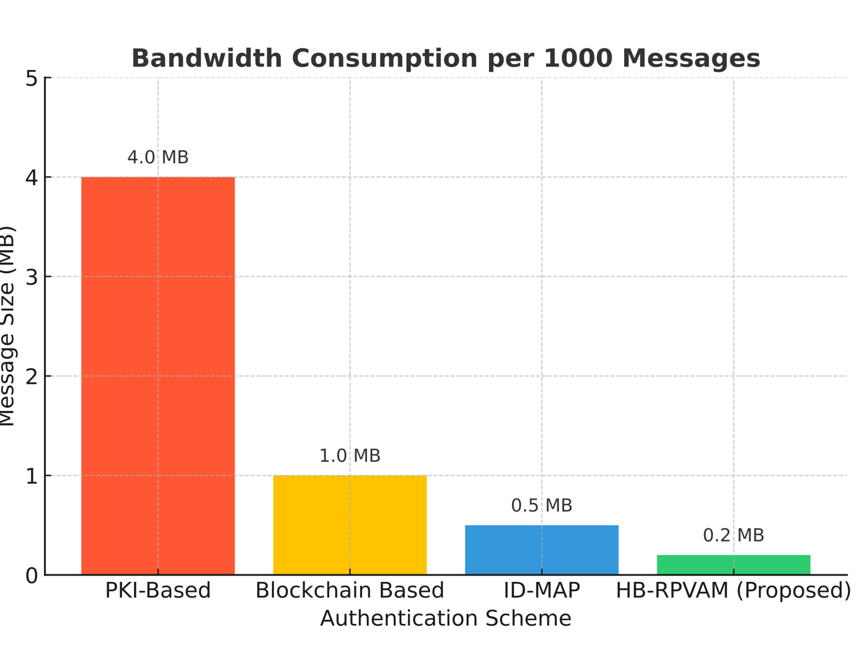
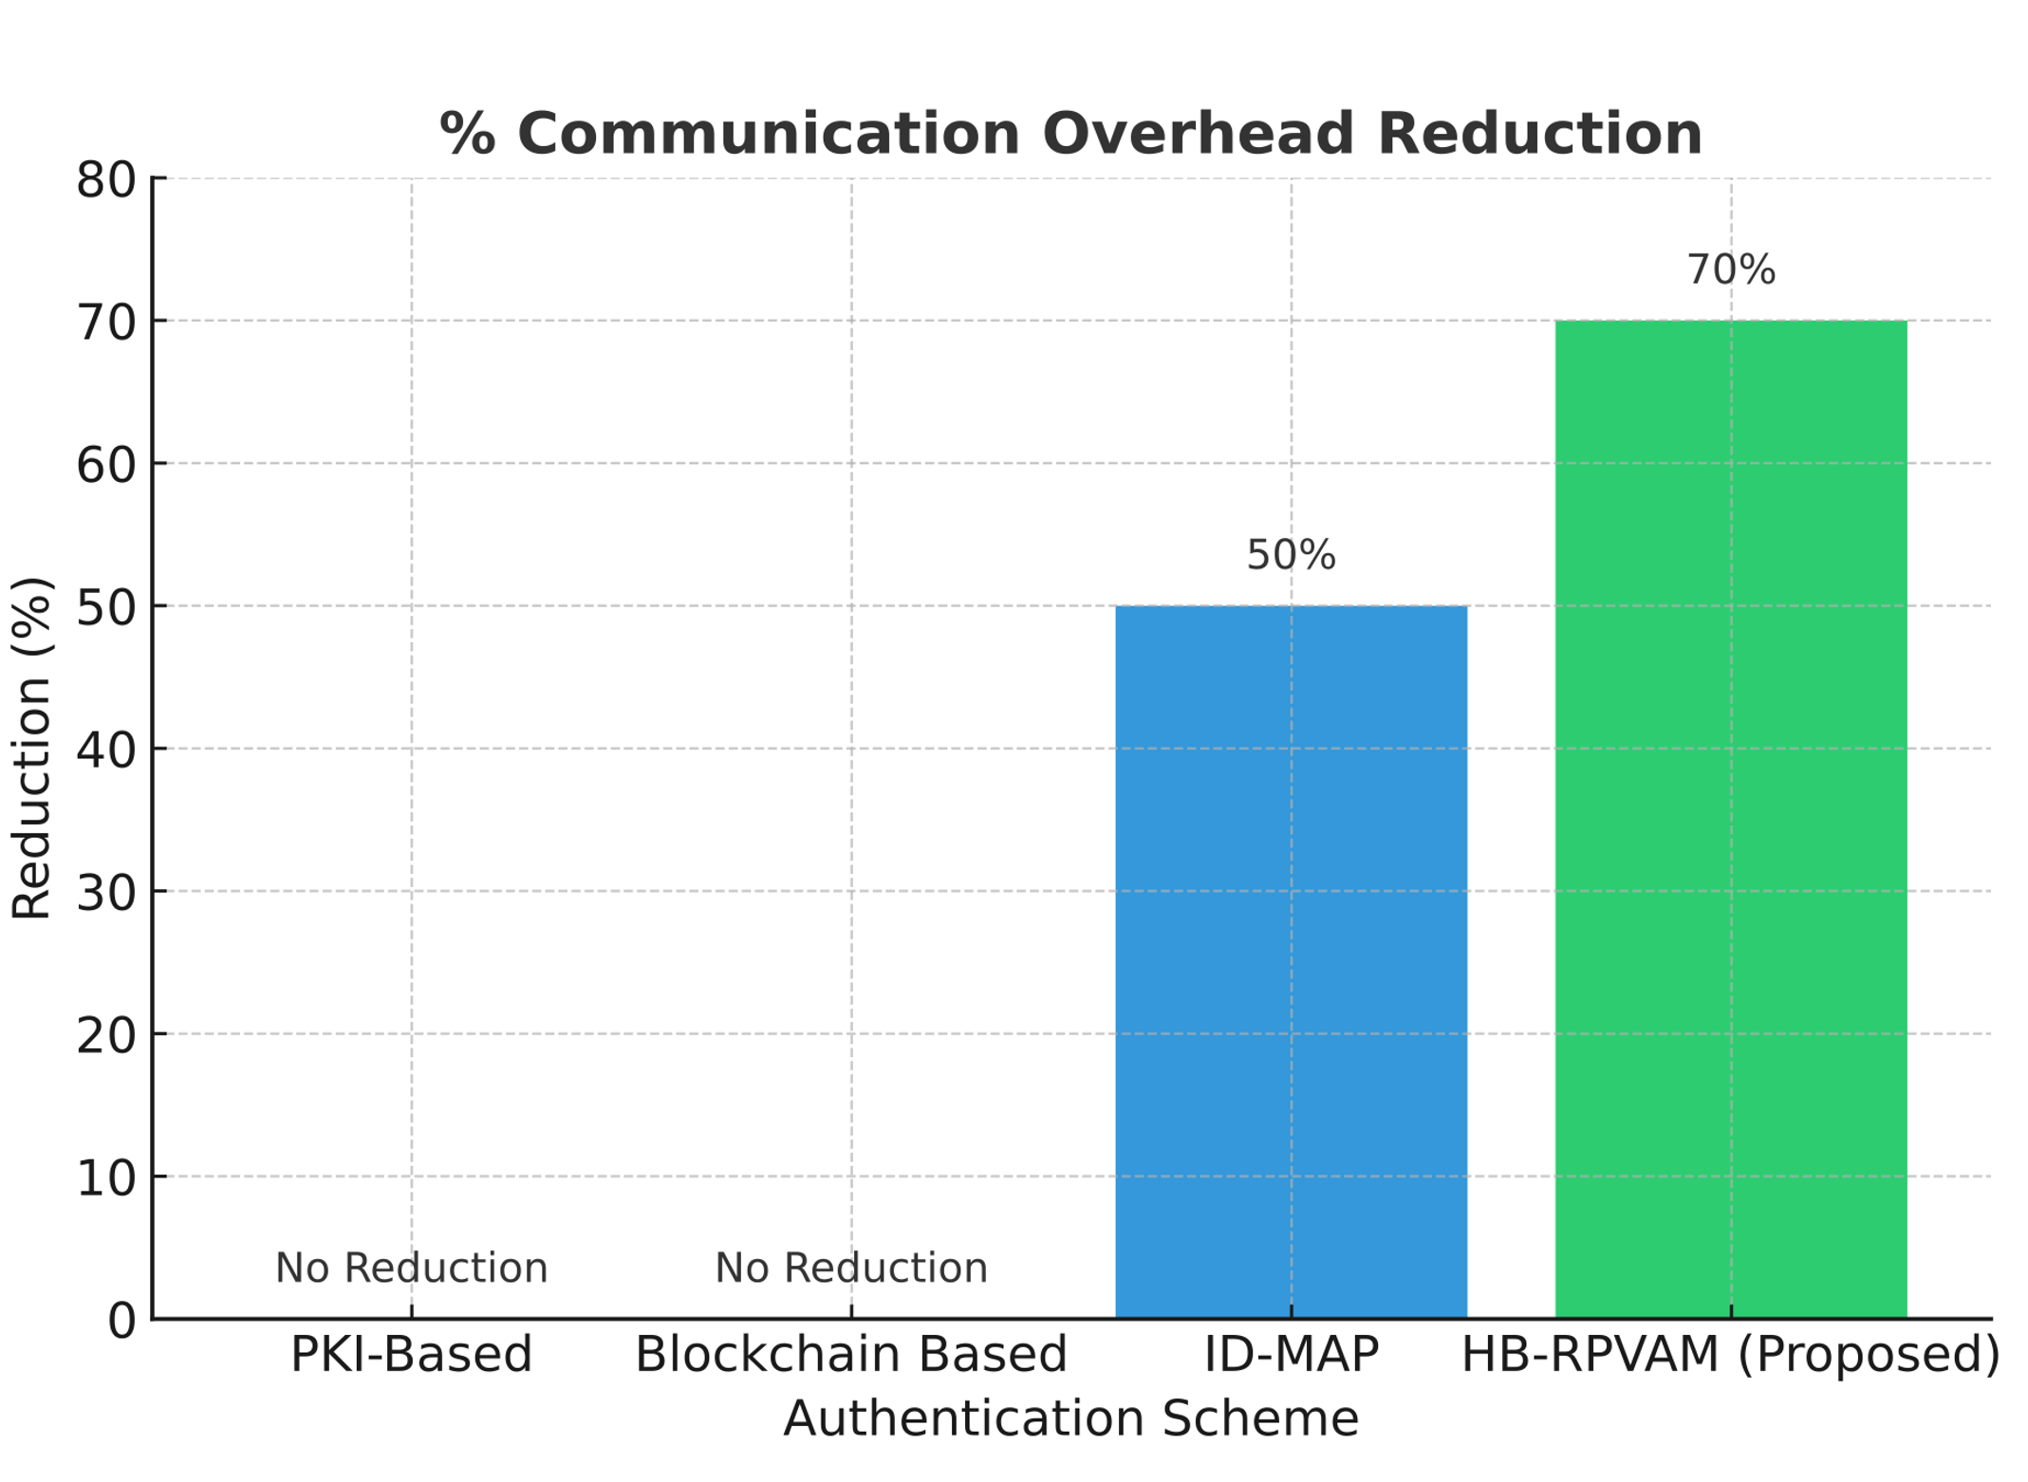
Key Results
Metric | PKI | Blockchain | ID-MAP | HB-RPVAM
Authentication Latency (1000 messages) | 1500 ms | 1800 ms | 350 ms | 220 ms
Verification Complexity | O(n) | O(n) | O(log n) | O(log n)
Bandwidth (1000 messages) | 4 MB | 1 MB | 0.5 MB | 0.2 MB
Gas Cost (per 1000 updates) | N/A | $30.00 | N/A | $3.00

Slide 10
Performance Analysis
3x lower latency than PKI
O(log n) complexity proxy verification
85% reduction in on-chain costs
AI swiftly flags malicious nodes

Slide 11
Security Analysis
Security Challenges | Defence Mechanism in HB-RPVAM
Sybil Attack | Reputation binding + AI anomaly detection
Replay Attack | Timestamped signatures
MITM Attack | ECC signatures & multi-proxy verification
Modification Attack | Cryptographic hashing (signature invalidation)
Collusion Attack | Multi-signature & multi-proxy checks

Slide 12
Conclusion & Future Work
Effective large scale VANET security
Successfully integrates blockchain and reputation scoring
Proven low latency and scalable authentication (O(log n))
Next Steps
Real-world testbed implementation
Privacy improvements with zero knowledge proofs
Further refinement of AI behavioral analysis

Slide 13
Thank You!

