Slide 1






Pribor Online
ALL WEATHER LEATHER!

Slide 2
Why was Pribor Online necessary?
It had became a necessity for the brand to have a platform where our worthy users and creators can connect and communicate.
This platform was specially built to serve our 3 point agenda.
1
An interactive Management interface for the creators to showcase all our products with their descriptions.
A user-friendly Cart interface for our buyers to view and purchase our products.
3
A separate class where all the out of stock products are placed in the wishlist category and displays it during every checkout
2
Notes:
Importance

Slide 3
Which Data Structures were necessary?
Depending upon 3 point agenda and platform support, We chose these 3 Data Sturctures in accordance to their time and space complexities, relaiblity and feasibility.
Management Interface
Hashing
Binary Search Tree
Wishlist
Interface.
Doubly Linked List
User’s Cart Interface

Slide 4

Why these Data Structures?

Slide 5

Hashing
Constant time operation.
Inserts are generally slow, reads are faster than trees.
Hashing is used so that searching a database can be done more efficiently.

Slide 6



Binary Search Tree
Binary Search Trees are memory-efficient.
Use when the data need to be sorted.
Search can be done for a range of values.
Height balancing helps to reduce the running time.

Slide 7
Doubly Linked List
Easier to insert and delete the node from the doubly linked list..
Insert or remove from double-linked lists faster.

Slide 8


Slide 9

Hashing
Admin Class
00
01
02
03
04
05
06
07
Product 1
The class structure uses Hash Table with a Hash Function for storage the storage of Products with their description price etc.
It stores them using insertproduct() method and searches them with searchProduct() method and prints the list using printProductList() method.
The Hash Function uses the serial key assigned to every product for easy insertion and retrieval of the product.
Product 8
Product 0
Product 6
Product 2
Product 3

Slide 10
Binary Search Tree
User’s Cart Class
Null
Product.price is used
83
Product 1
84
83
84
85
Product 2
86
87
Product 3
88
85
86
87
88
89
Product 4
90
91
Product 5
92
93
Product 6
94
95
Product 7
96

Slide 11
Doubly Linked List
Wishlist Class
84
85
86
87
83
User 1
85
84
User 2
86
85
User 3
87
86
User 4
88
Pointer temp
The class structure uses doubly linked list for storage of UsersWishlist.
It stores them using addToWishlist() method and adds Users total purchase amount using method.

Slide 12
Big O Analysis of Data Structures
Admin Class
insertProduct O(1)
Cart Tree
Hash Table
Hash O(1)
Insert O(n)
Wishlist
insertToWishlist O(n)
Rehash O(1)
Insert O(n)
Search O(n)
toString O(n)
getPrime O(n)
isPrime O(n)
priceUpdate O(1)
productInc O(1)
productDec O(1)
searchProduct O(1)
printWishlist O(n)
productList O(n)
Find O(n)
Deleteitem O(1)
CheckOut O(1)

Slide 13
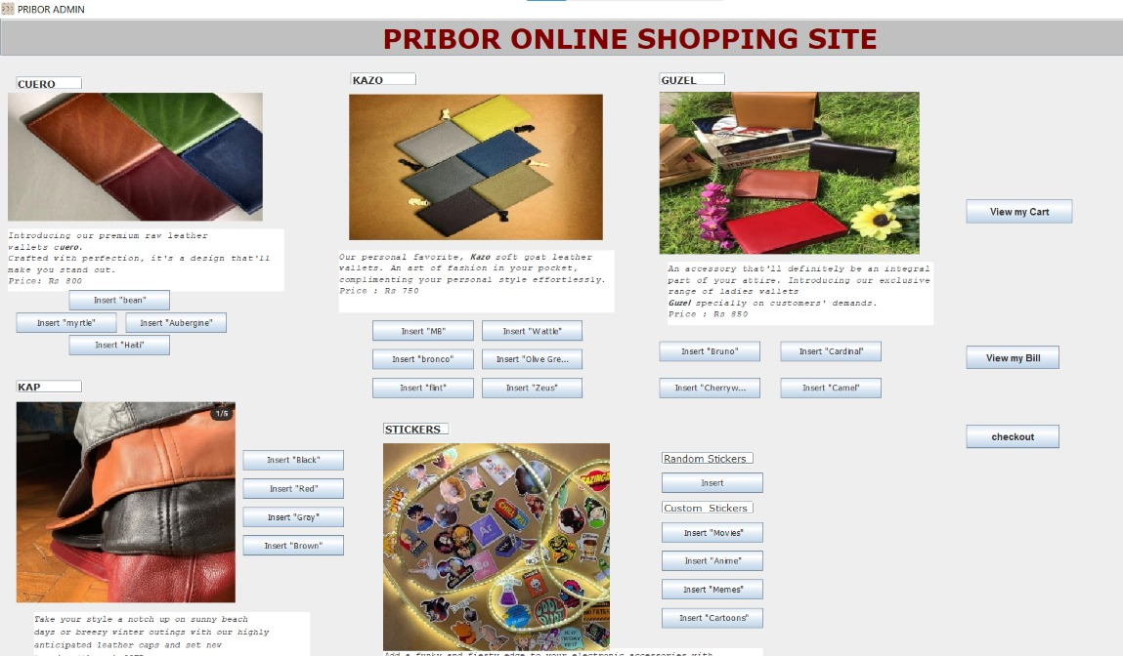
Graphical User Interface (GUI)

Slide 14
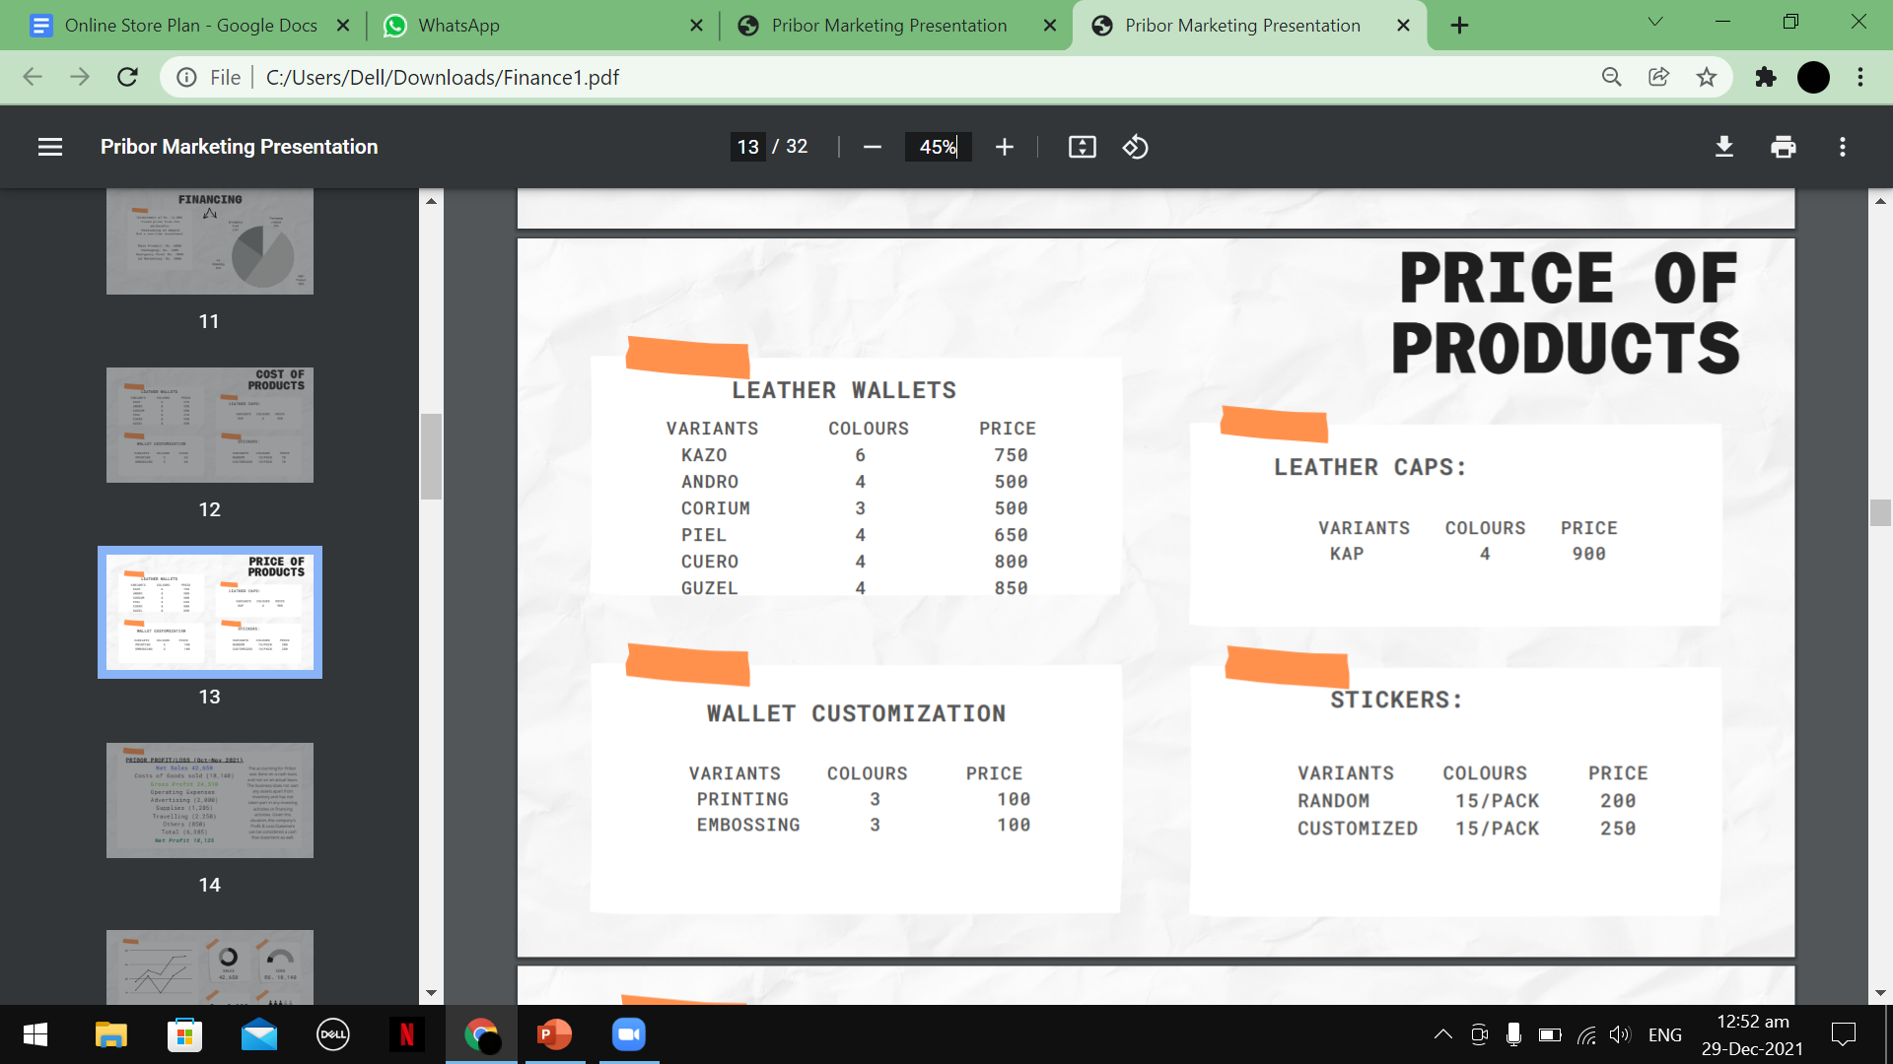
Data
Samples

Slide 15
References Used
Data Structure Selection:
https://www.careerdrill.com/blog/coding-interview/choosing-the-right-data-structure-to-solve-problems/
GUI Guide:
https://www.youtube.com/watch?v=mDxEGtMNPtA
Pribor Instagram Page for Data : https://www.instagram.com/pribor.official/?utm_medium=copy_link
PowerPoint Presentation Template:
SlidesCarnival.com

Slide 16



Team Presentation
Adeen Atif
Code Developer
Aman Ullah Faisal
Presentation Maker
Nada Waqar
GUI Maker

Slide 17

Thanks!
اللہ حافظ

