Slide 1

Jupyter Basics
Notes:
At this point you should have a rough idea what a Jupyter Notebook is like and how GenePattern cells work within it.
.
In this section we are going to take a step back and review some of the basics of Jupyter Notebooks upon which the GenePattern notebooks are based.
We’ll do a quick overview with a few slides and then we’ll open another notebook to try out some of these features...

Slide 2
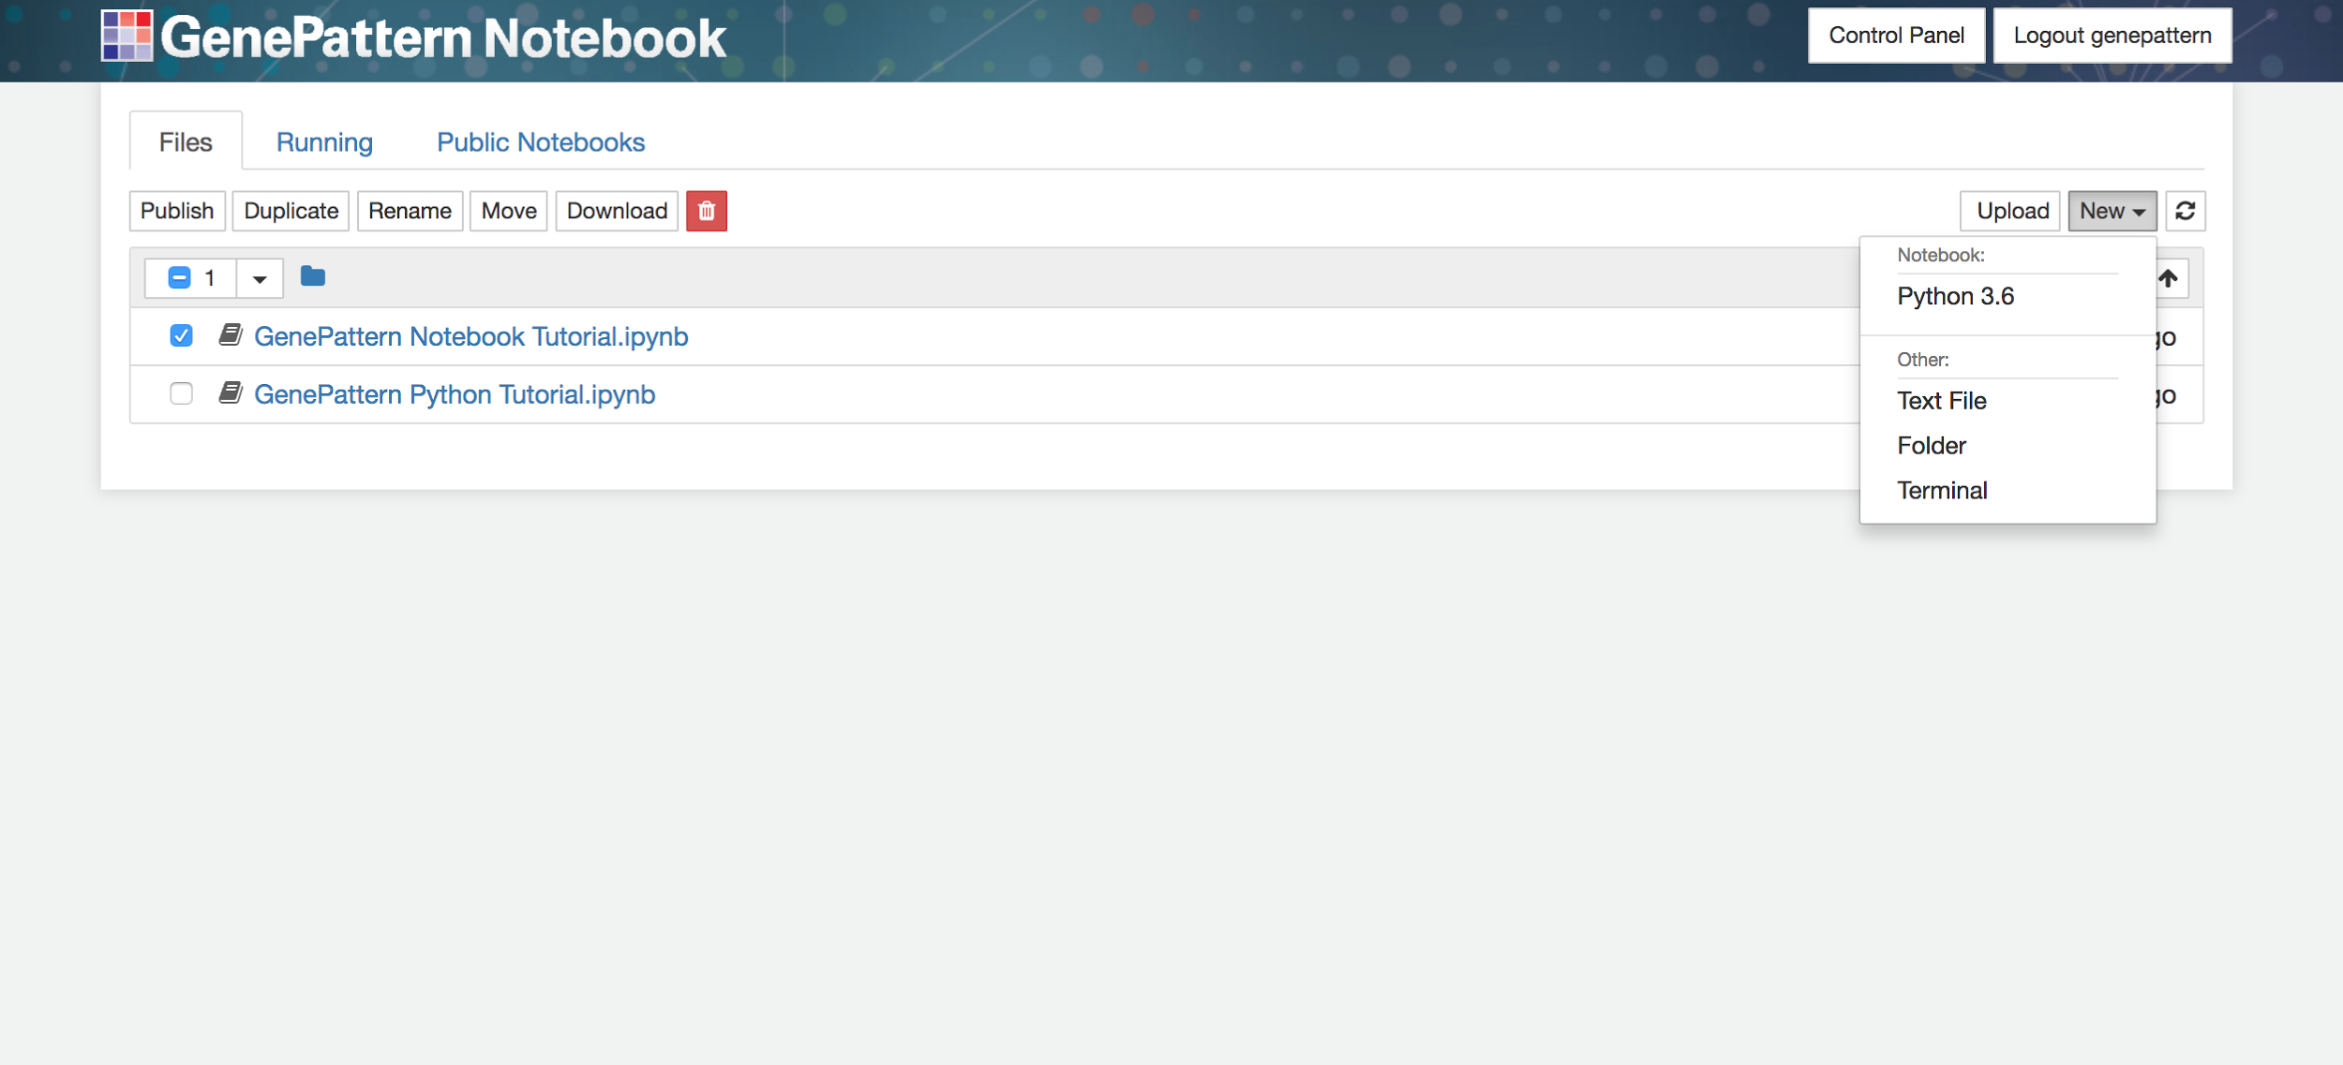
Create a New Notebook
Open the upper right menu and select “Python 3.6”
Notes:
The first thing we’re going to cover is how to create a new blank notebook. From the files page we can do this by clicking on the dropdown menu in the upper right and then selecting which notebook kernel we want to use. In this case we’re going to select Python 3.6.
You don’t need to know Python to build a notebook, if you do know it this language will be available for you to use.

Slide 3
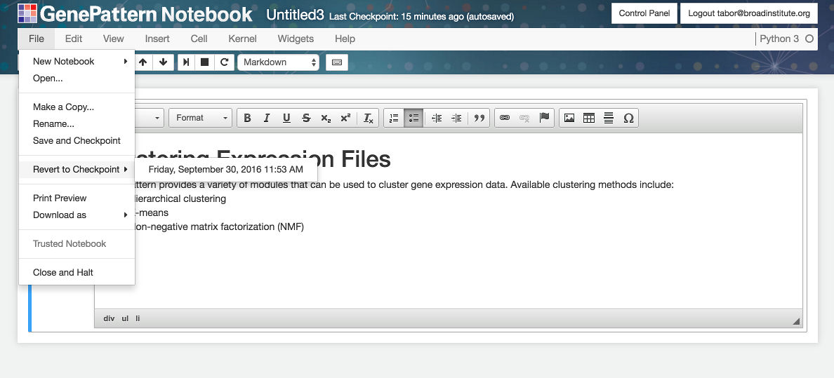
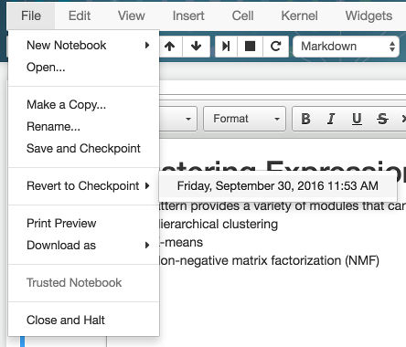
Name, Save & Checkpoint Notebooks
Name or rename notebooks
Save or revert to a checkpoint
Make a duplicate notebook
Notes:
When you are in a notebook, its useful to know you have the ability to save, or revert to a saved checkpoint. This works just like saving and checkpointing in Microsoft Word or similar word processor. Both features are available in the File menu at the top of a notebook.
This can be useful to recover your work when you have altered a notebook and discover that it no longer works properly anymore or accidentally delete a cell you want to get back.
You can also name or rename a notebook by clicking on the title at the top, and then giving it a name at the prompt.

Slide 4
Understanding Notebooks
All notebooks are backed by a “kernel,” which is a complete contained computational environment.
The kernel
provides programmatic capabilities for users who want to code,
allows for for interactive widgets for users who don’t want to code.
The kernel works by running cells
You must run or play a cell for a cell to have any effect
Notes:
Skip this slide if we’ve already talked about kernels
As a reminder, remember that notebooks are backed with a Kernel ; this is the thing that is calling the GenePattern server to tell it to perform analyses
The Kernel also allows us to execute arbitrary Python code if we want to. This is how Jupyter Notebooks are typically used by programmers and computational biologists.

Slide 5
Cell types
You have already worked with GenePattern cells
Other Cell types you will use today:
Markdown Cells
Code Cells
Notes:
Conceptually, all notebooks are divided up into blocks called cells. Each cell contains either code, explanatory text, an image to display, an interactive widget or some other element.
The notebooks we used earlier contained two types of cells – Markdown cells and GenePattern cells. We’ve already seen how to work with GenePattern cells so let’s look at the other two types we’ll be using today and how you control what type a cell is

Slide 6
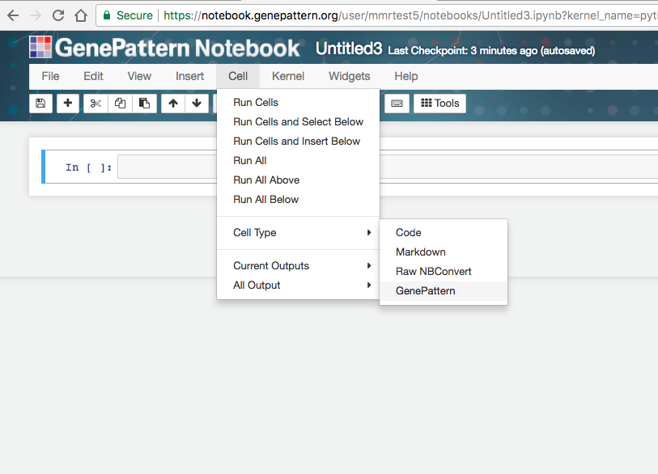
Selecting the cell type
Cell -> Cell Type
Choose the type of cell you wish to use
Notes:
After creating a cell to change a cell’s type, you can use the Cell menu.
Click the Cell -> Cell Type -> and then select the type of cell you want to use.
Or, you can use keyboard shortcuts. These will become very useful the more you work with the notebook environment, and it’s really worth the time to learn them.
6

Slide 7
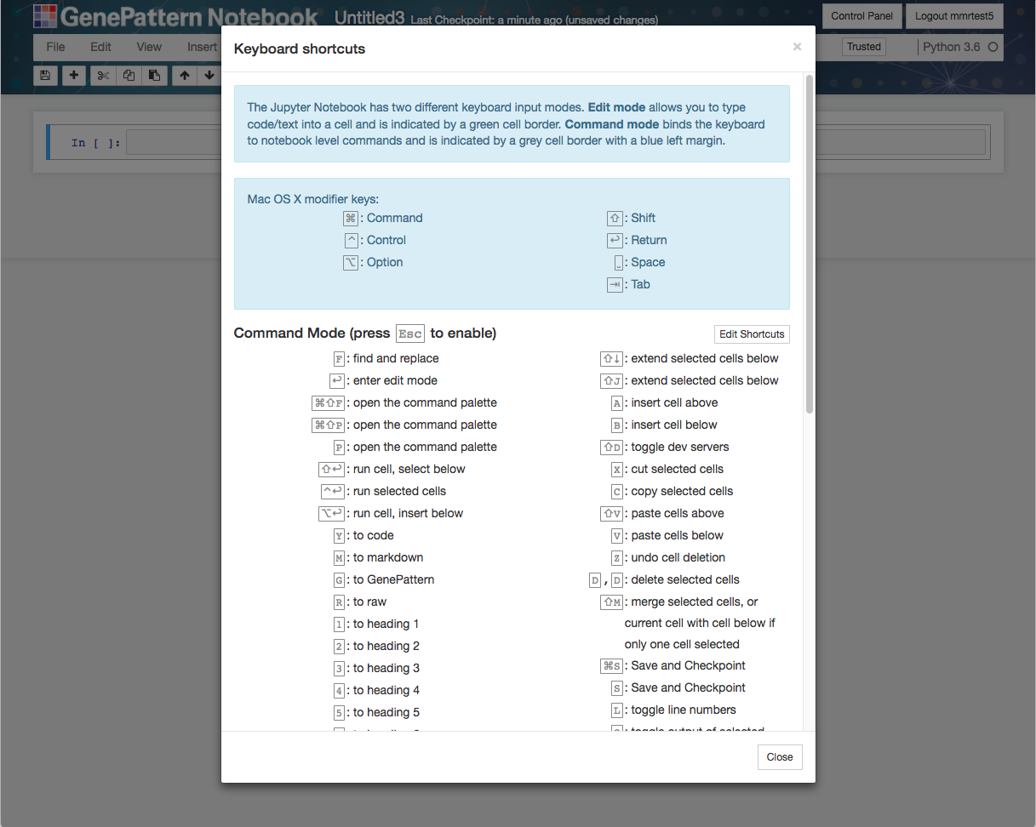
Keyboard Shortcuts
Type “h” for help to see shortcuts
Notes:
You should have received a handout with these as well…
These shortcuts work when you are not “in” a cell. Typing “h” to show this cheat-sheet of shortcuts is probably the first shortcut you should learn.
You can also use shortcuts to change a cell’s type. For example ‘g’ will make the current cell into a Genepattern cell.

Slide 8
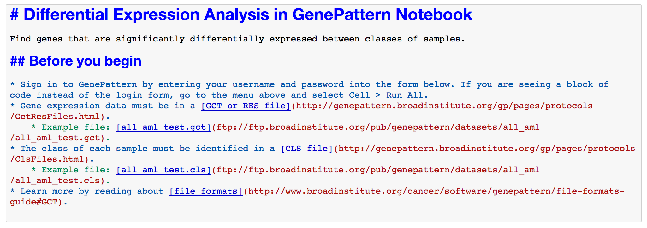
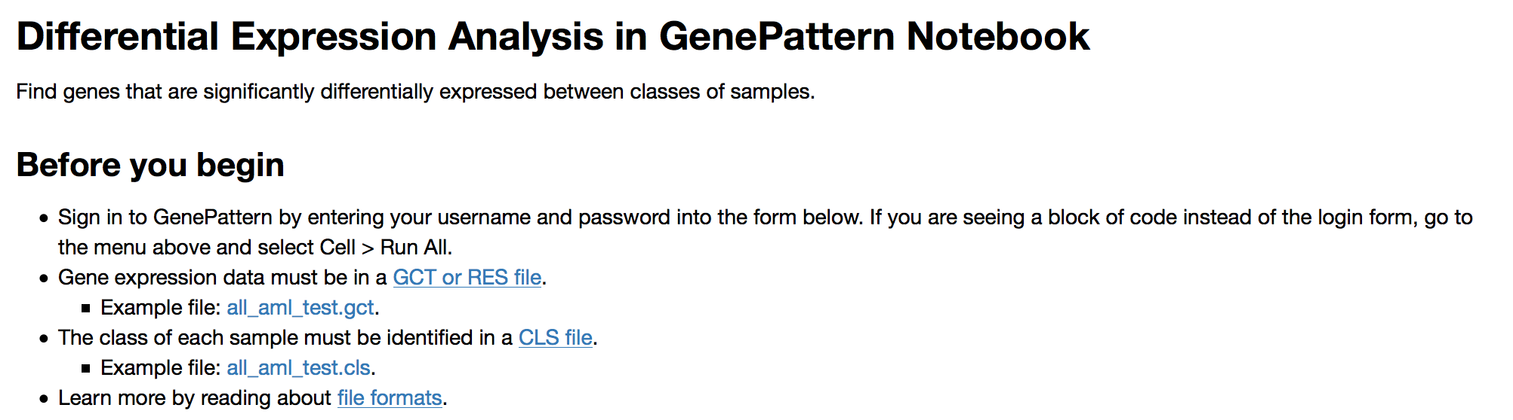
Markdown Cells
Create narrative cells using Markdown or HTML
Markdown text
Formatted text view
Notes:
If you've ever used a web forum, wiki or typed a text email, then you've probably already written something that's very similar to markdown.
With markdown, you type out whatever text you want to display, along with a very simple syntax for styling that text. Then, when you execute the cell, it displays it nicely formatted.
You can see an example on the slide. At the top is what you typed in and at the bottom is what is displayed when the cell is run.

Slide 9
Markdown
Headers
# Header Title Here
Lists
* List item here * Next list item here
Links
[Display Text Here](http://url.here)
Notes:
Here are some of the most common parts of markdown for reference. but don’t worry we don’t expect you to master Markdown today
On the display you can see how to create a header, how to create a bulleted list and how to create a link.
Markdown cells also support plain old HTML. So if you know HTML, you can always use that.
Of course, many people aren’t going to want to learn markdown or HTML, if they’re not already familiar with them.

Slide 10
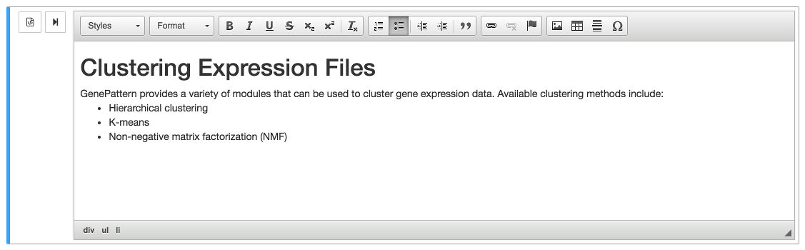
Rich Text Editor
Allows you to produce rich text without the need to write HTML/markdown
Notes:
For these people, GenePattern Notebook adds a rich text editor. This editor allows you to visually create text, headings, bulleted lists, links, tables and many other elements, without the need to write in a special syntax.
After you’re done, just click the “Run Cell” button and the rich text is rendered, exactly as you see it.

Slide 11
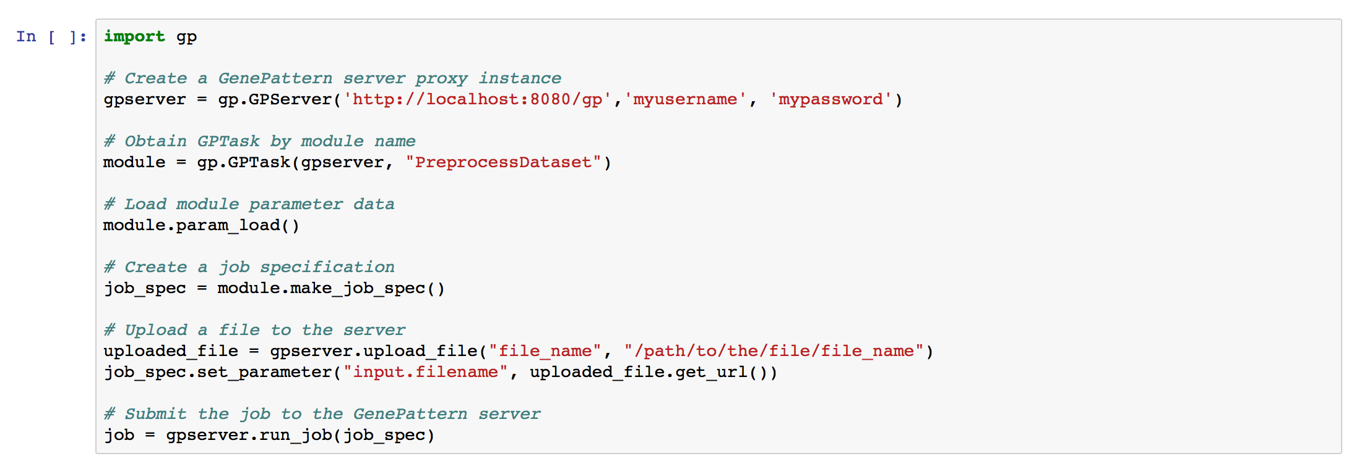
Code Cells
Embed and execute Python code from your browser
Framework supports R and a variety of other languages
Notes:
The final type of cell we’re going to talk about are code cells.
Code cells are conceptually pretty simple. They contain some code that can be modified or executed in the notebook.
By default these use the Python programming language, but support also exists for R, Perl and a variety of other programming languages.
If the code in a cell returns a value, the return value will also be displayed beneath it.
I’m not going to make you write code yourself right now - but I did want to note that code cells exist, and if fact they’re the default type of cell.

Slide 12
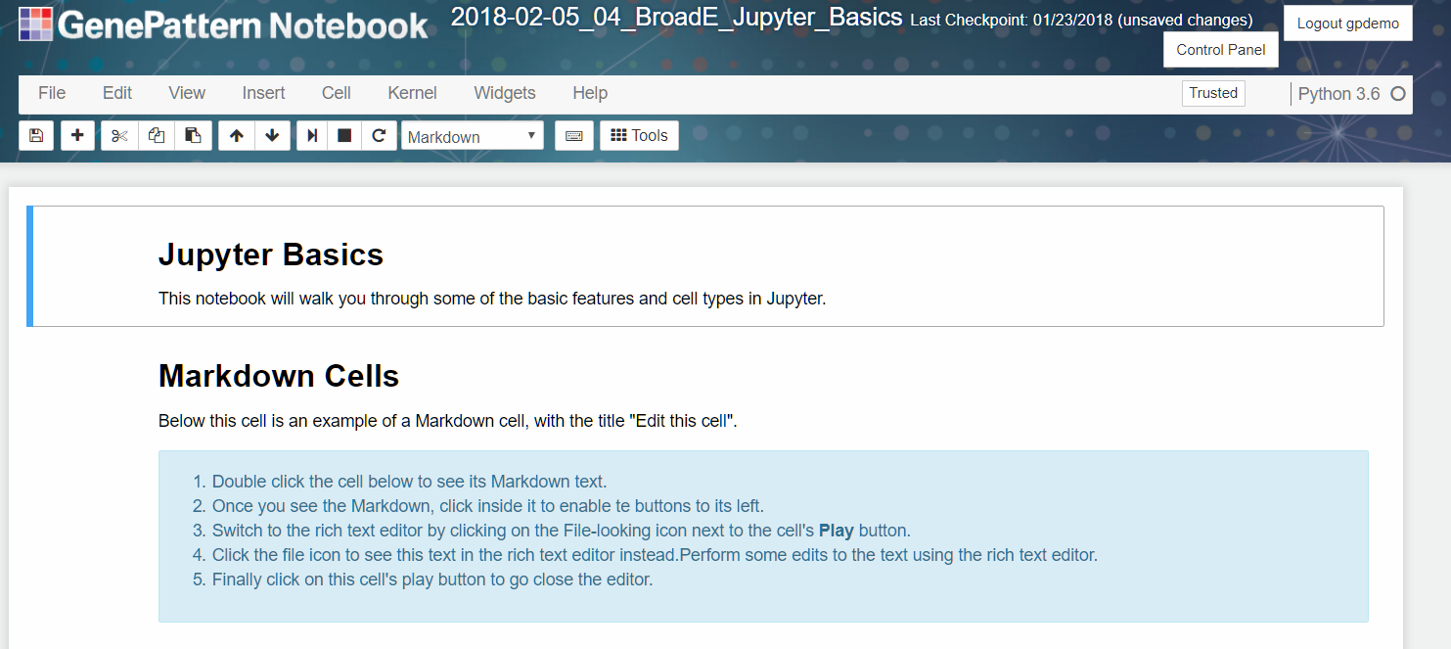
Follow along...
Copy and open the public notebook:
2018-02-05_04_BroadE_Jupyter_Basics
Notes:
12/11/17
12
12
Now that you have had a quick review of some of these features, lets go into an example notebook so you can see how they work in practice
Open the notebook called “Jupyter Basics”
<start lead follow>

