Slide 1

Clustering

Slide 2
Clustering/Class Discovery
Aim: Partition data (e.g. genes or samples) into sub-groups (clusters), such that points of the same cluster are “more similar”.
Example: How many clusters?
One has to choose:
Clustering method
Similarity/distance measure
Evaluate clusters
Notes:
Clustering is another typical analysis type …
How many clusters do you see?
The answer is 1 -53
YOU HAVE TO CHOOSE – what does it mean for two points to be close? There are many ways to define this, as we will discuss
There are many clustering methods which ask how many cluster you want to find, so it will find that many. So how do you know how many you want to find? You have to eval the goodness of fit.

Slide 3
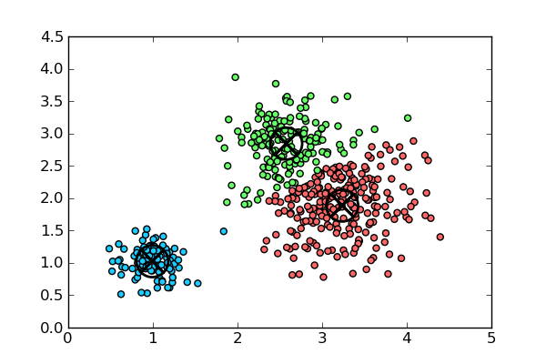
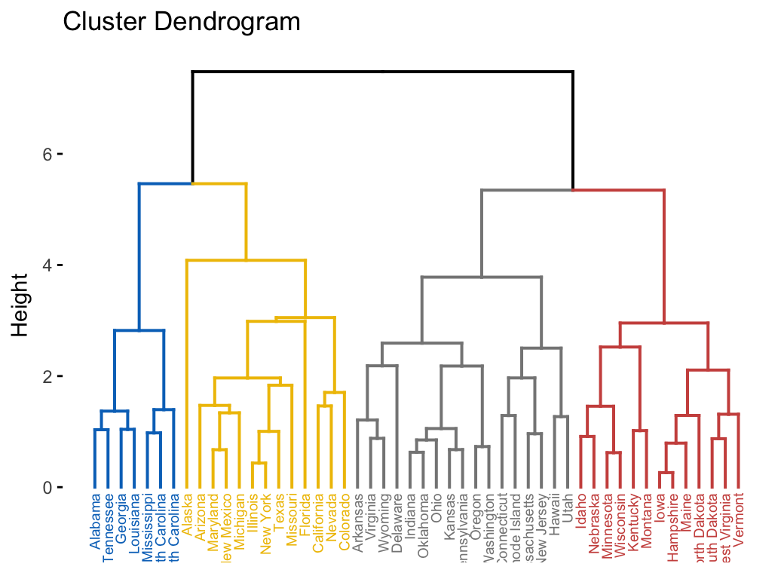
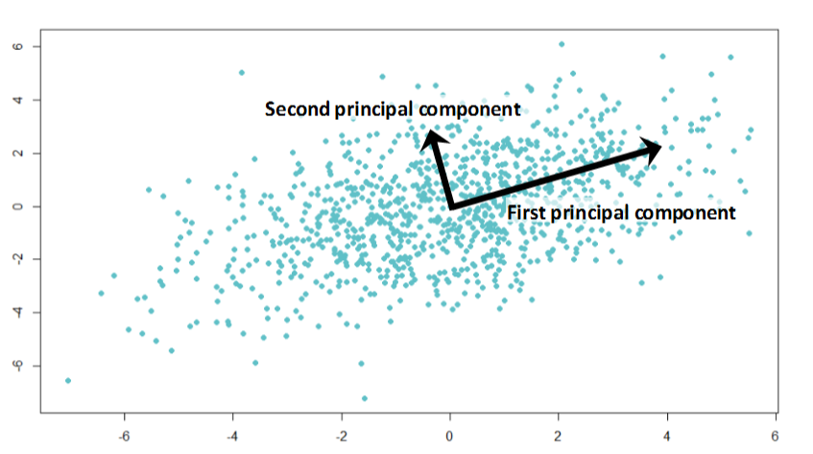
Clustering in GenePattern
Representative based:
Find representatives/centroids of the dataset
K-means
Self Organizing Maps (SOM)
Bottom-up (Agglomerative)
Create an ordering of the data by closeness
Hierarchical clustering
Clustering-like:
Reduce the data to a smaller number of dimensions containing the majority of the information content
NMF (Non-Negative Matrix Factorization)
PCA (Principal Components Analysis)
K-Means Clustering
Hierarchical Clustering
Principal Components Analysis
Notes:
There is no BEST method! For easy problems – most of them work.
Each algorithm has its assumptions and strengths and weaknesses.

Slide 4
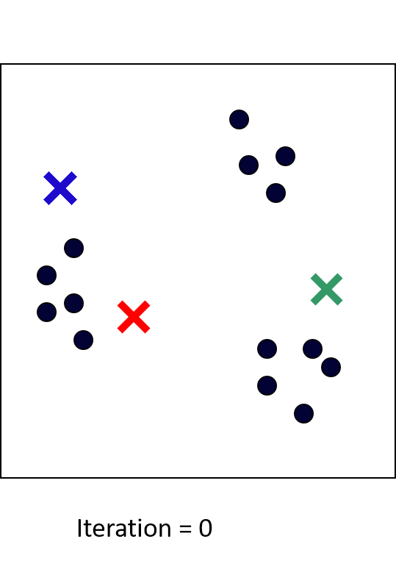
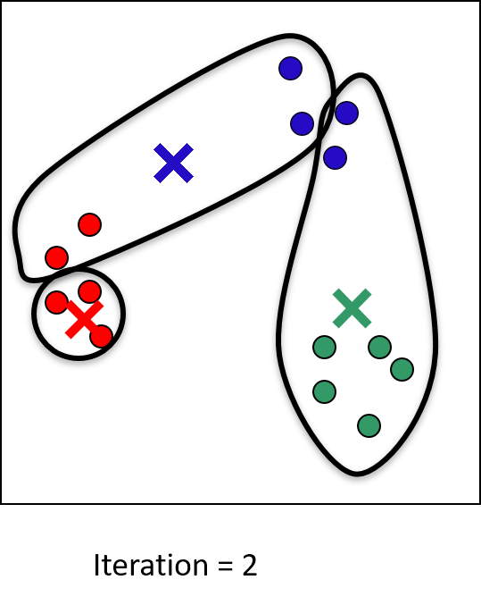
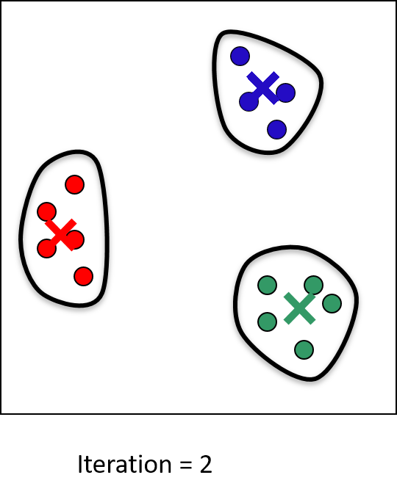
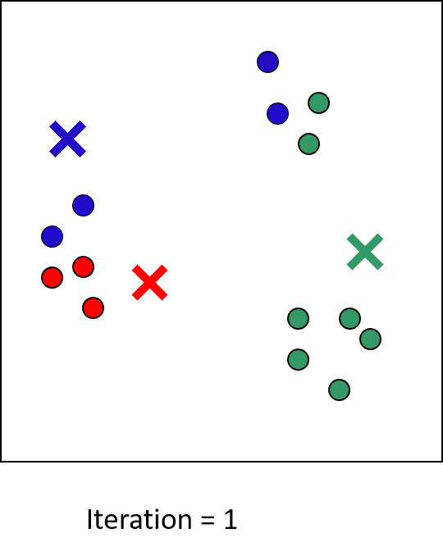
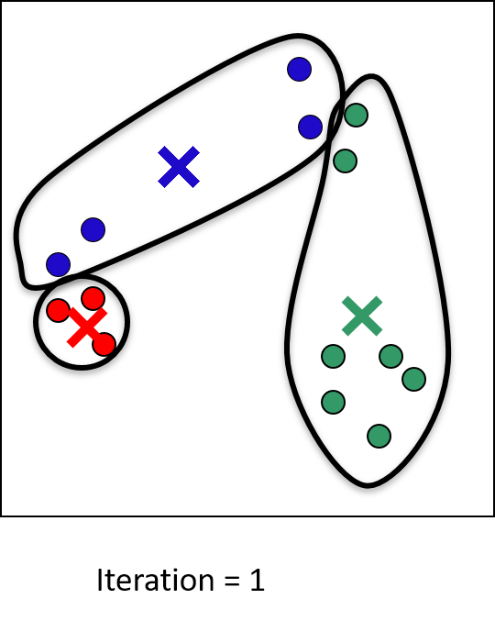
K-means Clustering
Initialize centroids at random positions
Iterate:
Assign each data point to its closest centroid
Move centroids to center of assigned points
Stop when converged
Guaranteed to reach a local minimum
K=3
Notes:
For each point that is closer to that centroid than any other – we’ll give it the color of that centroid
Stop because the centroids don’t move any more

Slide 5
Hierarchical Clustering
Distance between joined clusters
4
2
5
3
1
1
3
2
4
5
Dendrogram
Notes:
Remember next slide walks through how this works

Slide 6
Hierarchical Clustering
Distance between joined clusters
4
2
5
3
1
Linkage is the method for linking clusters based on the distance between them.
Average Linkage: average distance between all pairs
Complete Linkage: farthest distance between all pairs
Single Linkage: closest distance between all pairs
1
3
2
4
5
The dendrogram induces a linear ordering of the data points (up to left/right flip in each split)
Dendrogram
Notes:
Which two things are close together – start with points, then compare clusters as well – the dendrogram represents both distances
How do we determine closeness?
Linkage is how we determine how we compute the distance between the clusters ->average, complete, single

Slide 7
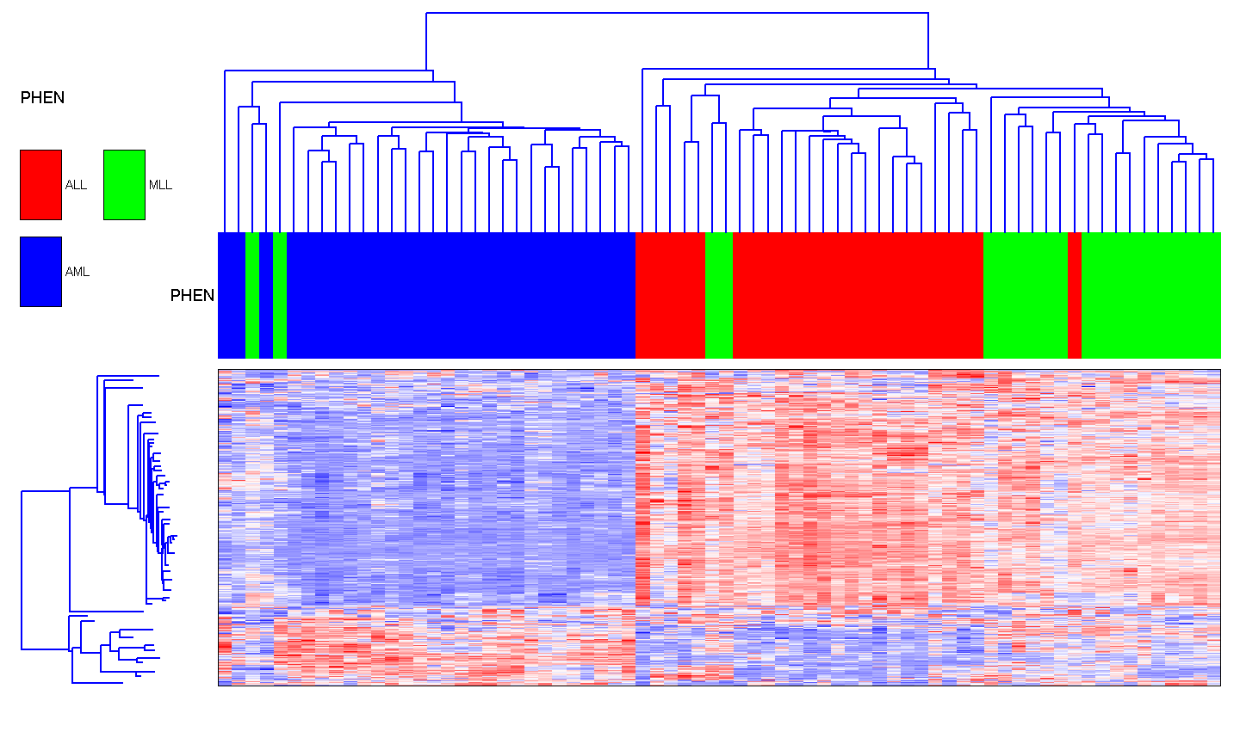
Average Linkage
Leukemia samples and genes
Notes:
Average Linkage: average distance between all pairs

Slide 8
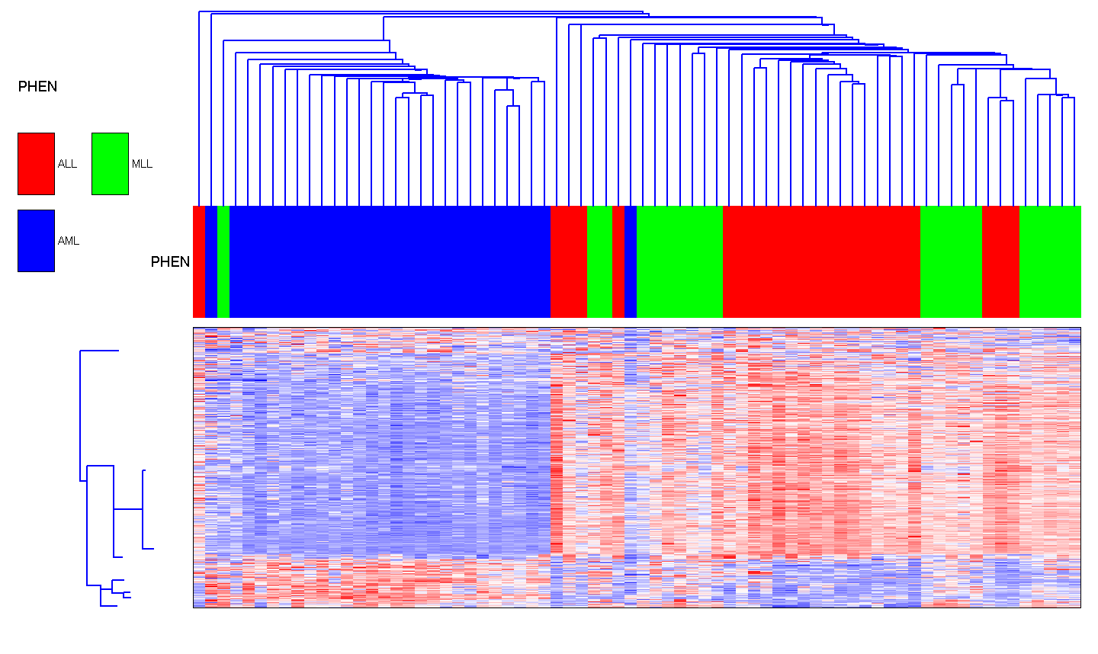
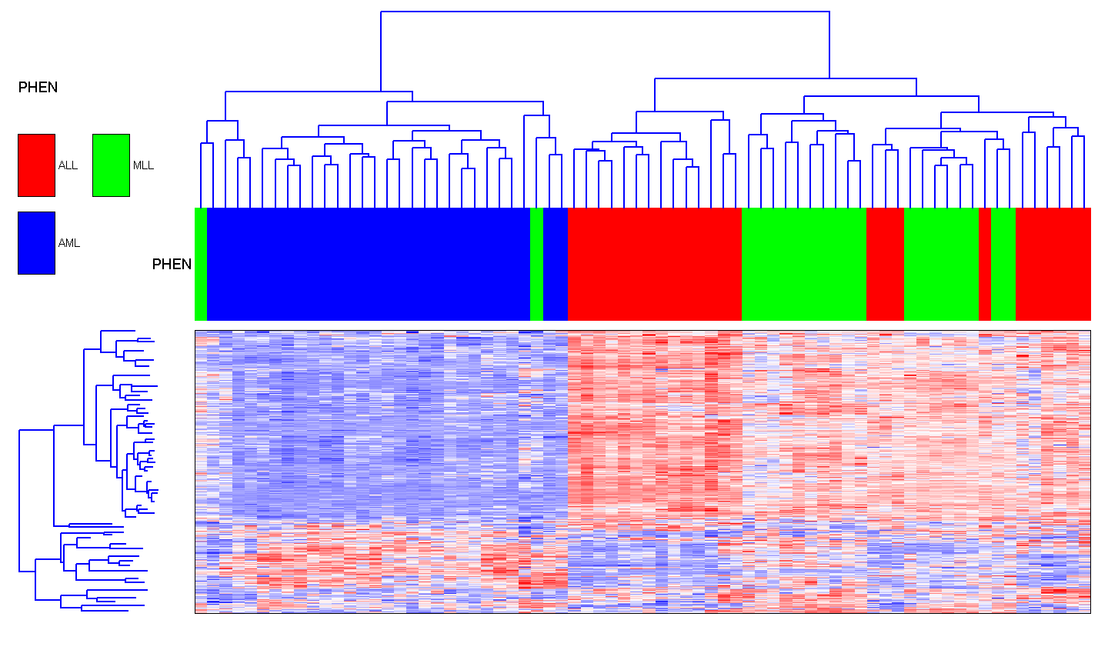
Single and Complete Linkage
Leukemia samples and genes
Single-linkage
Complete-linkage
Notes:
Complete Linkage: farthest distance between all pairs
Single Linkage: closest distance between all pairs

Slide 9
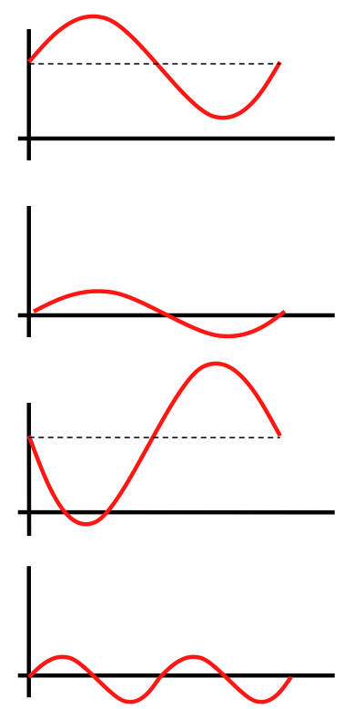
Distance metrics: Pearson and Euclidean
Pearson correlation
Measures linear dependence between genes
“General purpose” distance metric
Invariant to scaling
Invariant to addition by a constant
Euclidean distance
Measures standard distance between two points
Sensitive to scaling
Appropriate for row-normalized data
Notes:
In order to compute linkage you need a measure of distance.
Pearson is statistical distance
Euclidean is geometric
Notes to self:
Euclidian (Manhattan)- Standard distance is like Standard deviation – it is a summary metric of how far points are from the mean center. Sensitive to scaling because it is based on mean center – so the cal changes
Pearson – measure best point A to point B and then how far are data points from that best line of fit.

Slide 10
Reasonable Distance Measure
Euclidean distance on samples and genes on row-centered and normalized data.
Gene 1
Genes: Close -> Correlated
Samples: Similar profile giving Gene 1 and 2 a similar contribution to the distance between sample 1 and 5
Gene 2
Gene 3
Gene 4
Sample 1
Sample 5
Notes:
Our exercise will illustrate the difference between these two measures
**Euclidean requires row-centered and normalized so that you are comparing apples to apples
Notes to self:
Euclidian (Manhattan)- Standard distance is like Standard deviation – it is a summary metric of how far points are from the mean center. Sensitive to scaling because it is based on mean center – so the cal changes
Pearson – measure best point A to point B and then how far are data points from that best line of fit.

Slide 11
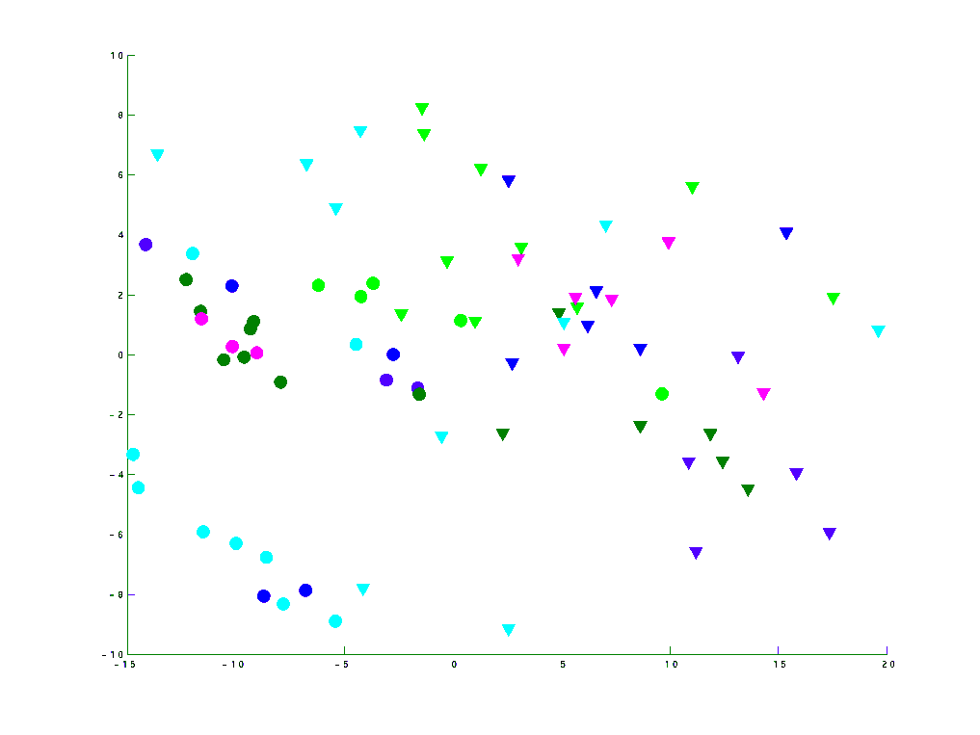
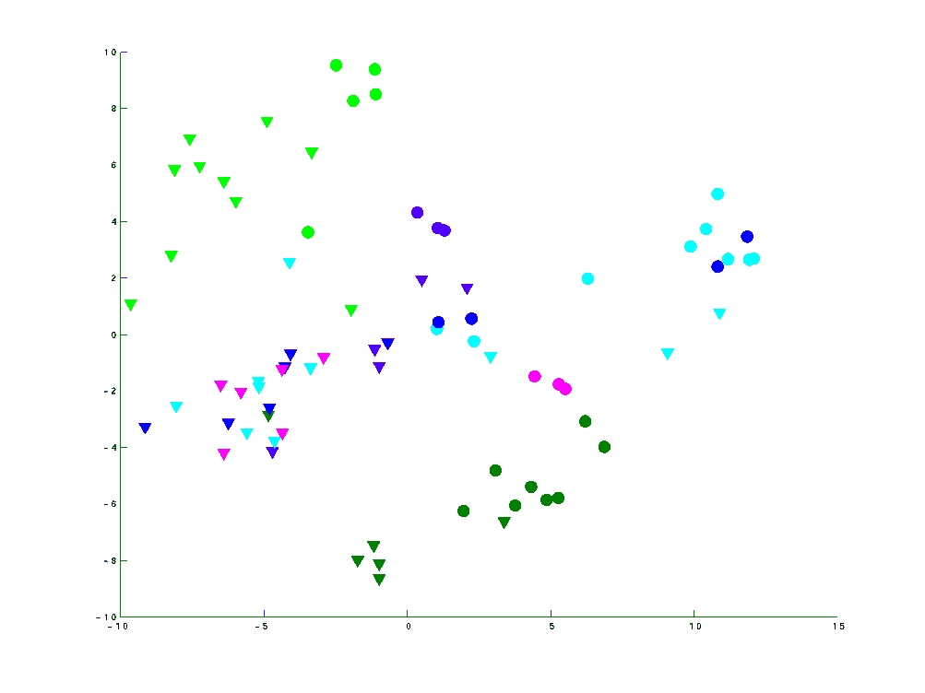
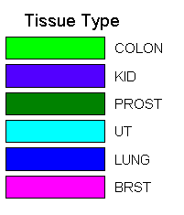
Different Distance Measures
Different distance measures can reveal different structures
Normal/Tumor
Center and normalize rows
Close samples have similar profiles
Tissue type
Center and normalize rows
Center and normalize columns
Close samples have correlated profiles
Euclidean
Pearson
2nd PC
2nd PC
Tumor
Normal
1st PC
1st PC
Data from Lu et al. Nature, 2005
Notes:
Depending on the distance measure you use, it will bring out different aspects of the data
Euclidean is good for structural differences – such as tumor vs normal samples
Pearson good for functional – such as tissue type

Slide 12
Similarity/Distance Measures
Decide: which samples/genes should be clustered together
Euclidean: the "ordinary" distance between two points that one would measure with a ruler, and is given by the Pythagorean formula
Pearson correlation - a parametric measure of the strength of linear dependence between two variables.
Absolute Pearson correlation - the absolute value of the Pearson correlation
Spearman rank correlation - a non-parametric measure of independence between two variables
Uncentered correlation - same as Pearson but assumes the mean is 0
Absolute uncentered correlation - the absolute value of the uncentered correlation
Kendall’s tau - a non-parametric similarity measure used to measure the degree of correspondence between two rankings
City-block/Manhattan - the distance that would be traveled to get from one point to the other if a grid-like path is followed

Slide 13
Pitfalls in Clustering
Elongated clusters
Filament
Clusters of different sizes

Slide 14
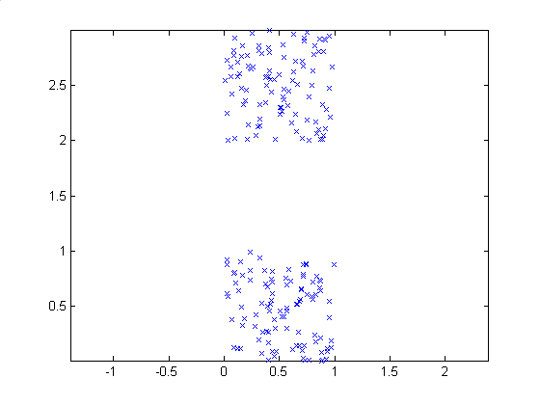
Compact Separated Clusters
All methods work
Adapted from E. Domany

Slide 15
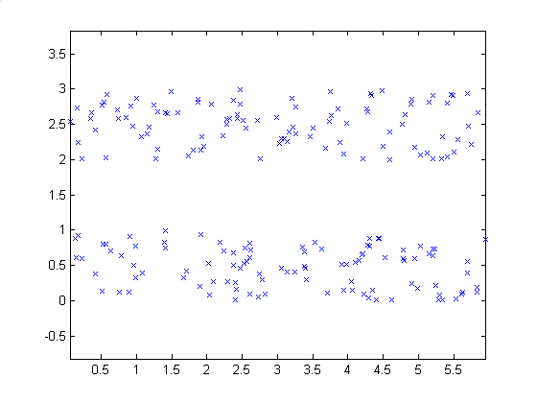
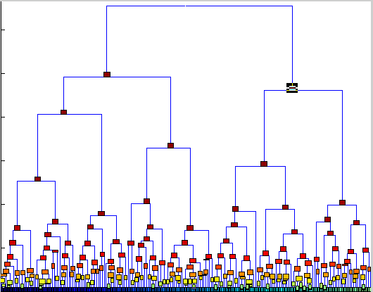
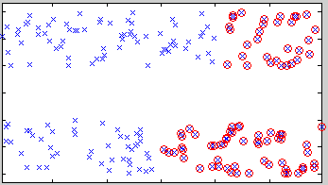
Elongated Clusters
Single linkage succeeds to partition
Average linkage fails
Notes:
Single linkage does better, because it is biased toward samples that are close – correctly identifies clusters that are visually obvious in this elongated shape
Average is better at globular clusters and so struggles with elongation

Slide 16
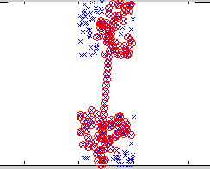
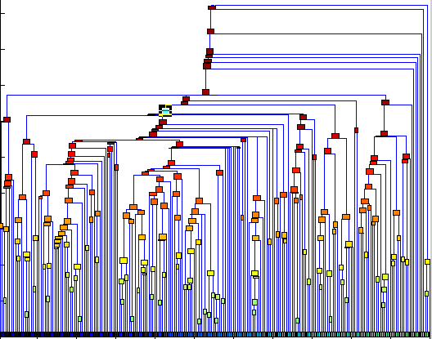
Filament
Single linkage not robust
Adapted from E. Domany

Slide 17
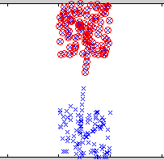
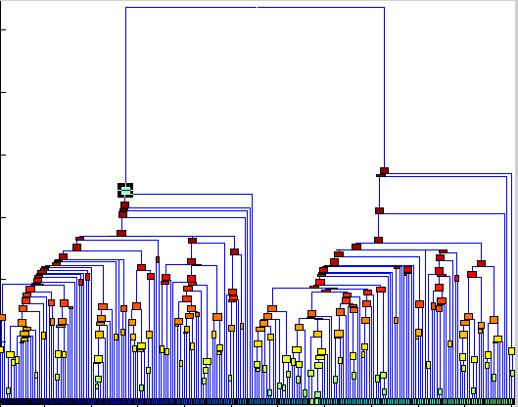
Filament with Point Removed
Single linkage not robust
Adapted from E. Domany

Slide 18
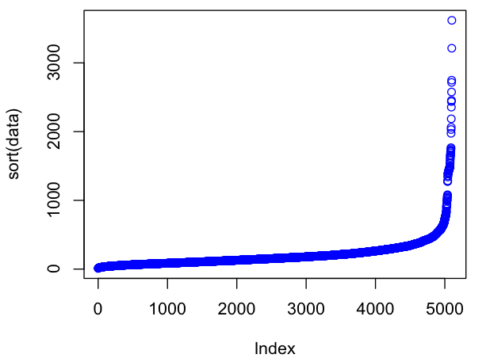
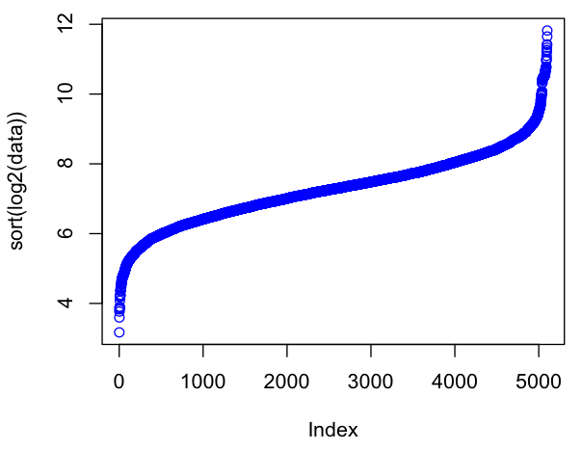
Data Preparation
Row Normalization
Makes genes expressed at different levels comparable to each other
Filtering
Removes lowly-expressed (noisy) and invariant genes
Log transform
Removes outliers by scaling distribution
Expression data after
log transform
Typical distribution of
raw expression data

Slide 19
Two-way Clustering
Two independent cluster analyses on genes and samples used to reorder the data (two-way clustering):
Notes:
Unearth clusters of coordinated gene and sample activity
- co-expressed genes, operating in clusters of samples – can help to point at biological processes

Slide 20
Clustering Exercise
2018-02-05_06_BroadE_Hierarchical Clustering – RNASeq
Notes:
Notes for exercise:
Pearson goes between 0 (correlated) and 2.0 (anti-correlated) – statistical measure
Euclidean, as a geometric measure has no upper bound
In the comparison diagrams
On the right side, they all get the same Pearson because Pearson is not impacted by scale or shifting.

