Slide 1
M&A VALUATION / INVESTMENT BANKING CASE
M&A Valuation &
Deal Analysis
Media industry acquisition case study
An integrated model covering DCF, WACC, trading comparables, transaction financing, EPS impact and sensitivities.
Prepared by Anumula Deepak Maruthi
Excel financial model • Python validation • 2026
DCF
WACC
COMPS
SOURCES & USES
EPS
HYPOTHETICAL MODEL — NOT THE REAL TRANSACTION

Slide 2
01 / EXECUTIVE SNAPSHOT
The base case shows value, but remains assumption-sensitive.
Corrected workbook outputs; every model assumption is hypothetical.
DCF ENTERPRISE VALUE
WACC
COMPS CROSS-CHECK
TOTAL TRANSACTION USES
$80.45bn
9.11%
$64.8bn
$16.436bn
PV of forecast cash flows + terminal value
CAPM cost of equity + after-tax debt cost
8.0x illustrative median EV / EBITDA
Sources match uses; check = $0.000bn
VALUATION READ-THROUGH
DEAL & EPS SIGNALS
DCF is 24.1% above the illustrative comps EV.
Year 1 EPS change: -2.20 per share; percentage accretion is not meaningful.
Terminal value accounts for 73.4% of DCF enterprise value.
Comps-implied target equity is only $2.0bn against $42.0bn target net debt.
DCF equity value is $23.4bn after $57.0bn of combined pre-deal net debt.
Treat price, debt funding, synergies and terminal assumptions as diligence priorities.
Source: corrected workbook tabs DCF, Comps, Transaction and Accretion-Dilution. All model figures are fictional educational outputs.
ILLUSTRATIVE MODEL • USD BILLIONS UNLESS NOTED • NOT ACTUAL PARAMOUNT / WBD FINANCIALS
02 / 13

Slide 3
02 / PUBLIC CONTEXT
A real transaction provides context — not the model inputs.
Paramount Skydance completed the WBD acquisition on 6 October 2026; the workbook remains a separate hypothetical case.
CASH CONSIDERATION / SHARE
ANNOUNCED ENTERPRISE VALUE
ANNOUNCED EQUITY VALUE
RUN-RATE SYNERGY TARGET
$31.0167
$110bn
~$81bn
≥ $6bn
Per WBD share at closing
Signing announcement metric
Signing announcement metric
Management target within 3 years
STRATEGIC ASSET COMBINATION
IMPORTANT MODEL SEPARATION
Two major film studios and deep content libraries
The workbook uses fictional companies, historicals, debt, peer multiples and transaction financing. Its $80.4bn DCF EV and $44.4bn illustrative transaction EV are not estimates of the actual Paramount–WBD transaction.
Two global streaming services and premium TV assets
CBS, HBO, cable networks, CBS News, CNN and sports
Management targets >$10bn FCF by 2030 and 3.0x net leverage by end-2029
Use public facts as context only; do not mix them into model outputs.
Sources: Paramount closing release (6 Oct 2026); Paramount acquisition announcement (27 Feb 2026); UK CMA merger inquiry. Links are listed on final slide.
ILLUSTRATIVE MODEL • USD BILLIONS UNLESS NOTED • NOT ACTUAL PARAMOUNT / WBD FINANCIALS
03 / 13

Slide 4
03 / MODEL SETUP
The valuation is driven by explicit, editable assumptions.
Valuation date in workbook: illustrative 31 December 2025. USD billions unless noted.
REVENUE GROWTH
EBITDA MARGIN
D&A / REVENUE
VALUATION FRAMEWORK
2.0% → 3.0%
12.5% → 14.5%
7.0%
2% in 2026, rising to 3% thereafter
+0.5 percentage points each year
Includes simplified content amortization
Unlevered DCF, forecast 2026–2030
Terminal value using a 2.5% perpetual growth rate
Illustrative peer median of 8.0x EV / EBITDA
CAPEX / REVENUE
CASH TAX RATE
TERMINAL GROWTH
Transaction financing and simplified EPS bridge
4.0%
25.0%
2.5%
Content cash spend not separately modelled
Simplified operating tax assumption
Must remain below WACC
KNOWN LIMITATIONS
Inputs are not actual filings or market data. Model simplifies content spending, working capital, purchase accounting, tax attributes, debt schedules and integration. Peer set is fictional. Use as a learning portfolio—not investment advice.
Source: Assumptions and Start Here worksheets. Assumptions are clearly labelled as fictional placeholders in the workbook.
ILLUSTRATIVE MODEL • USD BILLIONS UNLESS NOTED • NOT ACTUAL PARAMOUNT / WBD FINANCIALS
04 / 13

Slide 5
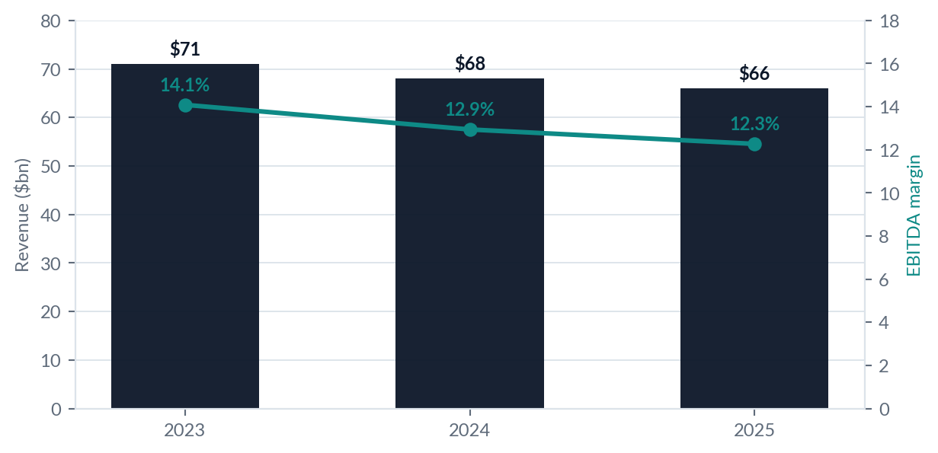
04 / HISTORICAL PROFILE
The fictional combined business shows declining revenue and EBITDA.
Historical inputs are invented for the educational case and are not Paramount / WBD reported results.
2025 REVENUE
2025 EBITDA
$66.0bn
$8.1bn
2023: $71bn
2023: $10.0bn
WHAT THE HISTORY SIGNALS
Revenue declines from $71bn to $66bn (2023–2025).
EBITDA margin falls from 14.1% to 12.3%.
2023 COMBINED NI
2024 COMBINED NI
2025 COMBINED NI
$1.0bn
-$0.35bn
-$1.4bn
Source: Historical worksheet; combined values calculated by adding the two fictional standalone businesses. Figures in USD billions.
ILLUSTRATIVE MODEL • USD BILLIONS UNLESS NOTED • NOT ACTUAL PARAMOUNT / WBD FINANCIALS
05 / 13

Slide 6
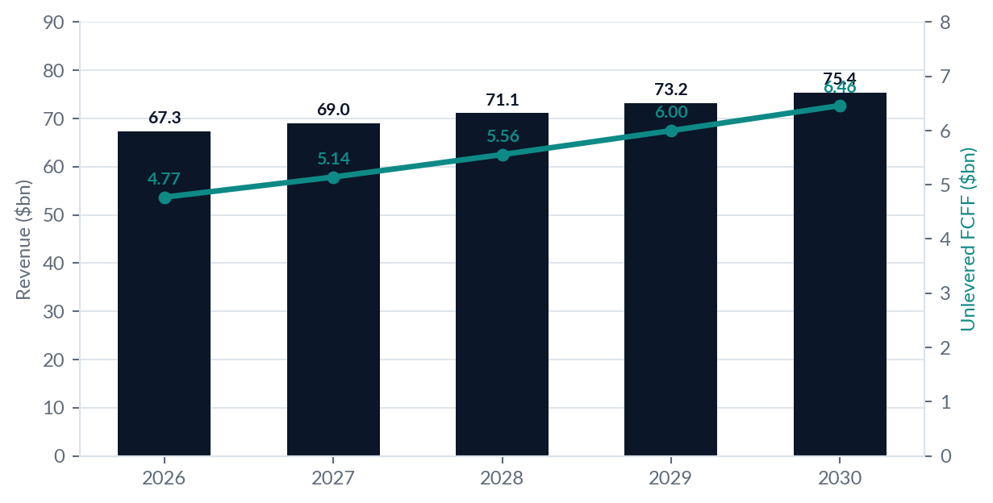
05 / PROJECTIONS
Revenue grows modestly as EBITDA margins gradually recover.
Base operating FCFF excludes deal synergies and one-time integration costs.
EBITDA MARGIN
12.5% → 14.5%
2026 to 2030 forecast
YEAR 1 SYNERGY BRIDGE
Gross synergies
+0.525
Dis-synergies
-0.250
Integration costs
-1.000
Net pre-tax benefit
-0.725
2030 REVENUE
2030 EBITDA
2030 FCFF
RUN-RATE SYNERGIES
$75.4bn
$10.93bn
$6.46bn
$1.5bn
Source: Projections and Assumptions worksheets. Synergy, dis-synergy and integration inputs are illustrative, not actual company guidance.
ILLUSTRATIVE MODEL • USD BILLIONS UNLESS NOTED • NOT ACTUAL PARAMOUNT / WBD FINANCIALS
06 / 13

Slide 7
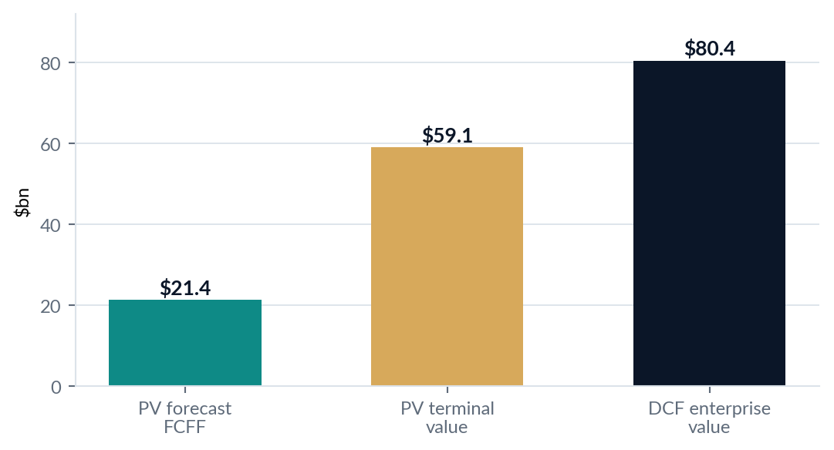
06 / DCF VALUATION
DCF enterprise value is $80.45bn under the base case.
Unlevered DCF; terminal value uses normalized terminal FCFF and a 2.5% perpetual growth rate.
VALUATION BRIDGE
PV of forecast FCFF
21.37
2026–2030
PV of terminal value
59.07
73.4% of EV
DCF enterprise value
80.45
Before acquisition financing
Less: combined pre-deal net debt
-57.00
2025A fictional inputs
DCF equity value (simplified)
23.45
Enterprise value less net debt
DCF EV / 2025A combined EBITDA = 9.93x | Implied terminal EV / 2030 EBITDA = 8.36x | Model EV is 24.1% above comps cross-check
Source: DCF worksheet. DCF excludes synergies and integration costs; terminal value is a large driver of the result.
ILLUSTRATIVE MODEL • USD BILLIONS UNLESS NOTED • NOT ACTUAL PARAMOUNT / WBD FINANCIALS
07 / 13

Slide 8
07 / DISCOUNT RATE & TERMINAL VALUE
A 9.11% WACC is built from explicit cost-of-capital assumptions.
These rates are illustrative placeholders—not valuation-date market observations.
COST OF EQUITY (CAPM)
TERMINAL VALUE
4.20% + 1.15 × 5.50% = 10.525%
$91.36bn
Risk-free rate + beta × equity risk premium
PV of terminal value = $59.07bn
WACC FORMULA
Terminal FCFF (normalized, grown): $6.041bn
75% × 10.525% + 25% × 6.50% × (1 − 25%)
Perpetual growth: 2.50%
Terminal value / DCF EV: 73.4%
WACC = 9.1125% | After-tax debt cost = 4.875%
TV = normalized terminal-year FCFF × (1 + g) / (WACC − g)
Sensitivity warning: 73.4% of DCF EV comes from terminal value; small changes to WACC / g materially move the valuation.
Source: Assumptions and DCF worksheets; cash-flow and terminal-value methodology as implemented in the workbook.
ILLUSTRATIVE MODEL • USD BILLIONS UNLESS NOTED • NOT ACTUAL PARAMOUNT / WBD FINANCIALS
08 / 13

Slide 9
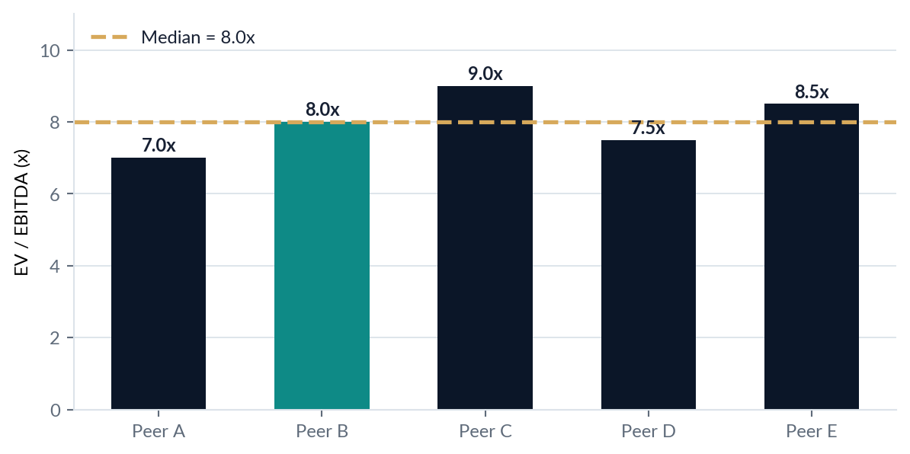
08 / TRADING COMPARABLES
The fictional peer median is 8.0x EV / EBITDA.
Comparables are an illustrative cross-check only; peers and multiples are not real market data.
IMPLIED VALUATION
Median EV / EBITDA
8.0x
Target 2025A EBITDA
$5.5bn
Target implied EV
$44.0bn
Less target net debt
-$42.0bn
Implied target equity
$2.0bn
Combined EV at median multiple
$64.8bn
Critical caveat: the target’s $2.0bn equity value is a thin residual after $42bn of net debt. At 7.0x, implied equity turns negative (−$3.5bn); a small multiple move changes the equity story dramatically.
Source: Comps worksheet. Fictional peer multiples: 7.0x, 8.0x, 9.0x, 7.5x and 8.5x; median 8.0x.
ILLUSTRATIVE MODEL • USD BILLIONS UNLESS NOTED • NOT ACTUAL PARAMOUNT / WBD FINANCIALS
09 / 13

Slide 10
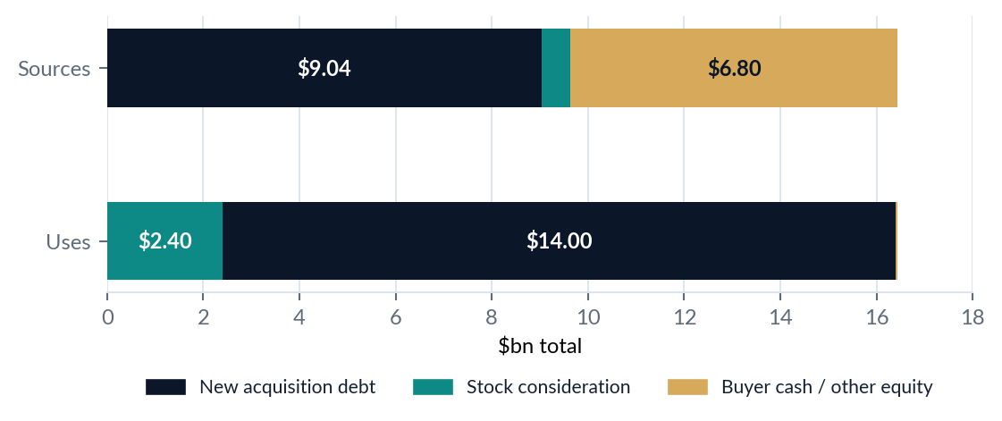
09 / TRANSACTION FINANCING
The illustrative sources-and-uses schedule balances at $16.436bn.
The structure is a simplified hypothetical acquisition funding case—not the actual Paramount–WBD financing.
SOURCES & USES ($bn)
USES
SOURCES
Equity purchase
2.4
Acquisition debt
9.0398
Debt refinancing
14
Stock consideration
0.6
Transaction fees
0.036
Buyer cash / other
6.7962
TOTAL USES
16.436
TOTAL SOURCES
16.436
Sources less uses = $0.000bn ✓ balanced
DEBT-FUNDED SHARE
NEW DEBT
STOCK ISSUED
DEBT RETAINED
55.0%
$9.04bn
0.040bn
$28.0bn
Of total transaction uses
At 6.5% pre-tax cost of debt
Shares, at $15 assumed price
Alongside $14bn refinanced
Source: Transaction and Assumptions worksheets. Retained target debt is separately accounted for in model check; it is not a cash use at close.
ILLUSTRATIVE MODEL • USD BILLIONS UNLESS NOTED • NOT ACTUAL PARAMOUNT / WBD FINANCIALS
10 / 13

Slide 11
10 / EPS ACCRETION & DILUTION
The simplified Year 1 case worsens EPS by $2.20 per share.
Because standalone acquirer EPS is negative, the percentage accretion/dilution measure is not meaningful (n.m.).
ACQUIRER STANDALONE EPS
PRO FORMA EPS
EPS CHANGE
ACCRETION / DILUTION %
-$0.57
-$2.77
-$2.20
n.m.
2025A fictional input
After Year 1 costs and interest
Per share vs standalone
Negative standalone EPS
YEAR 1 EARNINGS BRIDGE ($bn)
WHAT DRIVES YEAR 1
Acquirer net income
-0.400
Gross synergies realized: $0.525bn
Target net income
-1.000
Dis-synergies: −$0.25bn
After-tax deal benefits
-0.544
One-time integration: −$1.00bn
Incremental after-tax interest
-0.105
After-tax incremental interest: $0.105bn
Pro forma net income
-2.049
EPS ex integration: -$1.75 (change -$1.18)
EPS impact is not the same as value creation. The bridge omits purchase accounting, content amortization step-ups, debt amortization, tax attributes and share-price movements.
Source: Accretion-Dilution worksheet. $2.20 per-share decline reflects the model’s negative starting earnings and simplified transaction costs.
ILLUSTRATIVE MODEL • USD BILLIONS UNLESS NOTED • NOT ACTUAL PARAMOUNT / WBD FINANCIALS
11 / 13

Slide 12
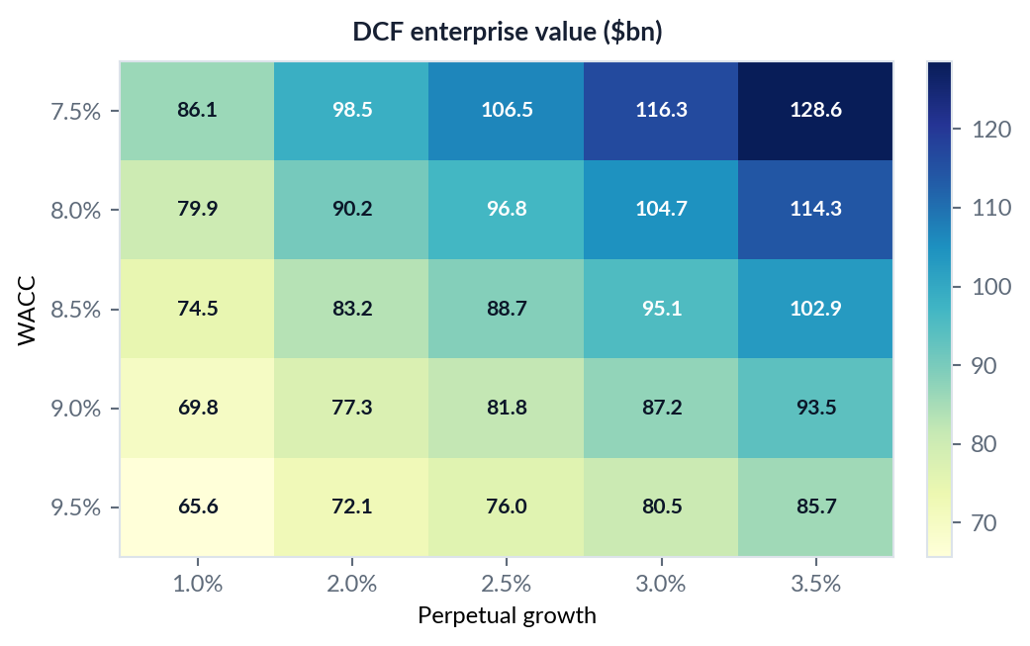
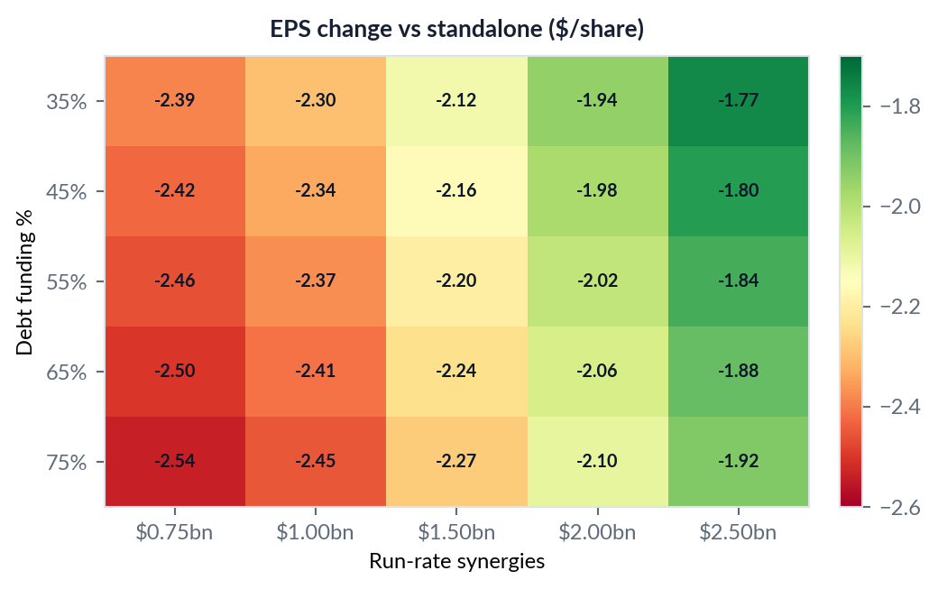
11 / SENSITIVITY
The DCF is most sensitive to WACC and perpetual growth.
Both sensitivity tables are taken directly from the corrected workbook’s Sensitivity worksheet.
At WACC 9.0% / growth 2.5%, workbook DCF EV is $81.85bn; at WACC 9.5% / growth 2.5%, it falls to $75.97bn. Higher debt funding worsens the modelled EPS change.
Source: Sensitivity worksheet. EPS sensitivity is dollars per share; percentage accretion/dilution is not meaningful with negative standalone EPS.
ILLUSTRATIVE MODEL • USD BILLIONS UNLESS NOTED • NOT ACTUAL PARAMOUNT / WBD FINANCIALS
12 / 13

Slide 13
12 / CONCLUSION
Strategic upside is clear; execution and model risk remain high.
The current spreadsheet is a strong educational scaffold; a live deal recommendation would need fully sourced inputs.
INVESTMENT-COMMITTEE TAKEAWAYS
KEY DILIGENCE PRIORITIES
DCF EV of $80.45bn is 24.1% above the $64.8bn comps cross-check.
Replace fictional historicals with filed financial statements and debt schedules.
73.4% of DCF EV comes from terminal value, so WACC and growth assumptions deserve scrutiny.
Source risk-free rate, ERP, beta, capital structure, peer set and market multiples as of a fixed date.
Target equity value of $2.0bn is fragile against $42bn of fictional target net debt.
Model content cash spend separately from PP&E capex; refine working capital and tax schedules.
Year 1 EPS worsens by $2.20/share; synergy delivery does not immediately offset deal costs.
Build debt paydown, purchase accounting, synergy timing and integration costs by workstream.
Do not treat the illustrative transaction EV of $44.4bn as a valuation of the actual Paramount–WBD deal.
Reconcile equity value, enterprise value, total debt and transaction financing against signed documents.
PUBLIC FACT SOURCES • Retrieved 27 Oct 2026
Paramount closing release (6 Oct 2026): ir.paramount.com/news-releases/news-release-details/paramount-completes-acquisition-warner-bros-discovery-creating | Paramount signing announcement (27 Feb 2026): paramount.gcs-web.com/news-releases/news-release-details/paramount-acquire-warner-bros-discovery-form-next-generation | UK CMA: gov.uk/cma-cases/paramount-slash-warner-bros-discovery-merger-inquiry | $110bn headline value: cbsnews.com/news/paramount-warner-bros-discovery-deal-skydance/
Analysis uses the workbook as the numerical source for hypothetical model outputs; public facts are only context, not model inputs.
ILLUSTRATIVE MODEL • USD BILLIONS UNLESS NOTED • NOT ACTUAL PARAMOUNT / WBD FINANCIALS
13 / 13

