Slide 1
Instacart Market Basket Analysis
Capstone Project: Data Science and Analytics Certificate Bootcamp
Stack Education at Framingham State University
Deepika Dittakavi

Slide 2
Introduction
Instacart is a grocery ordering and delivery app. Instacart’s data science team uses transactional data to develop models that predict which products a user will buy again, try for the first time, or add to their cart next during a session.
Data Analytics can be used to increase user base, sales, customer satisfaction, efficiency etc.
Business Users: Instacart Sales team, Market Basket Store Managers, Product Distributors.

Slide 3
Executive Summary
Goal: Understand, evaluate and analyze the data by leveraging Supervised Classification algorithms to predict the products Instacart users are likely to reorder from past purchases.
Data was analyzed using Tableau and R. Classification algorithms were evaluated in R on train and test data. Among many evaluated models, optimum performance was obtained by the Naïve Bayes model with an F1 score of 0.41.
Primary Recommendations:
Leverage insights to plan for shopper schedules
Build loyalty program and promotional sales to increase sales during off-peak days/hours.
Implement a 1-click cart to order for users to enable easy re-orders
Schedule additional workers on peak days/hours
For future, geographic location details and time to delivery could be added to get more insights.

Slide 4
Data Analysis Approach
METHODOLOGY:
Data Exploration & Insights
Understand data
Align with Stakeholders
Draw meaningful Insights
Feature Engineering
Explore relationships and derive features
Model Analysis and Performance
Evaluate different models, compare and apply best model to final data
Conclusion
Final summary and recommendations

Slide 5
Data Exploration: Dataset
Data Source: Kaggle (https://www.kaggle.com/c/instacart-market-basket-analysis)
Challenges:
Multiple files need merging
Dependent Variable and features not given and need to be defined
Huge data(3 million orders) lead to infrastructure limitations
Imbalanced Dataset
Departments
Dept name
Dept ID
Aisles
Aisle name
Aisle ID
Orders
Order ID
User ID
Order number
Order day/Hour
Days since
Order_products_train &
Order_products_prior
Order ID
Product ID
Add to cart order
Reorder
Products
Product name
Product ID
Dept ID
Aisle ID

Slide 6
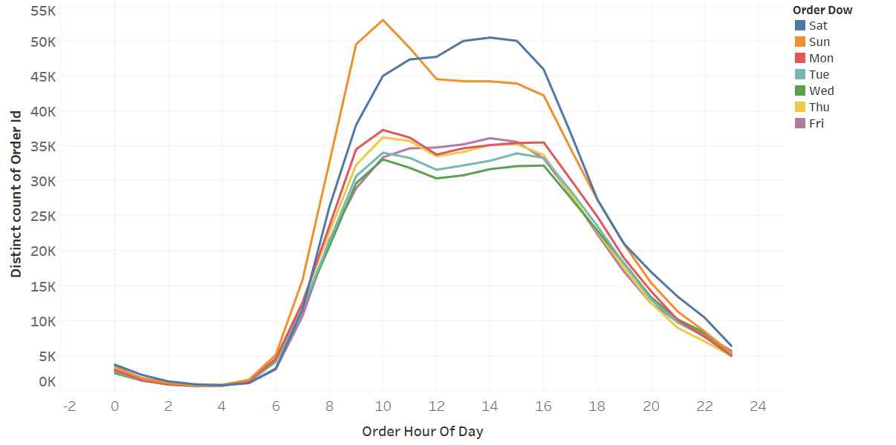
Data Exploration: Time
Store managers schedule Grocery supply by coordinating with Product distributors
Schedule shoppers by leveraging demand is critical for on time delivery and customer satisfaction
Saturdays are more even
throughout the day
Sundays mornings
have higher sales

Slide 7
Data Exploration: Key Insights
Parameter | Fact | Insight | Recommendation to Business Users
Department | Produce, Dairy eggs and Beverages are top reorders | Basic food items are reordered Reorders have a pattern, that can be used for features in the model | Work with product distributors to keep up the supply of these high demand products
Aisle | Fruits & Vegetables, Milk and eggs top reorders | Lower shelf life items have high reorders | Schedule store reps to stock items frequently, monitor freshness of products
Product | Bananas most popular product. Organic products very popular | Use “organic” feature for model Reorders seem to be most basic items | Arrange frequent reordered items like Organic near store entrance for easy shopping
Day of week | Weekends high sales, Wednesday lowest | Users think about groceries on weekends and on Thu/Fri to shop for weekend | Schedule for more shoppers on weekend and lower in mid-week
Hour of day | Early morning and afternoon are peak hours | Users likely ordering in the morning for evening delivery | Schedule shoppers & Re-stock
Days since prior order | Users mostly buy weekly, local maximums at 2 wks and 3 wks | Cart size expected to be smaller for lower gap in days. | Implement a 1-click cart to order of items for the user
Cart size | Increases with days since last order | User orders more products hence use as a feature in model
Add to cart order | First placed products are most needed products | Use position of product in cart for model & determine demand of product

Slide 8
Feature Engineering
Identify User behavior
User reorder percent
Average time of order, frequency
How many orders/products
Identify Product characteristics
Product reorder percent and frequency
Is it one of the popular products
Identify User-product combination patterns
Reorder percent for a product by a user
User cart order of the product

Slide 9
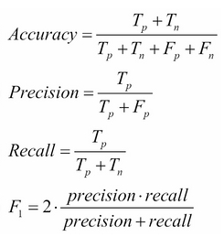
Model Analysis
Output Measure Method: Since data is imbalanced, accuracy will be biased one-way. F1-Score is used to measure performance.
Cut-off analysis was used for fine tuning.
Data split into 3 sets:
Train set – used to run different models
Evaluation set – used to compare outputs and evaluate models
Test set – used to run final model on data(not seen by model)
Prediction
 | True (1) | False (0)
True (1) | T_{p} | F_{n}
False (0) | F_{p} | T_{n}
Actual

Slide 10
Results
Results on Train and Evaluation data sets:
Final Results on Test data:
Model* | Accuracy | Precision | Recall | F1 Score
CART | 0.9085 | 0.1709 | 0.6120 | 0.2672
Random Forest | 0.9081 | 0.1675 | 0.6047 | 0.2623
Naïve Bayes | 0.8998 | 0.2978 | 0.4781 | 0.3669
Logistic Regression | 0.9086 | 0.1734 | 0.5952 | 0.2686
Naïve Bayes(Tuned-cutoff**) | 0.8628 | 0.4937 | 0.3543 | 0.4126
* Models were analyzed on a random sample of data with 10% users (13K) due to infrastructure limitations – 850K observations
** Cutoff analysis showed 0.25 cutoff yields higher F1 score than default 0.5
Model* | Accuracy | Precision | Recall | F1 Score
Naïve Bayes | 0.863 | 0.4840 | 0.3562 | 0.4104

Slide 11
Conclusions and Future Work
Wrap up:
The Naïve Bayes model showed optimum performance with an F1 score of 0.41.
This model can be used by Business users to take appropriate actions to increase profitability, optimize efficiency and get customer satisfaction
Future Work:
The model can include over sampling to address the imbalance in the data.
Extend analysis to include first time buying of new products
Include analysis based on Apriori theorem(products that are bought together).
Extend analysis to complete dataset on powerful infrastructure

Slide 12
References
https://www.kaggle.com/c/instacart-market-basket-analysis
https://topepo.github.io/caret/model-training-and-tuning.html
https://towardsdatascience.com/explaining-feature-importance-by-example-of-a-random-forest-d9166011959e
https://machinelearningmastery.com/threshold-moving-for-imbalanced-classification/
https://machinelearningmastery.com/tour-of-evaluation-metrics-for-imbalanced-classification/

Slide 13
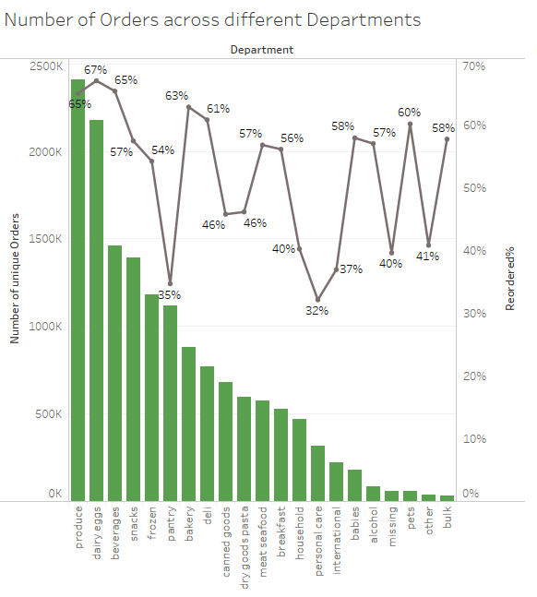
Appendix: Departments
Dairy and Eggs most reordered
Low shelf life items most re-ordered
Most orders from Produce,
Dairy & Eggs,
Beverages & Snacks

Slide 14
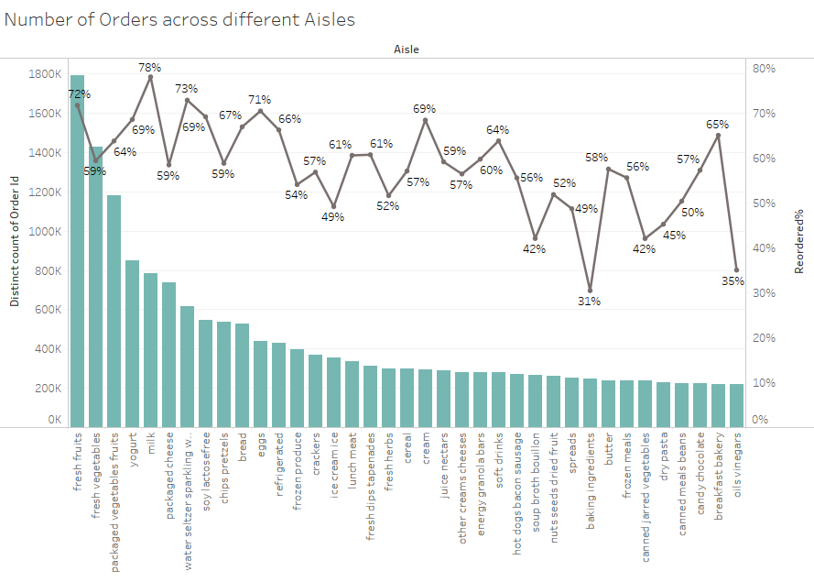
Appendix: Aisles
Milk most reordered
Bakery ingredients lower reorder rate
Most orders from Fresh fruits
& vegetables

Slide 15
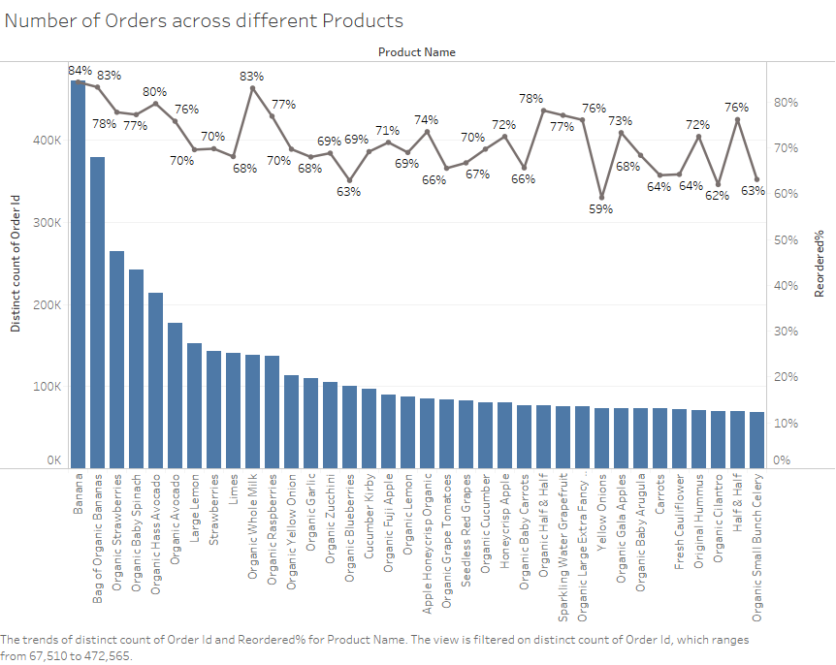
Appendix: Products
Bananas and organic whole milk
most reordered
Most orders for bananas,
Organic bananas,
Organic strawberries

Slide 16
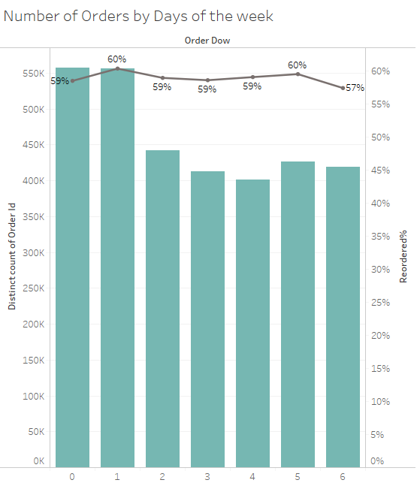
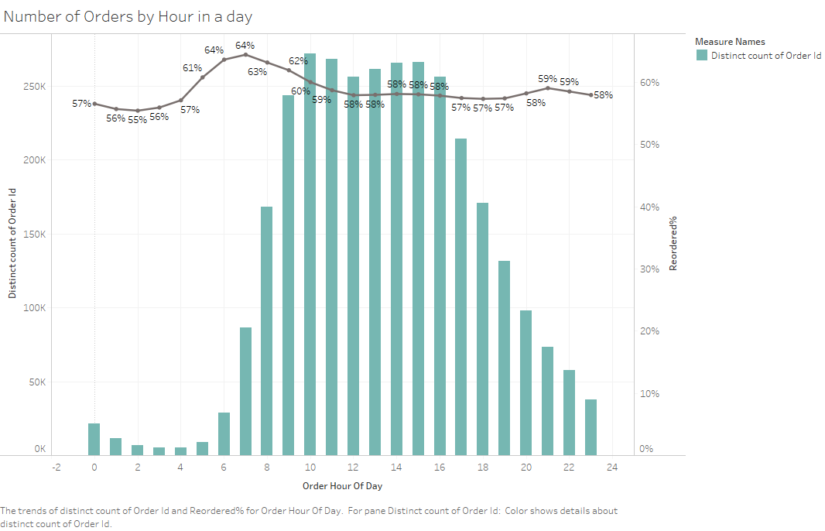
Appendix: Time
9AM to 4PM are peak hours
Weekends see higher sales
Sunday & Thursday have higher reorders
Early morning orders
have high reorders
Wednesday
Saturday
Monday
Tuesday
Thursday
Sunday
Friday

Slide 17
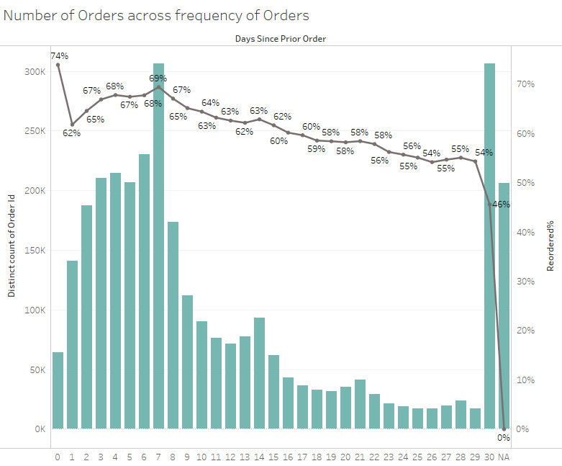
Appendix: Frequency of orders
Most users prefer ordering weekly or monthly
Reorders most when
ordering frequently
Many order every 2 weeks
And 3 weeks

Slide 18
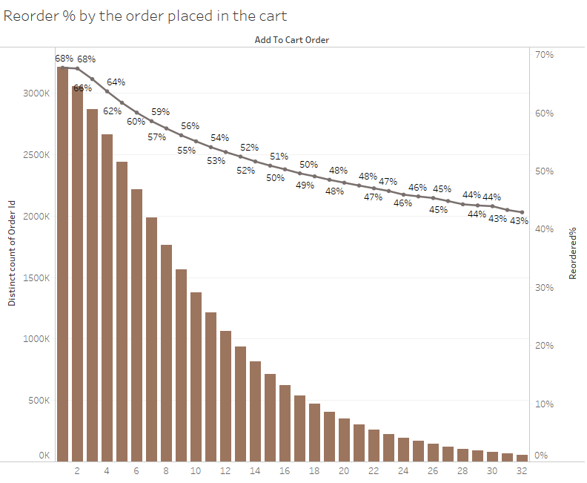
Appendix: Cart Order
Very clear decreasing trend of reordering
with order of items placed in cart
Users place most definitely needed
reordering items in order of priority

