Slide 1
Noise Modeling for Urban Planning Spacemaker AI, Boston MA
Industry Project for Data Science & Analytics Certificate Bootcamp with Stack Education
Authors: Deepika Dittakavi, Lois Dankwa, Tyler Gmerek
Mentor: Karoline Skatteboe, Spacemaker AI

Slide 2
EXECUTIVE SUMMARY

Slide 3
Contents & Design Flow
Introduction
Data Exploration
Features
Noise Models & Comparison
Final Results
Conclusion
References

Slide 4
INTRODUCTION
Noise Pollution refers to excessive amounts of noise that interfere with the natural bio-rhythms of everyday life.
Spacemaker AI developed technology to discover smarter ways to maximize building potential
At Spacemaker AI, noise pollution is an important aspect of urban design. A challenge for noise calculation is high computational demand limits, hence surrogate models are important research topics.
This project researches noise surrogate models
Project Goal:
Develop noise surrogate models to predict fraction of outdoor ground area in yellow zone of a test site.
Technical Skills:
Data Wrangling, Data Visualization, Statistical Analysis, Regression Analysis, Machine Learning
Techincal Tools:
R & Rstudio with ggplot, dplyr, caret
GitHub version Control

Slide 5
DATA EXPLORATION
Data:
Non-specific data: 4500 noise simulations from 9 different scenarios
Specific data: 250 noise simulations from the specific test scenario
Test data: 250 additional observations from the specific site
Data Dictionary:
Scenario(specific noise source pattern)
Building grid(npy matrix file with locations and heights)
Noise sources grid(npy matrix file with locations)
Fraction of outdoor ground area in yellow zone (dependent variable)

Slide 6
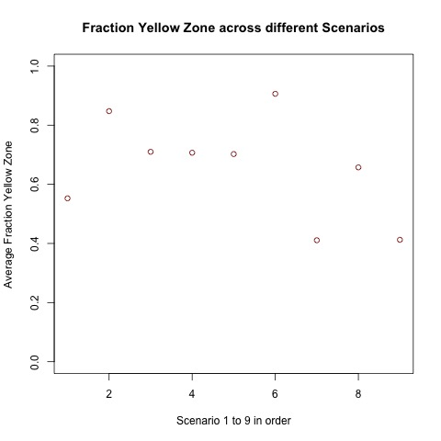
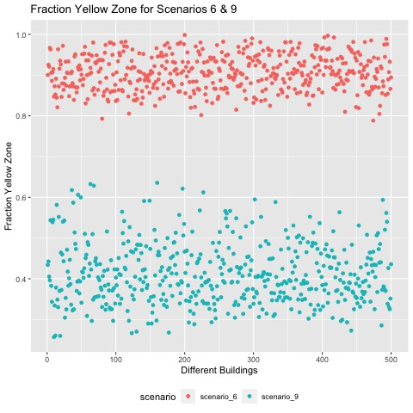
DATA EXPLORATION
Fraction yellow zone(the dependent variable) varies with different scenarios
Variation across different buildings can be dense or sparse

Slide 7
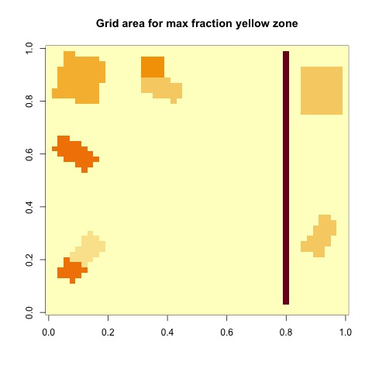
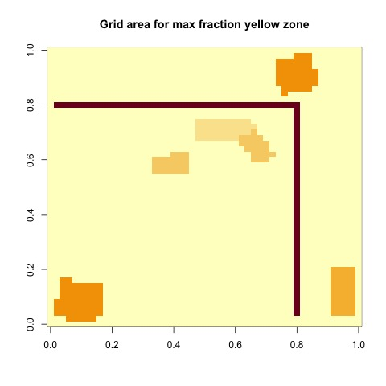
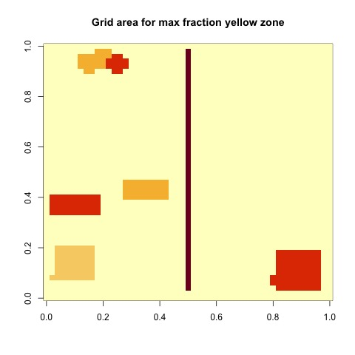
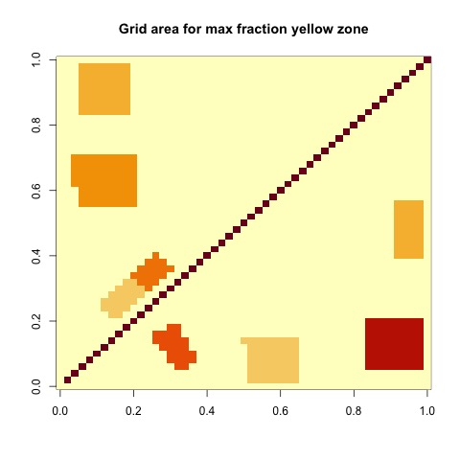
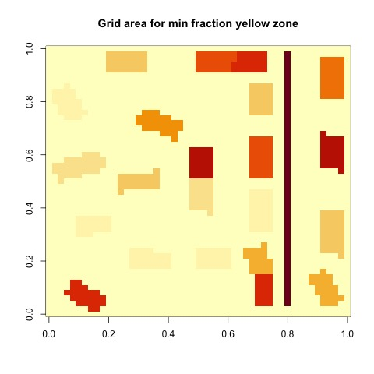
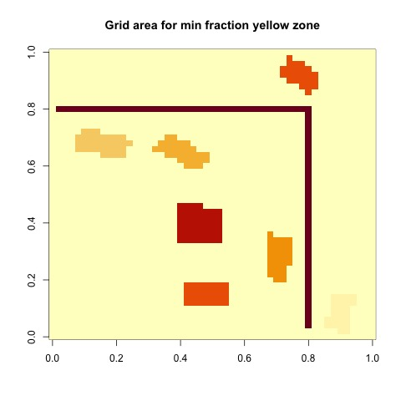
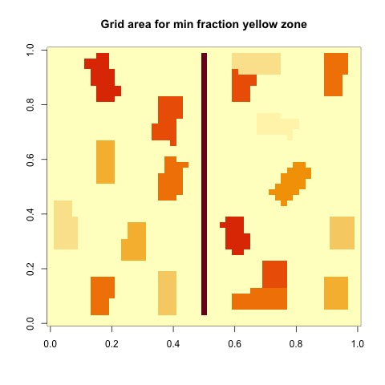
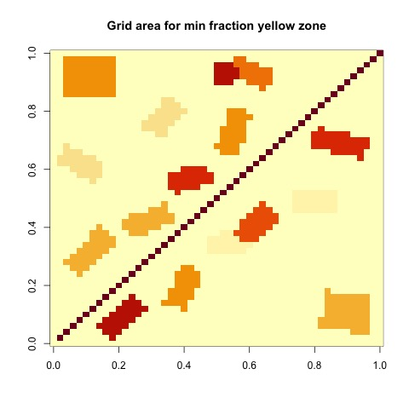
Grid configurations
DATA EXPLORATION contd.
Scenario 1
Scenario 2
Scenario 3
Scenario 4
(non-specific data)

Slide 8
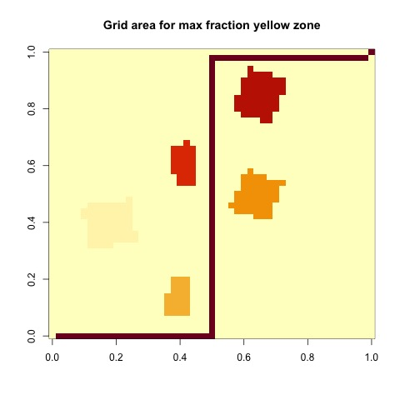
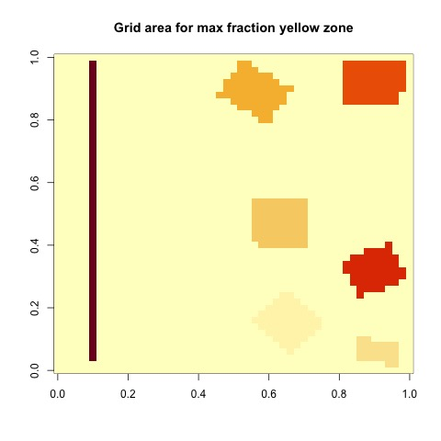
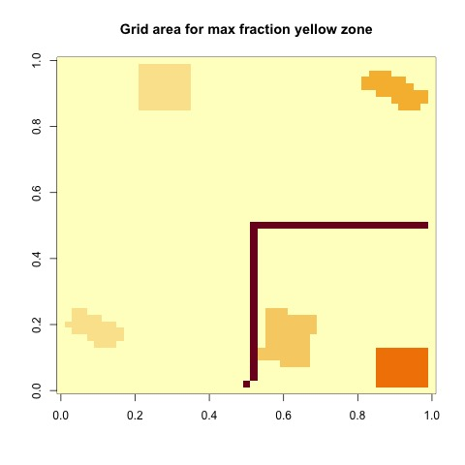
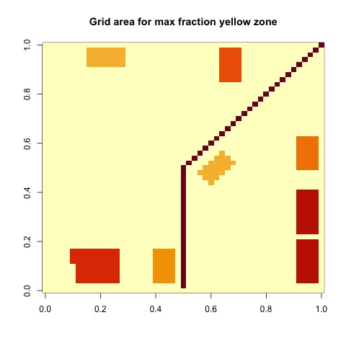
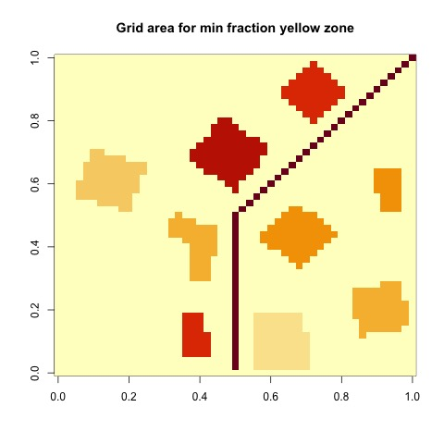
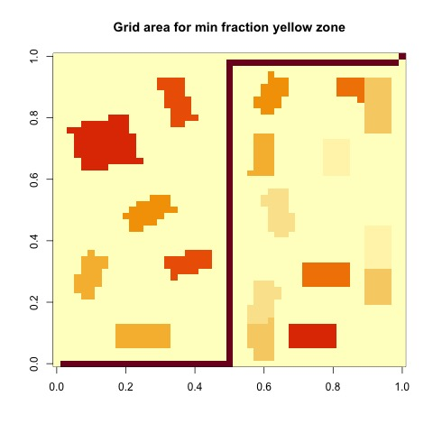
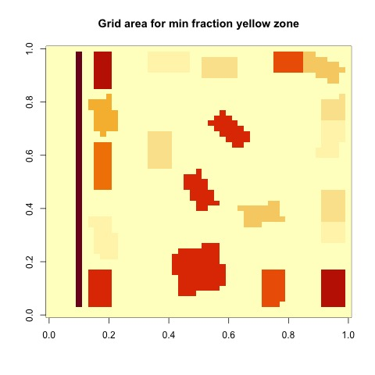
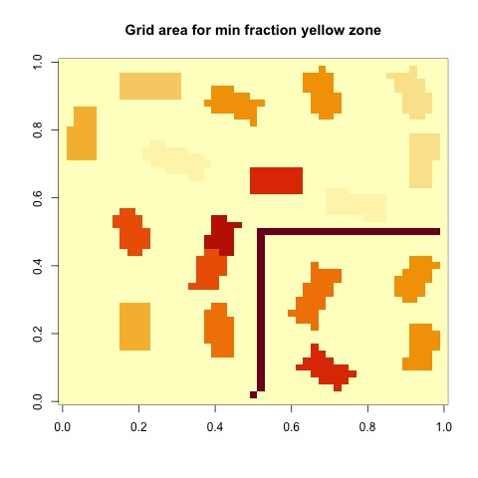
Grid configurations
DATA EXPLORATION contd.
Scenario 5
Scenario 6
Scenario 7
Scenario 8
(non-specific data)

Slide 9
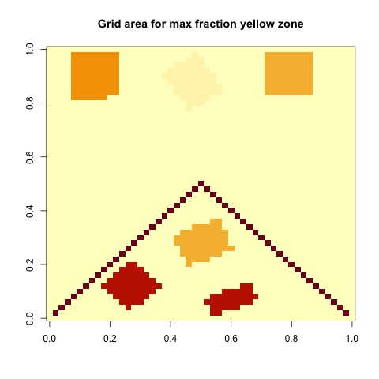
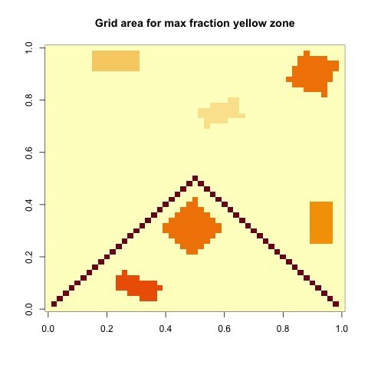
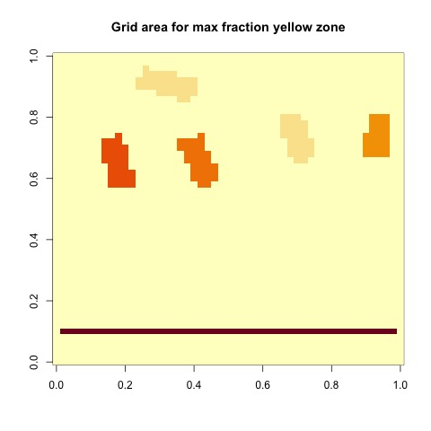
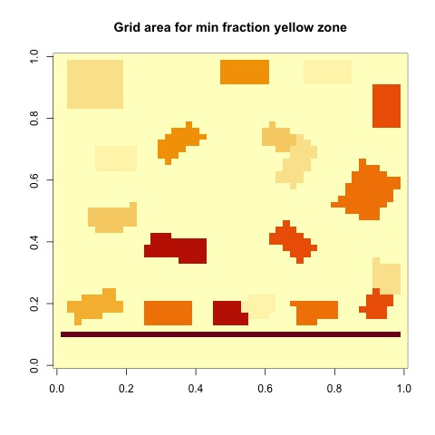
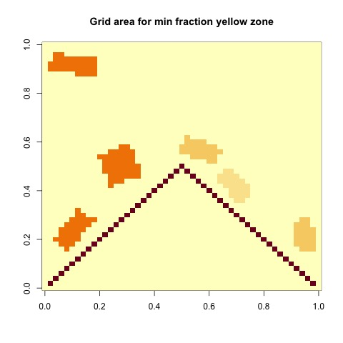
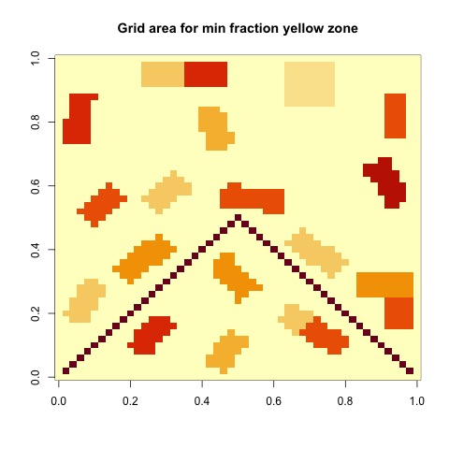
Grid configurations
DATA EXPLORATION contd.
Scenario 9
Specific site
(specific site data)
Specific site
(Test site data)
(non-specific data)

Slide 10
FEATURES
Buffer zone 1 < 12units
Buffer zone 2 < 12 to 24u
Buffer zone 3 < 12 to 36u
Buffer zone 4 >36u
Buffer 1
Buffer 2
Buffer 3
Buffer 4
Multiple features were defined, some important ones are:
Building Density(coverage)
Noise Source Density(coverage)
Building Density to Noise density ratio
Average Distance to road
Building Density in 4 zones
Building Heights
in the 4 zones
Buffer 3
All Scenarios will not have all buffer zones
Buffer 4 values will be zeros
Buffer 2
Buffer 1
Buffer 1
Buffer 2
Buffer 3

Slide 11
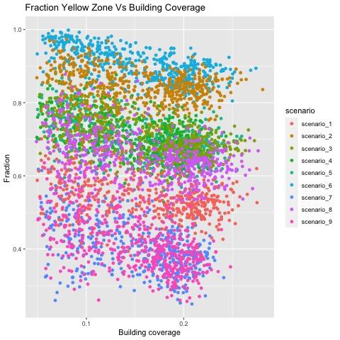
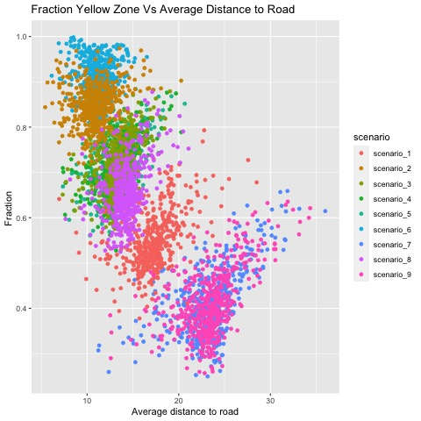
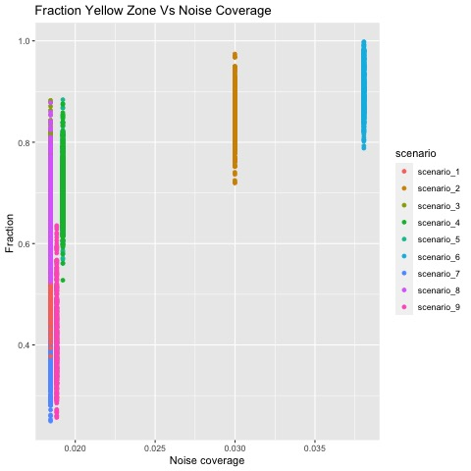
FEATURES: EXPLORATION
Fraction yellow zone increases with noise density
Fraction yellow zone decreases with building density and distance to road
Spread of distance to road has tightened
Scenario 1, 7 which have lower noise density have higher spread average distance to road
Scenario 2, 6 which have higher noise density have tighter spread of average distance to road

Slide 12
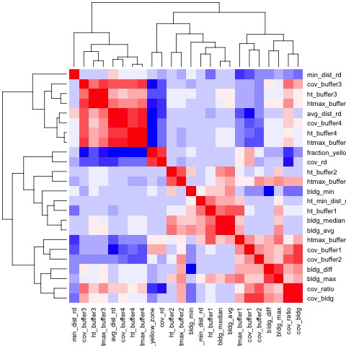
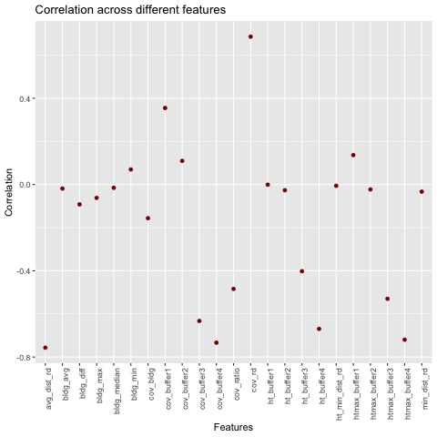
FEATURES: EXPLORATION
Correlation matrix was used to evaluate the important features
Features with almost no correlation were not used
Features that correlated with each other were optimized
Code facilitates features vector definition

Slide 13
FEATURES

Slide 14
NOISE MODELS & ANALYSIS
Data splitting
Measurement method
Baseline model

Slide 15
NOISE MODELS & ANALYSIS
Model name | RMSE | Hyper Parameters
Guess | 0.3766663 | NA
Average | 0.1691386 | NA
KNN | 0.0857905 | k
Linear Regress | 0.0750217 | NA
LOESS | 0.0673779 | span
Tree | 0.0624453 | cp
Forest | 0.0548306 | mtry, ntree
SVM | 0.0582215 | tunelength
1
2
3

Slide 16
ENSEMBLE MODEL

Slide 17
REFERENCES
https://topepo.github.io/caret/model-training-and-tuning.html
https://stats.stackexchange.com/questions/142873/how-to-determine-the-accuracy-of-regression-which-measure-should-be-used
https://glassboxmedicine.com/2019/09/15/best-use-of-train-val-test-splits-with-tips-for-medical-data/#:~:text=At%20the%20beginning%20of%20a,10%25%20val%2C%2010%25%20test
http://r-statistics.co/Loess-Regression-With-R.html

Slide 18
THANK YOU!

Slide 19
APPENDIX: Distance to Road calculation
min
min
Average closest distance to road
min
min

