Slide 1
STACK DSA
Spacemaker AI
Head of Operations
Karoline Skatteboe
Noise Surrogate Model for Urban Planning
Authors: Deepika Dittakavi, Lois Dankwa, Tyler Gmerek
Date: June 10, 2020
Industry Project - Data Science & Analytics Certificate Bootcamp with Stack Education

Slide 2
Noise Surrogate
Model
GOAL
To analyze statistical models for predicting the fraction yellow zone based on different building and noise source configurations.
Page 1 of 28

Slide 3
Design Methodology
Introduction
Data Exploration and Visualization
Feature Engineering
Model Analysis and Performance
Results – Test Site
Conclusion and recommendations
Page 2 of 28

Slide 4
Introduction
At the core of Spacemaker AI’s mission is the ability to generate urban building design proposals that minimizes the effect of noise, as excessive amount of noise is deemed to interfere with the natural biorhythms of everyday life.
An alternative to the high computational conventional method for noise calculation is surrogate models, which closely mimics the behavior of simulation models but computationally cheaper to evaluate.
Hence, the goal of this project.
Page 3 of 28

Slide 5
Data Exploration - Data
Data | Number of Scenarios | Source of noise simulations | Number of noise simulations
Non-Specific - training | 9 | different sites scenarios | 4500
Specific - training | 1 | test site scenario | 250
Test - testing | 1 | test site scenario | 250
*Data source: Spacemaker AI
Data Dictionary
Fraction Yellow Zone | Fraction of outdoor ground area in yellow zone
Building Grid | Numpy(npy) matrix file with locations and heights
Noise Source Grid | Numpy(npy) matrix file with locations
Scenario | Noise source configuration
* Source: Spacemaker AI
Page 4 of 28

Slide 6
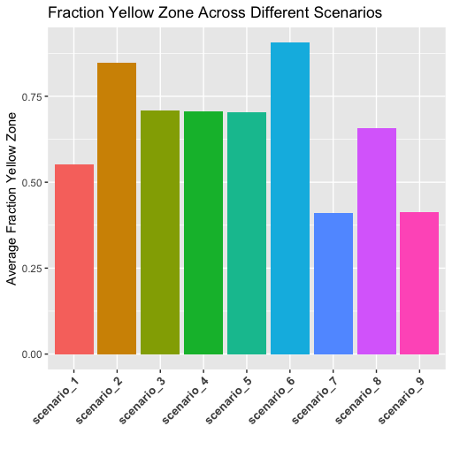
Data Exploration - scenarios
Fraction yellow zone(the dependent variable) varies with different scenarios.
Page 5 of 28

Slide 7
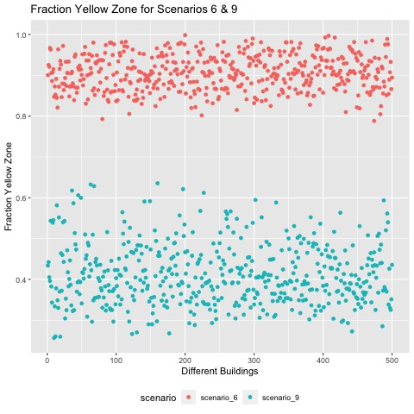
Data Exploration - scenarios
Variation is seen across different building configurations.
Variation can be dense or sparse.
Page 6 of 28

Slide 8
Data Exploration - grid configurations
Maximum Fraction Yellow Zone:
Visualizations for the various grid configurations for the combined building and noise source for:
Non-Specific data - scenario 1 – 9
Specific site data
Test site data
Minimum Fraction Yellow Zone:
Visualizations for the various grid configurations for the combined building and noise source for:
Non-Specific data - scenario 1 – 9
Specific site data
Test site data
Page 7 of 28

Slide 9
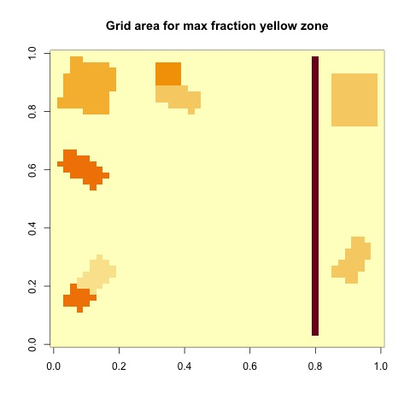
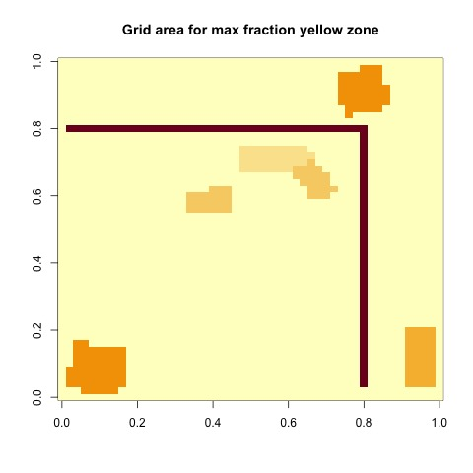
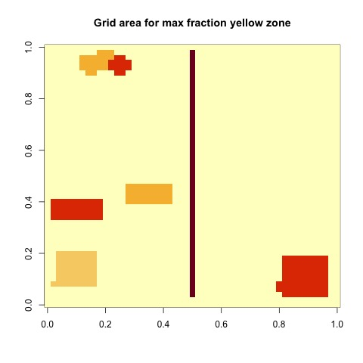
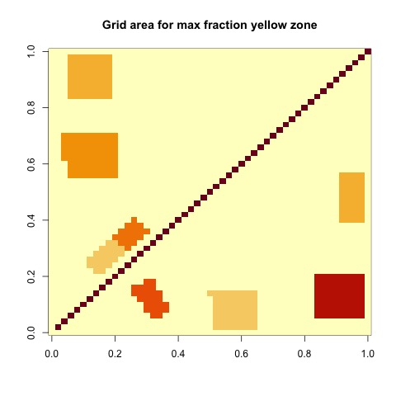
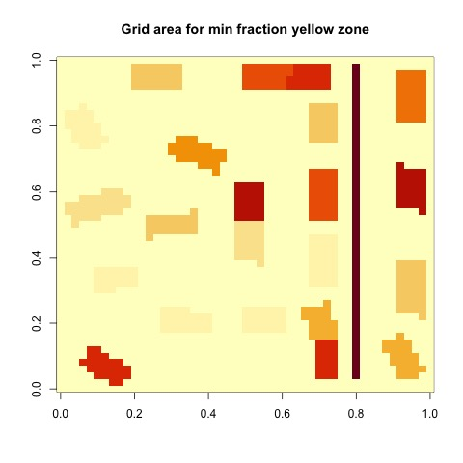
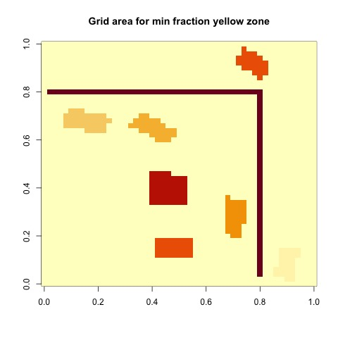
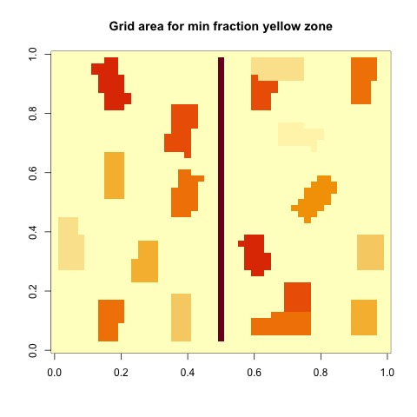
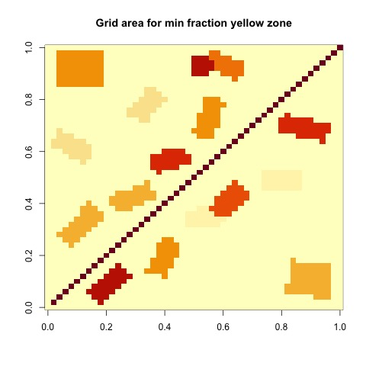
Data Exploration - grid configurations non-specific
Scenario 1
Scenario 2
Scenario 3
Scenario 4
Noise Source
Buildings
Building darker color=taller
Page 8 of 28

Slide 10
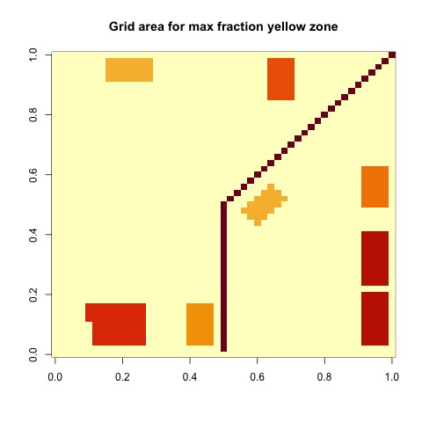
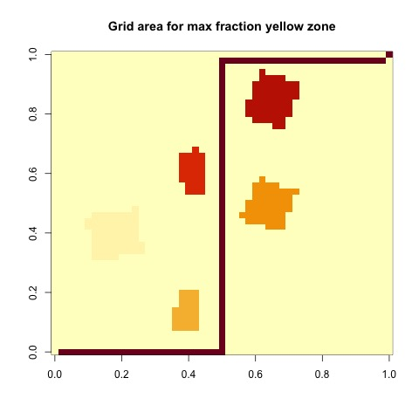
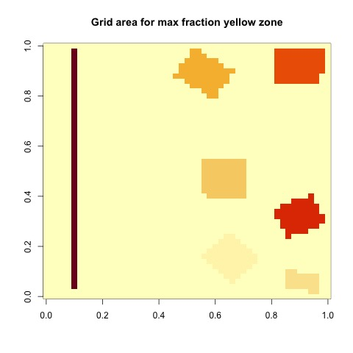
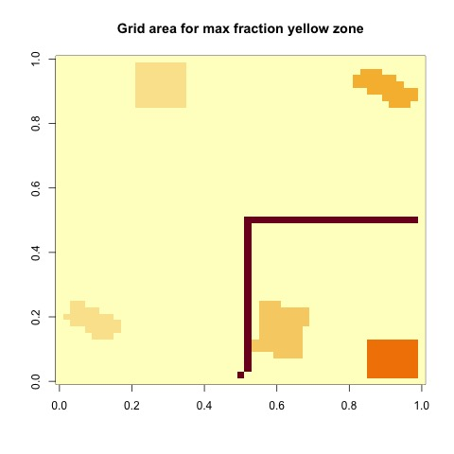
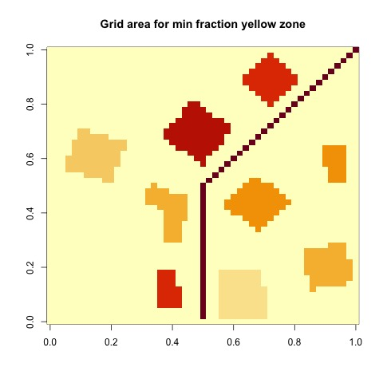
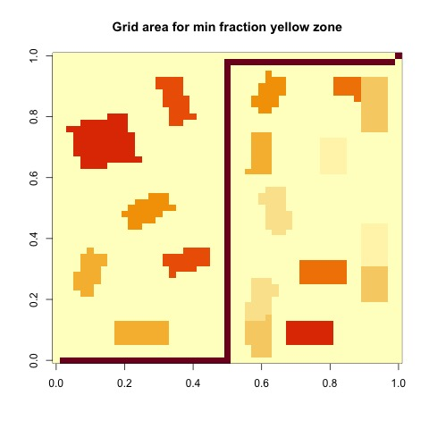
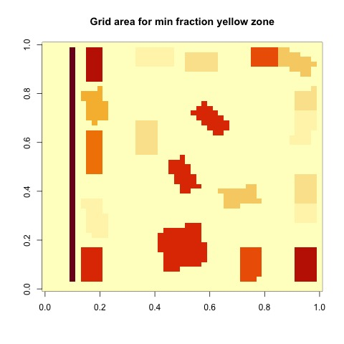
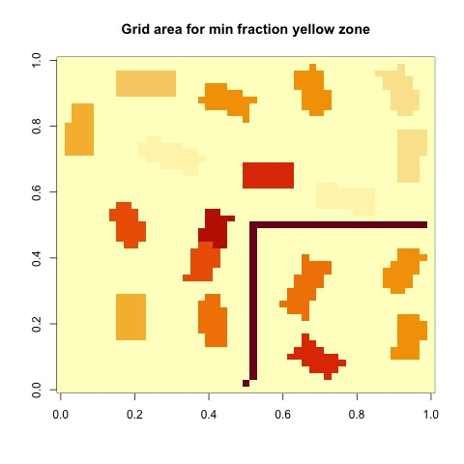
Data Exploration - grid configurations non-specific
Scenario 5
Scenario 6
Scenario 7
Scenario 8
Page 9 of 28

Slide 11

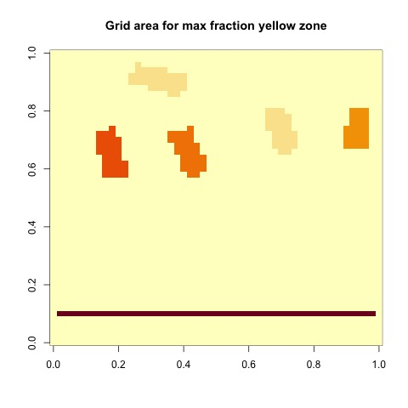
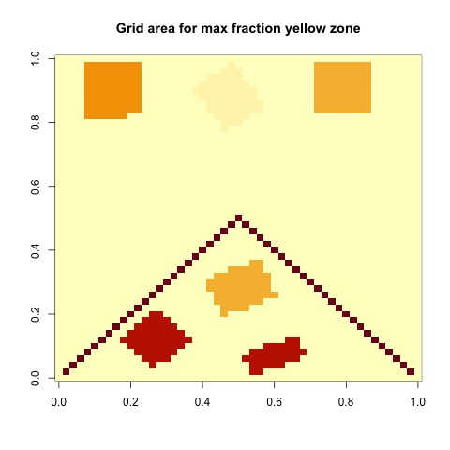
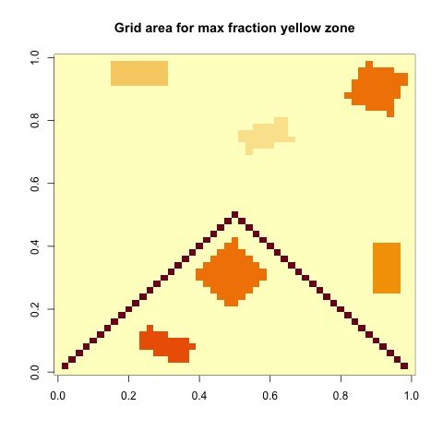
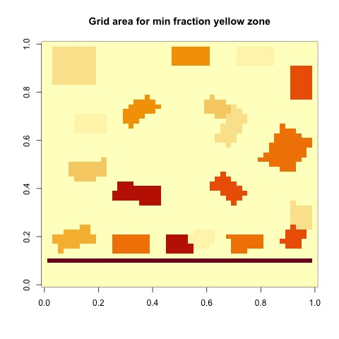
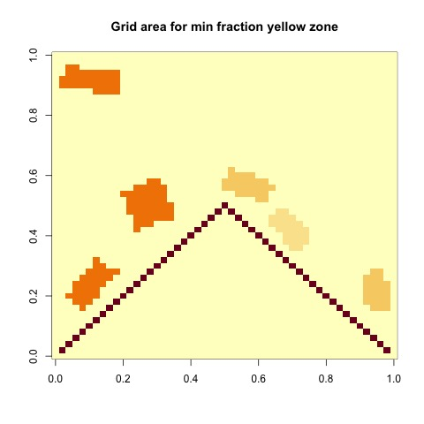
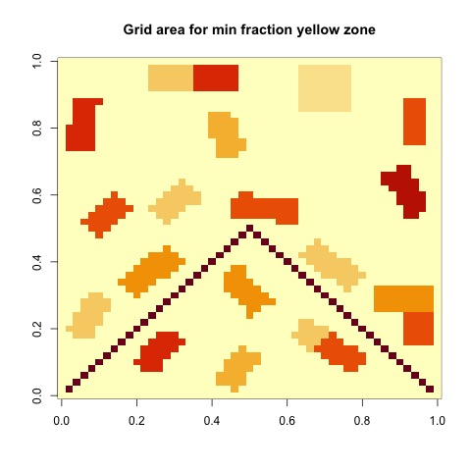
Data Exploration - grid configurations
Scenario 9
(non- specific site data)
Specific site
(specific site data)
Specific site
(Test site data)
Noise Source
Buildings
Building darker color=taller
Page 10 of 28

Slide 12
Feature Engineering - creating features
Based on the outcome of the trends gathered from the data exploration, all features used to analyze the statistical models fall under one of the following categories:
Building coverage
Noise coverage
Building coverage to noise coverage ratio
Average distance to noise
Building coverage in the 4 zones
Building heights in the 4 zones
Page 11 of 28

Slide 13
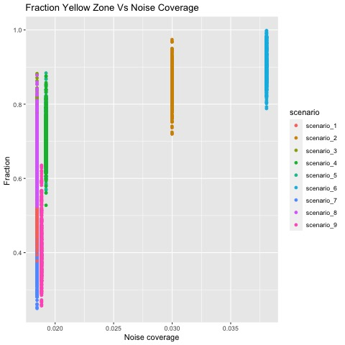
Feature Engineering - exploration
Fraction yellow zone increases with increasing noise coverage.
Scenario 1 and 7 have lesser noise coverage whilst Scenario 2 and 6 have a greater noise coverage.
6
2
1
7
Page 12 of 28

Slide 14
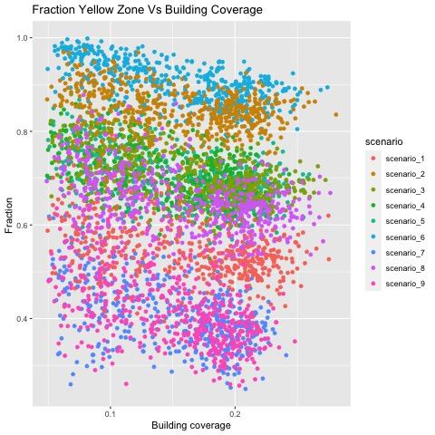
Feature Engineering - exploration
Fraction yellow zone decreases with increasing building coverage.
Page 13 of 28

Slide 15
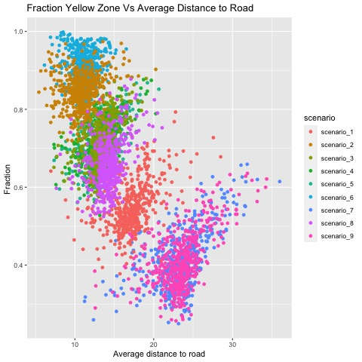
Feature Engineering - exploration
6
Fraction yellow zone decreases with increasing average distance to noise source.
Average distance to noise source for Scenario 1 and 7 have a broader range whilst that of Scenario 2 and 6 have a narrower range.
2
7
1
Page 14 of 28

Slide 16
Feature Engineering - creating features
Definition of Buffer zones for creating features
Buffer zone 1: within 12 units
Buffer zone 2: 12 to 24 units
Buffer zone 3: 24 to 36 units
Buffer zone 4: beyond 36 units
Buffer 3
Not all scenarios have all the 4 buffer zones
Buffer 4 values will be zero for this scenario
Buffer 1
Buffer 2
Buffer 3
Buffer 4
Buffer 2
Buffer 1
Buffer 1
Buffer 2
Buffer 3
Noise source
Page 15 of 28

Slide 17
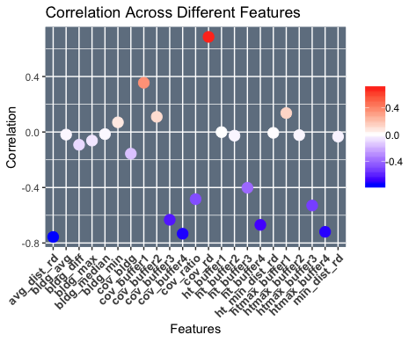
Feature Engineering - correlation
Correlation was used to evaluate the important features.
Features with zero or almost no correlation were omitted.
Page 16 of 28

Slide 18
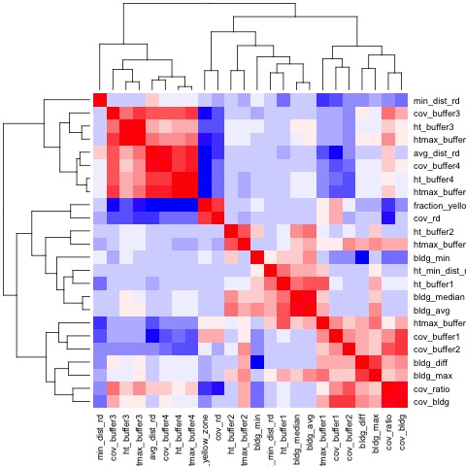
Feature Engineering - correlation
Features that correlated with each other were optimally selected by using feature importance generated by the Random Forest model
Final feature selection:
cov_rd | cov_bldg
cov_ratio | htmax_buffer1
htmax_buffer3 | htmax_buffer4
cov_buffer3
 | cov_buffer1
cov_buffer4 | avg_dist_rd
Page 17 of 28

Slide 19
Model Analysis and Performance
Data splitting
Non-specific data and specific data were combined to give 4750 observations
Split of 80% training data and 20% testing data made based on the following reasons:
specific dataset only about 5% and so not enough to use for testing.
specific dataset were observations from the test site and thus combining it with the non-specific data would be more efficient in training the models
Page 18 of 28

Slide 20
Model Analysis and Performance
Technical Skills: Data Wrangling, Data Visualization, Statistical Analysis, Regression Analysis, Machine Learning
Technical Tools: R & RStudio with ggplot, dplyr, caret package GitHub version Control
Page 19 of 28

Slide 21
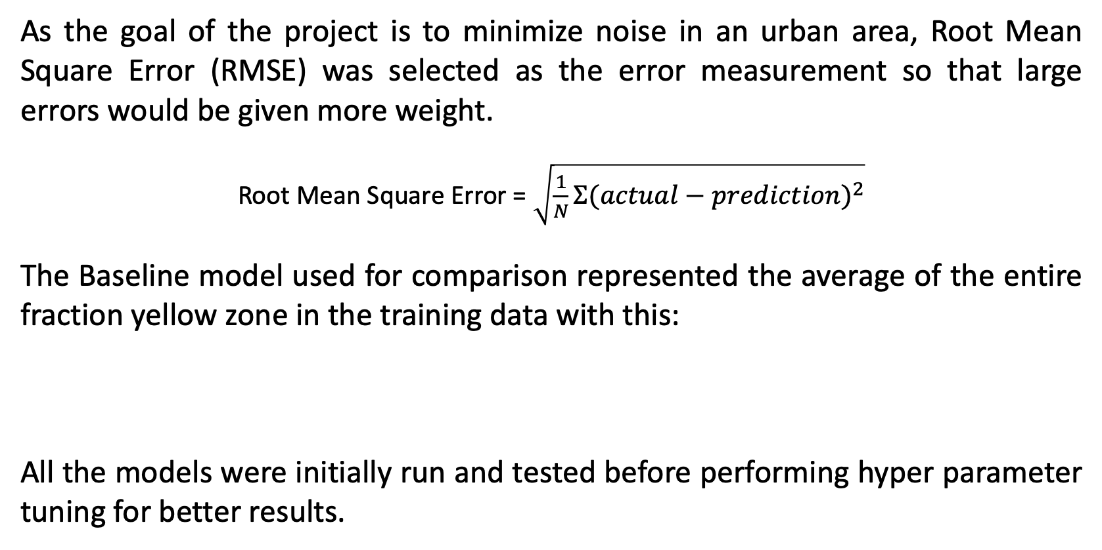
Model Analysis and Performance
Output measure/Analysis
As the goal of the project is to minimize noise in an urban area, Root Mean Square Error (RMSE) was selected as the error measurement so that large errors would be given more weight.
Root Mean Square Error = $\sqrt{\frac{1}{N}Σ{(actual−prediction)}^{2}}$
The Baseline model used for comparison represented the average of the entire fraction yellow zone in the training data with this:
All the models were initially run and tested before performing hyper parameter tuning for better results.
Minimum Value | Maximum Value | Overall Average
0.2526 | 0.9983 | 0.6572
Page 20 of 28

Slide 22
Model Analysis and Performance
The following models were run:
Model name | RMSE | Hyper Parameters
Guess | 0.3766663 | NA
Average (Baseline) | 0.1691386 | NA
KNN | 0.0857905 | K
Linear Regression | 0.0750217 | NA
Gam Loess | 0.0673779 | span
Regression Tree | 0.0624453 | Complex parameter
SVM | 0.0582215 | tunelength
Random Forest | 0.0548306 | mtry, ntree
Random Forest showed the best performance with RMSE of 0.0548
Page 21 of 28

Slide 23
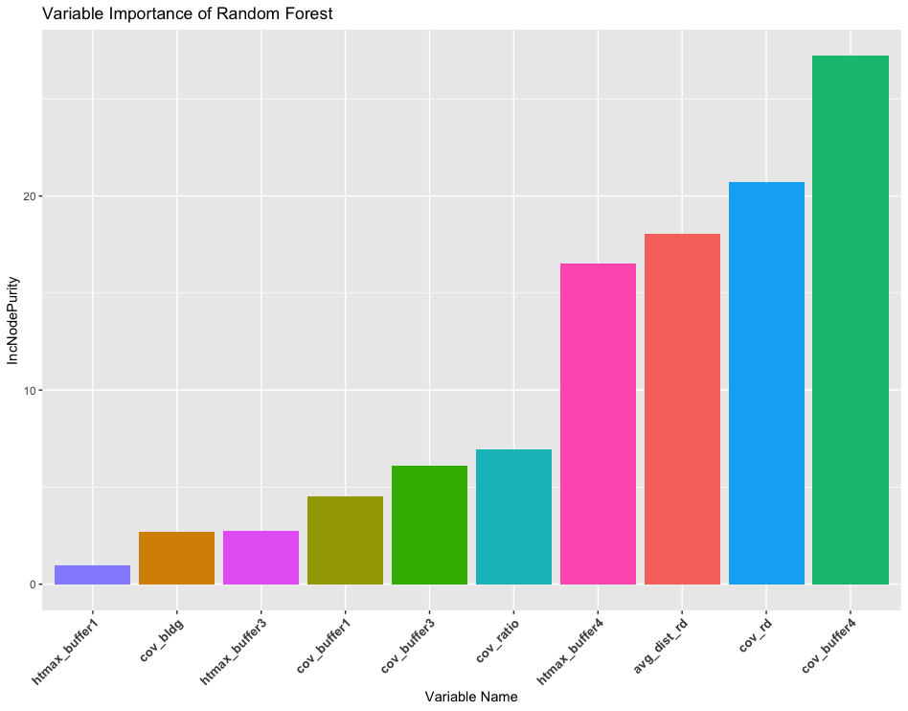
Model Analysis and Performance
Random Forest Variable Importance
The noise coverage in Buffer zone 4 was the most important feature in explaining the target variable in the Random Forest model.
Page 22 of 28

Slide 24
Results – Test Site
Random Forest Testing:
The Random Forest model was tested on the test site data and resulted in an RMSE of 0.0516.
Ensemble Model Testing:
To get better results an average of the three models with the lowest RMSE values: Regression Tree, SVM and Random Forest were used as an ensemble model and tested on the test site data resulting in an
RMSE of 0.0472.
Page 23 of 28

Slide 25
Conclusion and recommendations
With a 96% prediction accuracy of the fraction yellow zone, clients would be well informed to be able to predict the fraction yellow zone based on which building and noise configuration their proposal intend to utilize and thereby be able to comply with code and regulations.
For future work based on our research, neural networks and ensemble models like stacking and blending can be explored. Features could also be trimmed further based on the feature importance and the models re-trained to compare performance.
Page 24 of 28

Slide 26
References
https://topepo.github.io/caret/model-training-and-tuning.html
https://stats.stackexchange.com/questions/142873/how-to-determine-the-accuracy-of-regression-which-measure-should-be-used
https://glassboxmedicine.com/2019/09/15/best-use-of-train-val-test-splits-with-tips-for-medical-data/#:~:text=At%20the%20beginning%20of%20a,10%25%20val%2C%2010%25%20test
http://r-statistics.co/Loess-Regression-With-R.html
https://towardsdatascience.com/explaining-feature-importance-by-example-of-a-random-forest-d9166011959e
https://library.municode.com/ma/cambridge/codes/code_of_ordinances?nodeId=TIT8HESA_CH8.16NOCO
https://www.modelop.com/blog/the-importance-of-rapid-iteration/
Page 25 of 28

Slide 27


THANK
YOU

Slide 28
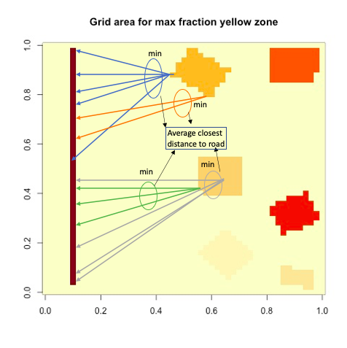
Appendix
Distance to Road Calculation
Page 26 of 28

