Slide 1
World Wide Tuberculosis data analysis using tableau
By: Deepika Dittakavi

Slide 2
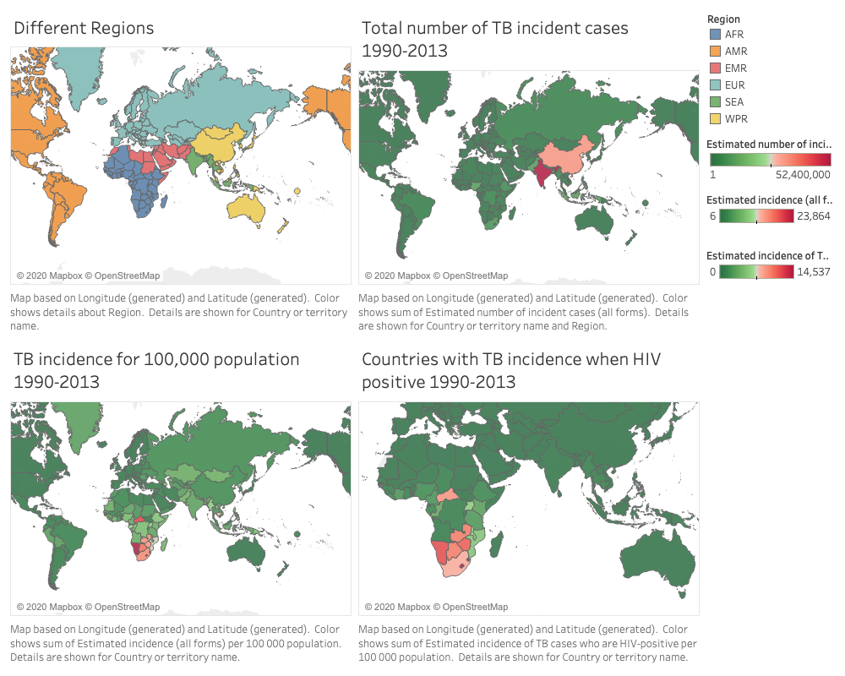

Slide 3
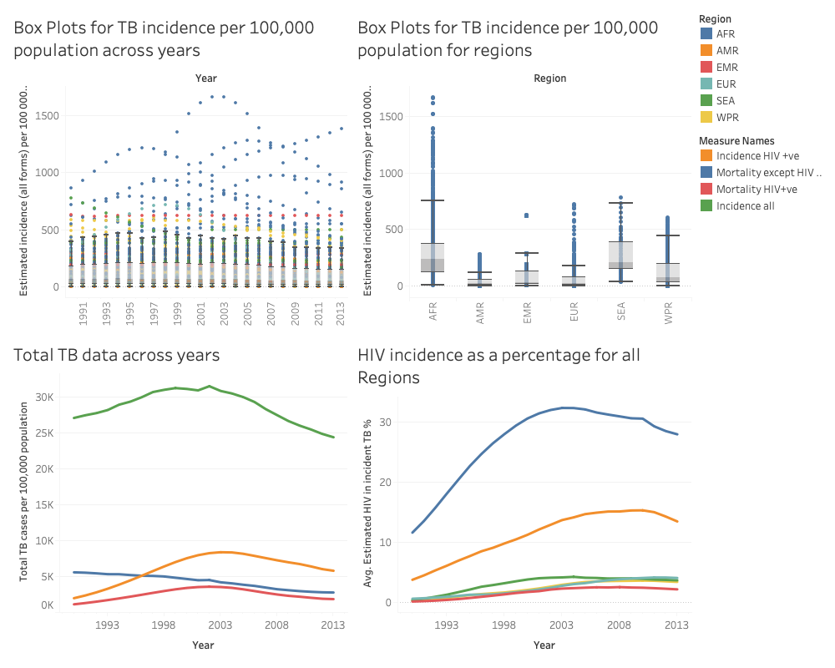

Slide 4
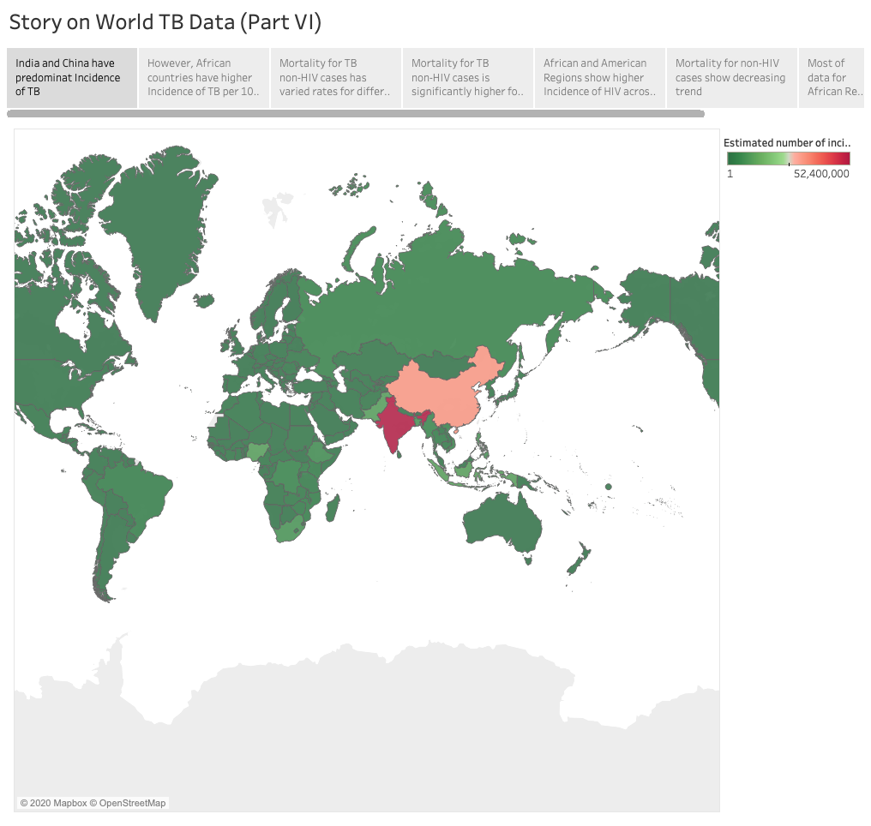
India and China have predominant Incidence of TB

Slide 5
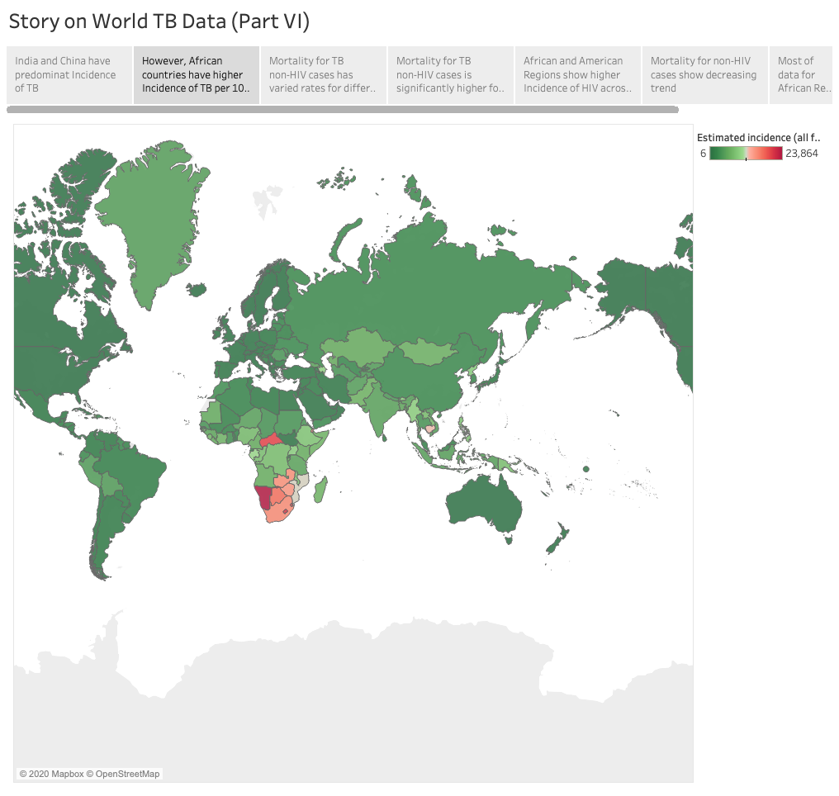
However, African countries have higher Incidence of TB per 100,000 population

Slide 6
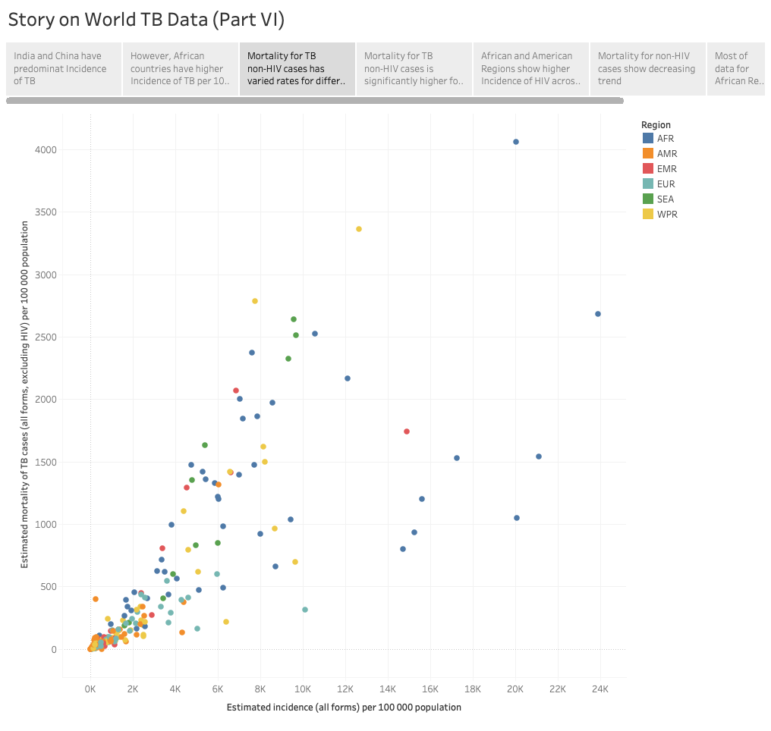
Mortality for TB non-HIV cases has varied rates for different countries

Slide 7
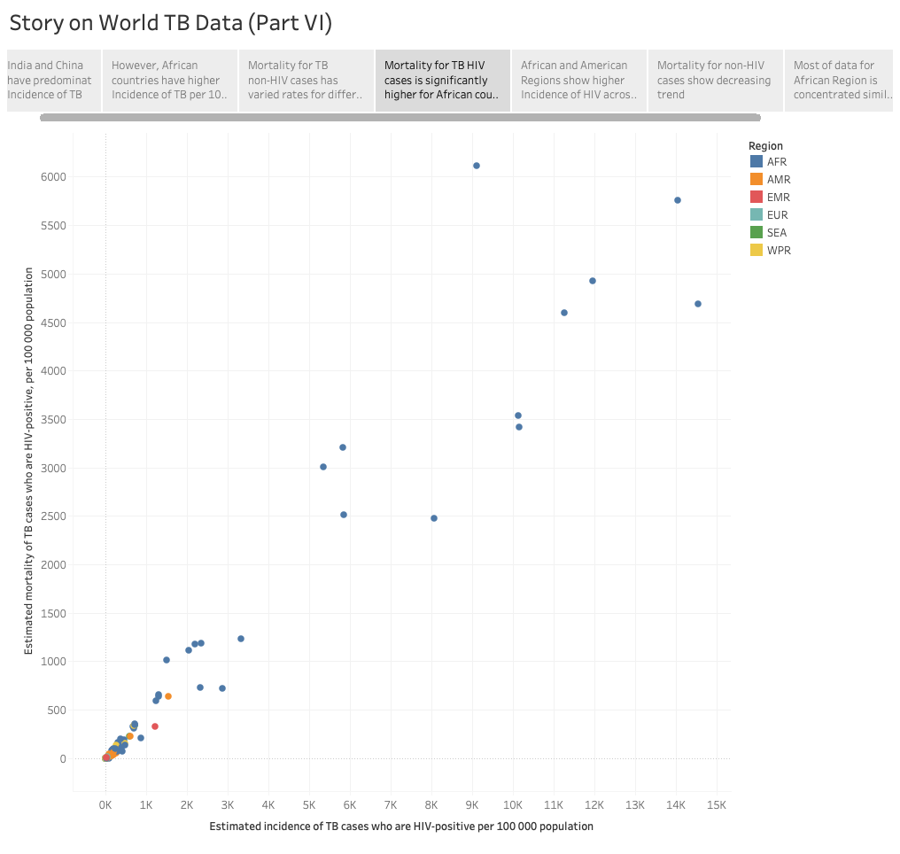
Mortality for TB HIV cases is significantly higher for African countries

Slide 8
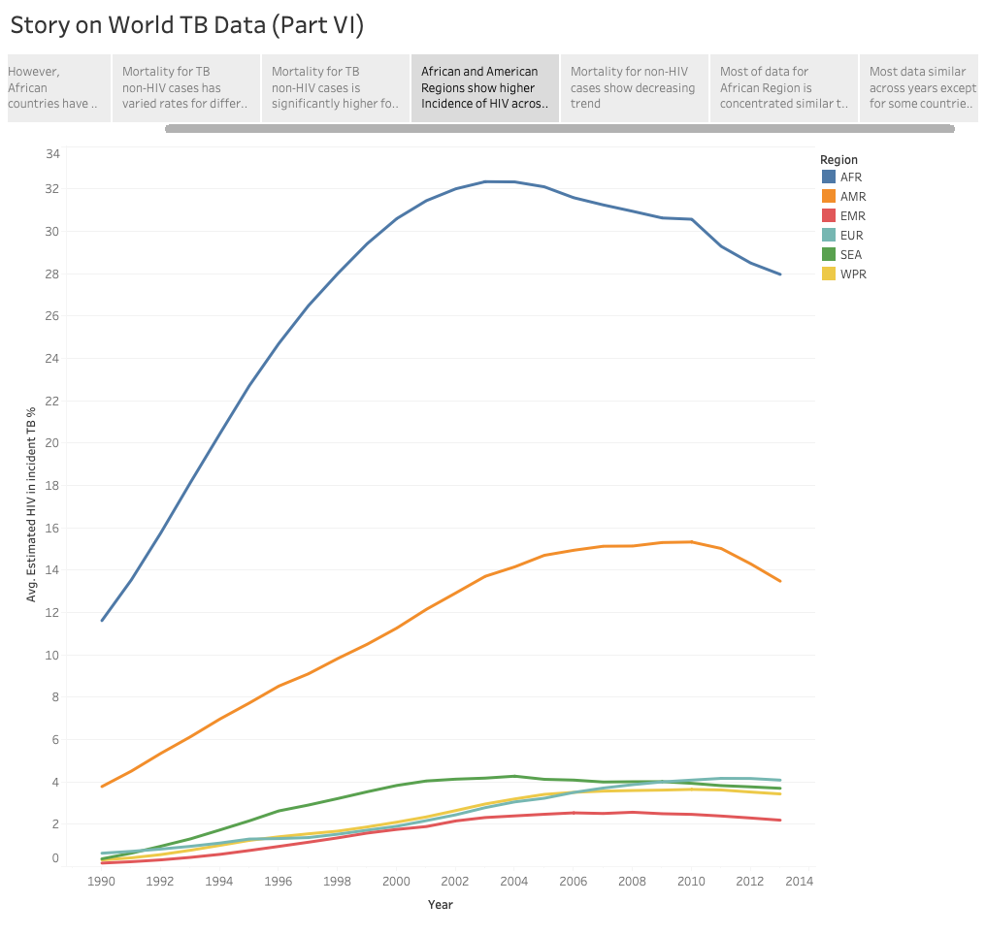
African and American Regions show higher Incidence of HIV across years peaking between 2002 and 2010

Slide 9
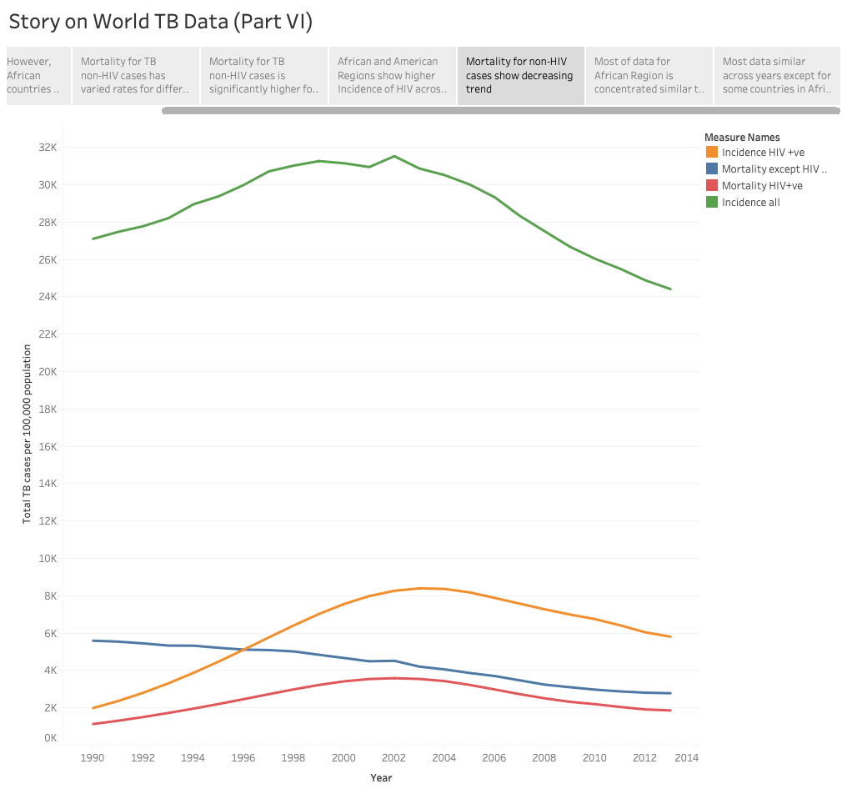
Mortality for non-HIV cases show decreasing trend

Slide 10
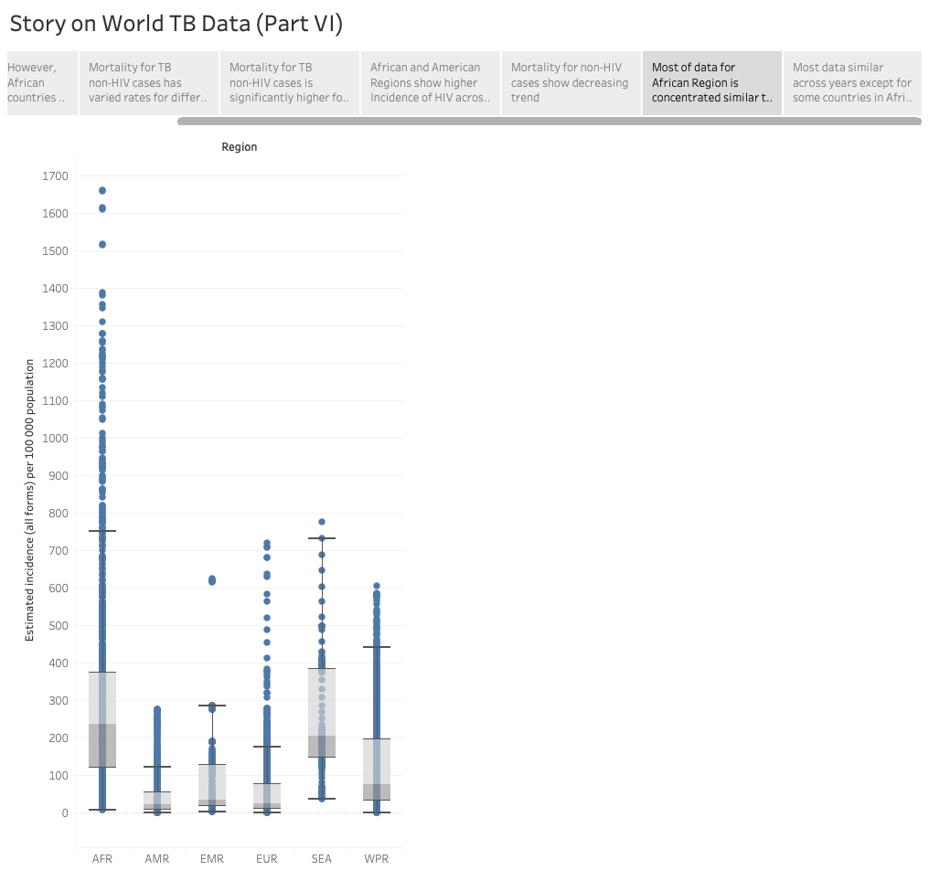
Most of data for African Region is concentrated similar to other Regions

Slide 11
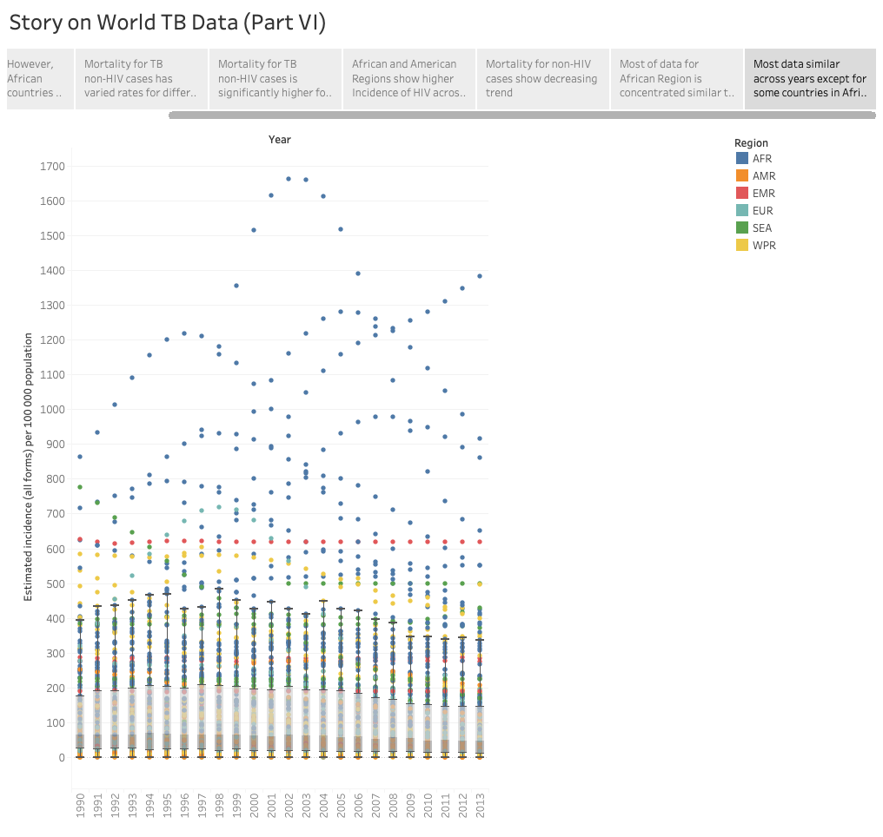
Most data similar across years except for some countries in Africa

Slide 12
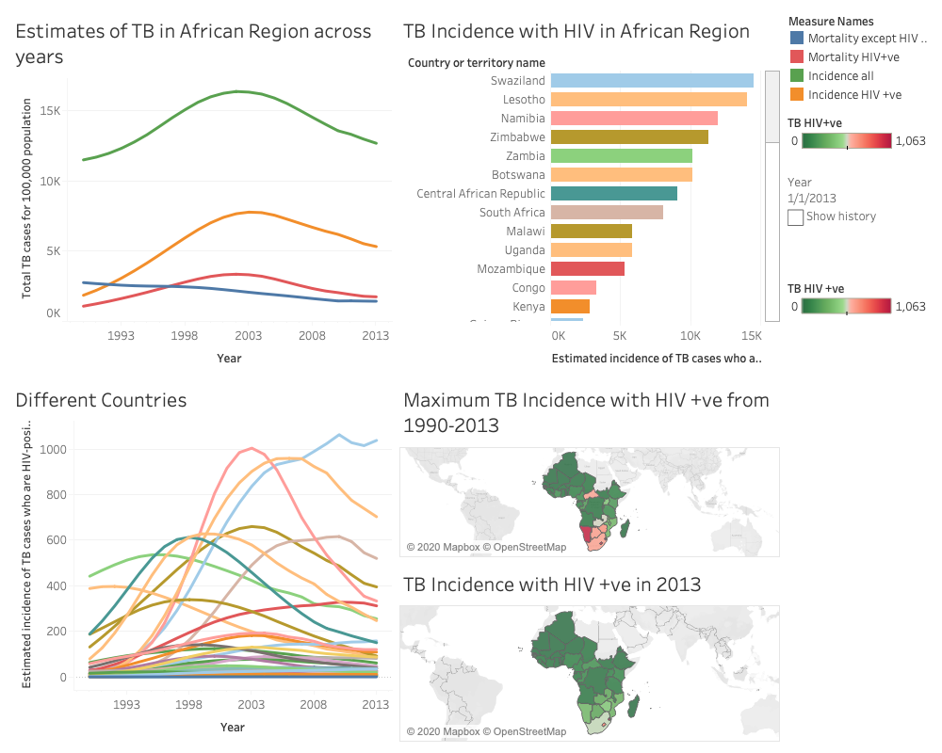

Slide 13

India and China have predominant Incidence of TB

Slide 14
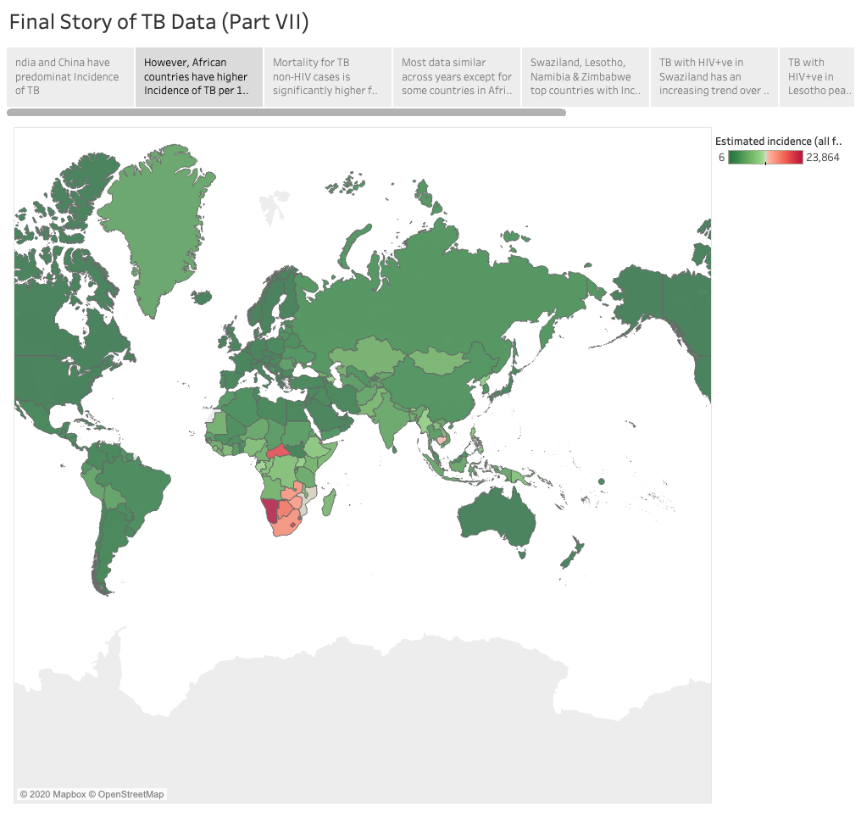
However, African countries have higher Incidence of TB per 100,000 population

Slide 15
Mortality for TB HIV cases is significantly higher for African countries

Slide 16
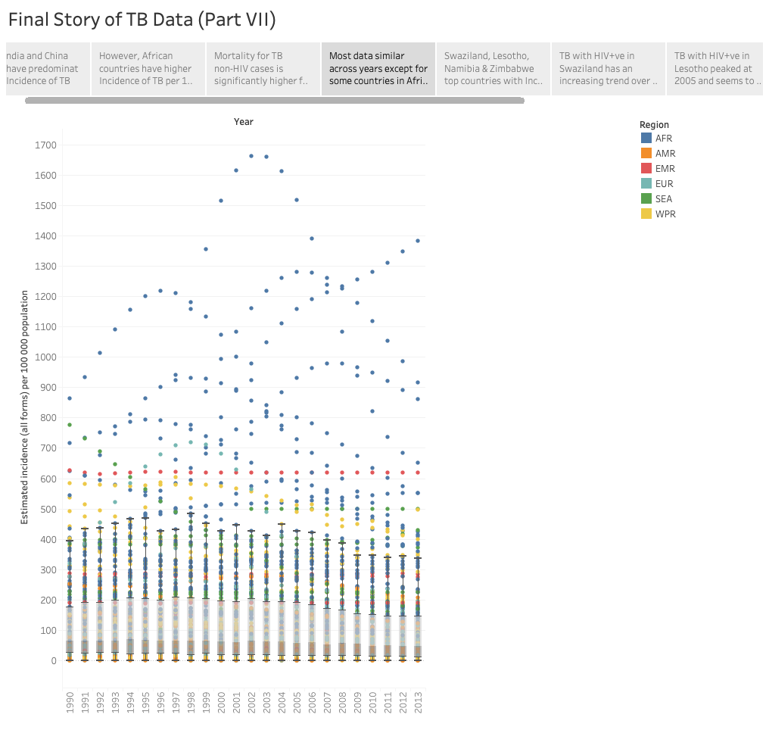
Most data similar across years except for some countries in Africa

Slide 17
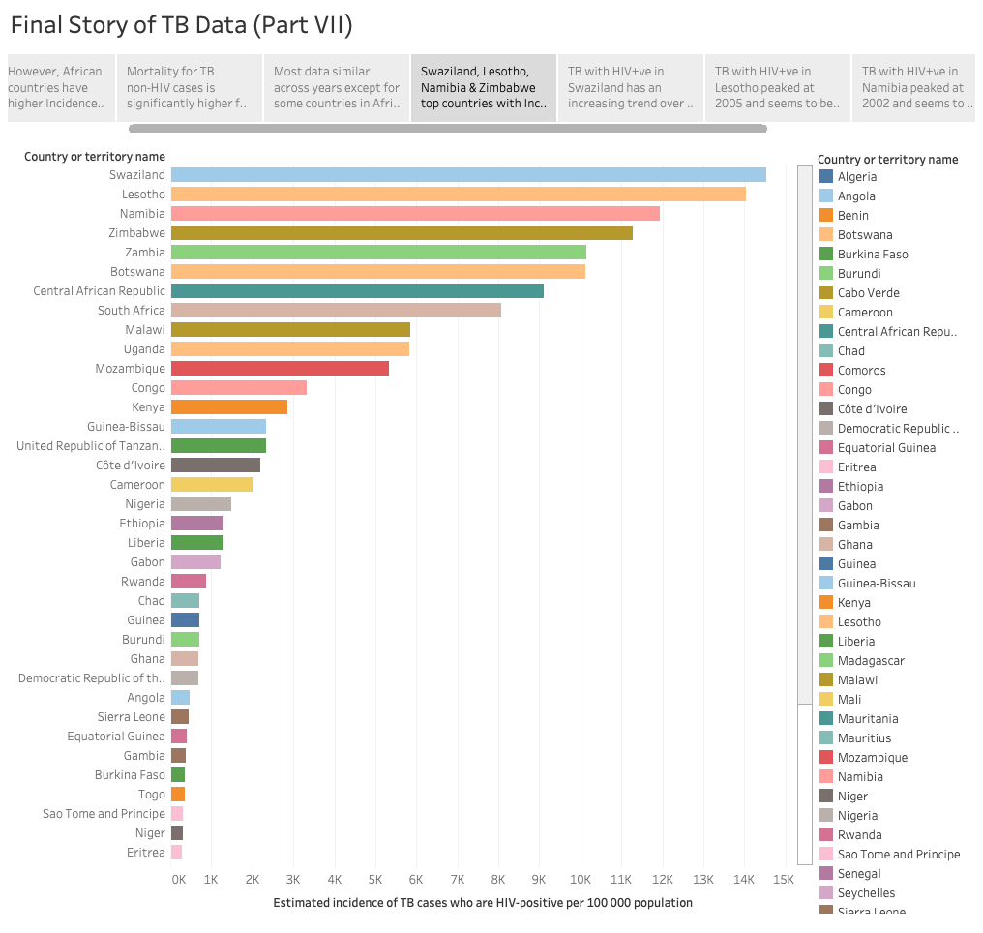
Swaziland, Lesotho, Namibia & Zimbabwe top countries with Incidence of TB with HIV+ve

Slide 18
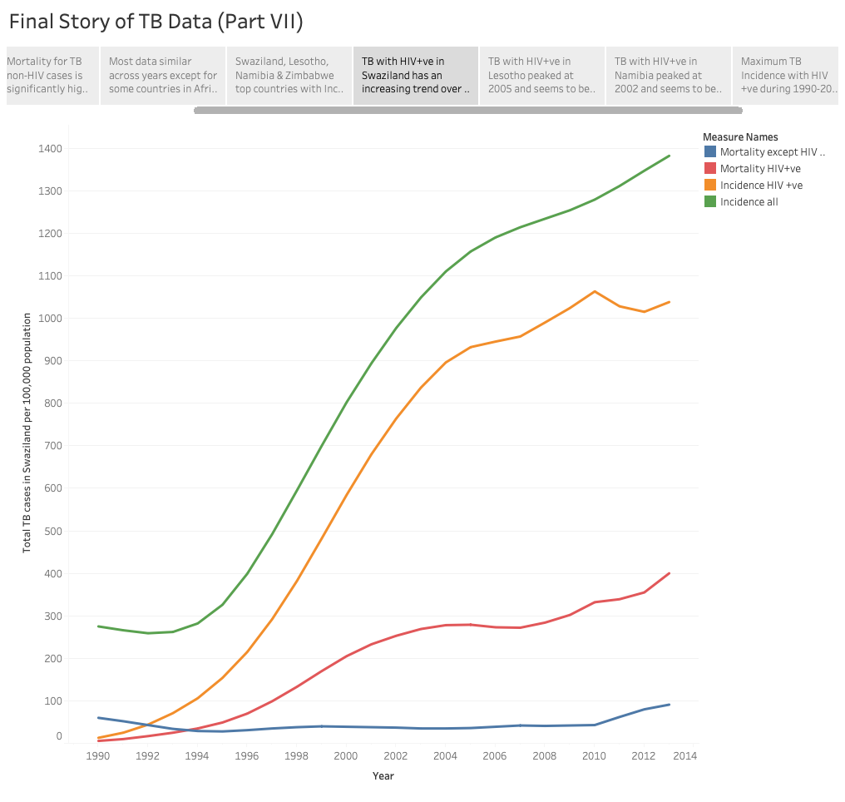
TB with HIV+ve in Swaziland has an increasing trend over the years

Slide 19
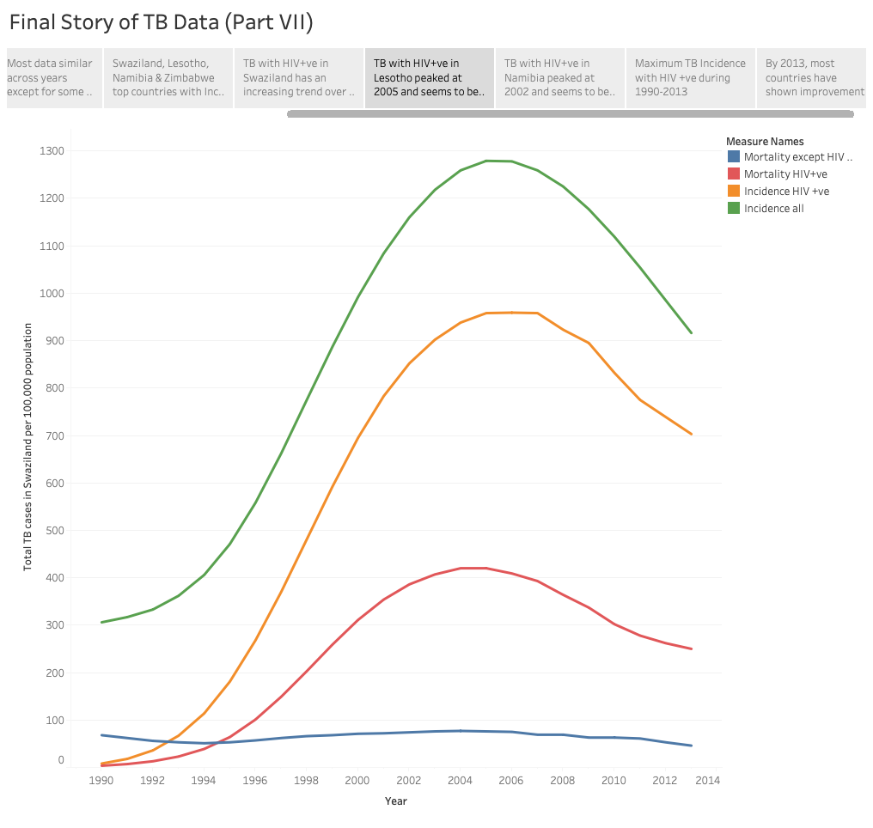
TB with HIV+ve in Lesotho peaked at 2005 and seems to be on a decreasing trend

Slide 20
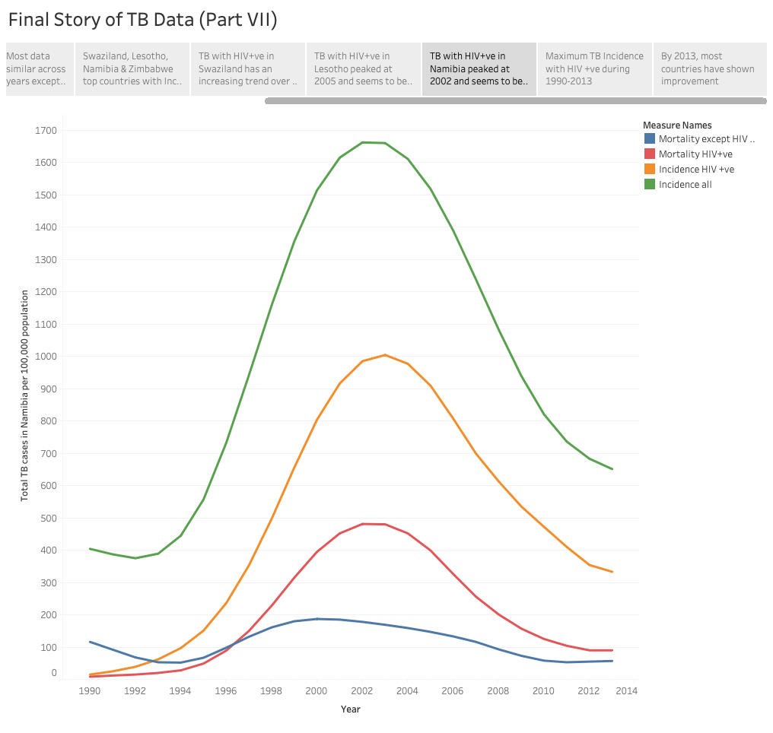
TB with HIV+ve in Namibia peaked at 2002 and seems to be on a decreasing trend

Slide 21
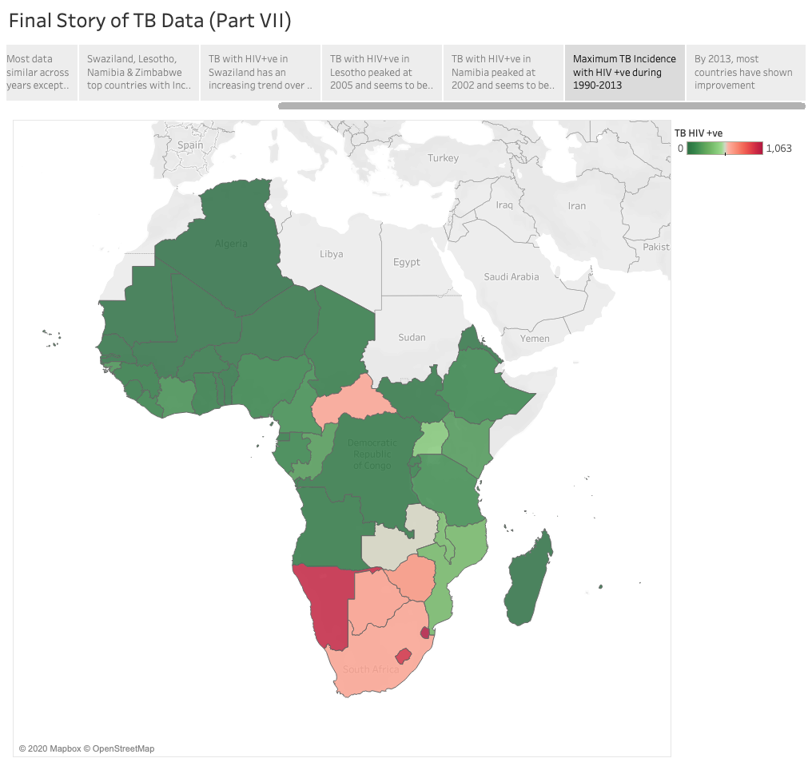
Maximum TB Incidence with HIV +ve during 1990-2013

Slide 22
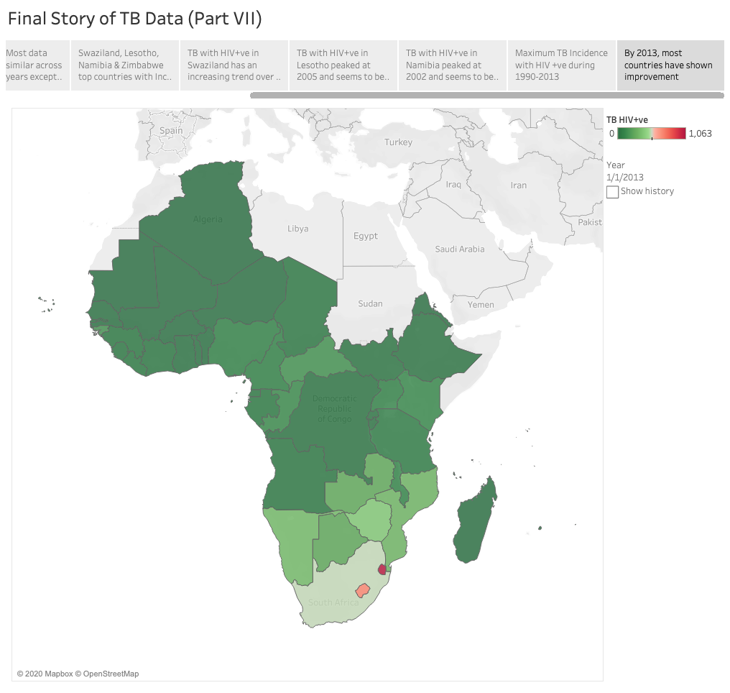
By 2013, most countries have shown improvement

Slide 23
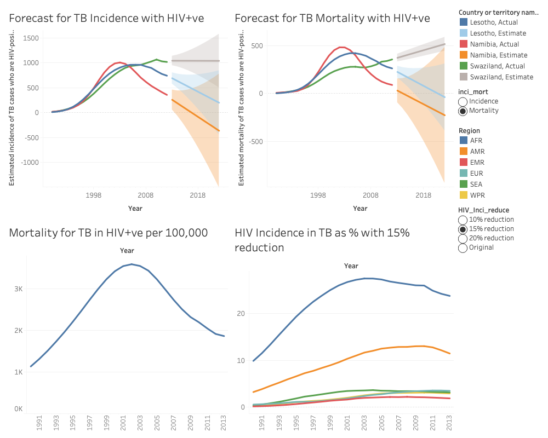
BONUS LAB

