Slide 1
MA School Data Descriptive Analysis
Data Science and Analytics Bootcamp with Stack Education
Framingham State University
By: Deepika Dittakavi

Slide 2
What is done?
Analysis on the Massachusetts Public Schools data
The goal of this analysis is to understand and evaluate to identify the key indicators to increase the performance of the schools
How is it done?
Massachusetts Public Schools data was first separated into Elementary, Middle and High schools
For each set of schools, the data from top and bottom 10% of few parameters was taken for evaluation.
Performance is graphed across each parameter for each set of schools to observe general trend, patterns and identify outliers
Among all outliers 5 Schools were selected for further analysis and presented here

Slide 3
Parameters & Performance Indicators
The key parameters identified to evaluate performance are:
%English Language Learner
%Student with Disability
%High Needs
%Economically Disadvantaged
Average Salary (of teachers)
Average Expenditure of pupil
The performance indicators identified for evaluation are:
%MCAS Score in Math and English for Elementary Schools
%MCAS Score in Math and English for Middle Schools
%AP Score and SAT Scores for High Schools
Sample graphs for each parameter are included here. The trend was very similar for elementary, middle and high schools.

Slide 4
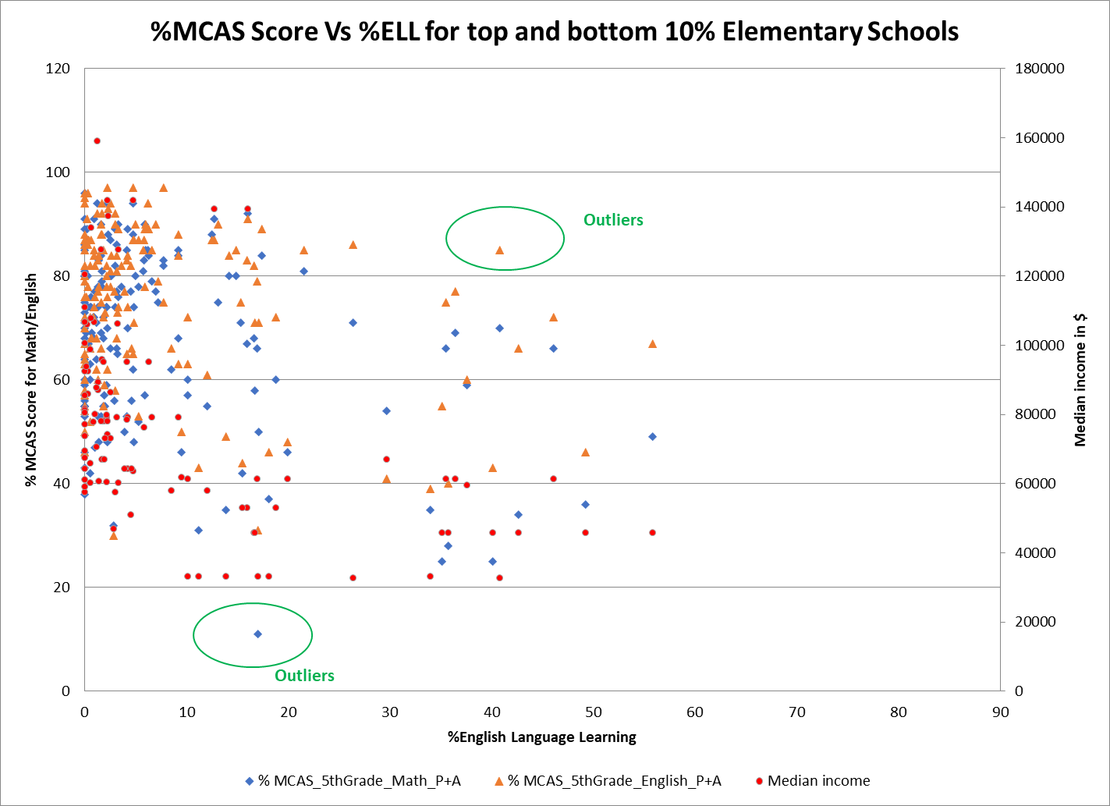
%English Language learner Vs MCAS scores for Elementary school showed:
Most data was within 10% of %ELL, after which MCAS score decreased slightly with %ELL increase
Median income of town also decreased with %ELL and mostly was between 35K to 65K

Slide 5
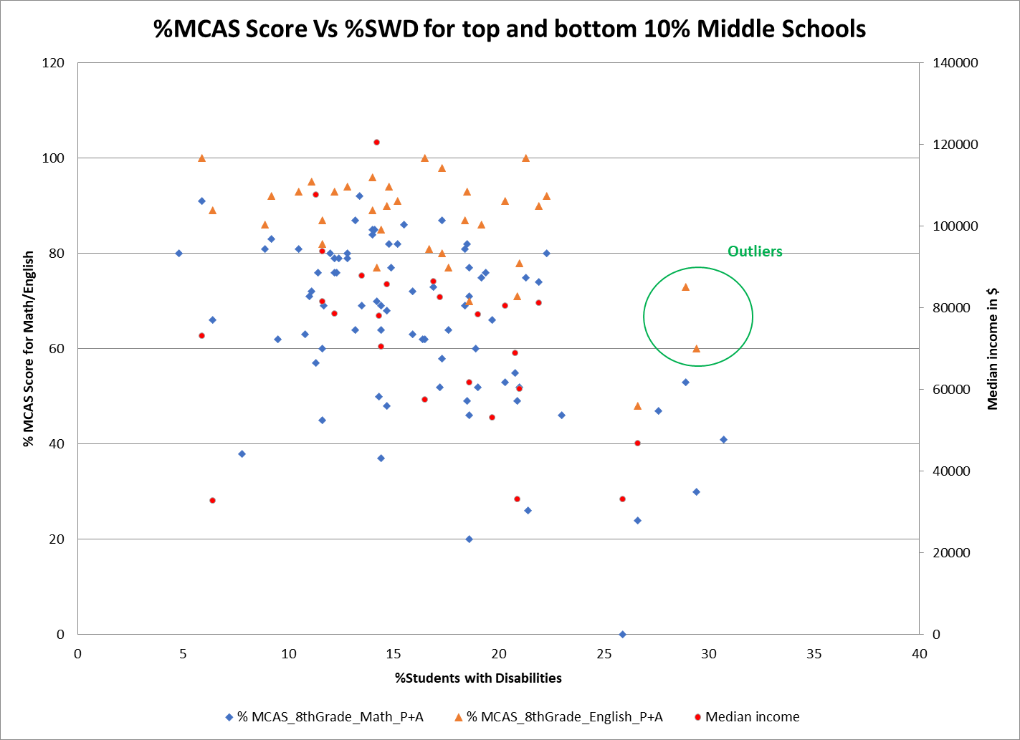
%Student with Disabilities Vs MCAS scores for Middle schools showed:
%MCAS score for Math had more decrease than %MCAS score of English with %SWD increase
Median income of town slightly decreased with %SWD

Slide 6
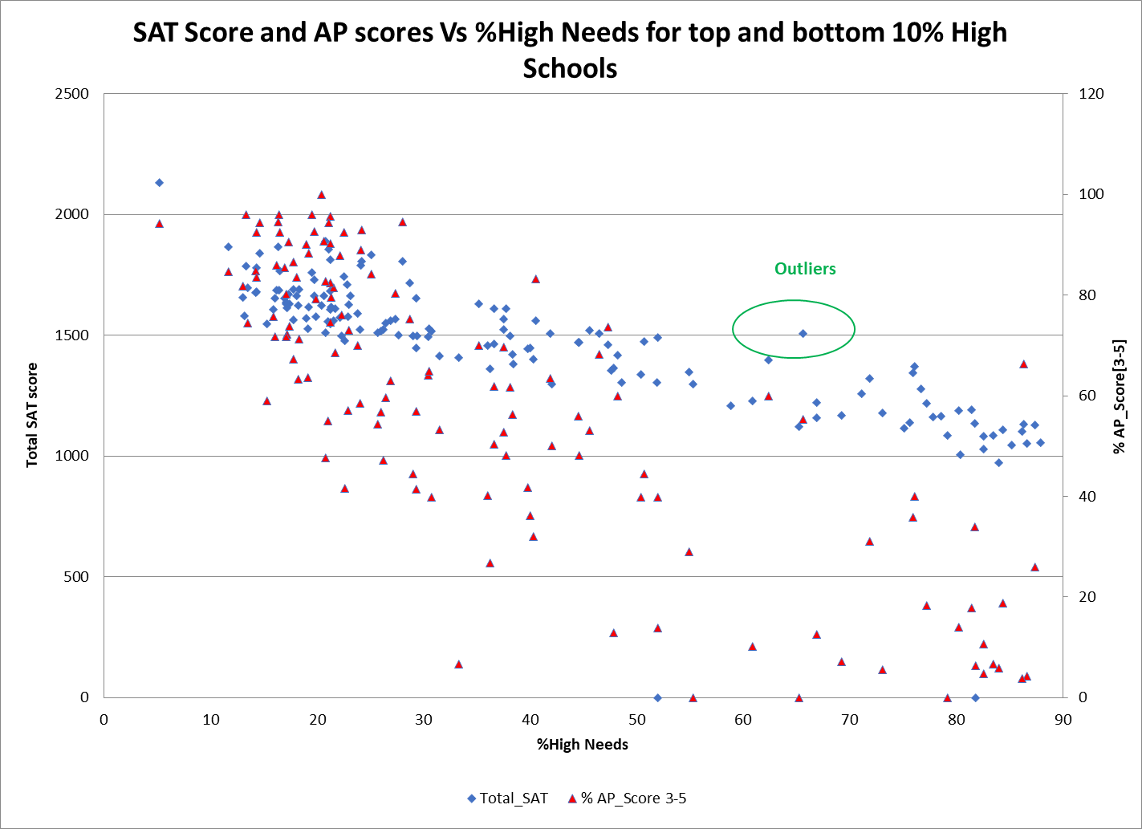
%High Needs Vs MCAS scores for High school showed:
%AP Score had more decrease than SAT score with %High Needs increase

Slide 7
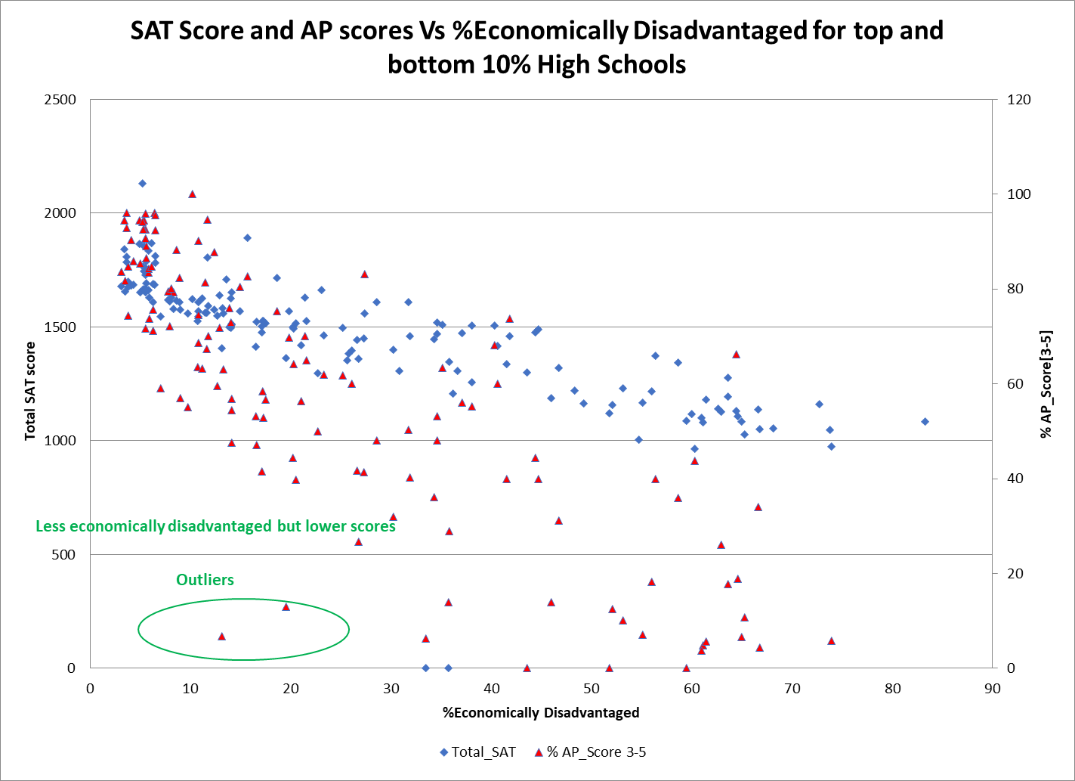
%High Needs Vs MCAS scores for High school showed:
%AP Score had more decrease than SAT score with %High Needs increase
There were schools that were less economically disadvantaged but yet showed less scores

Slide 8
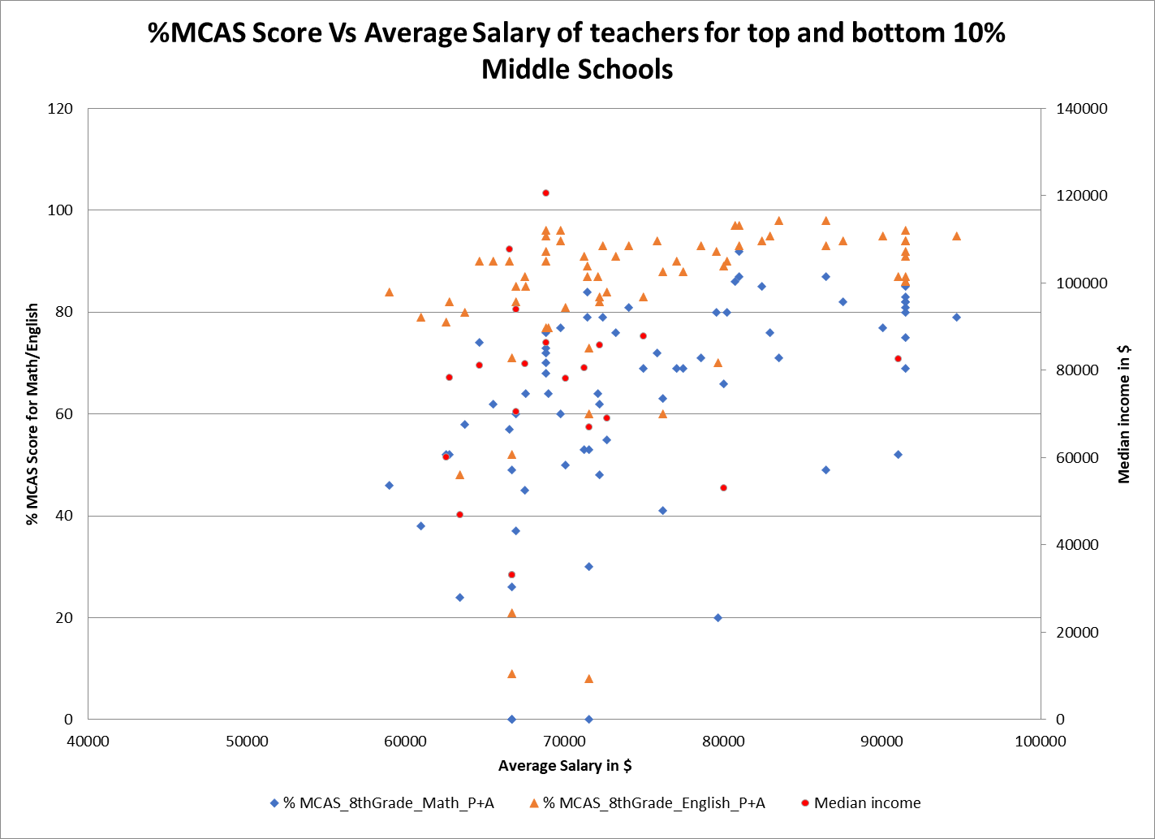
Average Salary of Teachers Vs MCAS scores for Middle school showed:
MCAS scores have shown slight increase with Salary of teachers though not significant, so did the median income

Slide 9
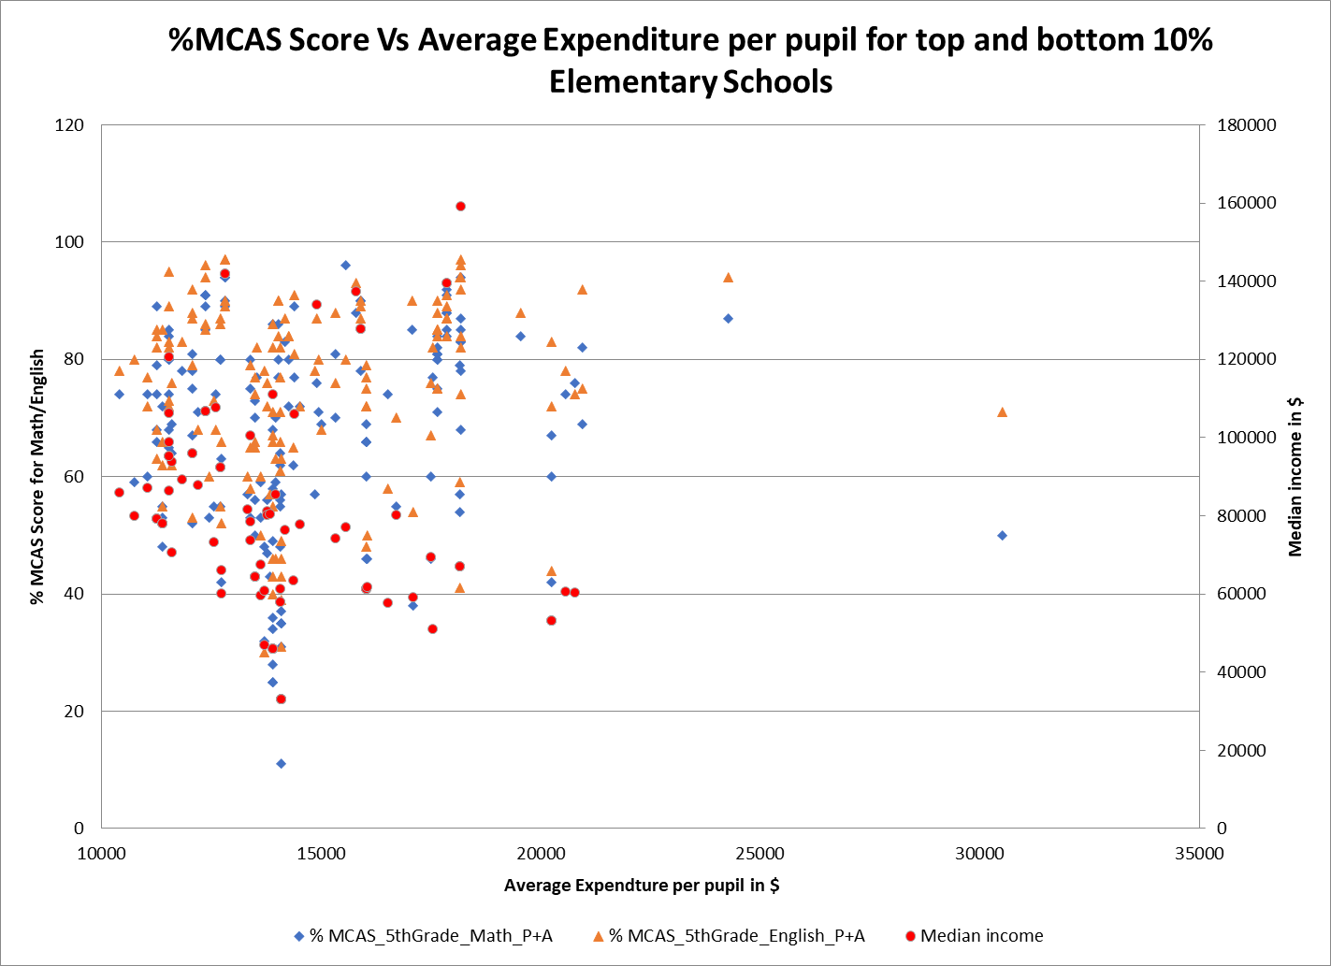
Average Expenditure per pupil Vs MCAS scores for Elementary school did not show any significant correlation

Slide 10
Five Schools
Based on similar graphs as shown, 5 schools have been identified for further analysis.
School Code | School Name | Specific Characteristic
350542 | New Mission High School | Low % of English Language Learner & Low AP score
8230605 | Gr Lawrence Regional Vocational Technical | Low % of English Language Learner & Low AP score
4680505 | Ma Academy for Math and Science School | Low % of English Language Learner & High AP score
8710605 | Shawsheen Valley Vocational Technical High School | Less Economically Disadvantaged & Low AP score
8520605 | Nashoba Valley Technical High School | Less Economically Disadvantaged & Low AP score

Slide 11
New Mission High School
New Mission High School is in Hyde Park in the Boston District
It has students enrolled in Grades 9,10,11,12
Total enrollment 320 students, 108 take AP classes
Diversity: 65% African American and 31.6% Hispanic
High School Graduates is 57/84
% Attending College is 89.5
Though the %English Language Learner and %Student with Disabilities are lower with 5.9% and 16.3%, %High needs and %Economically Disadvantaged are higher with 60.9% and 53.1%
Low Scores: SAT is 1229/2400, 90% get AP score 1-2
Accountability and Assistance Level 1

Slide 12
Gr Lawrence Regional Vocational Technical
Gr Lawrence Regional Vocational Technical is in Andover
It has students enrolled in Grades 9,10,11,12
Total enrollment 1473 students, 16 take AP Tests
Diversity: 80.6% Hispanic and 17.4% White
High School Graduates 304/325
% Attending College is 56.3%
Though the %English Language Learner and %Student with Disabilities are lower with 9.8% and 20.3%, %High needs and %Economically Disadvantaged are higher with 66.9% and 52.1%
Low Scores: SAT is 1158/2400, 87.5% get AP score 1-2
Accountability and Assistance Level 1

Slide 13
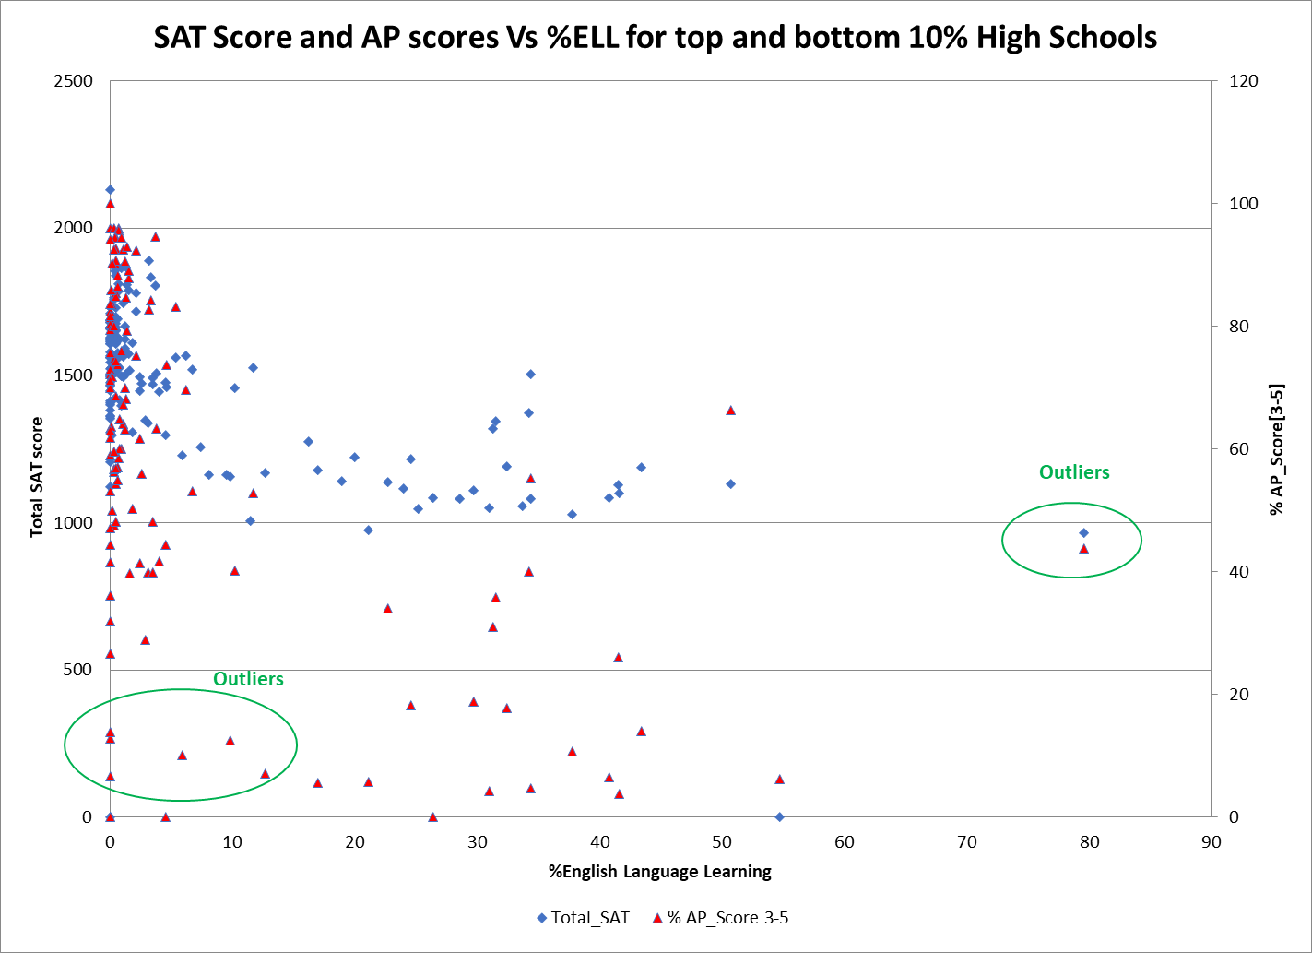
Under Performance of 2 Schools
Picked 2 schools that are relatively under performing in AP scores.
These schools have low % ELL, suggesting that the scores will be higher. This was not the case.
These schools are highly economically disadvantaged, and have high %high needs, possible reason for the low scores.
However, contrary to conventional wisdom, the average salary of the teachers in each school is higher than the average.
Also observed that these two schools have less diversity and skew more towards a race.
New Mission High School
Gr LRT School
After looking at multiple variables, wasn’t able to find a silver bullet in opportunities to increase the performance of the school.
However, given that more than half the students have high needs, addressing this may help the students focus on scores.

Slide 14
MA Academy for Math and Science School
MA Academy for Math and Science is in Worcester
It has students enrolled in Grades 11,12
Total enrollment 197 students, 39 take AP Tests
Diversity: 52.6% White and 42.3% Asian
High School Graduates 46/48
% Attending College is 93.5%
~<5% in various variables including ELL, High Needs, SWD, and economically disadvantaged.
High Scores: SAT is 2132/2400, 94.2%% get AP score 3-5

Slide 15
Over Performance
Picked this school for its high performance scores in SAT and AP courses.
These schools have low extra needs such as ELL, SWD, high needs and economically disadvantaged students suggesting that the scores will be higher. This was the case.
The average salary of the teachers in this school is higher than the average as well.
MA Academy of Math and Science School
After looking at multiple variables, observed that the key possible factor contributing to the high scores may be high diversity, defined by 52.6% White and 42.3% Asian. Another possible factor is the low enrollment suggesting a possible high teacher to student ratio.

Slide 16
Shawsheen Valley Vocational Technical High School
Shawsheen Valley Vocational Technical High School is in Billerica
It has students enrolled in Grades 9,10,11,12
Total enrollment 1336 students, 15 take AP Tests
Diversity: 91.5% White and 4.3% Hispanic
99.1% Graduates
% Attending College is 55.3%
Though the %English Language Learner and %Economically Disadvantaged are lower at 0% and 13.1%, this school has about 33% of High Needs
Low Scores: SAT is 1407/2400, 93.3% get AP score 1-2
Accountability and Assistance Level 1

Slide 17
Nashoba Valley Technical High School
Nashoba Valley Vocational Technical High School is in Westford
It has students enrolled in Grades 9,10,11,12
Total enrollment 732 students, 88 take AP Tests
Diversity: 88.7% White and 6.3% Hispanic
High School Graduates 162/193
% Attending College is 56.2%
Though the %English Language Learner and %Economically Disadvantaged are lower at 0% and 19.5%, this school has about 47.8% of High Needs
Low Scores: SAT is 1364/2400, 87.1% get AP score 1-2
Accountability and Assistance Level 1

Slide 18
Under Performance of 2 Schools
Picked 2 schools that are relatively under performing in AP scores.
These schools are less economically disadvantaged, suggesting that the scores will be higher. This was not the case.
These schools have relatively high %high needs, possible reason for the low scores.
Also observed that these two schools have less diversity and skew more towards a race.
Shawsheen VVT High
Nashoba VT School
Highly diverse schools with less students with high needs seem to be the winning formula for high scores. In this case, both of the above are not satisfied.

Slide 19
Key Insights
This analysis is performed on a lot of variables. However, only few parameters seemed to have a significant impact in differentiating the schools performance behavior.
The schools with less extra needs from students perspective are showing better performance. This is quite intuitive and logical explanation.
This suggests that the state and schools should focus on addressing the economic and intellectual barriers of the students and enable them to focus on the education.
Information on educational background of parents/caregivers and student to teacher ratio (not included in the analysis) will be a good metric to compare across towns and scores. This could have added more robustness to the analysis.

