Slide 1
Clearquest Daemon

Slide 2
Overview
Controlled checkins of code into release branches
Tightly control which bugs go into which releases
Minimize overhead
Allowances for dev branches
Ability to produce release notes

Slide 3
Environment
Small company (~30 Engineers)
Offices in Santa Clara and Shanghai, China
All Windows shop
Rational Clearcase LT, Clearquest and Multisite
One main server for CC and CQ
Slow VPN WAN to Shanghai
Multisite and the Shanghai office were not initially rolled out but the design considered them nonetheless. Unfortunately Multisiting to the Clearquest database was rules out as too expensive

Slide 4
Requirements
Verify all elements checked into release branch were associated with a Clearquest defect for that release
Verify the defect was:
Owned
Only in Assigned or Resolved state
On the list of defect for the release branch
Different release branches will have different lists
Allow for development branches where no defect number was required
Defect numbers are entered into the checkin comment. Allow multiple defects
Provide a way to log out checkins of defects for building
Provide a way to generate Release Notes based on defects fixed.

Slide 5
Assumptions
All checkins that require a bug ID would have a label applied to them of the bug ID
When engineers were finished checking in these labels would be locked, stopping further checkins
Engineers would be allowed to continue to work on the release branch while the release was building

Slide 6
Checkin Trigger
Checkin trigger would insure that all conditions were met for the checkin to proceed
CQPerl was used to retrieve data from Clearquest
Initial testing showed that it took a very long time to connect to the Clearquest database. If many elements were to be checked in this would significantly slow down checkin
Shanghai would also use this trigger and would be slower because of the slow WAN to China

Slide 7
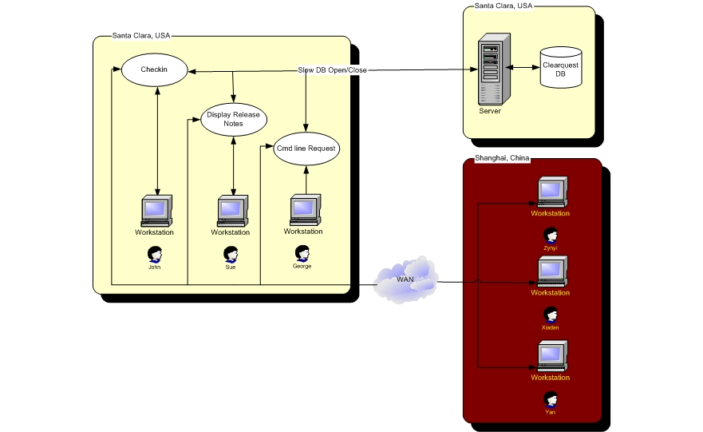
Data flow

Slide 8
Daemon
In order to minimize open/close times a daemon was developed that would hold the Clearquest database open and respond to requests for information through a socket
The daemon would return information about a bug ID to the caller.
Additionally this general purpose daemon could be used to produce web based Release Notes

Slide 9
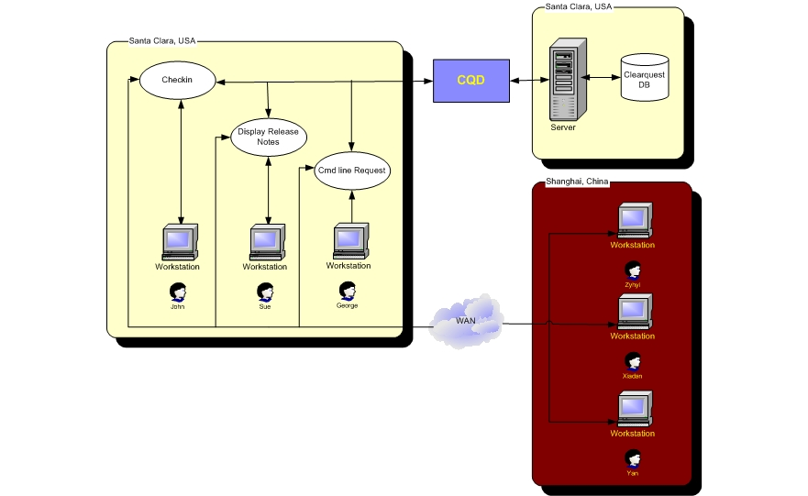
With CQD

Slide 10
CQPerl Problems
A good daemon process:
Puts itself into Daemon mode
Is multithreaded meaning it forks a child of itself to handle request then goes back to accept the next client
However…
CQPerl is ActiveState based and ActiveState Perl does not support setsid, which is required to enter Daemon mode
ActiveState Perl also doesn’t handle signals

Slide 11
SetSID
So then how does one go into Daemon mode on Windows under ActiveState Perl?
Cygwin is a Linux like environment that runs under Windows. It has a process (cygrunsrv) which allows you to deamonize any other process

Slide 12
Multithreading
Multithreading was still a problem. Code was written but the poor signal handling under Windows proved to be a problem that could not be easily overcome.
Possible solutions included:
Figure out signal handling in ActiveState – not supported
Rewrite the code in another language – however much work was already done
In the end it was decided since the demand on the server would not be that great, a single threaded server would suffice

Slide 13
Client/Server
After the CQD was written a Perl module (CQC.pm) was written to provide an API to CQD
To test CQC.pm another Perl script (cqc) was written to exercise CQC.pm.
cqc ended up being a handy tool
For example:
$ cqc 1234 owner
swang
$ cqc 1322 owner headline
owner: jliu
headline: Unable to modify ACLS that are created (observed during ACL tests)
$

Slide 14
Trigger
A preop Checkin Trigger was created to:
Make sure that a comment was specified
Extract all bug IDs from the comment
If the check in was on a release branch requiring a bug ID the trigger would make sure the bug ID
Existed in Clearquest
Was owned and in the proper state
The label was not locked
Was listed in a file for that release branch (i.e. <release branch>.lst)

Slide 15
Release Notes
The release flat file of bug IDs served as a basis for web page of release notes
Additional web pages were created to allow for maintaining lists of bug IDs into the release.lst files
From the release notes one could drill down into another web page that exposed all of the fields of the bug ID

Slide 16
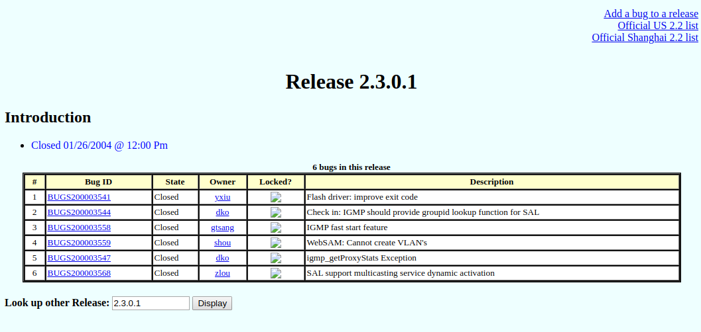

Slide 17
Further Reading
This process is further documented, along with links to full code listings at http://clearscm.com/clearquest/cqd
There is another process that I put together at another client utilizing a similar Client/Server technology to provide full text searches of an issue tracking system called ECRDig at http://clearscm.com/scripts/ecrd

