Slide 1

COLLEGE OF BASIC AND APPLIED SCIENCES SCHOOL OF ENGINEERING SCIENCES DEPARTMENT OF COMPUTER ENGINEERING
SMART SHUTTLE SYSTEM FOR UNIVERSITY OF GHANA CAMPUS
PROGRESS PRESENTATION BY
BOSOMAFI ELVIS -10625392
DEGBANG ALFRED -10619811
OSEI AGYEMANG HENRY -10626740
PROJECT SUPERVISOR
DR. ROBERT A. SOWAH, PHD

Slide 2
TABLE OF CONTENTS
System Requirements
Hardware and Application Development
Project Progress
Expected Outcome
Conclusion
References
Introduction
Problem Statement
Research/Survey
Project Objectives
System Architecture
-Schematic Diagram
-Use Case Diagram
-Activity Diagram
-Simulation

Slide 3
Introduction
A shuttle is a a form of transport that travels regularly between two places in this case a vehicle.
In University of Ghana, the shuttles (RSTC and Boafuo) serve as a means of transportation for most students particularly those in the Diaspora halls to convey them to and from their lecture halls.
This project seeks to provide an effective and efficient solution for some of the problems that the students face when trying to use the services of the shuttle.

Slide 4
Problem Statement
There is a recurring and pressing need to improve the operation of the shuttle system on campus because it is difficult to track its route and arrival/departure times[1].
Students find themselves arriving too early or late for the shuttle due to a lack of means of tracking the shuttles arrival and departure time thereby wasting a significant amount of time[2].
There is need to develop a smart shuttle system to help students utilize the shuttles very efficiently and effectively by providing a payment platform[3].

Slide 5
Research/Survey
A survey was conducted using google forms where certain questions relating to the project was asked.
127 responses were gathered from the survey and the results was then compiled and processed into a graphical format.

Slide 6
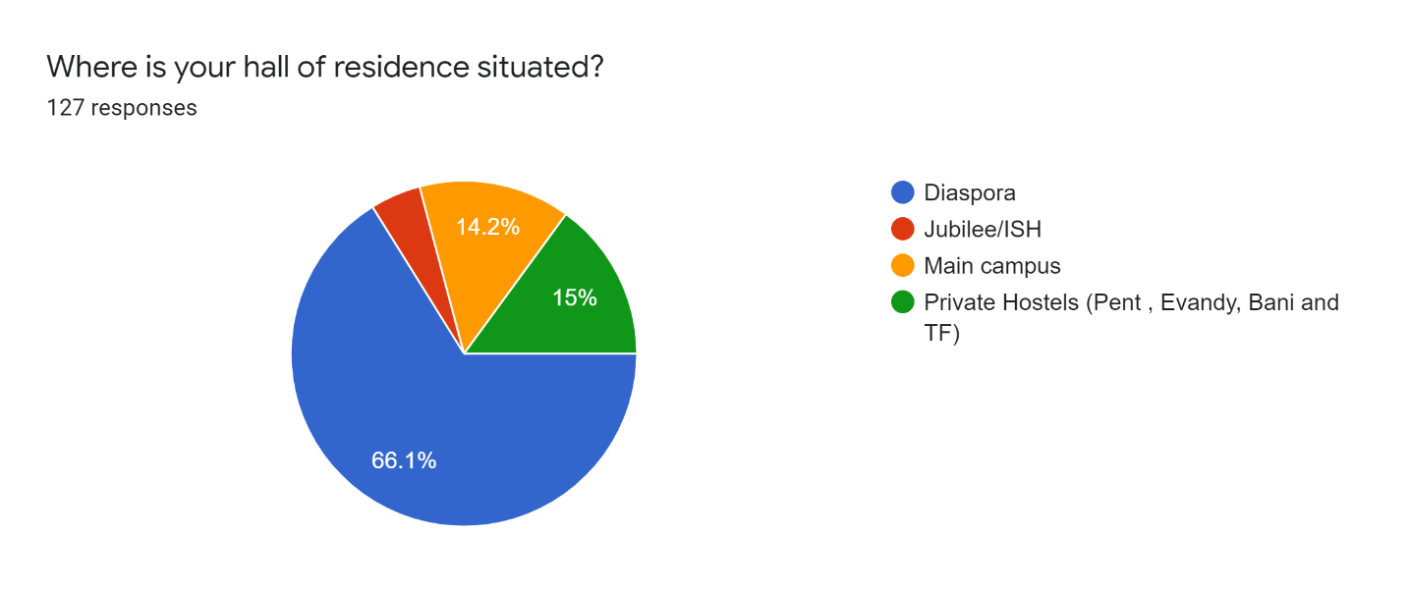
Research/Survey Cont.

Slide 7
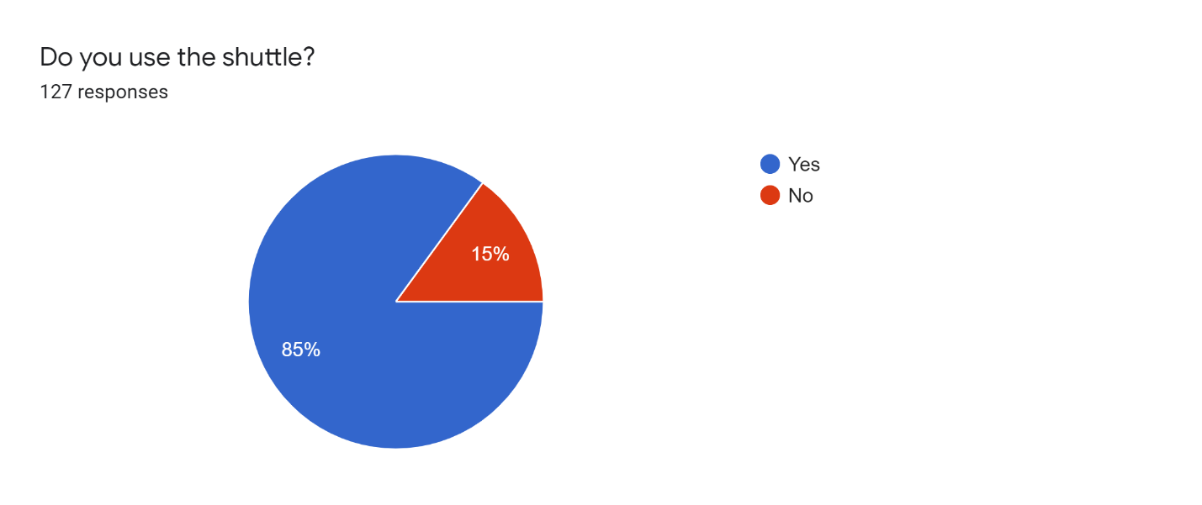
Research/Survey Cont.

Slide 8
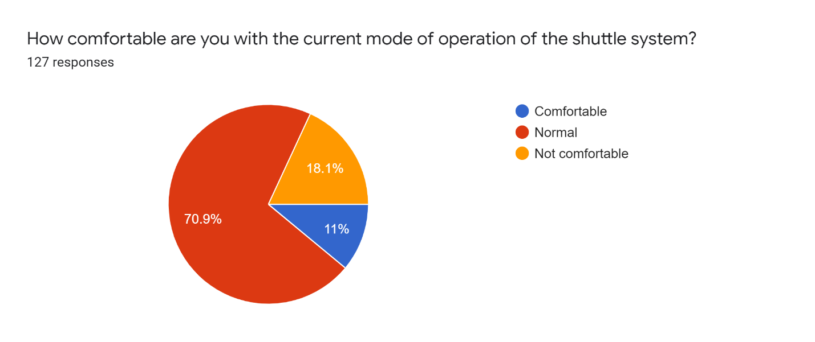
Research/Survey Cont.

Slide 9
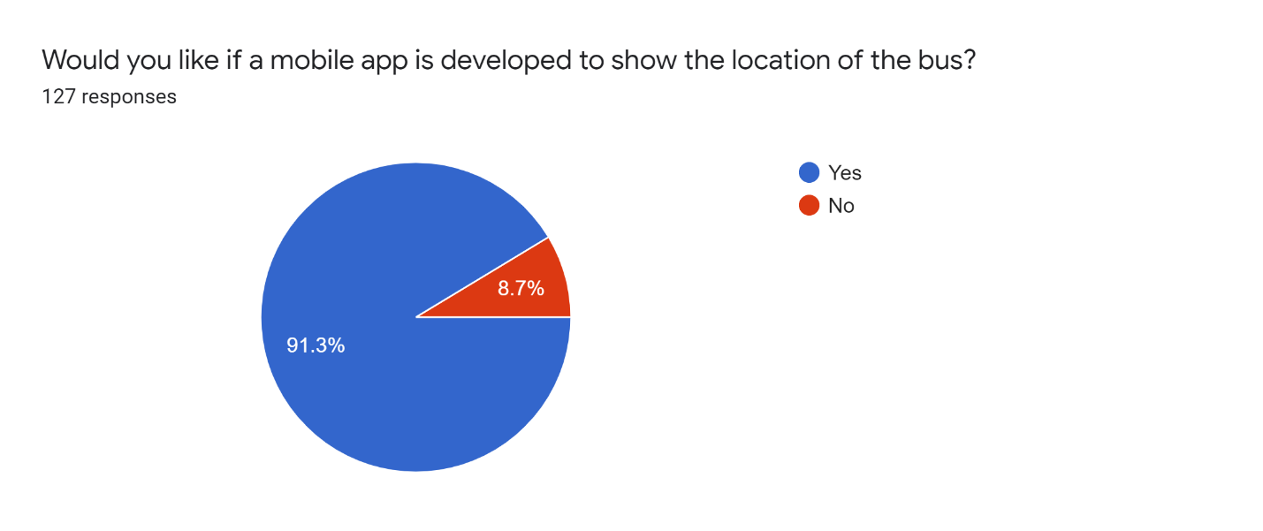
Research/Survey Cont.

Slide 10
Research/Survey Cont.

Slide 11
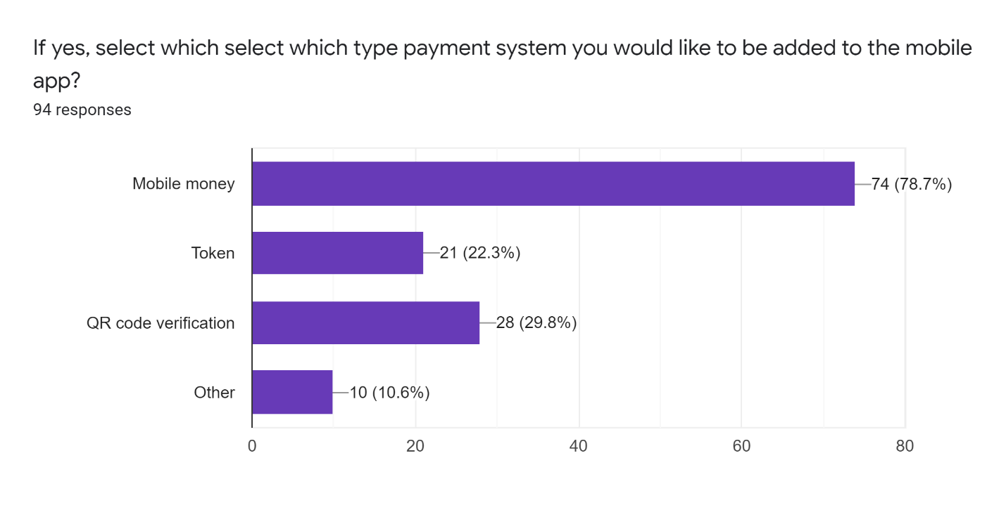
Research/Survey Cont.

Slide 12
Project Objectives
Provide easy way of tracking the shuttles on campus via web and mobile application.
Providing estimated time of arrival based on student's current location and distance from shuttles.
Providing a payment system where students can pay without physical cash.

Slide 13
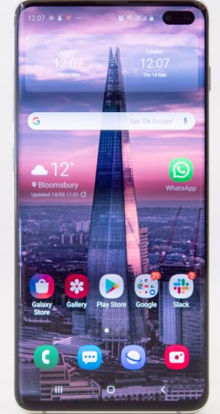
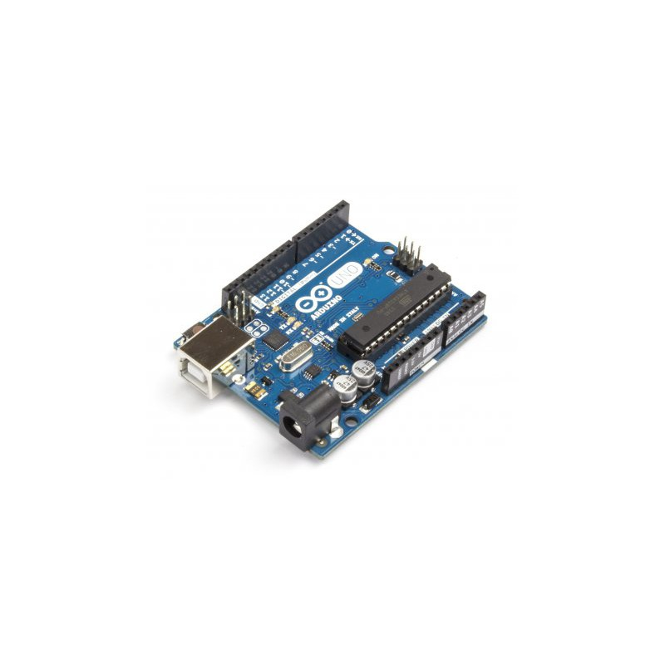
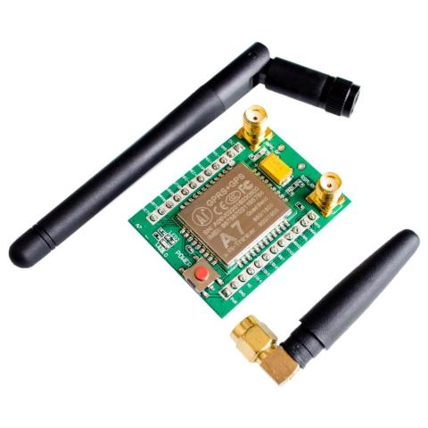


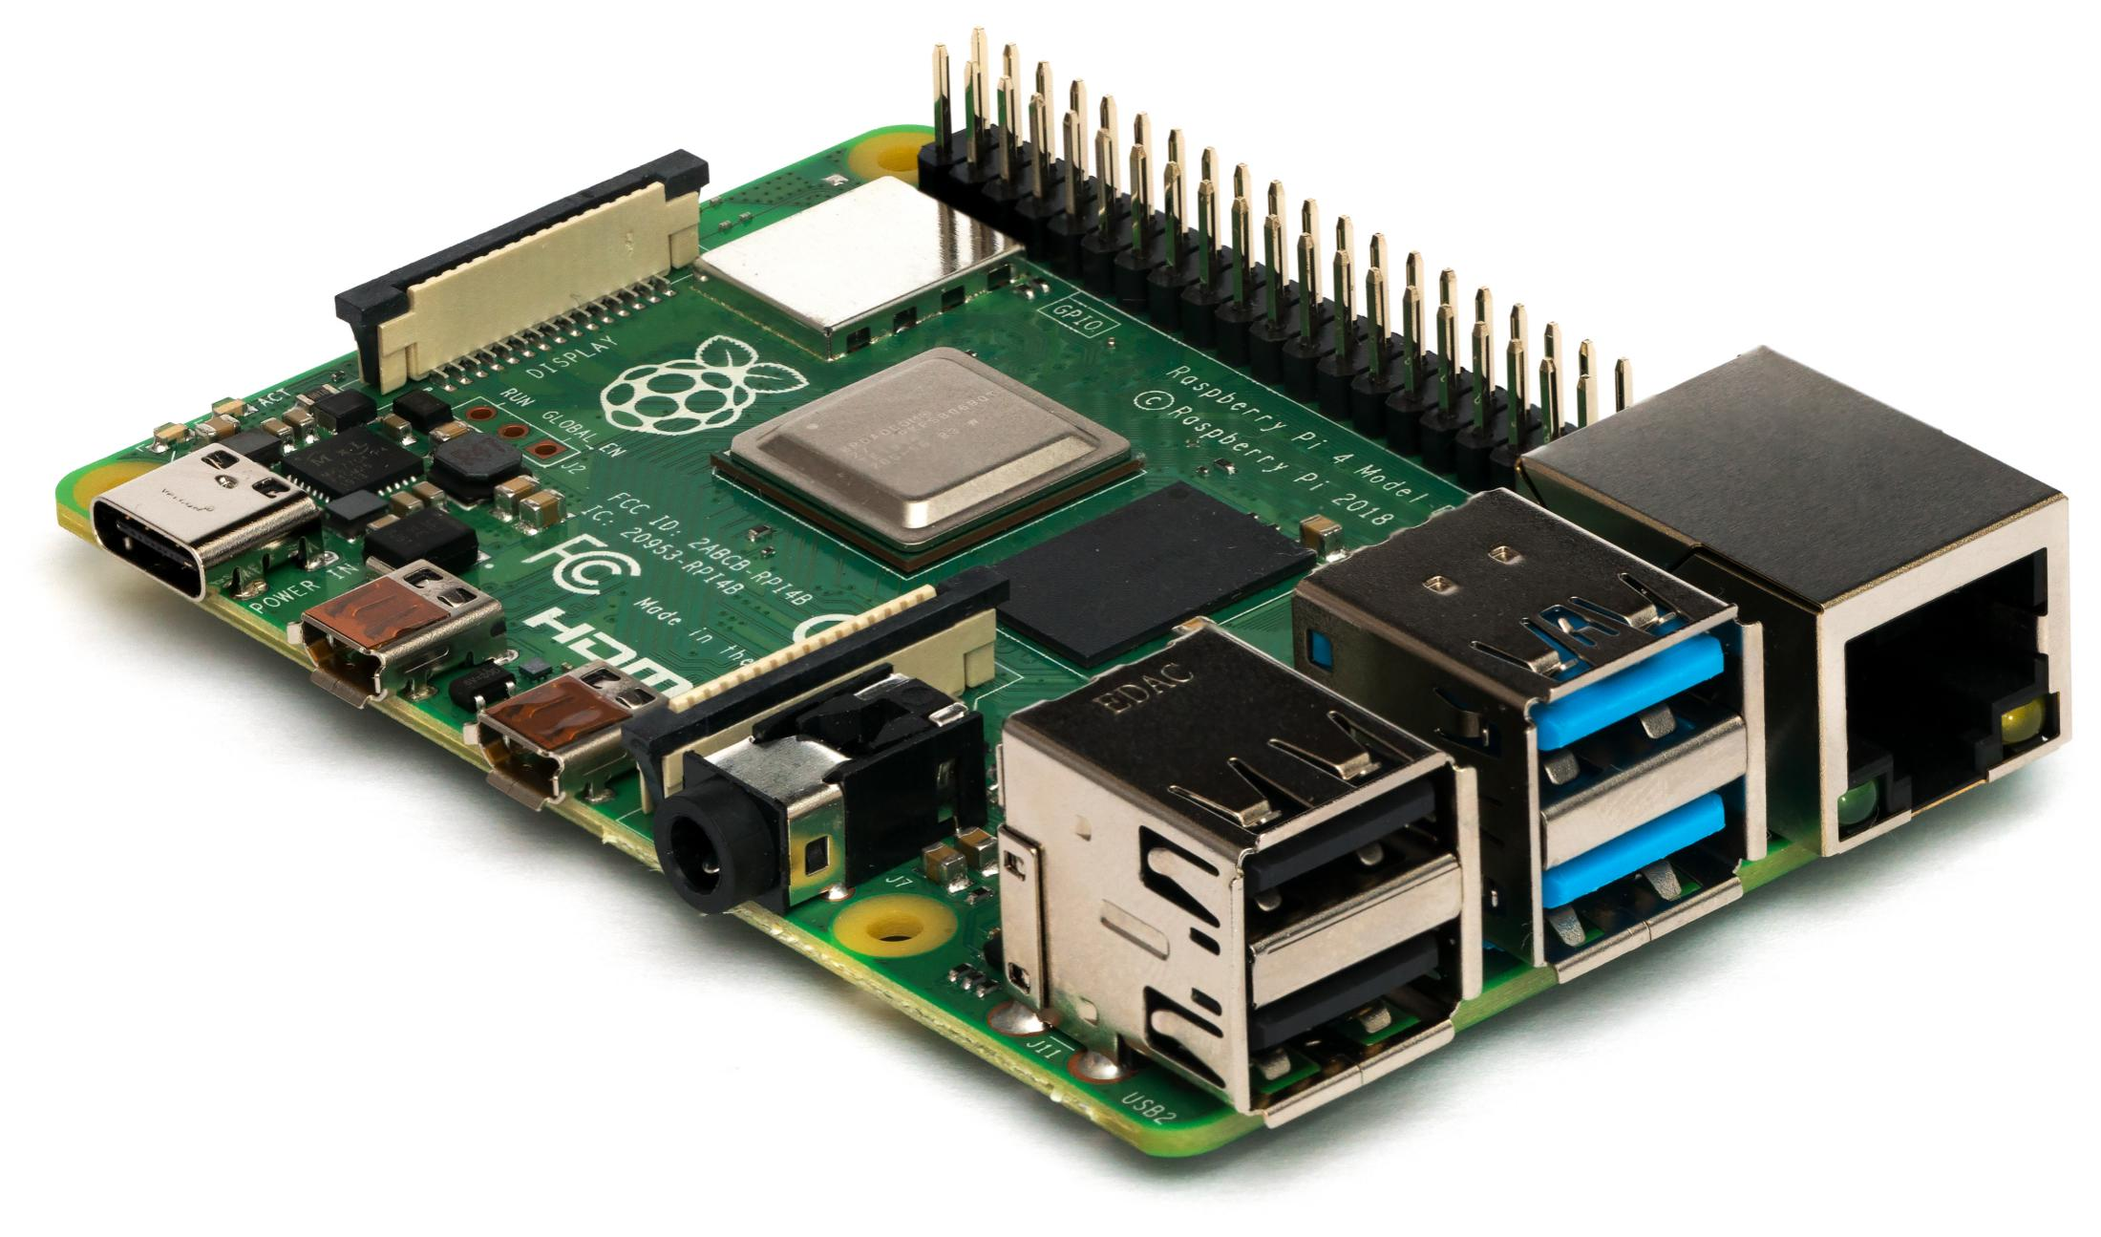
System Architecture
GSM/GPS MODULE
Arduino
Smartphone
Raspberry Pi(server)
Desktop

Slide 14
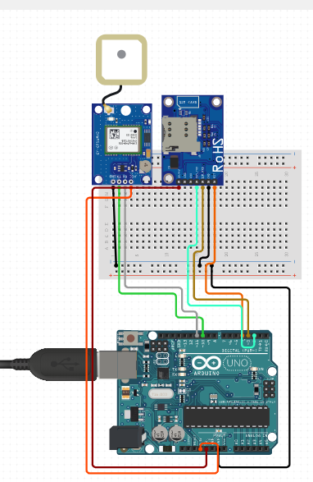
Schematic Diagram
Neo 6m(gps) module
Sim 800l(gsm module)
Breadboard
Power
Arduino uno

Slide 15
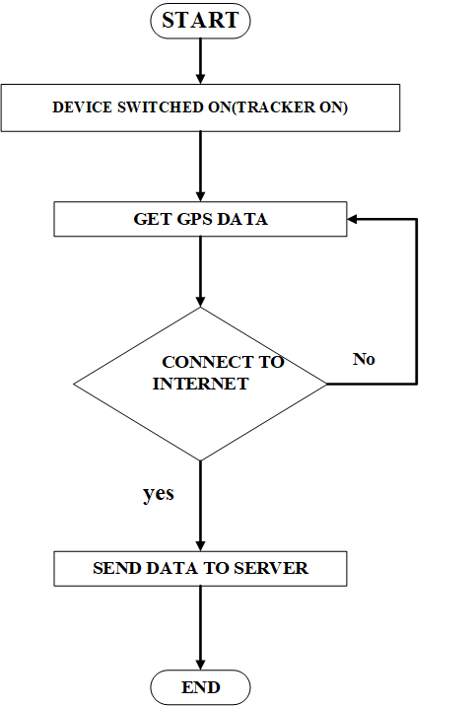
Flow Diagram
TRACKING SYSTEM

Slide 16
Flow Diagram
MOBILE/WEB APPLICATION

Slide 17
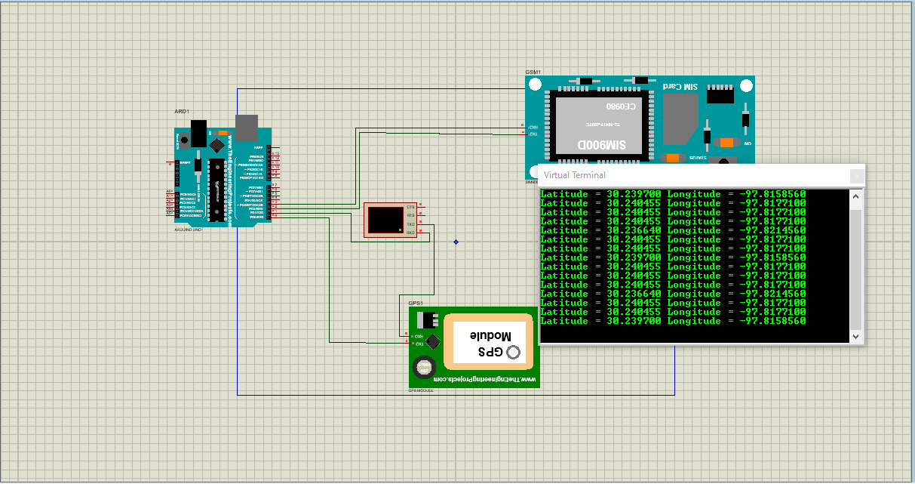
Hardware Simulation

Slide 18
Use case diagram

Slide 19
System Requirements
The system to be developed must be able to:
Sense and record the latitude and longitude of its current location.
Transmit the latitude and longitude recorded to a web server.
Retrieve the latitude and longitude from the server on mobile device.
Show the location of the shuttle based on the retrieved gps coordinates via Google maps and provide estimated time of arrival of shuttle.
Provide a platform for users to pay their shuttle fares on mobile device.

Slide 20
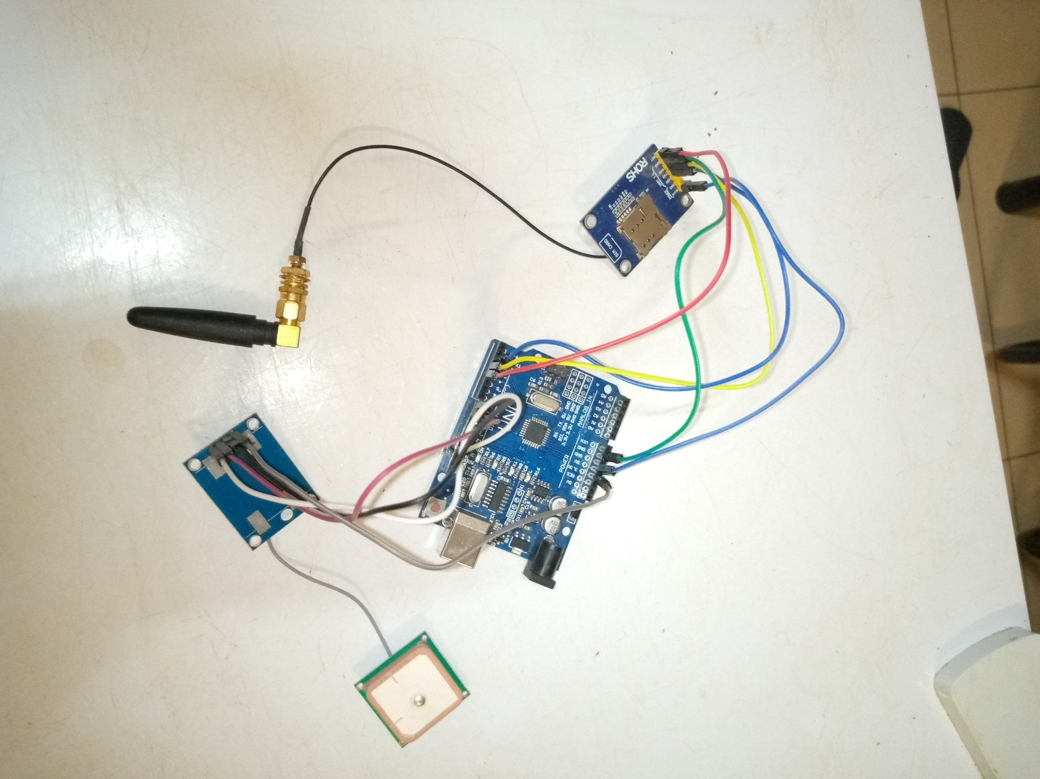
Hardware/Tracker Development

Slide 21
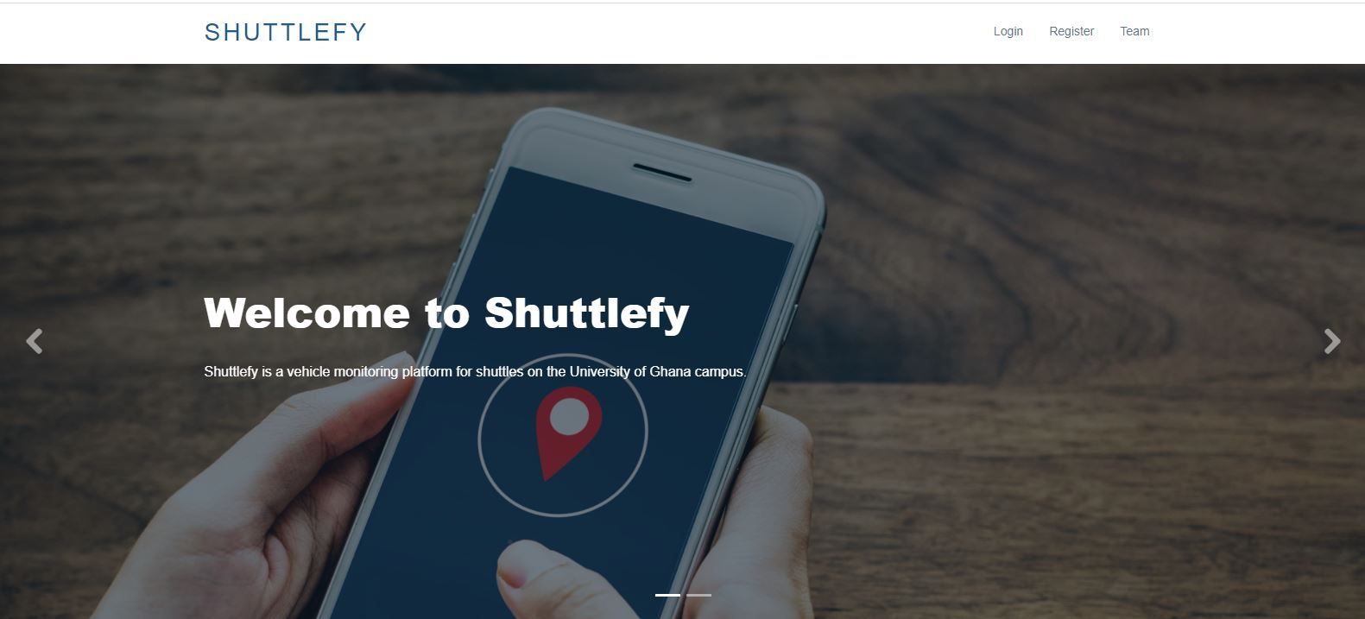
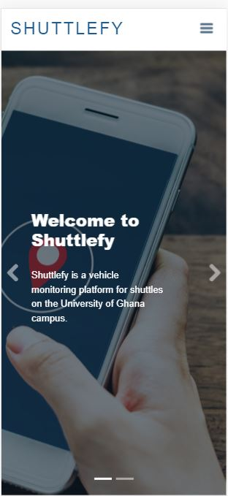
App Development
WEB APPLICATION
MOBILE APPLICATION

Slide 22
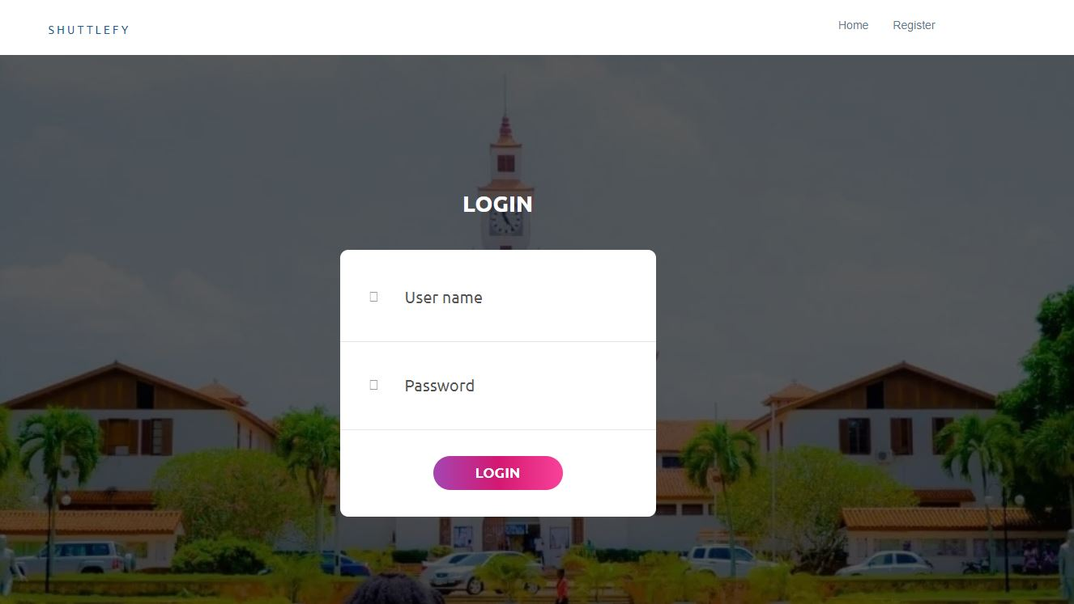
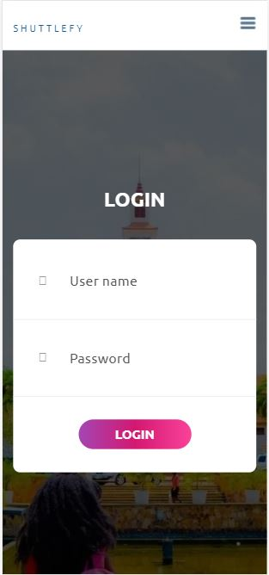
App Development Cont.
WEB APPLICATION
MOBILE APPLICATION

Slide 23
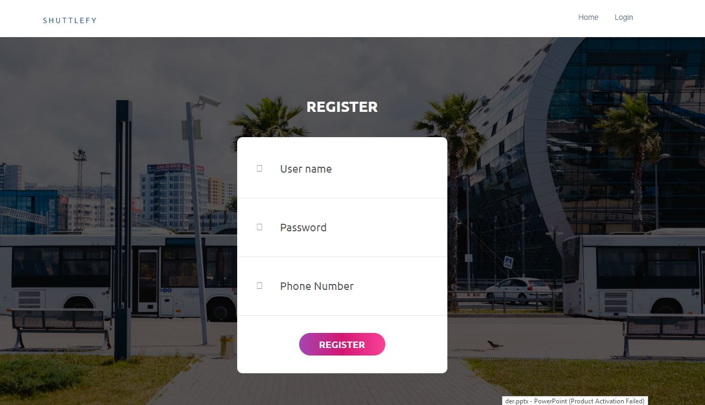
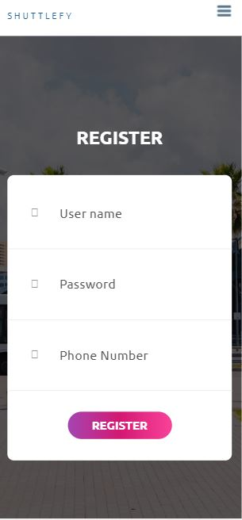
App Development Cont.
WEB APPLICATION
MOBILE APPLICATION

Slide 24
Project Progress
Requirements engineering (Done)
Background of Project (Research and Survey) (Done)
Design of GPS tracker hardware (Done)
Simulation of GPS tracker hardware (Done)
Ordering of hardware components (Done)
Building/Implementation of GPS tracker hardware (In Progress)
Web and mobile application Design (In Progress)
Interfacing GPS tracker hardware with web and mobile application (In Progress)
Interfacing payment services with web and mobile application (Pending)
Setting up of server (Pending)
Testing of project (Pending)

Slide 25
Expected Outcome
The system developed should be able to:
Sense, record and transmit gps coordinates to a web server.
View location of shuttle based on retrieved gps coordinates on mobile device.
Provide a platform for users to pay their shuttle fares on mobile device.

Slide 26
Conclusion
The project is proceeding on schedule and we have achieved some of the expected outcome of this project and the next phase is setting up a web server so that we can integrate the hardware tracker and payment platform into the web an mobile applications.

Slide 27
References
[1] Y. N. P. Andri , Z. Ahmad and Y. Mike, "Implementation of IoT-based passengers monitoring for smart school application," in 2017 International Electronics Symposium on Engineering Technology and Applications (IES-ETA), Surabaya, Indonesia, 2017.
[2] M. C. Su, Y. C. Lee, L. T. Chee and Y. L. Chiw , "A pilot study: Shuttle bus tracker app for campus users," in 2017 International Conference on Research and Innovation in Information Systems (ICRIIS), Langkawi, Malaysia, 2017.
[3] K. Sanam, B. Murtuza, S. Fahreen and S. Anamta, "Smart E-Ticketing System for Public Transport Bus," in 2018 International Conference on Smart City and Emerging Technology (ICSCET), Mumbai, India, 2018.

Slide 28
THANK YOU!

