Slide 1
Gradle
Quick start guide
https://iuliana-cosmina.com

Slide 2
summary
Technical ecosystem
What is a build tool
Build tools for Java
Gradle demo project
Advantages & Disadvantages
Questions?
https://iuliana-cosmina.com

Slide 3
TEchnical Ecosystem
Web-based hosting service for version control
(GitHub)
Continuous integration tools
(test, check code quality, build artifacts)
(Jenkins)
Versioning
Control
System
(Git)
Share
Implementation
Retrieve Sources
Artifact
Repository
Manager
(Nexus)
Get
Specs
Issue tracking product
(JIRA)
Development Tools
Build
Tools
(Gradle)
https://iuliana-cosmina.com

Slide 4
What is A build tool
Big software projects are made of code organized in modules
Modules must be composed and processed into a deliverable (executable)
Modules composition + processing = building
For Java projects, a build operation includes the following:
Download dependencies (optional)
Compiling the source code
Run tests (optional)
Packaging the source code
Deploy (optional)
https://iuliana-cosmina.com
Notes:
Hierarchical structures
The bigger the project the more difficult is to do those said operations (composition/processing/testing) manually. - sure you can create a bash/bat script, but you need serious expertise for that.
Solution -> build tools.
Composition + processing => executables
The process of building must be automatized - speed
Download dependencies from a public/private Nexus/Artifactory server
Deploy - upload to Nexus/Artifactory - or directly to test/acceptance servers
Build tools are tools to manage and organize your builds, and are very important in environments where there are many projects, especially if they are inter-connected. They serve to make sure that where various people are working on various projects, they don't break anything. And to make sure that when you make your changes, they don't break anything either.

Slide 5




Build tools for Java
Setup uses build.xml files
$ ant
Setup uses pom.xml files
$ mvn clean install
Setup uses *.gradle files (Groovy)
$ gradle clean build
Setup uses WORKSPACE & BUILD files (Bazel)
https://iuliana-cosmina.com
Notes:
Currently adopting Kotlin
Bazel is Multi-language support (and apparently is the fastest - developed by Google)
Ant -> tasks
Maven -> goals
Gradle -> tasks
Bazel -> rules

Slide 6
Gradle Sample Project
parent
child-01
grand-child-01-01
grand-child-01-02
child-02
grand-child-01-01
grand-child-01-02
Commands:
gradle build
gradle clean
gradle clean -x test
build --refresh-dependencies
gradle projects
gradle test
Plugins:
java, jar, idea, eclipse, gretty, nebula
gradle aggregateJavadoc
Demo…(Gradle & Maven projects will be shown for comparison)
https://iuliana-cosmina.com

Slide 7
Advantages & Disadvantages
Advantages
Reduced configuration
Write your own build script or tasks in Groovy (or Kotlin)
Dynamic dependency set
Works with Apache Ivy and Maven Repositories as well
Allows access to any part of the build
Disadvantages
Not as many plugins available as for Maven
Poor integration with Eclipse
Slower than Ant
https://iuliana-cosmina.com
Notes:
Reduced and more pleasant (easy to set up)
Eclipse plugin messes up the project hierarchy (as it does for Maven as well)
Maven is slower than Ant too
Maven access build phases through plugins with predefined fixed configuration

Slide 8
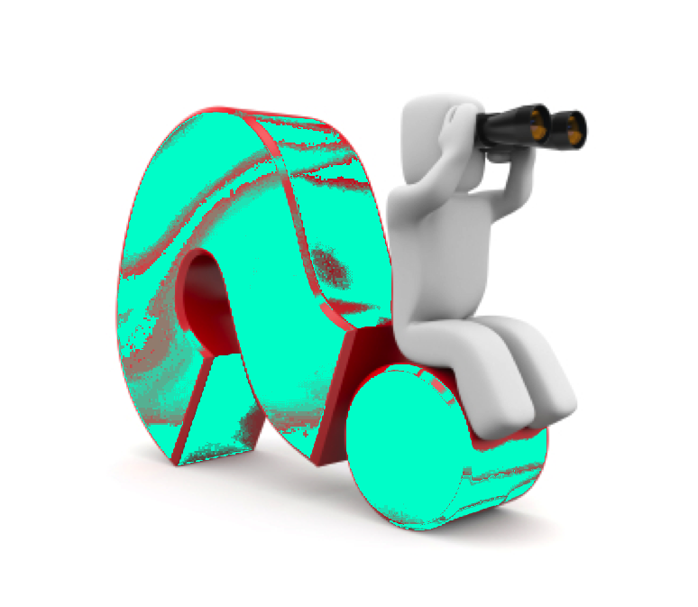
Questions?
https://iuliana-cosmina.com

